Slide 1
Digital Transformation towards 2030 Data Strategy - Draft Foundations Sprint 2021- 2024
Mr. Martin Tully – Head Of Data & Analytics - MSc Data Analytics
CSO Housing Statistical Working Group
4th May 2022

Slide 2

Artificial Intelligence
Virtual Reality
Machine Learning
Data for Enabling Sustainable Communities & Delivery of Homes
IoT
Mobile Apps
Wearables
Social Messaging
In Dublin only 14% of houses are constructed within walking distance of a train station – EY
‘Good decisions made on bad data are just bad decisions you don’t know about yet’ – Scott Taylor
The Information & Experience Age

Slide 3

Current Challenges
Why do we not have a portal and mobile apps?
Is there evidence that the policy is working?
Can I access evidential data?
How fast can I implement change?
Is this data the only truth?
Excel spreadsheets again? Seriously?
Does this data from A mean the same thing as data from B?
How can we plan ahead?
Why is data disconnected?
Why is it so hard to find the data?
Getting the Basics Right

Slide 4

Data is the power that we unleash, manage, open, and embrace in our culture. It must be deployed in an integrated, standardised platform to empower us, our partners and citizens with accurate information at the right time to enable the co-development of sustainable smart cities, regions and communities
Vision
Mission
To revolutionise how we, our partners and citizens access the trusted data we need, when we need it, and use it to make better smarter decisions today, to build a more sustainable future tomorrow.

Slide 5

Our Goals
Governance Classifications & Standards
Skills, Awareness & Culture
Data Management Practices
Sustainable Communities & Delivery of Homes
Live Data, Analytics & Reporting
Integrated Data Platform. Open Data

Slide 6
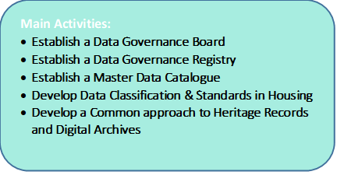
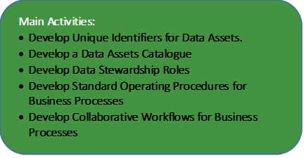
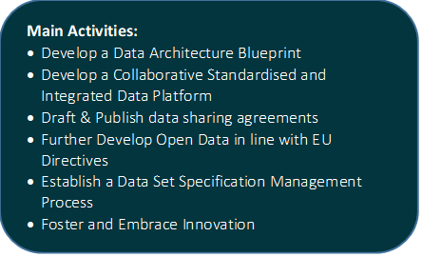
Roadmap to 2024
Programme 1: Governance, Classifications and Standards
Programme 2: Data Management Practices
Programme 3: Integrated Data Platform. Open Data
Programme 4: Live Data, Analytics & Reporting
Programme 5: Skills, Awareness & Culture
Main Activities:
Develop timely reports and Dashboards
Develop Data Analytics and Data Modelling tools and capability
Streamline and Update the Social Housing Schedules data collection and processes
Update the HNDA toolkit
Main Activities:
Draft and Coordinate Departmental Data Skills Assessment
Develop Training Materials
Deliver Stewardship Training
Develop Communities of Practice
Develop and Rollout Lunch n Learn Programme.
Gain Accreditation
Notes:
Data & Policy
Project Dion & HFA
Workstreams

Slide 7
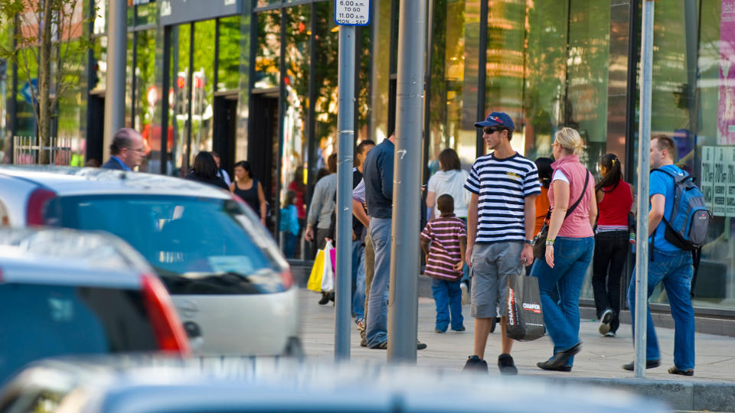
EXPECTED OUTCOMES
FOR CITIZENS
IMPROVED CITIZEN DIGITAL EXPERIENCE
INCREASED TRANSPARENCY & TRUST IN DATA
OPEN DATA
IMPROVED DIGITAL SERVICES
DATA MANAGEMENT
DATA OPENNESS
DATA IS FOR LIFE

Slide 8
EXPECTED OUTCOMES
FOR MANAGEMENT BOARD
FOR SENIOR MANAGERS FORUM
FOR OPERATIONS
FOR PARTNERS, LA’s AGENCIES
ACCESSIBLE KPI’s
AGILE ANALYTICS
ENDORSED DATA DEFINITIONS
DATA GOVERNANCE REGISTRY
DATA GOVERNANCE
DATA DISCOVERY
IMPROVED DATA
DATA DISCOVERY
DATA SPECIFICATIONS
STREAMLINED DATA COLLECTION
DATA STANDARDS
PARTNERSHIP
DATA MANAGEMENT
DATA OPENNESS
DATA IS FOR LIFE

Slide 9
Data for Enabling Sustainable Communities and Delivery of Homes Thank you

Slide 10
Appendix Slide

Slide 11
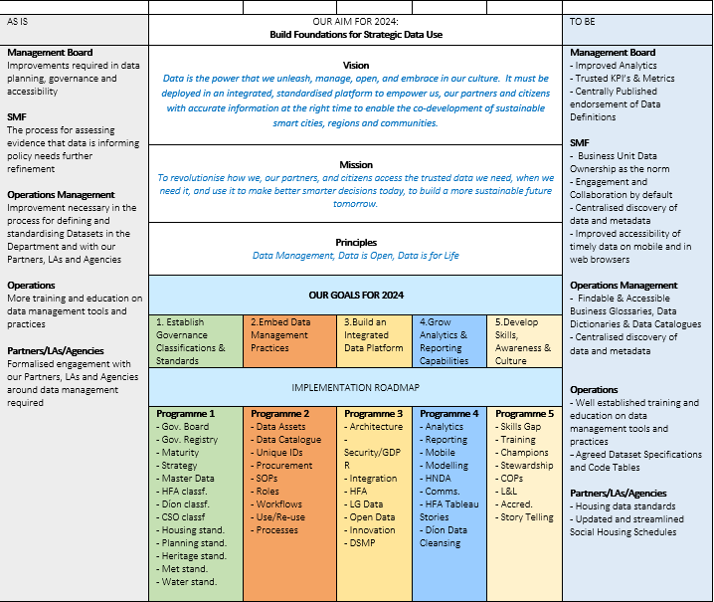
One Page Data Strategy

Slide 12
Sample Current outputs
Report | Data source | Frequency
Commencement Notices | BCMS | Monthly
Registrations | Homebond | Monthly
House prices | CSO | Monthly
Planning Permissions | CSO | Quarterly
New dwelling completions | CSO | Quarterly
Social Housing - Schedules | Local authorities | Quarterly
Housing Activity & LA Reports | Various | Monthly
Housing For All - Dashboard | Various | Monthly

Slide 13
GIS - Ukraine Humanitarian Aid Data Management
Data Collections Apps | Users
Lands | Department, and the agencies or bodies under their aegis
Buildings | Department, and the agencies or bodies under their aegis
Lands | Local Authorities
In addition on going work and assistance on;
Accommodation Schema
Vacancy

