Slide 1
CSO / Met Éireann
Climate Data Rescue Project
Progress Update
August 2018
Environment and Climate Division

Slide 2
Purpose
This update gives
Some brief background on the Met Éireann / CSO data rescue project
An indication of progress on data capture and data checking
Completion targets for the Phoenix Park meteorological station
Example indicators of daily data for 1931-1959
An indication of the staff resources required
A further update will be posted when 1900-1959 data are all keyed and have undergone preliminary data checking

Slide 3
Facilitating Analysis
1832-1959 records are held in manuscripts in Met Éireann library
Researchers access manuscripts by visiting the Met Éireann office
Scanning manuscripts facilitates making them more available
Keying scanned manuscripts will enable integration with post 1960 data
Manuscript pages contain numbers, meteorology symbols and text
File management, keying, and checking takes around six person hours per station month

Slide 4
Data Rescue Tasks Sequence
Manuscripts sent by Met Éireann to external company for scanning
Scanned images named e.g. MO-1_54_095_c_-
Images sent to CSO for keying
CSO designed excel templates to look like scanned images
Scanned image keyed using two monitors and keying instructions (e.g. valid codes)
Monthly excel file read into SAS and checked by CSO
Further checking of keyed month (text data and time series)
Time-series of all years created by CSO
Data returned to Met Éireann in one tab-delimited file
Monthly excel files will be made available to Met Éireann

Slide 5
Manuscript Daily Data Page
Thermometer and barometer readings
Air pressure
Various temperatures
Humidity
Wind force and direction*
Weather summary**
Visibility indicators*
Cloud formations**
Rainfall
Sunshine hours
Remarks**

Slide 6
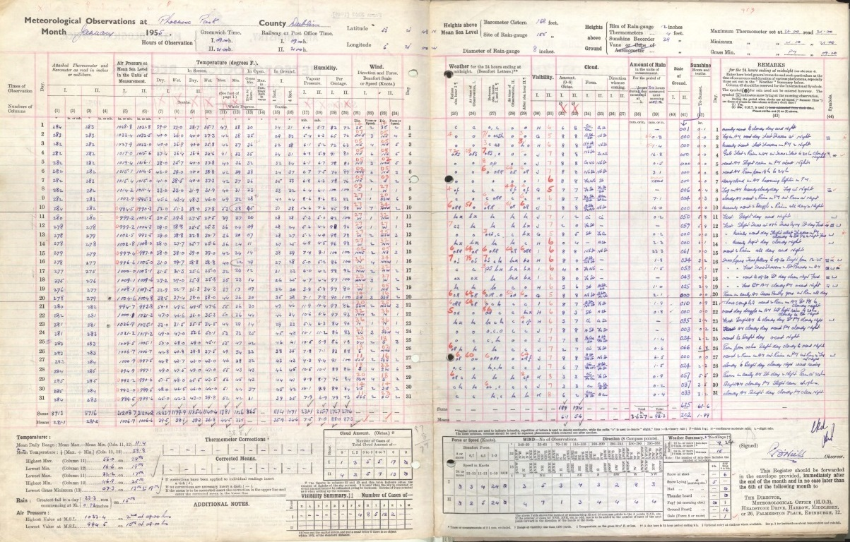

Slide 7
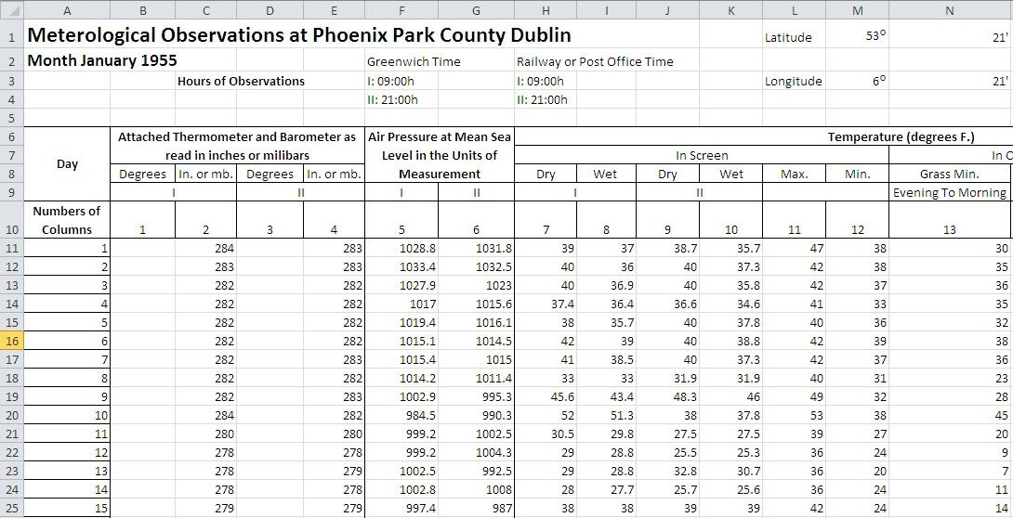
Rescued Data (extract from excel file)

Slide 8
Progress as of Mid-August 2018
Project started in March 2018 with existing CSO staff keying when time permitted. This resulted in slow progress so temporary Clerical Officers recruited to ensure consistent progress
Daily data for 1900-1925 and 1931-1959 have been keyed (1926-1930 with scanning company)
Phoenix Park 1832-1959 should be keyed by early 2019
Target is to complete data quality checking of Phoenix Park during Spring 2019
An initial test file covering 12 months was sent to Met Éireann in May 2018 to ensure that a longitudinal file could be produced by CSO and read by Met Éireann
Valentia Observatory, Blacksod Bay and Roches Point are the probable next stations

Slide 9
Advantages of Daily Data
Monthly maximums, means, minimums currently used for pre 1960s analyses
Daily data will facilitate:
- more granular analyses including combining months to identify spells of exceptional weather
- allows variables to be cross-classified e.g. relationships between air pressure, humidity, rainfall, and temperature
- facilitates examination or removal of extreme weather e.g. days with very high rainfall
- allows more accurate calculation of indicators such as length of the frost-free season, drought, and heatwaves
- enables a more-informed analysis of the extent and nature of climate change

Slide 10
Phoenix Park Droughts
There are many climate indicators that can be derived from rainfall data such as wet days (>1 mm) and very wet days (>20 mm). Rainfall data can also be used to identify historical floods and droughts that may have impacted on human settlements, non-residential premises, agriculture, and water ecosystems.
A drought is defined as a consecutive period of at least 15 days where the daily rainfall was less than 0.2 millimetres.
There were 10 droughts recorded at the Phoenix Park during 1931-1959.
Analysing drought periods in conjunction with other weather data adds important context
The longest drought was in 1947 and lasted for 32 days. It occurred in conjunction with a mean maximum temperature during that period of 72.8° F. In contrast the 1932 drought was in February/March and had a mean maximum temperature of 45.7° F.

Slide 11
Drought | Start | End | Duration | Mean maximum temperature | Mean minimum temperature
1 | 13/02/1932 | 04/03/1932 | 21 days | 45.7 °F | 32.9 °F
2 | 02/09/1933 | 16/09/1933 | 15 days | 69.0 °F | 48.6 °F
3 | 03/04/1938 | 01/05/1938 | 29 days | 55.3 °F | 33.6 °F
4 | 22/05/1939 | 09/06/1939 | 19 days | 68.7 °F | 44.1 °F
5 | 01/03/1945 | 17/03/1945 | 17 days | 53.5 °F | 38.7 °F
6 | 01/05/1946 | 15/05/1946 | 15 days | 56.7 °F | 38.5 °F
7 | 03/08/1947 | 03/09/1947 | 32 days | 72.8 °F | 50.6 °F
8 | 03/03/1953 | 24/03/1953 | 22 days | 50.6 °F | 32.9 °F
9 | 12/04/1954 | 29/04/1954 | 18 days | 55.7 °F | 35.7 °F
10 | 04/07/1955 | 01/08/1955 | 29 days | 71.7 °F | 51.5 °F

Slide 12
Other Example Climate Indicators
A heatwave is five consecutive days of 25° C or above. There was one heatwave in June 1949 which lasted for six days.
Another example is a cross-classification of the number of sunshine hours with the extent of cloud cover. An okta is used to describe the amount of cloud cover at any given location. A value of zero indicates a completely clear sky, a value of 1-5 is scattered clouds (1-5), broken clouds (6-9), and 10 means it was overcast. In general there is a strong correlation between cloud cover and sunshine hours in Ireland.
The daily temperature range is the difference between the daily maximum and minimum temperatures. It varies substantially by month with the highest differences occurring in May and June and the least variation in November to February.
Other example indicators (not examined in this presentation) include: cold wave duration index; extreme precipitation; thermal growing season; stormy periods; and heating degree days.
Access to a long period of daily data can enable statisticians to use the data to identify, compile, and eventually cost a representative time series of extreme weather events.

Slide 13
Heatwave | Maximum temperature | Minimum temperature | Humidity period ending 9am | Humidity period ending 9pm
Overall | 80 °F | 51 °F | 65% | 88%
22/06/1949 | 77 °F | 45 °F | 66% | 91%
23/06/1949 | 83 °F | 45 °F | 60% | 87%
24/06/1949 | 80 °F | 53 °F | 63% | 94%
25/06/1949 | 81 °F | 49 °F | 64% | 93%
26/06/1949 | 81 °F | 53 °F | 59% | 79%
27/06/1949 | 77 °F | 61 °F | 75% | 83%

Slide 14
Sunshine hours Jan 1931 to May 1950 | No Sunshine hours | Less than 3 hours | 3 < 6 hours | 6 < 12 hours | 12 or more hours | Total (Days)
Cloud Amount (0-10 Oktas)
0 | 0% | 1% | 7% | 17% | 46% | 7%
1 | 0% | 1% | 5% | 9% | 17% | 4%
2 | 1% | 4% | 12% | 19% | 23% | 9%
3 | 0% | 2% | 5% | 8% | 5% | 4%
4 | 0% | 2% | 6% | 7% | 2% | 4%
5 | 1% | 4% | 8% | 8% | 2% | 6%
6 | 1% | 4% | 6% | 7% | 2% | 4%
7 | 2% | 8% | 9% | 6% | 1% | 6%
8 | 6% | 13% | 13% | 7% | 1% | 10%
9 | 4% | 8% | 6% | 3% | 0% | 6%
10 | 85% | 53% | 23% | 9% | 1% | 40%
Total days | 1,198 | 2,402 | 1,598 | 1,646 | 230 | 7,091

Slide 15
Temperature Daily Range 1931-1959 | 0.1 < 9 °F Max – Min 0.1 < 5 °C | 9 < 18 °F Max – Min 5 < 10 °C | 18 < 27 °F Max – Min 10 < 15 °C | 27 < 36 °F Max – Min 15 < 20 °C | 36 °F or more Max – Min 25 °C or more
January | 15% | 9% | 5% | 1% | 0%
February | 13% | 8% | 4% | 2% | 0%
March | 10% | 8% | 10% | 9% | 0%
April | 4% | 8% | 11% | 14% | 17%
May | 4% | 7% | 13% | 20% | 33%
June | 2% | 8% | 11% | 17% | 33%
July | 4% | 9% | 10% | 12% | 0%
August | 3% | 8% | 12% | 10% | 0%
September | 5% | 9% | 9% | 8% | 17%
October | 9% | 9% | 8% | 5% | 0%
November | 14% | 9% | 4% | 1% | 0%
December | 17% | 8% | 3% | 1% | 0%
Total days 1931-1959 | 1,710 | 5,980 | 2,558 | 307 | 6

Slide 16
Wind Direction | Beaufort Force |  |  |  | Total
 | Calm | 1 to 3 | 4 to 7 | 8 or more
Calm | 100% | 0% | 0% | 0% | 2%
North | 0% | 10% | 5% | 3% | 8%
North-East | 0% | 8% | 4% | 3% | 6%
East | 0% | 15% | 9% | 4% | 12%
South-East | 0% | 5% | 5% | 4% | 5%
South | 0% | 10% | 17% | 20% | 13%
South-West | 0% | 14% | 20% | 23% | 16%
West | 0% | 30% | 33% | 39% | 31%
North-West | 0% | 8% | 6% | 5% | 7%
Total (days) | 175 | 6,140 | 3,927 | 256 | 10,498

Slide 17
Station | Date | Highest Daily Rainfall Amounts 1931-1959
Phoenix Park | 21/08/1955 | 71.3 mm
 | 03/09/1931 | 69.2 mm
 | 19/09/1946 | 59.5 mm
 | 25/10/1937 | 55.4 mm
 | 24/09/1957 | 50.5 mm
 | 04/01/1948 | 48.9 mm
 | 04/12/1947 | 47.7 mm
 | 24/02/1933 | 45.8 mm
 | 13/07/1932 | 44.4 mm
 | 17/07/1936 | 44.1 mm
 | 01/09/1944 | 42.5 mm

Slide 18
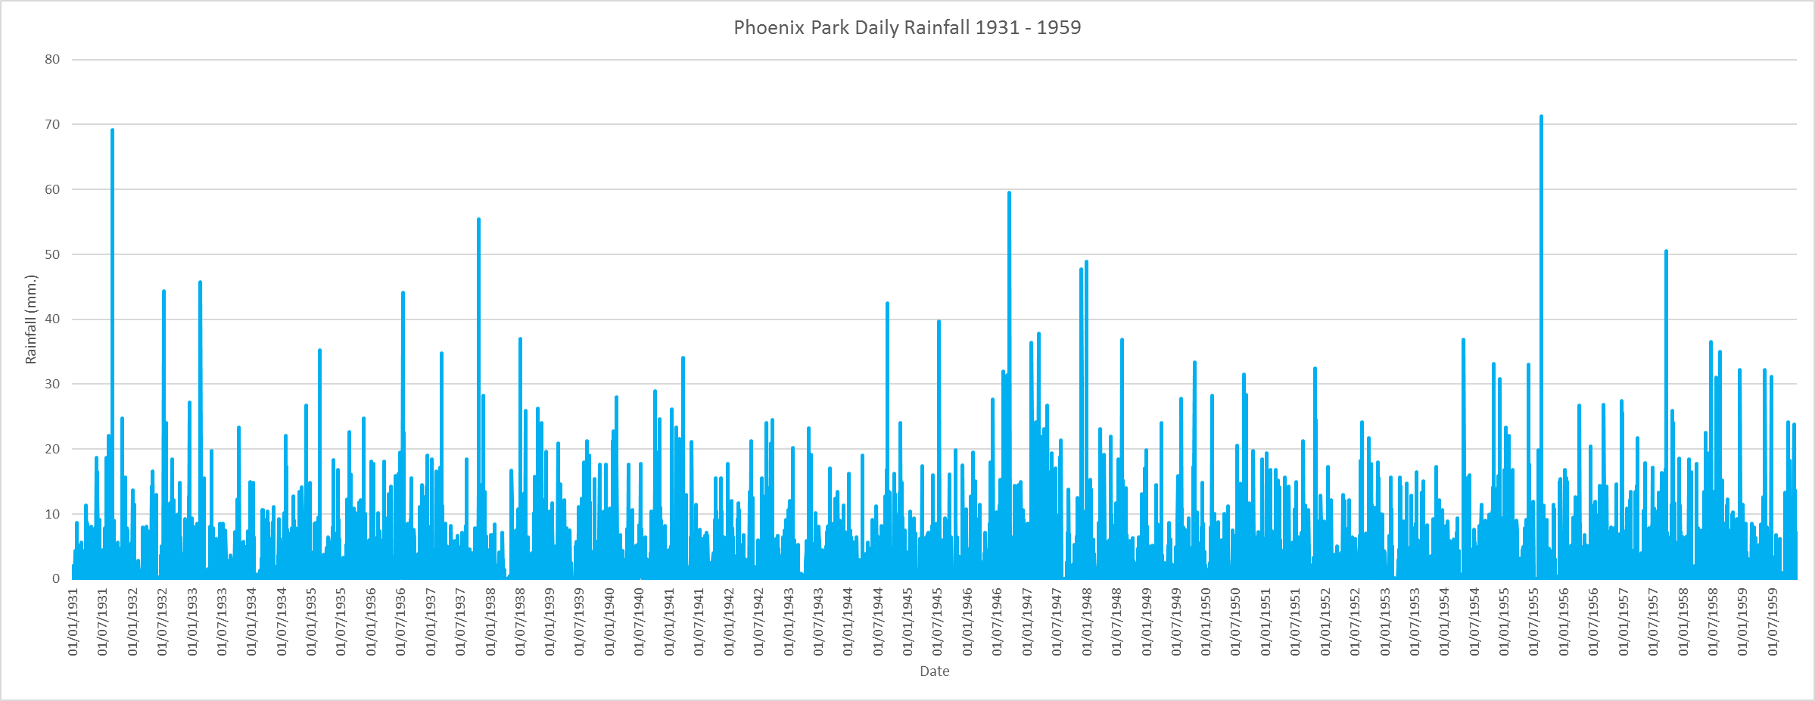

Slide 19
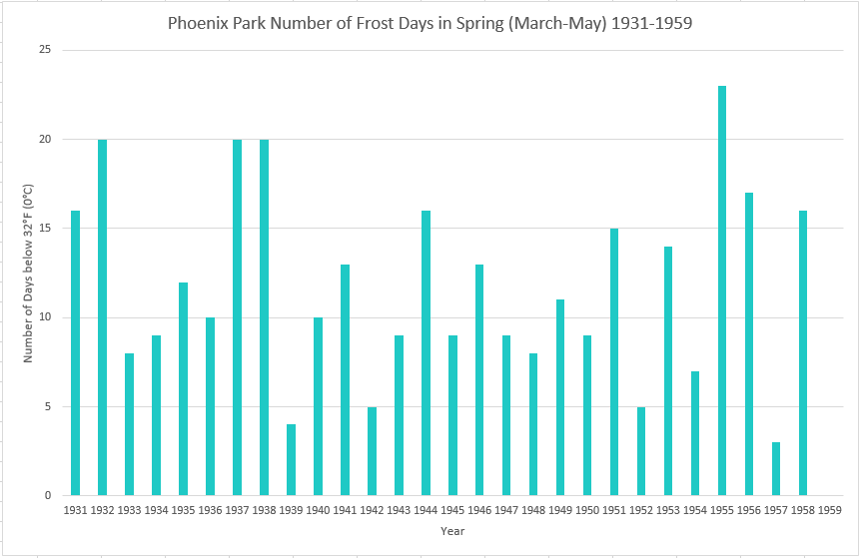

Slide 20
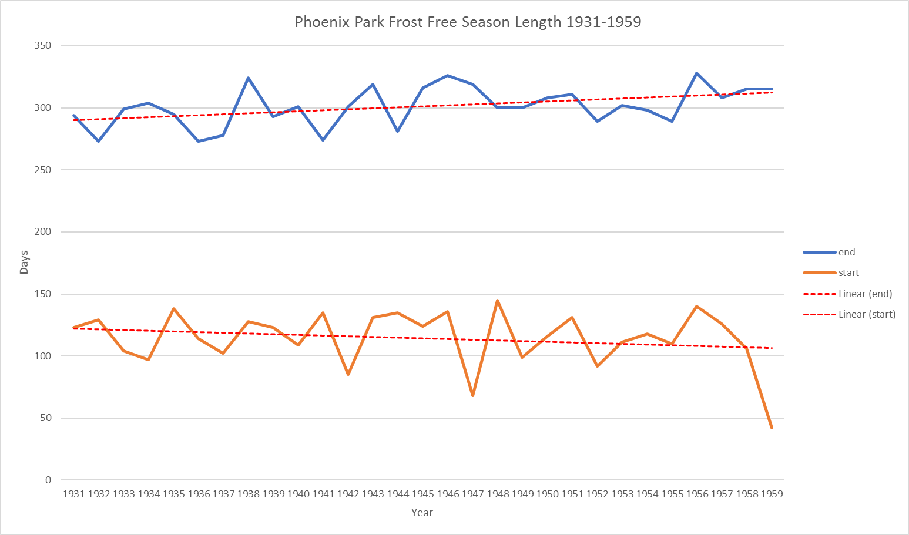

Slide 21
CSO Resource Requirements
Management of project at statistician level
Excel templates designed to reflect monthly sheets completed by meteorological officer (this makes it easier to key as the excel file looks like the scanned image)
SAS used to create a consistent time series file ensuring that a data item, e.g. wind direction at 3 pm, is always given the same SAS variable name
SAS used for checking keyed data
Data checking is very important but very time-consuming as there have been many changes in the design of the monthly recording sheet
Longitudinal file created for Met Éireann with every data item consistent over time
Each station month takes around six hours on average for all tasks
120 years by 12 months by 6 hours = 8,640 person hours for Phoenix Park

Slide 22
Conclusions
Climate change impacts on all aspects of our life and of our environment
Meteorological variables provide important front-line insight into climate change
Daily data should result in a much more granular understanding of climate change
Keying more stations will show how the impact varies geographically and across seasons
Ecosystem services would be affected by significant climate change
Help to identify occurrences of extreme weather events such as flooding, droughts, forest fires
Dedicated data capture staff an essential requirement given amount of work involved
Statistical offices can undertake difficult data rescue projects including data quality checking

