Slide 1
CSO Administrative Data Centre Seminar 8 November 2022 1. Climate Data Rescue Project
Paul McElvaney
Environment and Climate Division

Slide 2
Overview of Presentation
1. Climate daily data rescue project (1830s-1959)
What is involved in data rescue project
Data capture process of daily data
Data quality checking of daily data
Creating one longitudinal file
2. Climate indicators examples
3. Identifying extreme events

Slide 3
1. Climate Daily Data Rescue Project
Research on climate change indicators made CSO aware that pre-1960s daily meteorological data for Ireland was generally not computerised (pre-1940s for rainfall)
The CSO has a role in the development of the Irish Statistical System including ensuring that the statistical potential of administrative records is realised
CSO offered to assist Met Éireann with data rescue and it was agreed that given our experience with capturing and processing large scale datasets that we would take on a data rescue of the full monthly meteorological sheets
Each monthly sheet contains around 40 data items for each day as well as summary monthly tables

Slide 4
Manuscript Daily Data Page
Thermometer and barometer readings
Air pressure
Various temperatures
Humidity
Wind force and direction
Weather summary
Visibility indicators
Cloud formations
Rainfall
Sunshine hours
Remarks

Slide 5
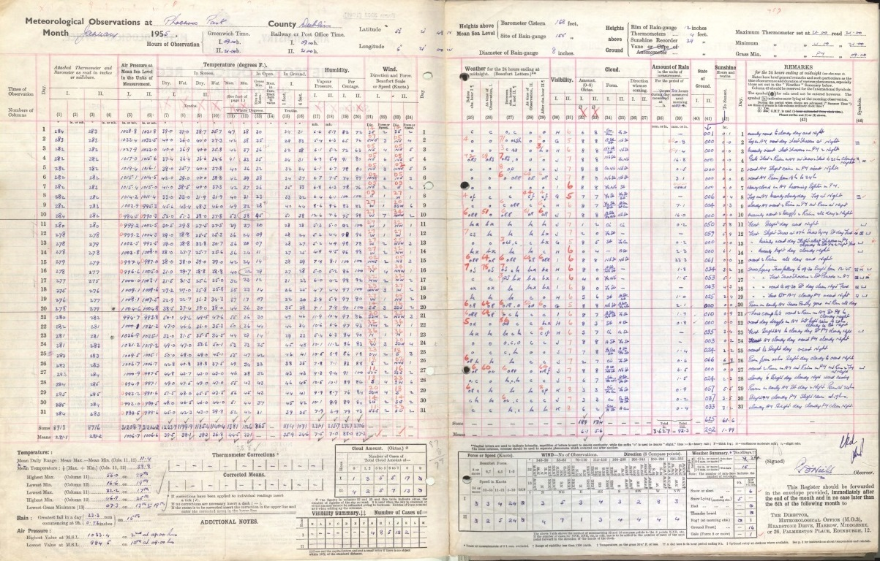

Slide 6
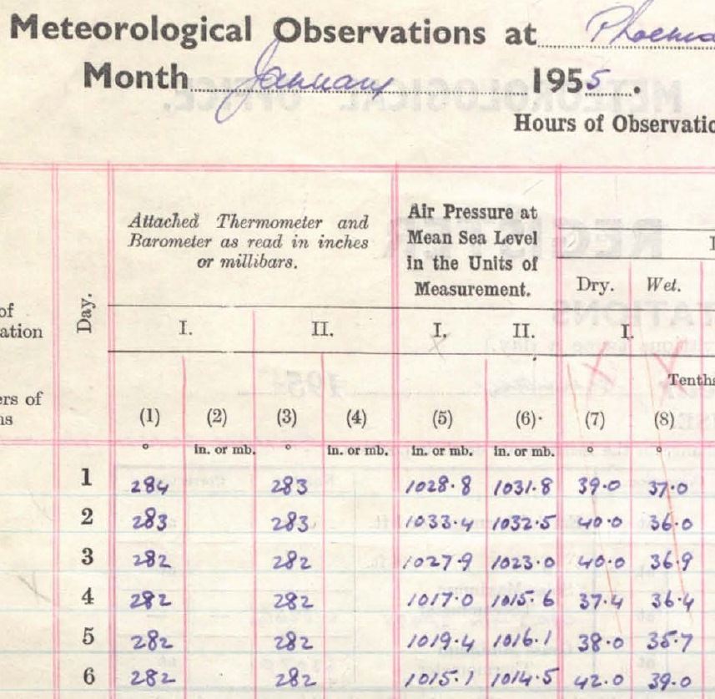
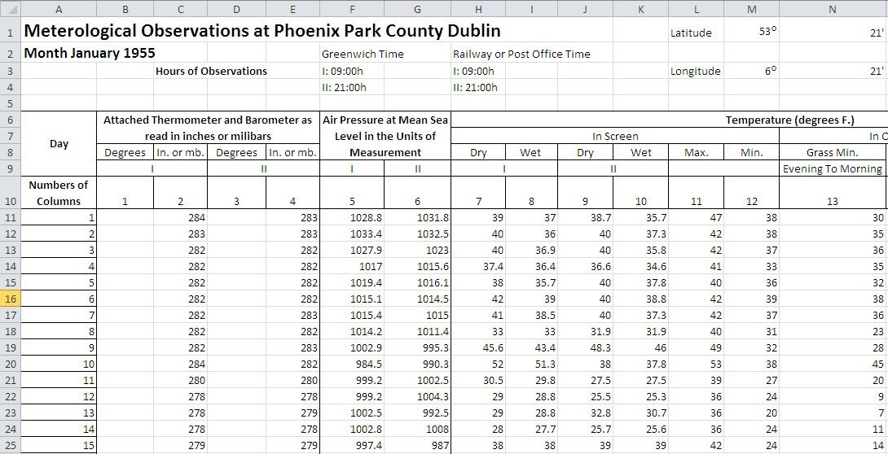

Slide 7
Data Quality Checking of Daily Data
Met Éireann will integrate the fully checked daily data from the data rescue project with daily data from 1960 onwards and publish this as a research file on their website
Quality of daily data must be very accurate as the file will be used at daily level
Initial CSO checks are to compare consistency of daily data with monthly summary tables in monthly report e.g. monthly summary table may have maximum temperature in shade as 72.8° F on 15th May 1892 which should correspond with the highest daily temperature in shade in that month
Monthly sheets contain totals and means for numerical variables and these are recalculated by CSO from daily data and compared
Further checks for outliers e.g. cloud formation codes that only occur a few times
Meteorological offices checking standard is to have two persons key same month and compare but SAS offers an alternative approach

Slide 8
CSO Resource Requirements for Data Rescue
Day to day management of project at statistician level
Excel templates designed to reflect monthly sheets completed by meteorological officer
SAS used to create a consistent time series file (consistent naming of SAS variables)
SAS used for checking keyed data
Data checking is very important but very time-consuming as there have been many changes in the design of the monthly recording sheet => new templates and SAS programs
Longitudinal file will be created for Met Éireann with every data item consistent over time
Each station month takes around six hours on average for all tasks
-> 2 hours keying; 2 hours checking; and 2 hours excel and SAS programs for longitudinal consistency
120 years by 12 months by 6 hours = 8,640 person hours for Phoenix Park

Slide 9



Progress so far
Station | Years | Keyed | Checked
Phoenix Park | 1829-1959
Blacksod Bay | 1884-1956
Roches Point | 1873-1956 |  | Ongoing
Markree Castle | 1869-1940
Fitzwilliam Square | 1896-1930
Malin Head | 1885-1955
Valentia | 1873-1914
Birr Castle | 1872-1951
Maximum, Mean, Median, Minimum, Percentiles
Frost days (daily minimum temperature < 0° C)
Ice days (daily maximum temperature < 0° C)
Summer days (daily maximum temperature > 25° C)
Tropical nights (daily minimum temperature > 20° C)
Heatwave (five consecutive days > 25° C for Ireland)
Absolute drought (15 days with all < 0.2 mm)
Partial drought (29 days with total < 5.8 mm)

Slide 10
2. Example Climate Indicators
Maximum, Mean, Median, Minimum, Percentiles
Frost days (daily minimum temperature < 0° C)
Ice days (daily maximum temperature < 0° C)
Summer days (daily maximum temperature > 25° C)
Tropical nights (daily minimum temperature > 20° C)
Heatwave (five consecutive days > 25° C for Ireland)
Absolute drought (15 days with all < 0.2 mm)
Partial drought (29 days with total < 5.8 mm)

Slide 11
Absolute drought | Start | End | Duration | Mean maximum temperature | Mean minimum temperature
1 | 13/02/1932 | 04/03/1932 | 21 days | 45.7 °F | 32.9 °F
2 | 02/09/1933 | 16/09/1933 | 15 days | 69.0 °F | 48.6 °F
3 | 03/04/1938 | 01/05/1938 | 29 days | 55.3 °F | 33.6 °F
4 | 22/05/1939 | 09/06/1939 | 19 days | 68.7 °F | 44.1 °F
5 | 01/03/1945 | 17/03/1945 | 17 days | 53.5 °F | 38.7 °F
6 | 01/05/1946 | 15/05/1946 | 15 days | 56.7 °F | 38.5 °F
7 | 03/08/1947 | 03/09/1947 | 32 days | 72.8 °F | 50.6 °F
8 | 03/03/1953 | 24/03/1953 | 22 days | 50.6 °F | 32.9 °F
9 | 12/04/1954 | 29/04/1954 | 18 days | 55.7 °F | 35.7 °F
10 | 04/07/1955 | 01/08/1955 | 29 days | 71.7 °F | 51.5 °F

Slide 13
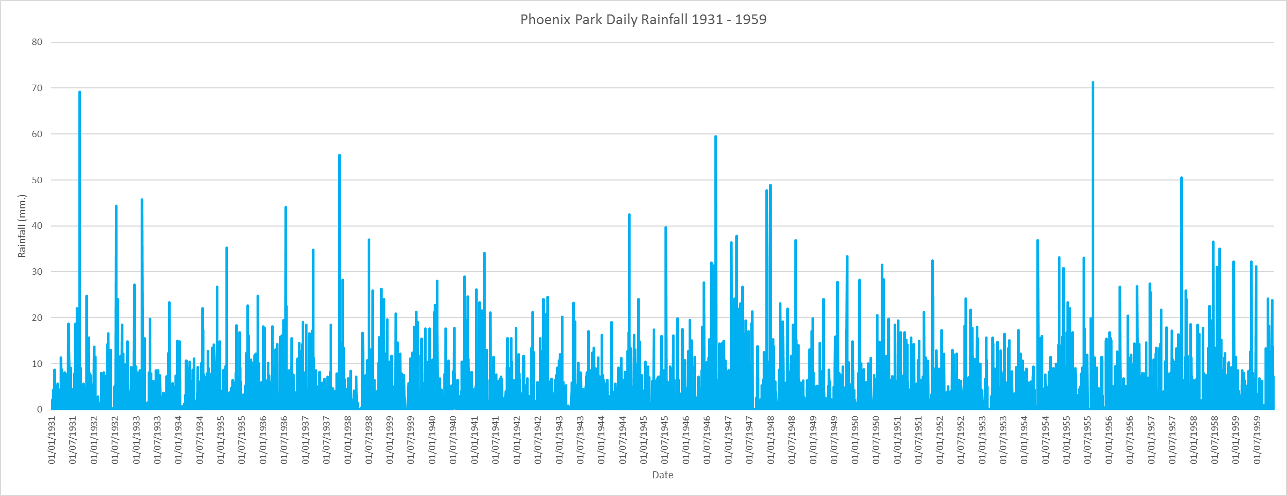

Slide 15
3. Steps in Measuring Extreme Events
CSO will compile an inventory based on daily weather data from 1960 onwards from the Met Éireann website: https://www.met.ie/climate/available-data/historical-data
The characteristics of known exceptional events will be identified in the daily data e.g. amount of rainfall that resulted in a media reported flood event
Duration and intensity inclusion thresholds can be lowered to include exceptional but not extreme events
Typology of events will initially be based on UNECE and SENDAI framework etc.

Slide 16
Minimum Temperature < -15° C in 1960s-2019
Period (13 days) | Counties
16th and 17th February 1969 | Mayo
1st and 2nd January 1979 | Carlow, Kildare, Louth, Meath (both days), Offaly
12th January 1982 | Offaly
7th January 2010 | Kilkenny
3rd December 2010 | Kilkenny
20-25 December 2010 | Cavan, Dublin, Galway, Mayo (all days), Roscommon, Sligo

Slide 17
Heatwaves in Ireland 1960s-2019
Defined as five consecutive days > 25° Celsius
396 heatwaves were recorded at meteorological stations across all of the 26 counties in Ireland (112 in 1995 and 59 in 2018)
Using five consecutive days > 28° Celsius
13 heatwaves were recorded across 7 counties
Using three consecutive days > 30° Celsius
7 heatwaves were recorded across 7 counties and three years
Offaly (1976), Kilkenny and Wexford (1983), and Clare, Kerry, Laois and Mayo (2018)

Slide 18
Highest Daily Rainfall 1942-2018 | Station | County | Date
260.3 mm | Beenreagh mountain | Kerry | 03/10/2016
243.5 mm | Cloone lake, Caragh | Kerry | 18/09/1993
208.5 mm | Torc mountain no.4 | Kerry | 05/08/1986
206.5 mm | Glenvicee, Caragh | Kerry | 05/08/1986
205.2 mm | Moanbane no.2 | Wicklow | 09/03/1995
201.2 mm | Waterville octive no.9 | Kerry | 03/10/2016
200.2 mm | Kilcoole (treatment plant) | Wicklow | 25/08/1986
198.6 mm | Cloone lake, Caragh | Kerry | 03/10/2016
194.5 mm | Ballaghbeama gap | Kerry | 05/08/1986
192.7 mm | Cummeragh mountain no.2 | Kerry | 05/08/1986

Slide 19
Conclusions
Meteorological variables provide important front-line insight into extreme events
Longer time series should result in a much more granular understanding of climate change
Climate change impact could vary greatly within a country and across seasons
Daily data can lead in the identification of actual extreme events especially historical ones
Statistical agencies and offices can lead in integrating weather and climate data into official statistics

Slide 20
Thank you
environment@cso.ie
paul.mcelvaney@cso.ie

