Slide 1
The Potential of Eircodes to Enable Decision Making at Local Level
Paul Rockley, CSO
Dublin, 4th December 2018

Slide 2
Introduction
Motivation for Geospatial Data
Geocoding in CSO
Challenges
Possibilities
Conclusion
Notes:
Geocoding – many hours work; Complex process; Not perfect yet
Sample – we will show you an example of what is possible

Slide 3
Section 1:
Motivation for Geospatial Data

Slide 4
Motivation for Geospatial Data
Leverage potential of admin. data
Better data at local level
Notes:
Motivation
Leverage the potential in Admin data so as to allow decisions to be made at a more local level.
Extract geospatial out of data.
Rifle v Shotgun approach (@ Local Level – keep mentioning this!)
Examples (“I’m not a policy guy but…”)
Short term needs with respect to Children/Elderly/Unemployed/Sick.
If we have numbers of children under age 4 -> better school planning.
Unemployment – Can target campaigns with more accuracy.
Future:
- CSO’s intention to geocode all relevant admin. data holdings
End on…
For these reasons this is why the CSO and the NSB are pushing so hard, through the NDI, for wider adoption of Eircodes across government bodies.
This is why Eircodes so important

Slide 5
Section 2:
Geocoding in CSO

Slide 6
Geocoding Process
Address String Matching
Probabilistic Matching
Eircode
Eircode
Electoral Division
Small Area
Notes:
<Skim over the technical bits>
Mention:-
Long hours of work on this.
Still issues with this.
Eircodes are needed to provide information at local level (keep banging the drum!)
Summary of work:-
Address string matching. To Geodirectory.
Non-Unique addresses – needed to probabilistically assign EDs.
Accuracy information…
Data Protection. Done using a protected identifier – preserves privacy but keeps linking ability.
Very technical, not going to get into the details here – “Happy to talk over the technical side of things later on over coffee or by email”

Slide 7
Section 3:
Challenges
Notes:
“some vagaries of Irish Addresses…”
Non-unique address strings
Time lag in master dataset

Slide 8
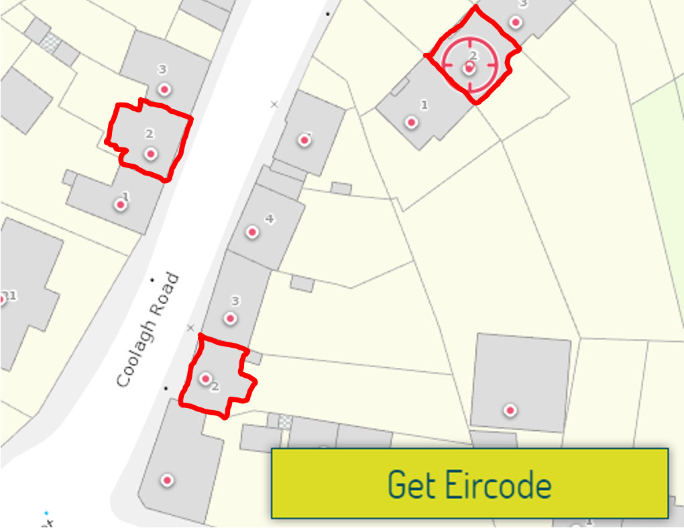
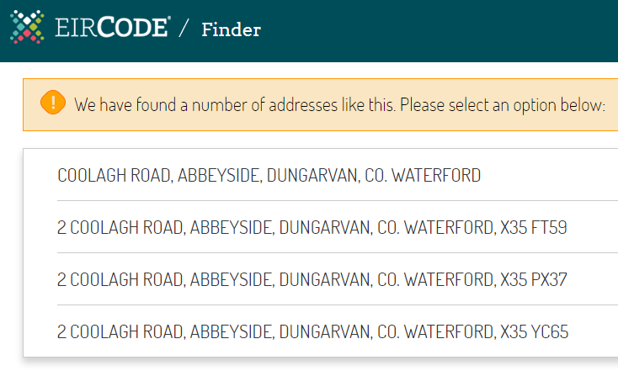
Notes:
Same address (same house number ‘2’) different properties. Eircodes would remove any confusion.

Slide 9
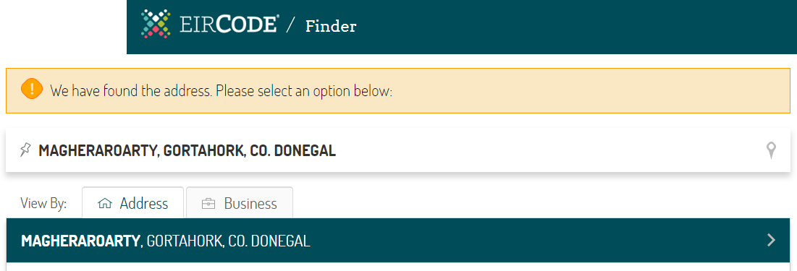
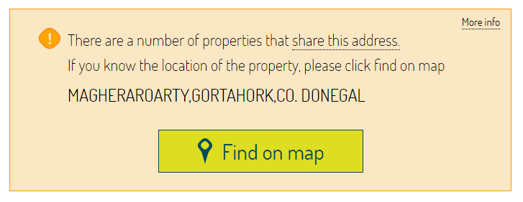
Notes:
MAGHERAROARTY GORTAHORK DONEGAL
Over 100 times
Other problems?

Slide 10
Section 4:
Possibilities – Social Welfare Payments
Notes:
Start…
“Given all of these warts we have prepared the following samples to give an idea of what could be achieved…”

Slide 11
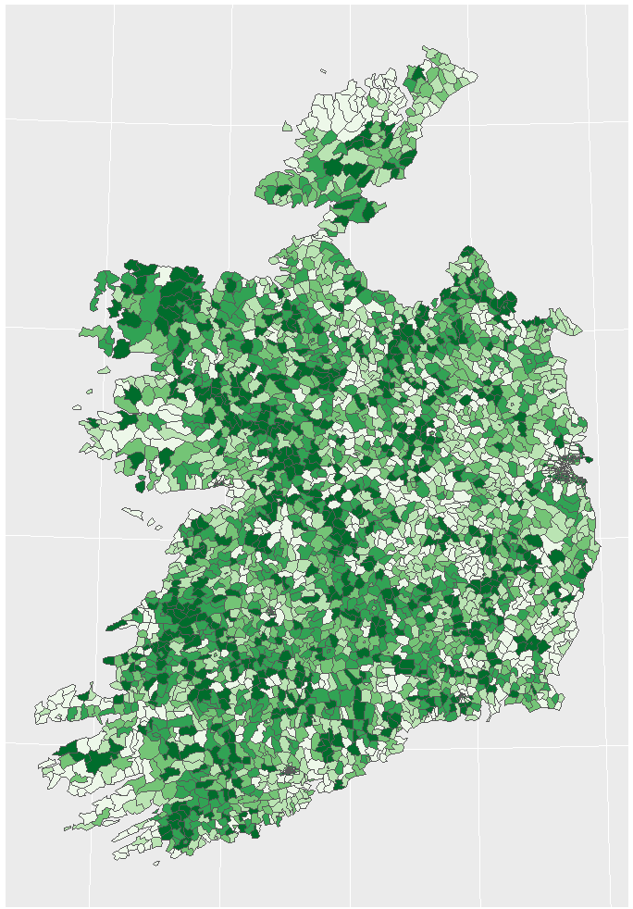
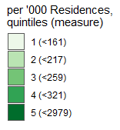
Pension Recipients
Notes:
Pension Recipients
We compared this to Census ED figures. In Donegal there was a greater proportion of retired persons shown than above. Could be due to multiple things, such as:-
Pension from Northern Ireland
Gaelthacht areas with Irish addresses.

Slide 12
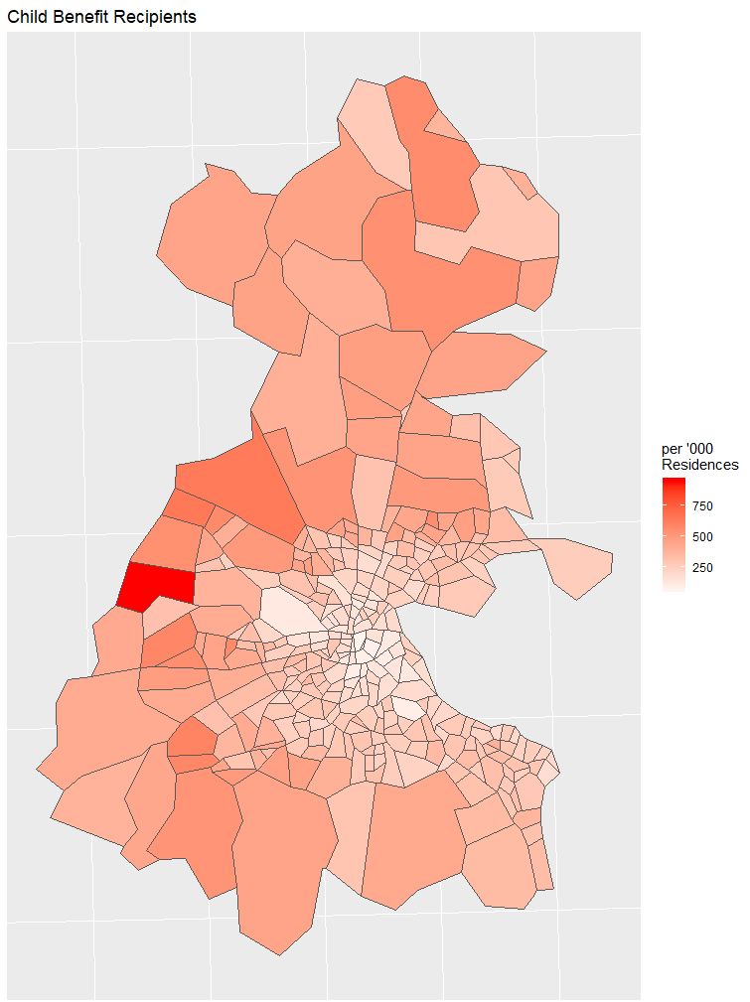
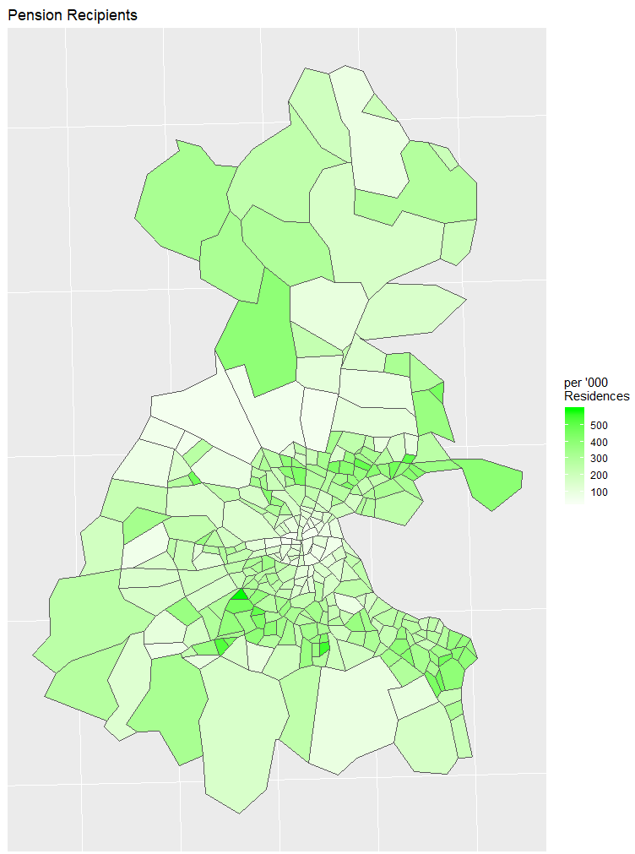
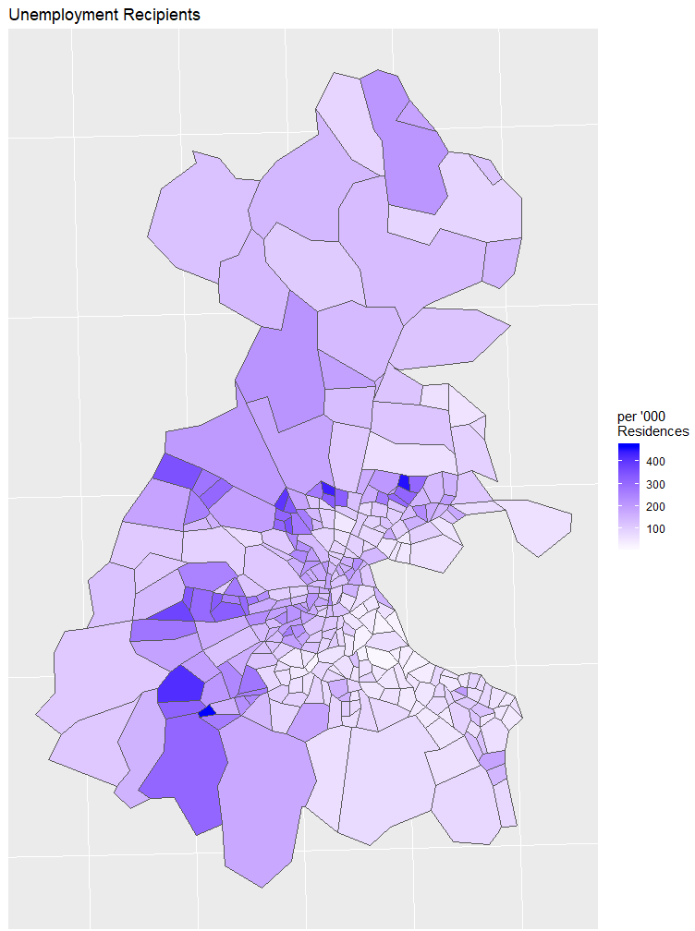
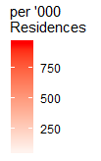


Child Benefit Recipients
Pension Recipients
Unemployment Recipients
Notes:
At end:
“Will be making these slides available online, and if you have any questions about this please let me know.”

Slide 13
Section 5:
Conclusion
- Use Eircodes
Notes:
Closing:
“If you want effective data at local level, to make effective decisions at local level, data needs to have as high a coverage of Eircodes as possible.”

