Slide 1
Covid-19 Dashboard
Emma Hogan
December 3rd 2020

Slide 2
March 2020
Request for “dashboard” for Cabinet from dept. of Taoiseach
Data to include Health indicators but also Economic and Society
Track in real time the critical data which will provide evidence of a need to respond to certain trends rapidly as well as potential emerging issues which will need to be dealt with through recovery.

Slide 3
Technology
Looked at options for dashboard, CSO website, Geohive
Built in Wordpress
easy to update
Add users and control access
data to be hosted in CSO
https://covid19.cso.ie/

Slide 4
Data
Official statistics as well as new data sources
Real time so needed Daily/weekly data
Publicly available
Open Data
Data requests to public bodies

Slide 5
Data Sources
CSO
HSE
Tusla
DCYA
Local Authorities
Gardai
Central Bank
Eirgrid
TII
NTA
Revenue
DEASP
DBEI
…

Slide 6
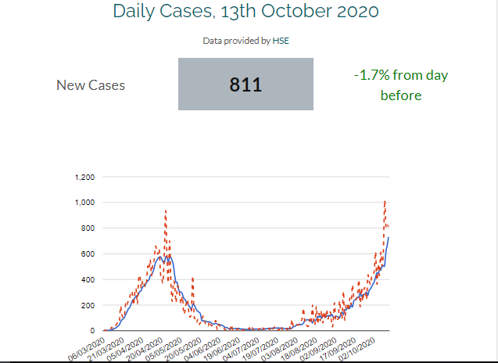
Statistics

Slide 7
Health Response Capacity & Impact indicators on COVID-19 testing, contact tracing, numbers of recoveries and deaths.

Slide 8
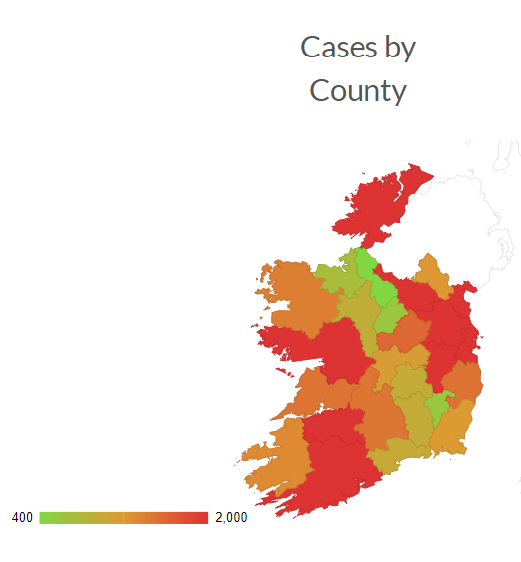
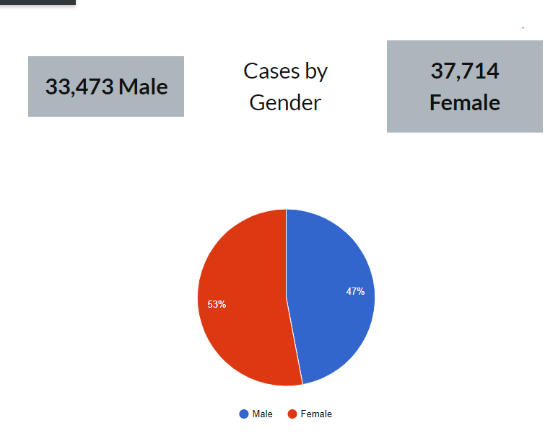
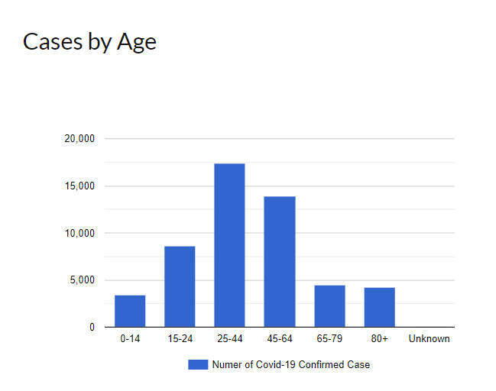
Cases

Slide 9
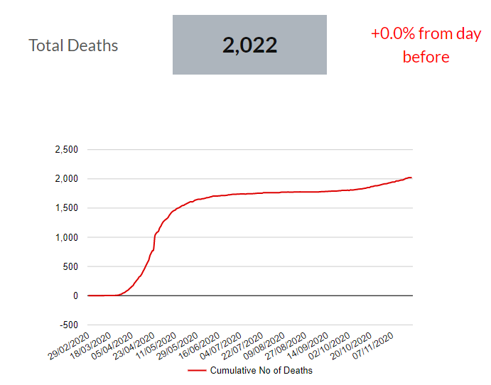
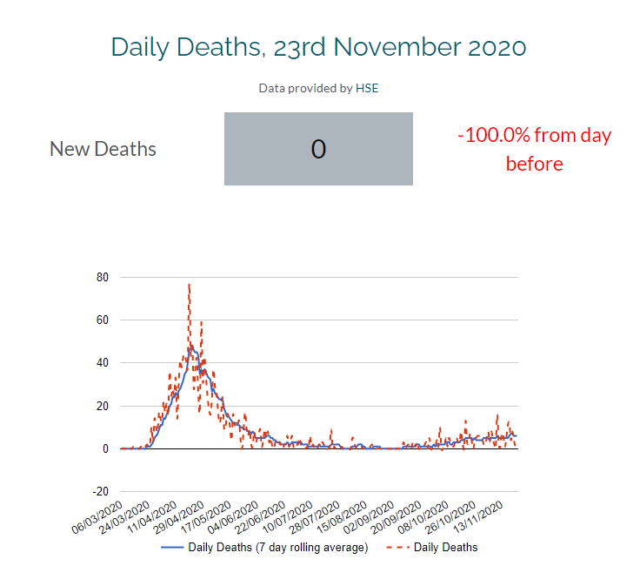
Deaths

Slide 10
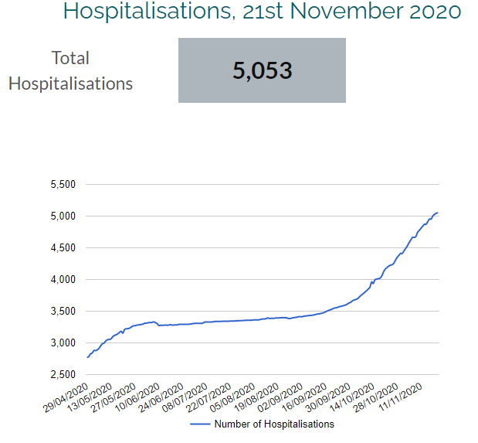
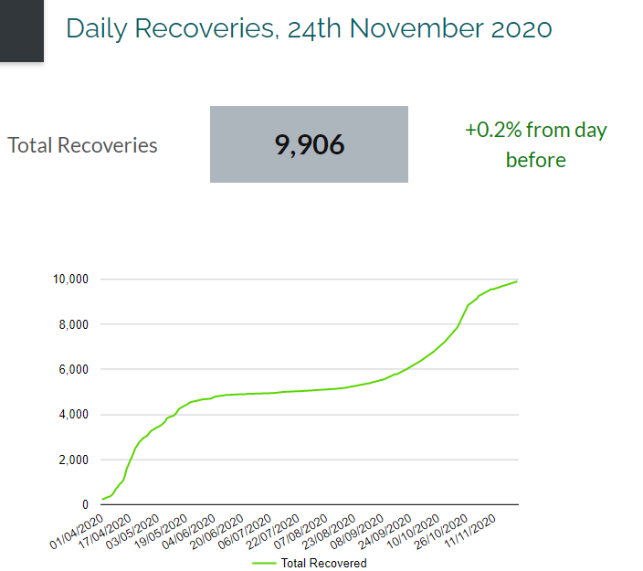
Hospitalisations & Recoveries

Slide 11
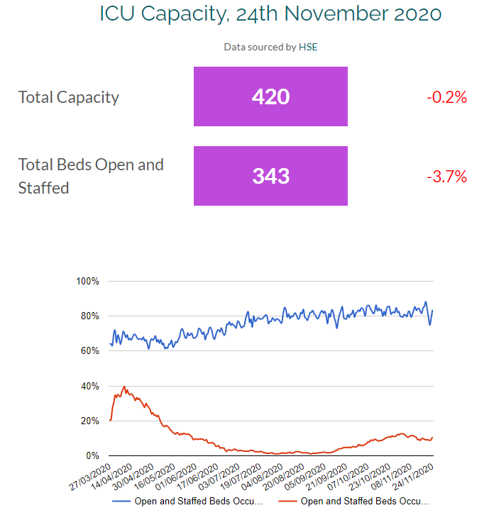
ICU Capacity

Slide 12
Economic Impact Indicators of Social Protection and Revenue Activities and Demand, Supply Chain, Businesses Supports, Economic indicators, Banking and Insurance, Financial Markets

Slide 13
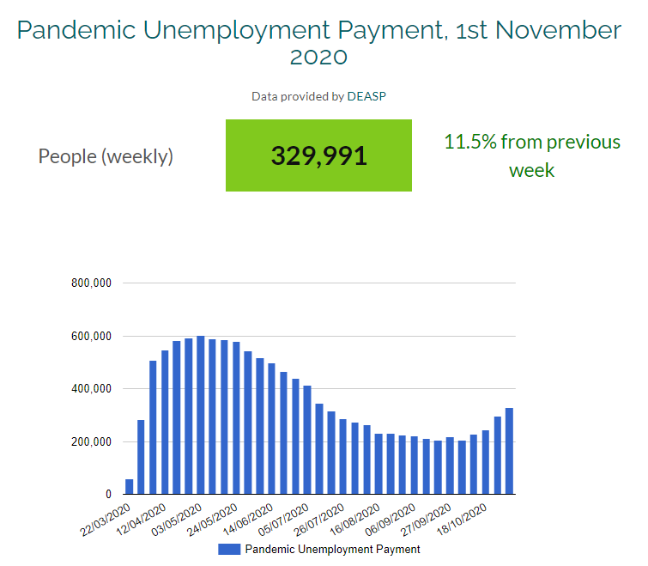
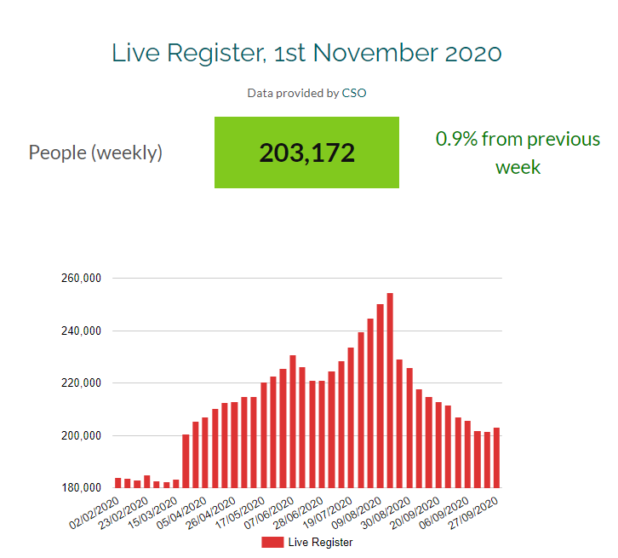
PUP, TWSS & Live Register

Slide 14
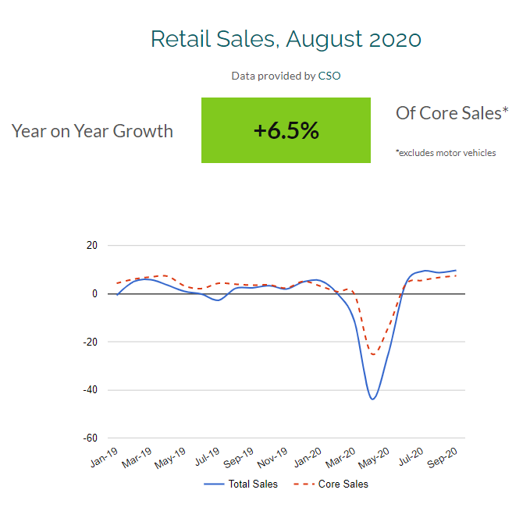
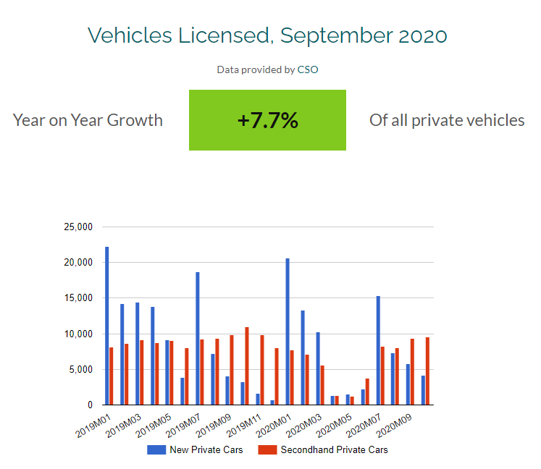
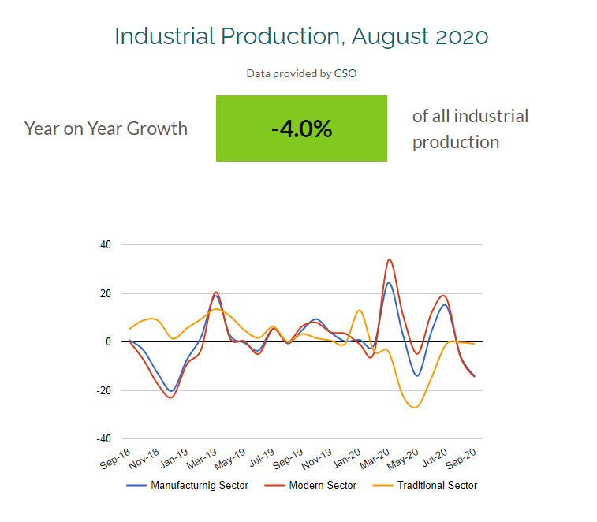
Industrial Production, Retail Sales and Vehicle Registration

Slide 15
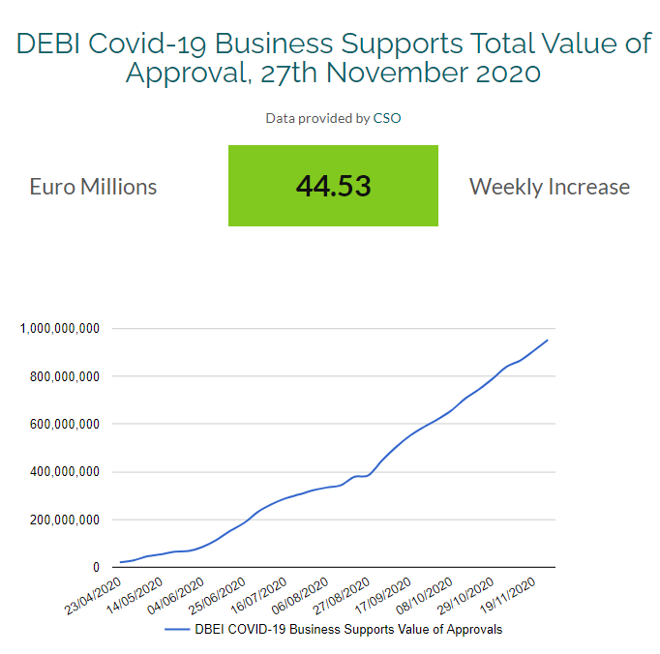
DEBI Business Supports

Slide 16
Compliance with Public Measures Indicators of restrictions on movement and closure of all non-essential services.

Slide 17
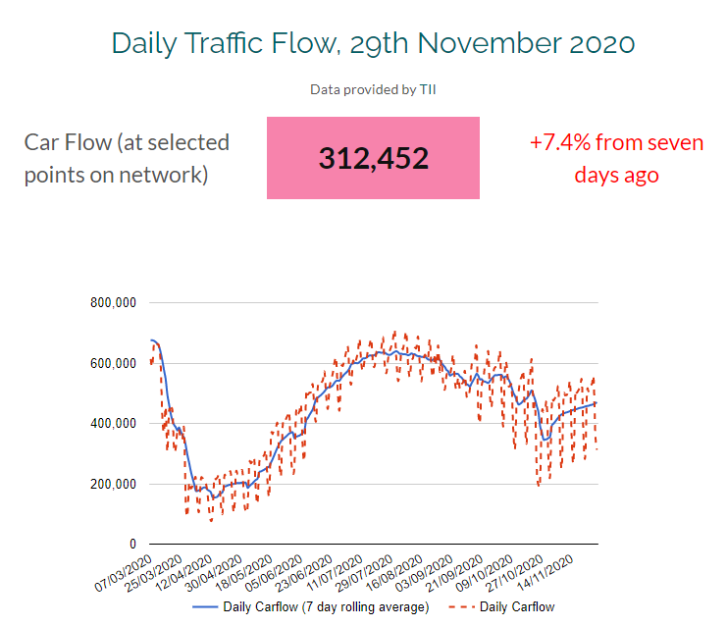
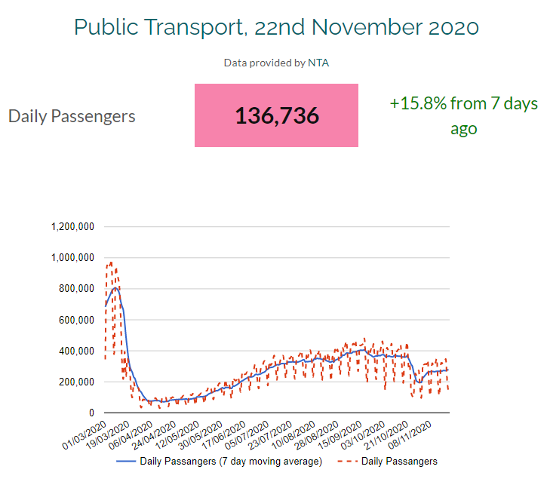
Traffic and Public Transport Data

Slide 18
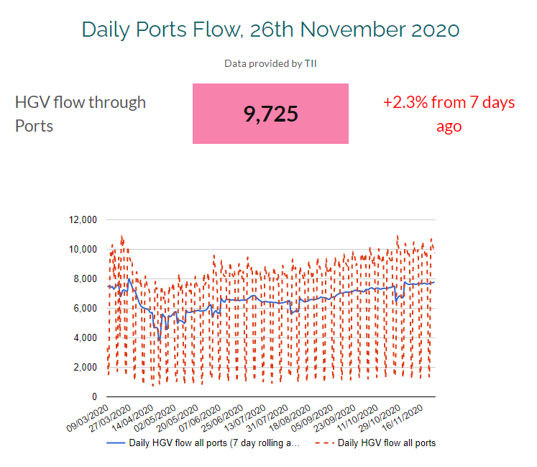
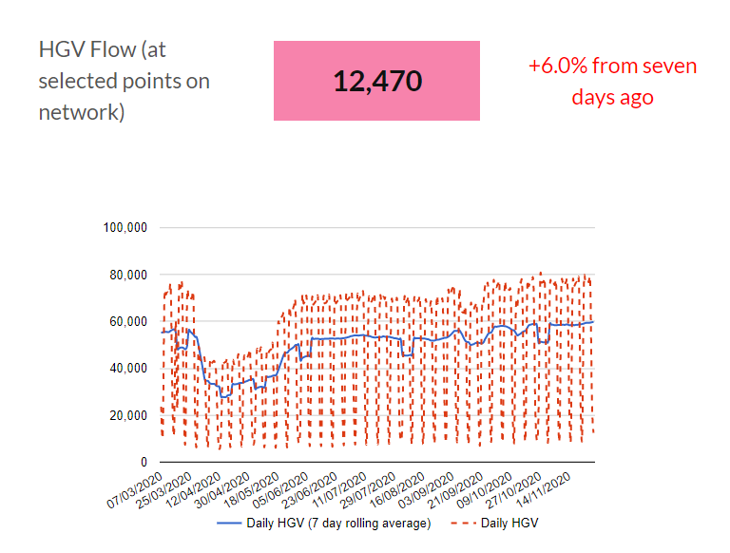
HGV Traffic Data

Slide 19
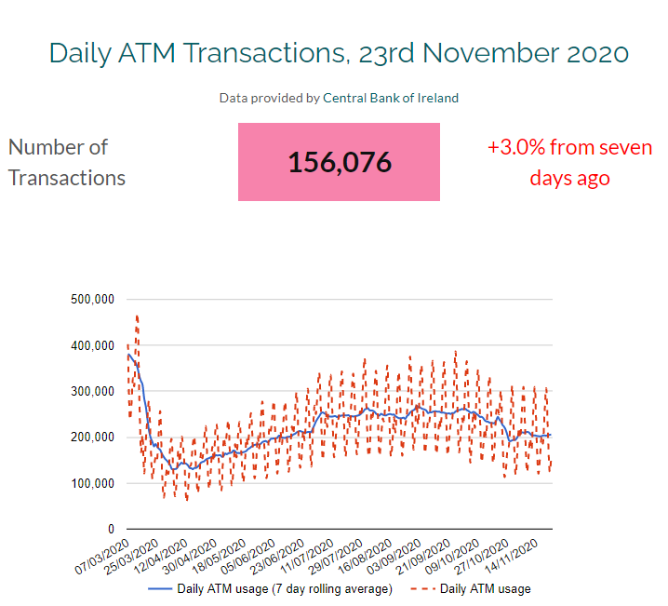
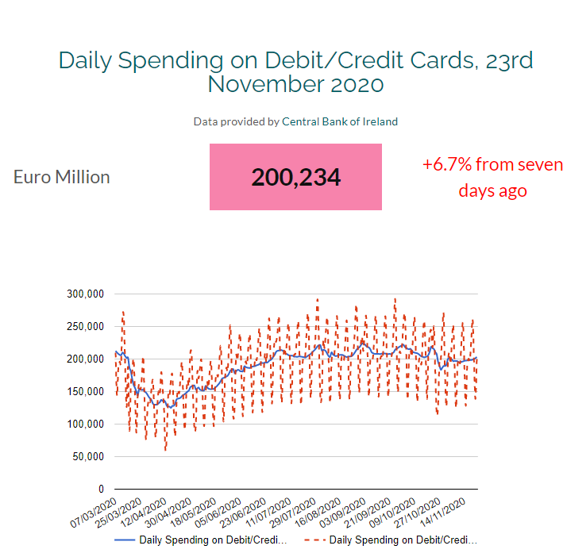
Credit and Debit Card Data

Slide 20
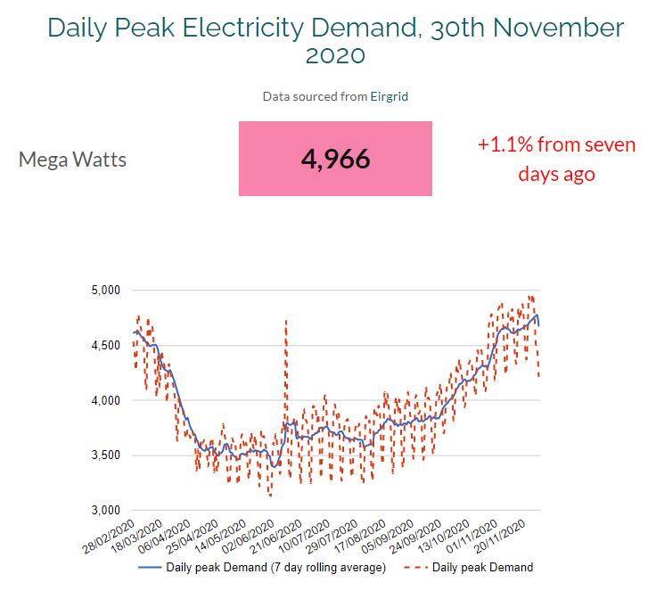
Electricity Demand

Slide 21
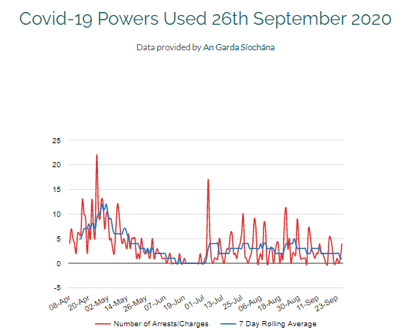
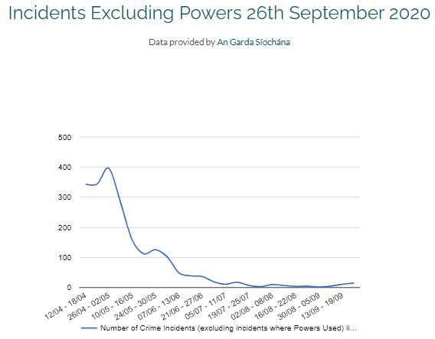
Garda Data

Slide 22
Vulnerable Groups Indicators of impact of Cocooning and on services for Child Protection, Domestic Sexual and Gender based Violence, Homelessness, Alcohol and Drug Addiction and Mental Health

Slide 23
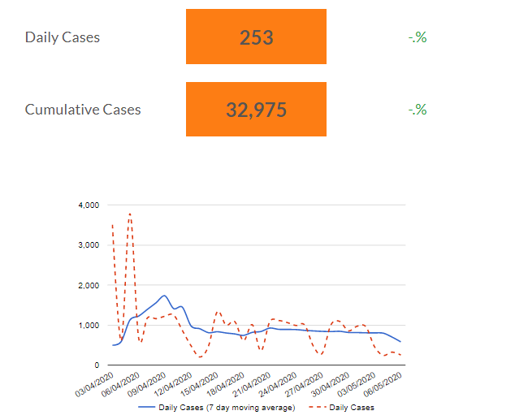
Local Authority Community Response

Slide 24
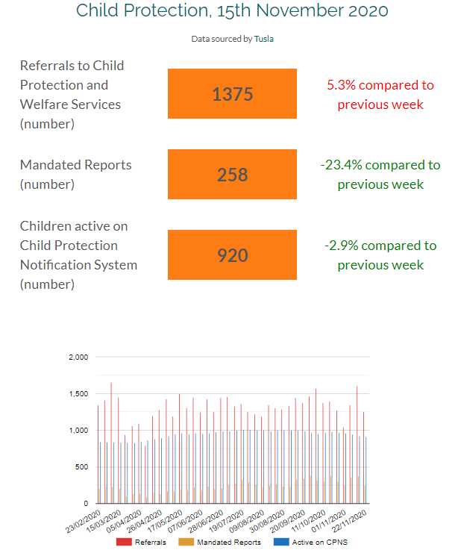
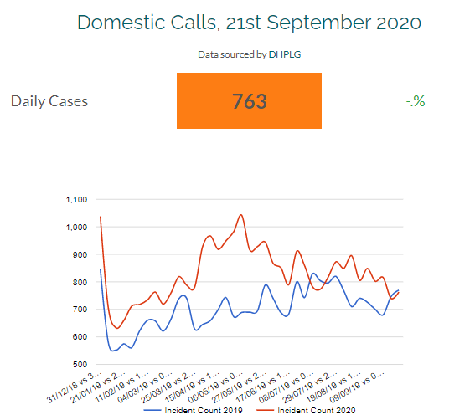
Domestic Calls & Child Protection

Slide 25
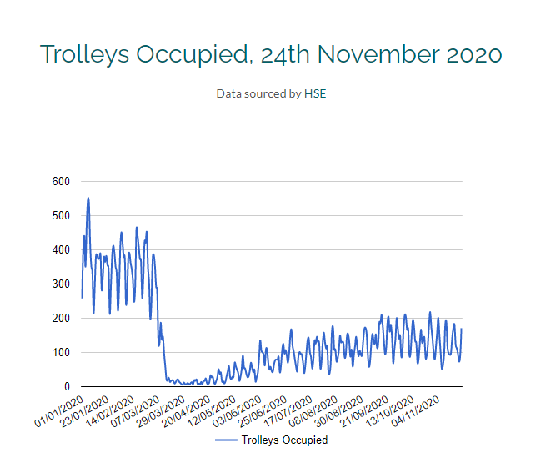
Hospital Capacity

Slide 26
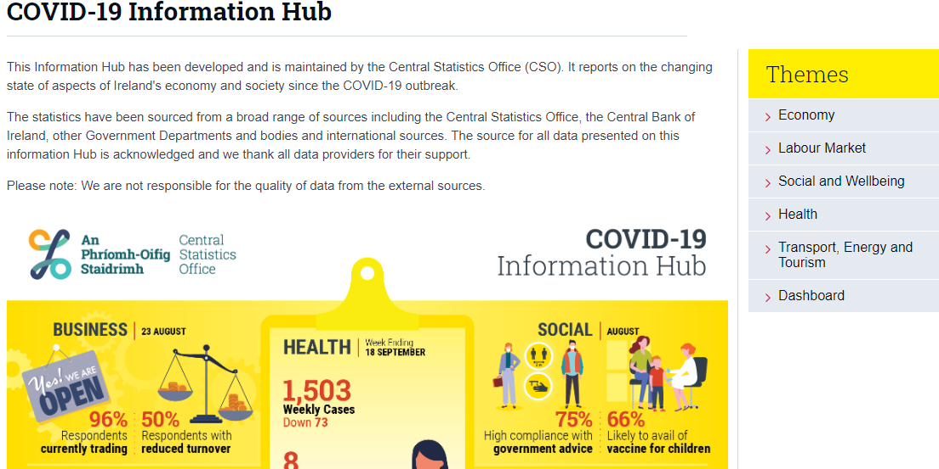
CSO Covid-19 Information Hub

