Slide 1
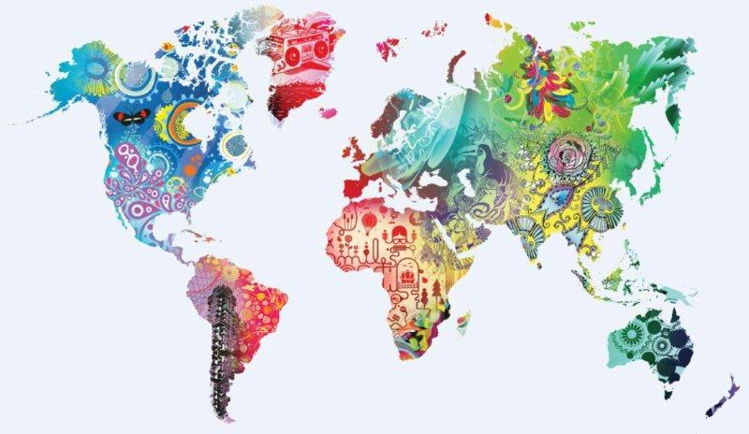
Some International Context
steve.macfeely@unctad.org

Slide 2
Topics
Some International Context
Data Revolution
Sustainable Development Goals
Globalisation
Ireland’s role

Slide 3
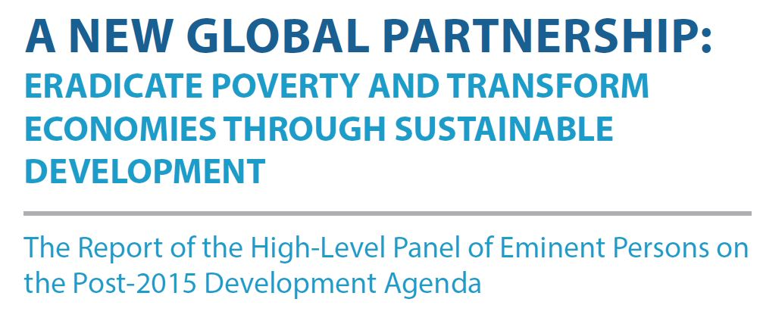
High-Level Panel of Eminent Persons (2013)
International Context
Transformative Shift – Data Revolution
…a new international initiative to improve the quality of statistics and information

Slide 4
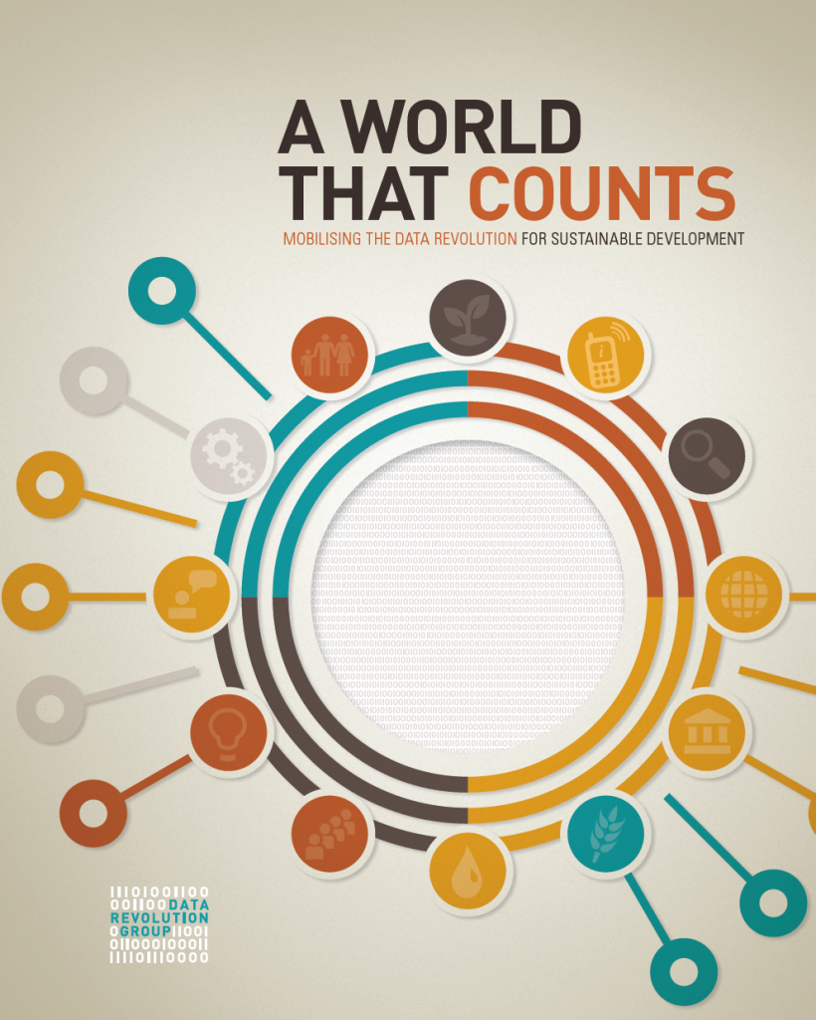
000 Data Revolution 0000000000000002014
International Context
Good points
Importance of geospatial/regional/local data
Need for adequate funding
'Access' to data
Organisation of data to facilitate re-use
Links ‘data’ and ‘inequality’
Lost opportunities
Link to wellbeing
Insufficient emphasis given to basic building blocks – infrastructure
Globalised data and the implications for production
Data a new frontier of inequality - making 'data' a SDG goal in and of itself
Access (data protection)

Slide 5
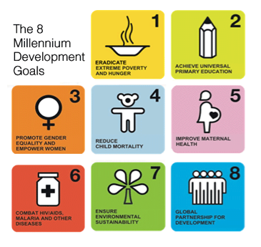
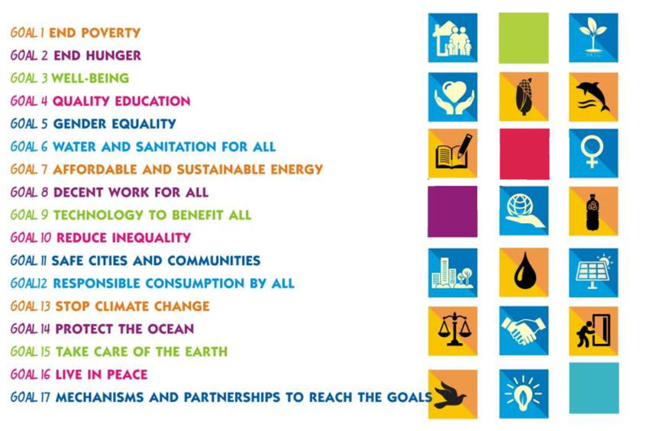
From Millennium to Sustainable
International Context
8 Goals
24 Sub-targets
17 Goals; 169 Sub-targets

Slide 6
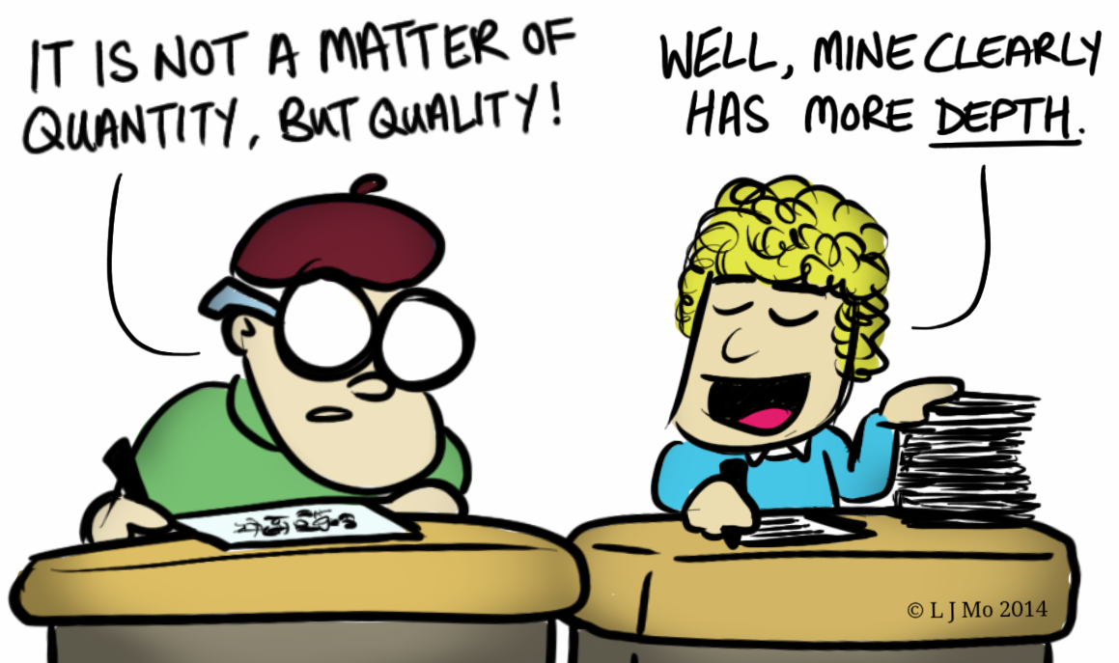
Stupid Development Goals?
International Context

Slide 7
Sustainable Development Goals
International Context
End poverty
End hunger
Wellbeing
Quality education
Gender equality
Reduce inequality
Decent work for all
Technology to benefit all
Water and Sanitation for all
Affordable and sustainable Energy
Safe cities and communities
Responsible consumption by all
Stop climate change
Protect the Ocean
Take care of the earth
Live in peace
Mechanisms and partnerships to reach the goals

Slide 8

International Context

Slide 9
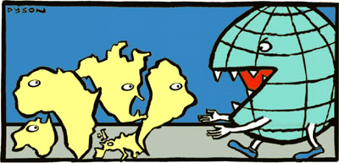
Globalisation
International Context

Slide 10
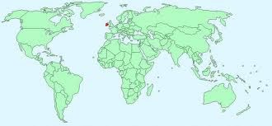
Global influence
Ireland’s role

Slide 11
