Slide 1
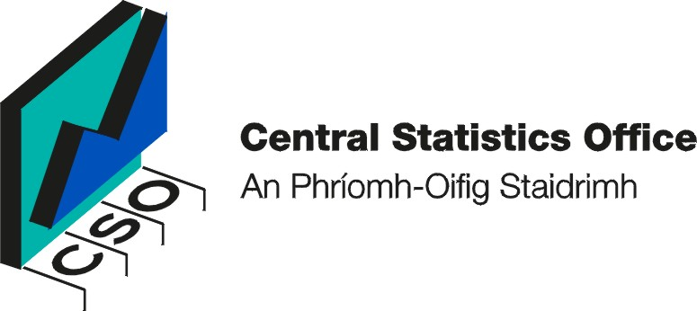
Probation and Prison Recidivism Statistics - Answering Policy Questions using administrative data linkage.
Crime Section,
Central Statistics Office.

Slide 2
Areas of Discussion
The Policy Question
The Challenge to measuring recidivism
The Initial State of Affairs
The Benefits of linkage.
The matching process
The results

Slide 3
The Policy Question
What is the Rate of Recidivism?
  Recidivism is a measure of re-offending rates and is a key measurement for criminal justice policy.
  Different definitions in different countries
  Irish formal definition:
    Probation/Prison Service: A recidivist (re-offender) is an individual who committed a recorded offence within three years of commencing probation (or being released from Prison); and who is convicted in court proceedings that commenced within two years of the offence

Slide 4
The Policy Question
Why is recidivism important?
  Allows measurement of effectiveness of rehabilitation schemes over time
  Determines factors that lead to higher/lower recidivism rates
  Identify populations prone to recidivism
    E.g. the under 25s.
    Value for money from informed decision making

Slide 5
The Challenge to measuring recidivism
How to define recidivism
There is a need to integrate Garda, Probation and Prison data.
There is no common identifier between the datasets
CSO uses a matching methodology to link these separate datasets.

Slide 6
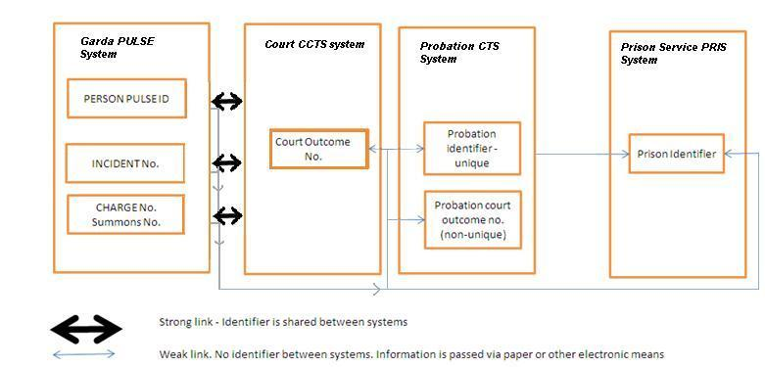
The Initial State of Affairs

Slide 7
The Benefits of Linkage
Permits the study of recidivism.
Extremely low cost – no surveys required
Results can be generated on a frequent (annual) basis
Leads to comprehensive statistics studying the entire populations of interest.

Slide 8
The Main Matching Exercise -Process chart

Slide 9
The Matching Process
Probation and Prison datasets used to develop a matching algorithm
Complex, lengthy process – no common identifier
Use of first names/surnames/dates of birth
Difficulties in linking the datasets

Slide 10
The Matching Process
This matching process had some additional complexities.
Large datasets.
Intentional errors (by offenders) in names and age addressed by methodology.
A success, with 95% of individuals matched.

Slide 11
Results
Development of complex linking algorithm
Reliable and accurate recidivism figures were produced
  Analysis by age, sex, initial and subsequent offence.
Statistics can be produced cheaply, quickly.
New policy outcome indicators for Justice

Slide 12
Results (ctd.)
Probation Recidivism Results
  Selected results for 2007 and 2008
Table 1 Offender numbers classified by sex, age group, probation type, probation referral offence and whether there was a re-offence within three years, 2008 and 2009 cohort
 |  | 2008 cohort |  |  |  |  | 2009 cohort
 |  | Re-offence within |  |  | Recidivism¹ |  | Re-offence within |  |  | Recidivism |  | Recidivism
 |  | three years |  |  | rate |  | three years |  |  | rate |  | rate
 |  |  |  |  |  |  |  |  |  |  |  | Absolute
 |  | Yes | No | Total | % |  | Yes | No | Total | % |  | change
Total offenders |  | 1,543 | 2,218 | 3,761 | 41.0 |  | 1,436 | 2,418 | 3,854 | 37.3 |  | -3.8
Sex
 | Male | 1,373 | 1,888 | 3,261 | 42.1 |  | 1,279 | 2,059 | 3,338 | 38.3 |  | -3.8
 | Female | 170 | 330 | 500 | 34.0 |  | 157 | 359 | 516 | 30.4 |  | -3.6

Slide 13
Conclusion
Data linkage can be possible even with absence of common identifiers
  Including where errors in linking fields
Data linkage can produce quick, cheap and reliable measures of urgent public policy questions.
If common identifiers such as PPSN are included in future, more analysis possible.

