Slide 1

Unemployment and Employment Transitions
5th Administrative
Data Seminar
12th April 2016
Paul Rockley

Slide 2

Overview
Introduction
Data Sources
Outcomes
Next Steps

Slide 3
Introduction
Purpose: to look at the utility of a data merge between two data sources:-
Unemployment Claims
PAYE Earnings
(Undertaken as an Officer of Statistics.)
Data matching using PIK
Hashed PPSN; hides identity but preserves linking capabilities.

Slide 4
Data Sources
PAYE Earnings
(P35 Returns to Revenue)
Unemployment Claims
(ISTS data from DSP)

Slide 5
Unemployment Claims Data
ISTS - Integrated Short Term Systems
From Department of Social Protection
Weekly files
Information:
Claim Start Date
Local Welfare Office
Occupation
Age & Gender

Slide 6
PAYE Earnings Data
P35 Annual Returns from Business for PAYE Employees
From Revenue
Annual files
Information:
Period of Work
Enterprise – ID and NACE Sector
Date of Birth
Total Pay

Slide 7
Data Linking
P35
(PAYE Returns to Revenue)
ISTS
(Weekly DSP Claims)

Slide 8

Some Outcomes

Slide 9
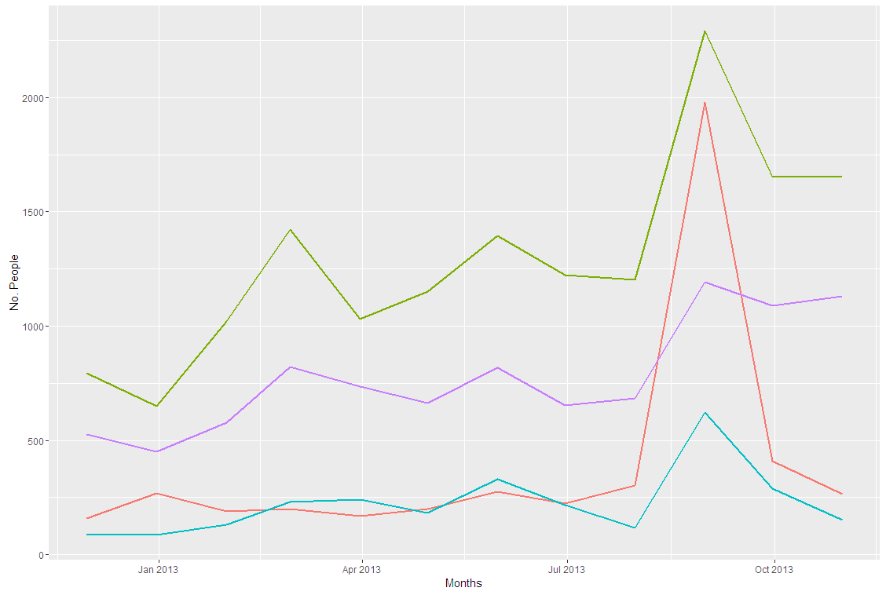
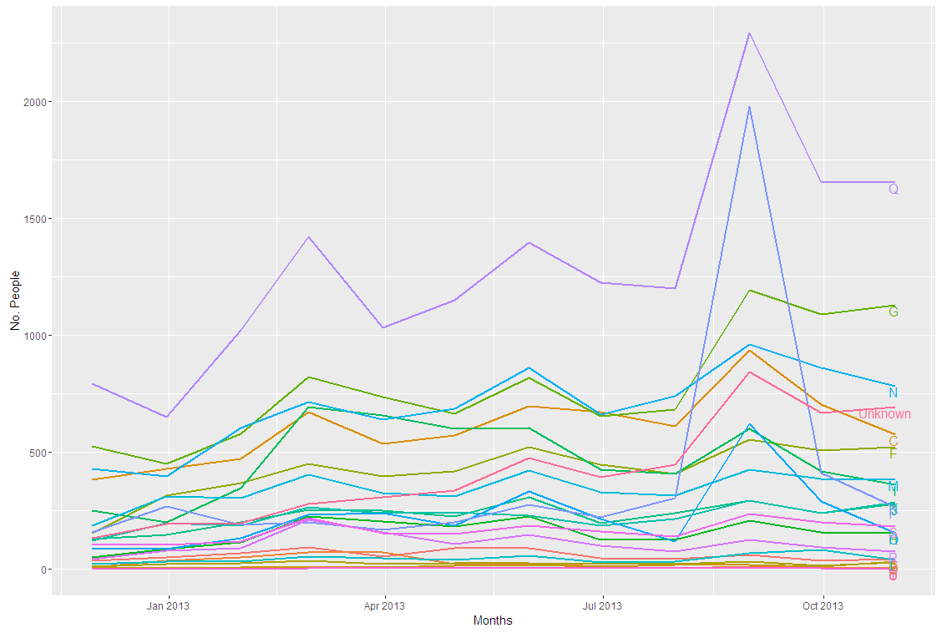

Leavers to P35 Employment for 2013 by NACE2

Slide 10
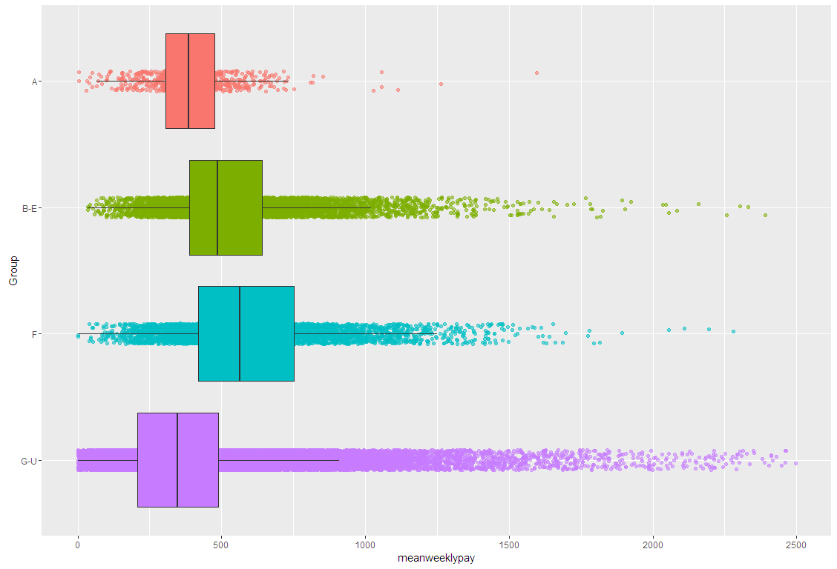
Leavers to P35 Employment by Mean Weekly Pay (2013)
A Agriculture, forestry and fishing
B-E Industry
F Construction
G-U Services

Slide 11
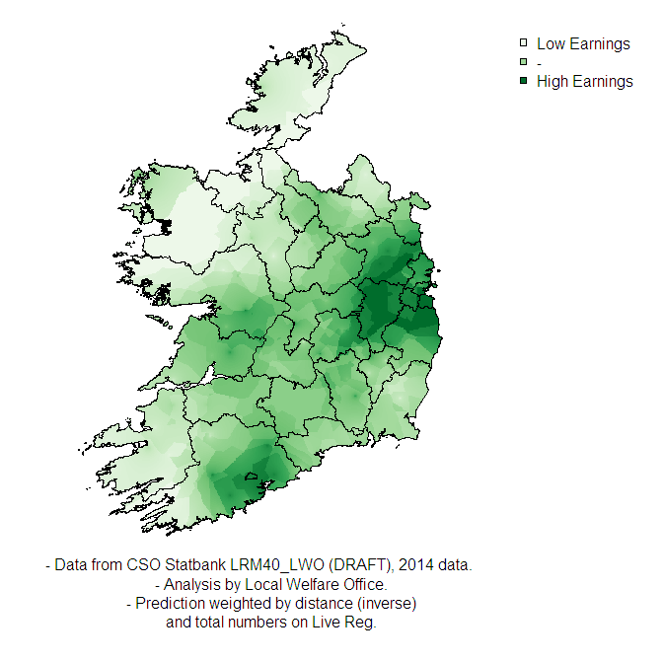
Earnings in New Employments upon leaving Live Register

Slide 12
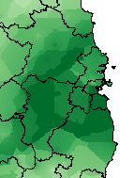
Earnings in New Employments upon leaving Live Register
Great Dublin Area
L
M
H
H

Slide 13
FETAC Data

Slide 14
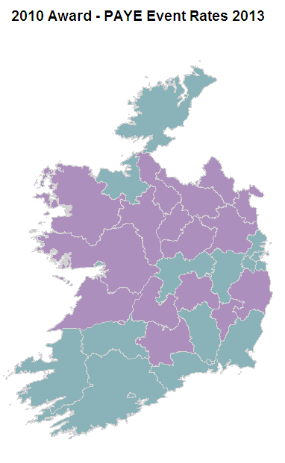

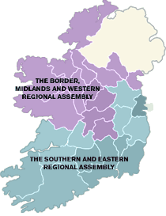
Regions of Ireland
**Major FETAC awards at NFQ Level 5

Slide 15
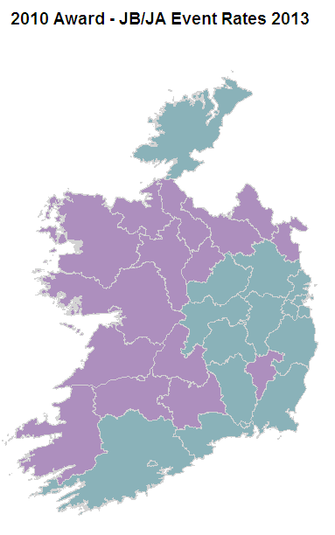

Regions of Ireland
**Major FETAC awards at NFQ Level 5

Slide 16
Next Steps

Slide 17
Next Steps
Study leavers from LR who don't go back into work – where did they go?
Destination occupations may be of more interest than Industry NACE Sectors.
LR has the occupation that the claimant lists when they first make a claim. Could study what jobs they go into when they leave the LR. "Flow". Career change?
Could compare what benefits before and after gaining PAYE/P35 work
...

Slide 18



Slide 20
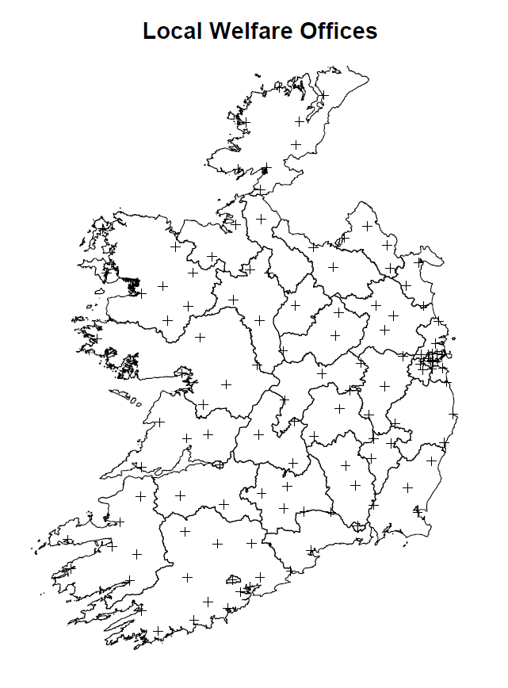

Slide 21
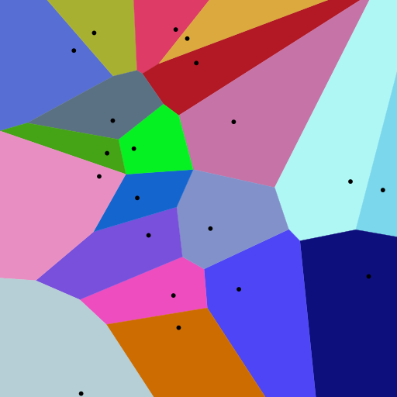
Voronoi Diagram
A Voronoi diagram is a partitioning of a plane into regions based on distance to points in a specific subset of the plane. That set of points (called seeds, sites, or generators) is specified beforehand, and for each seed there is a corresponding region consisting of all points closer to that seed than to any other. These regions are called Voronoi cells.

