Slide 1
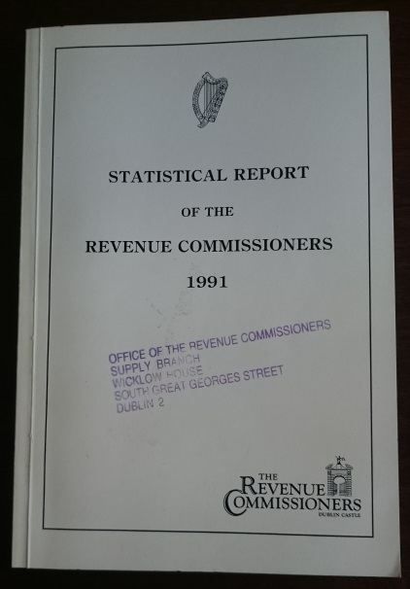
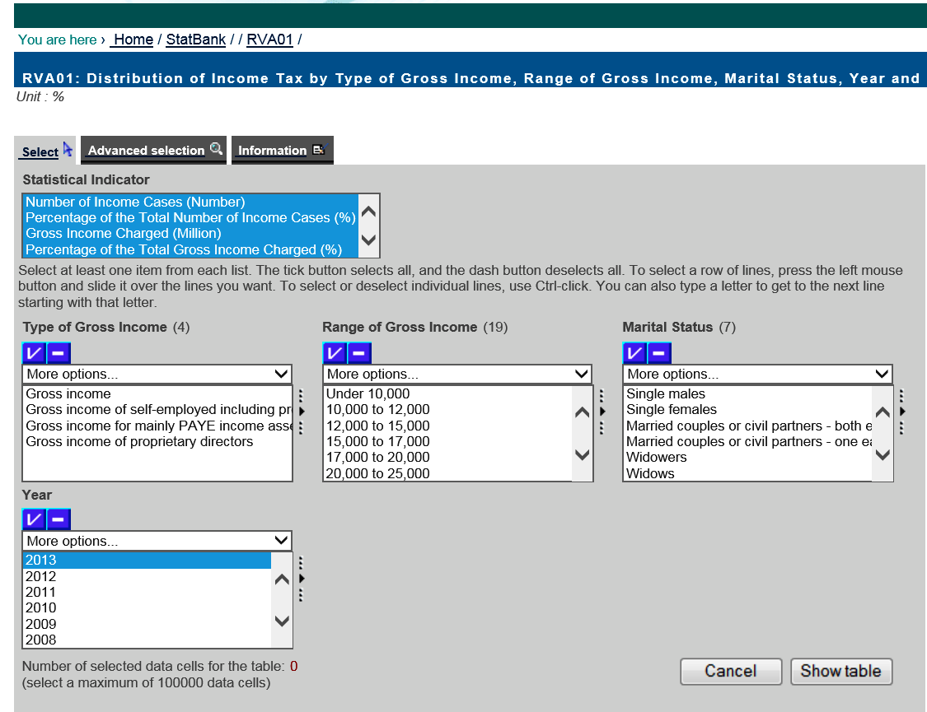
C&E
Opening Revenue Data; ‘from paper to pivot table’
5th Administrative Data Seminar
12th April 2016
Pat Mulhall
Statistics & Economic Research Branch
Office of the Revenue Commissioners

Slide 2
Presentation Objectives
Objective of Presentation
Provide a brief guided tour of the changed Revenue Statistics landscape, focussing on ;
  Why change
  What Revenue statistical resources are available
  Where and how these may be accessed
  How we have enriched and extended our output
Outline what is in the pipeline and how we need your assistance

Slide 3
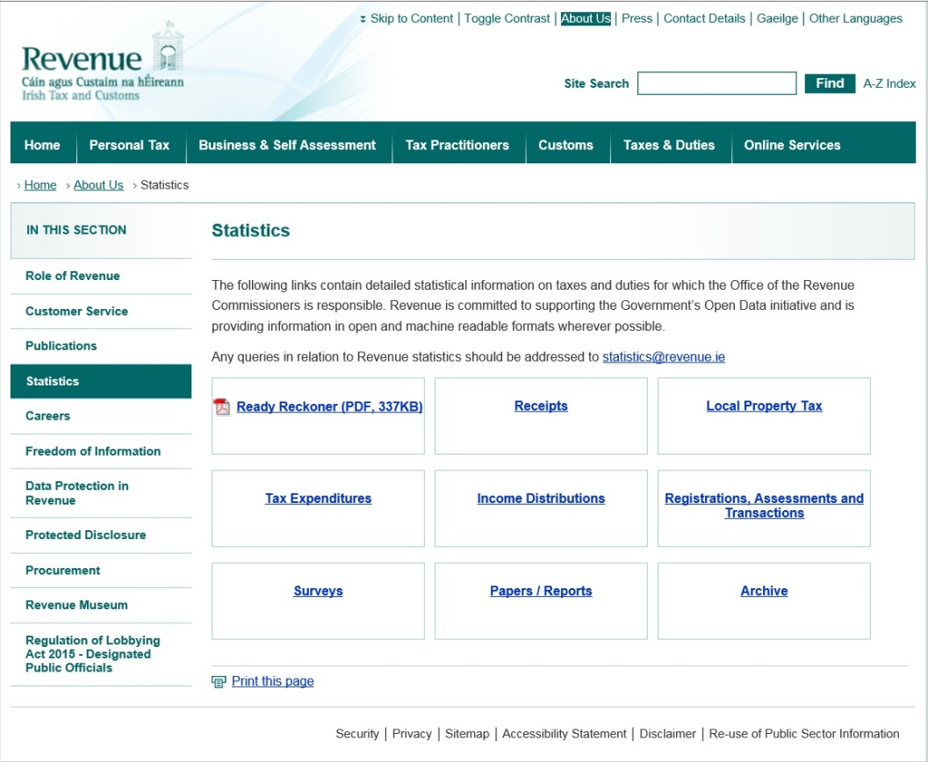
Revenue Statistics Menu
Introducing the ‘Revenue Statistics Menu’ - Primary statistics gateway
Navigable on Revenue.ie hompage via ‘About Us>Statistics>’ or directly at http://www.revenue.ie/en/about/statistics/index.html (Shortly to be directly accessible from Revenue.ie hompage)
Replaced previous single scrollable statistics webpage with menu/sub-menu structure
Better delivery
  More information
  Easier navigation and access
  Links to Research material
Provides access to
  Statistical Datasets
  Distribution Statistical Tables
  Ready Reckoners
  Statistical Reports/Papers

Slide 4
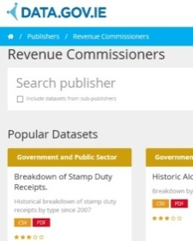
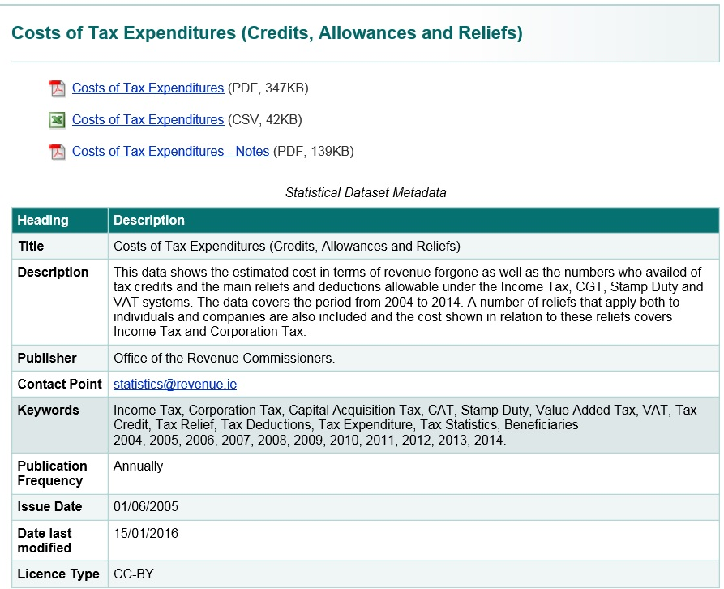
Statistical Datasets
Statistical Datasets available through Revenue Statistics Menu & sub-menus
Dataset Metadata also published
Open Data Datasets are also referenced on National Portal

Slide 5
Distributions
Hosted by CSO (StatBank), accessible from Revenue Statistic Menu or http://www.cso.ie/px/pxeirestat/pssn/rv01/homepagefiles/rv01_statbank.asp
Interrogatable & downloadable distribution statistical tables across multiple years in respect of
  Income Tax
  Corporation Tax
  VAT
  Vehicles
Leverages Statbank interface
  User-defined views/queries
  Many download formats
Demo available today

Slide 6
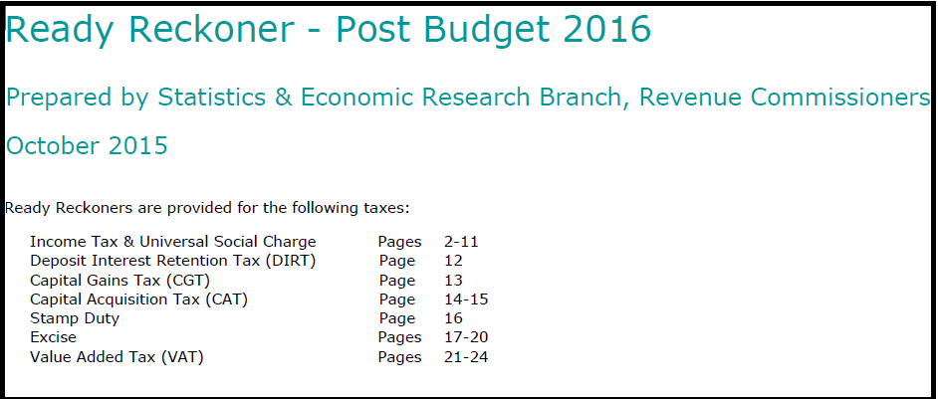
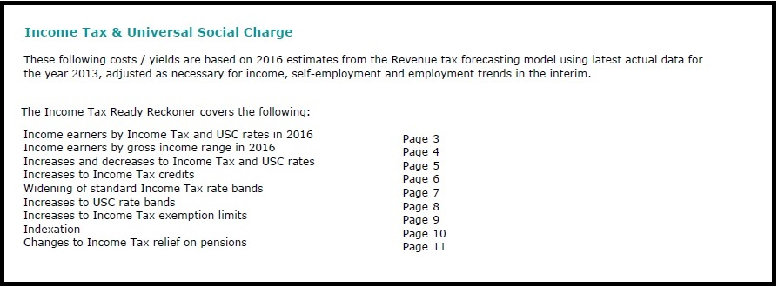
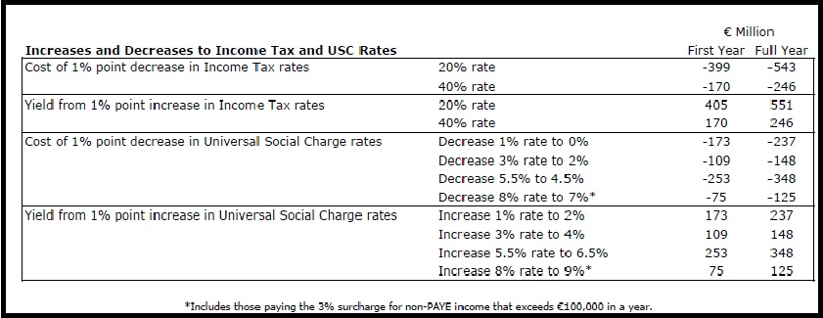
Ready Reckoners
Provides indicative estimates across a range of taxes for the yield/cost that might result from changing elements such as band, rate, etc.,
Resource available through Revenue Statistics Menu or at http://www.revenue.ie/en/about/statistics/ready-reckoner.pdf

Slide 7
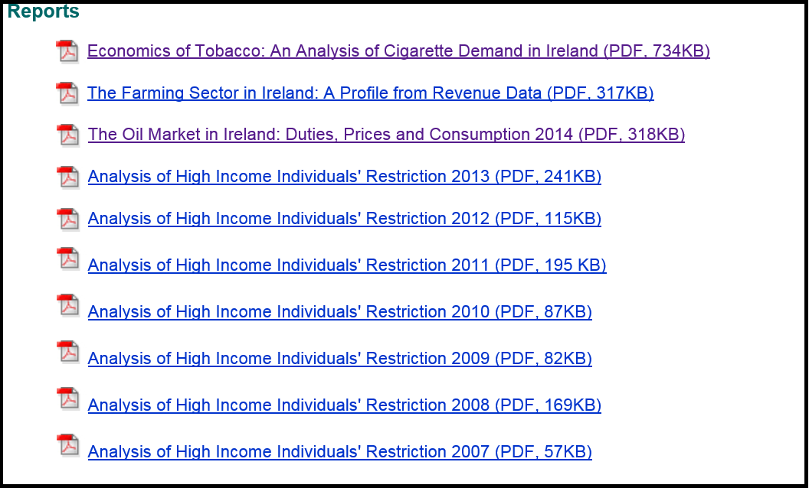
Statistical Reports/Papers
Range of Statistical Reports/Papers published
Available through Revenue Statistics Menu or at http://www.revenue.ie/en/about/publications/other.html#reports
Includes
  Annual Reports e.g. Analysis of High Income Individuals Restriction
  Once-Off or Sectoral Reports e.g. The Farming Sector in Ireland, Economics of Tobacco

Slide 8
Initiatives
Aside from our ‘Normal’ Business we are undertaking a range of initiatives to enhance and enrich Revenue’s Statistical Output
Continual review of the quality and relevance of our output
Open Data Audit on-going – continue to increase volume of Open Data datasets published to a minimum of Berners-Lee's ‘3 Star’ rating
Evaluating the feasibility and value of publishing an anonymised sample unit record file of individual tax returns for a series of income years
Explore opportunities of proposed upgrade to Revenue.ie to
  Provide more direct and dynamic access to Revenue Statistics
  Deliver interactive Ready Reckoner data
  Create a separate ‘Research’ space
Developing a more ‘Demand’ driven approach

Slide 9
  Future Priorities
  Demand Driven Focus
  Extending our Open Data Audit we are prioritising data which has already been sought
  Pro-active Approach --- process of engagement with a range of users and potential users of Revenue Statistics
  Enable resources to focussed production of statistical products which are more likely to be used
  Encourage feedback therefore at Statistics@Revenue.ie
      The statistics currently produced
      What other Revenue statistics would be valued
    However…Revenue are a tax collection agency
  Thank You

