Slide 1
Microsimulation modelling to inform policy debate: the case of SWITCH
Tim Callan
Economic and Social Research Institute

Slide 2
Overview
Context: the role of SWITCH
Simulating Welfare and Income Tax CHanges
A tour of the SWITCH model
Illustrative applications to policy issues
Future potential

Slide 3
SWITCH and SILC: Informing policy debate and policymakers
Analysing the potential impact of tax and welfare policy reforms
on household disposable incomes
on financial incentive to work faced by individuals
Official post-budget “social impact assessment”/ “poverty proofing”
Assessing cost, distributive and/or incentive implications of actual or potential policy changes
e.g., medical card, UHI, property tax, childcare

Slide 4
Areas investigated using SWITCH
Income tax
Welfare
PRSI & levies
Property tax
USC
Public sector pay
Childcare costs & ECCE
Gender impact
Water charges & subsidies
Medical and GP visit cards
Housing:
HAP & differential rent
Indirect
taxes
Labour supply
Social welfare and occupational pensions
Social impact assessment
Notes:
In the early years, we were very careful to brand the model as SWITCH, the ESRI tax-benefit model. I think we’re going to have to revisit this, because now the range of the model goes well beyond tax and welfare.
We’re now well past the 100 publications mark, and closing in on the 150.
These range of publications includes journal articles, ESRI publications, reports to government commissions and working groups.
SWITCH research is referenced in Dail debates, newspaper articles

Slide 5
Selected users of SWITCH research
Dept of Social Protection*
Dept of Finance*
Dept of Public Expenditure and Reform*
Dept of Environment
Dept of Health
Advisory Group on Tax and Welfare
Tax and Welfare Integration Group
Commission on Taxation (Mark 2)
Interdepartmental Group on Property Tax
OECD
EU Commission
Social Protection Committee of EU
*=makes direct use of SWITCH model
Notes:
Very strong engagement with policy makers and policy debate.
Strong reputation that has to be guarded and enhanced by careful attention to detail and to quality.
Model is built around the Levers of policy – what would be the impact if policy changed in this way or that
Direct use by policy makers – in advance of the budget, and in social impact assessment post-Budget.

Slide 6
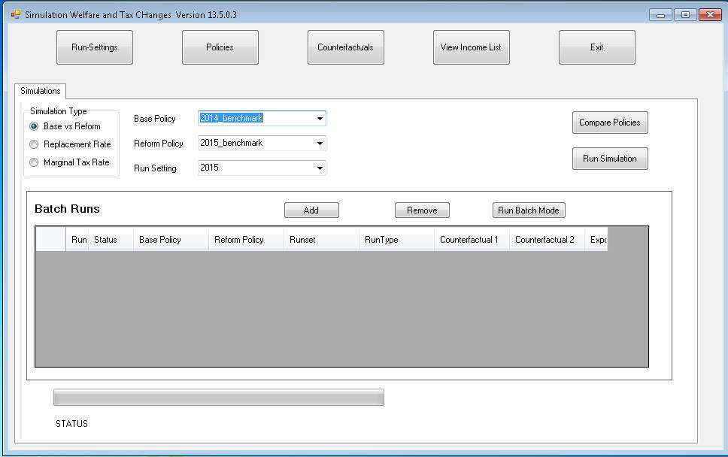

Slide 7
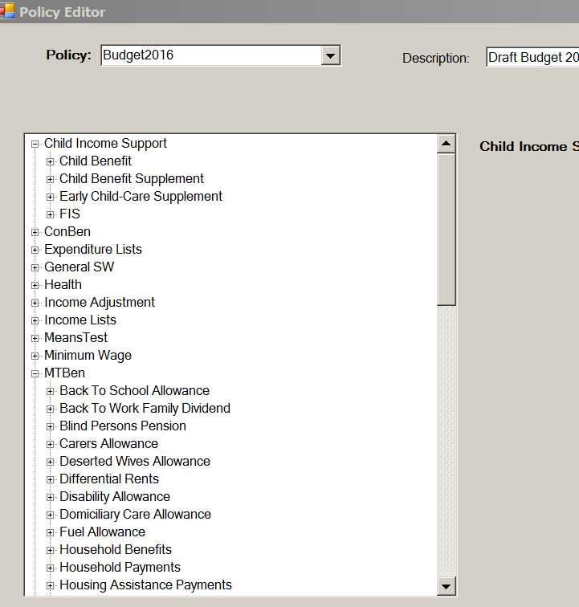
Editing a policy (1): Navigation

Slide 8
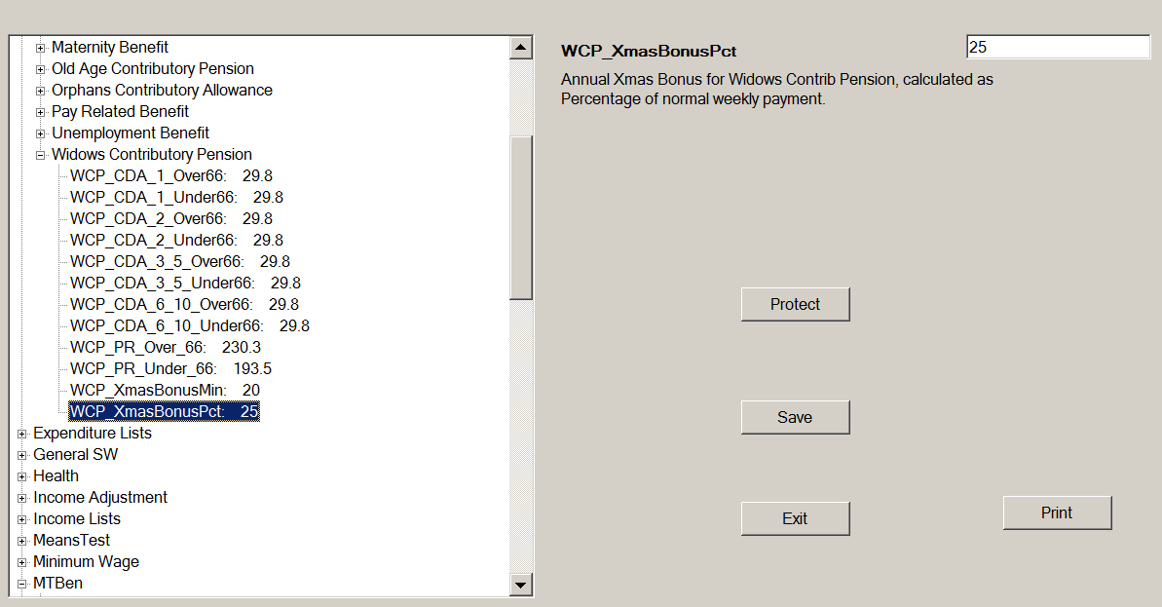
Editing a policy (2): Changing parameter values

Slide 9
Administrative data and household surveys
Differing strengths and weaknesses
Choice of data source depends on the purpose of the analysis
SILC could be seen as a “hybrid”
Data gathered through household survey;
And with permission of the respondents, who supply PPSNs, data supplemented with information from administrative records

Slide 10
SWITCH model: Background
Microsimulation model:
currently based on CSO’s SILC 2010 data
soon to be re-based using SILC 2013
Database is adjusted to represent the 2016 population
Representative sample of the population (12,000 individuals)
Simulates taxes & benefits to arrive at disposable income
Counterfactual analysis: replacement rates, marginal effective tax rates, minimum wage

Slide 11
Example 1: Medical/GP Visit Cards
SWITCH calculates assessable income based on
current income
age
living alone/with family (if under 70)
number of children
housing costs
actual childcare costs
No travel to work costs in the underlying data (SILC)
estimation procedure could be developed, but items covered capture most of the variation in assessable income

Slide 12
% of Tax Units with a GP Visit Card by Income Decile

Slide 13
Example 2: Does Work Pay?
It is easy to construct examples of households where individuals face high replacement rates
A key issue is whether such examples are realistic or representative
Detailed microsimulation analysis of a nationally representative sample of households is needed
to identify the nature and extent of problems in this area
and to explore policy options to address such difficulties

Slide 14
Employment Rate* by Replacement Rate Category, 2015
*Employment Rate defined as EE/(EE+UE)

Slide 15
Distribution of Replacement Rates, Ireland 2015
Rep Rate Category | Unemployed on JA/JB | Employees
 | % | %
>70 | 18.3 | 16.2
>80 | 11.0 | 8.3
>90 | 5.6 | 3.4
>100 | 2.8 | 1.4
Est. Pop. | 163,000 | 1,581,000

Slide 16
Impact of the Back to Work Family Dividend on Replacement Rates– first year in employment
Replacement Rate Category | Unemployed on JA/JB with Children
 | 2015 No BTWFD | 2015 With BTWFD
>70 | 39.2 | 31.6
>80 | 24.2 | 16.5
>90 | 12.8 | 8.7
>100 | 6.6 | 4.8

Slide 17
Microsimulation: how does it work?
Large scale nationally representative survey
Specify baseline policy, reform policy
Read in detailed information for each individual/family/household
e.g., income components, ages, children
Define relevant income for each scheme
income tax, PRSI, welfare, medical/GP visit card
Simulate benefit to which entitled, or tax/PRSI/USC liability
Summarise results along dimensions of interest

Slide 18
What can microsimulation tell you?
Cost estimate
Or how far will a given budget stretch?
Profile of beneficiaries, and size of gain/loss
Wide range of dimensions available
Income: disposable, gross, equivalised
Demographic characteristics: age, gender, family type, household type
Socio-economic characteristics: employed, unemployed, not in labour market
Can optimise design of scheme in light of initial findings – iterative process

Slide 19
Microsimulation: Some advantages
Calibrated to represent the next budgetary year
Simulate policies using the appropriate “policy unit”
e.g., tax/welfare unit, PRSI unit=individual, medical card unit
Can analyse policy impact at these levels and also at household level
Uses current rather than annual income
current income is the basis for welfare entitlements, medical card
potential to use annual income as well
Information on both recipients and non-recipients

Slide 20
Summing up.....
Microsimulation methods can add valuable information for the analysis of potential policy changes
Requires early engagement of policy makers with researchers, and building of capacity
Crucially dependent on a nationally representative sample with detailed and high quality information on relevant variables for policy
Administrative data contributes substantially to the quality of the underlying data

Slide 21
Thank you for your attention
More information at:
www.esri.ie/switch
Questions welcome to:
tim.callan@esri.ie
or
switch@esri.ie

