Slide 1
Population estimates from administrative data sources
5th Administrative Data Seminar
Dublin Castle
12th April 2016
John.Dunne@cso.ie
Notes:
There are seven layouts pre-set in this PPT add additional layouts slides from the home tab by clicking the new slide drop arrow . Black text reads best in most situations, use bold colours to retain readability in bright conditions.
Consider animations with care they can become repetitive or visually disruptive.

Slide 2
Overview
Traditional approach
Proposed new approach
Extending to migration (in and out)
Concluding remarks

Slide 3
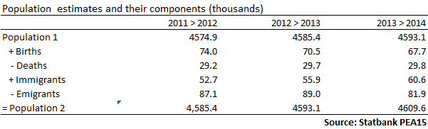
Traditional – Component method
Quality Profile
Census years
Time

Slide 4
New approach – data ‘signs of life’
Two datasets
PAR (excluding drivers)
DL – Driver licence renewals
Sources
(Cradle to Grave)
- Births
- Child benefit *
- Post primary
- Higher Ed
- Further Ed
- Employee
- Self Employed
- Social Welfare
- Drivers ***
- Medical **
- Pensions *
- Deaths
PAR - Person Activity Register
(CSOPPSN)
2011 (4.3m)
Admin Active Population during year
Signs of life
Does PAR have undercount?
Does PAR have overcount?

Slide 5
New approach – population concepts
U_{I} de facto census night definition
U_{II} usually resident population
U_{A} hypothetical PAR population
U_{B} hypothetical DL population
Assume U_{II} = U_{A} = U_{B}

Slide 6
Dual System Estimation - undercoverage
Population (N)
PAR (x)
E[N] = x n/m
Assumptions
Independence
Matching
Catchability ?
No overcount ?
See Wolter (1986)
PAR ∩ DL (m)
DL (n)
But we can look for signs of overcount by trimming PAR

Slide 7
Looking for overcoverage
Remove suspicious records step by step
Observe behaviour of population estimate
if stable OK
drops before stabilising => overcoverage?
Suspicious records?
Low pay and no other activity
Steps of €1k
Method is called Trimmed Dual System Estimation

Slide 8
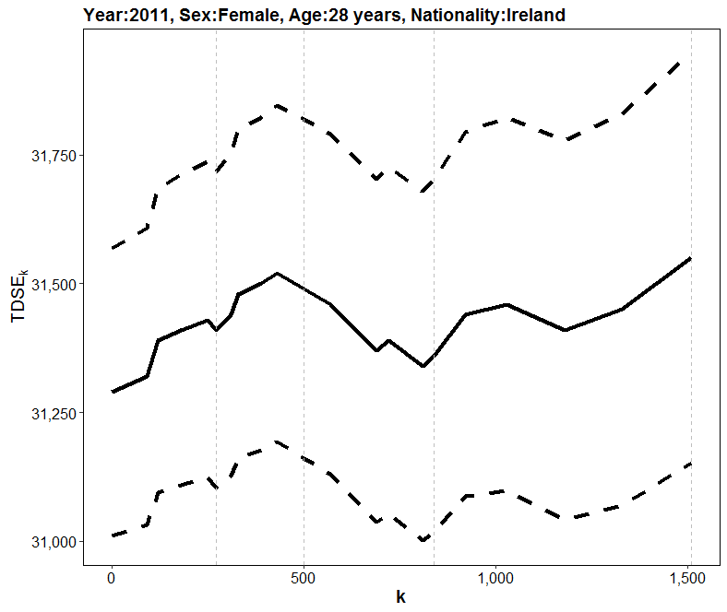
Trimmed Dual System Estimate (TDSE) with 95% CIs

Slide 9
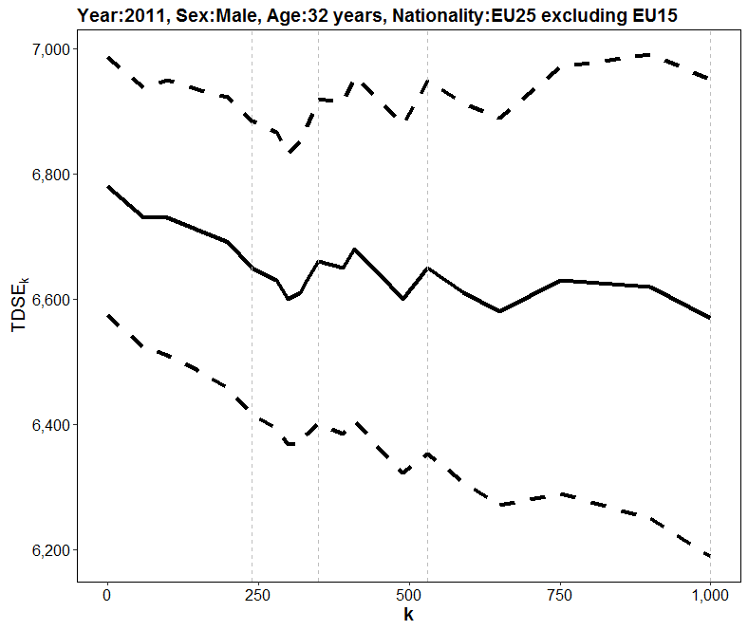
Trimmed Dual System Estimate (TDSE) with 95% CIs

Slide 10
DSE Population Estimates
Assuming no overcoverage
Adjust for undercoverage using DSE model

Slide 11
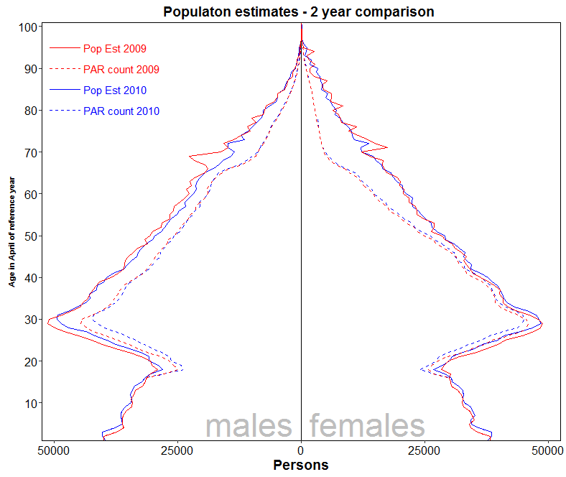

Slide 12
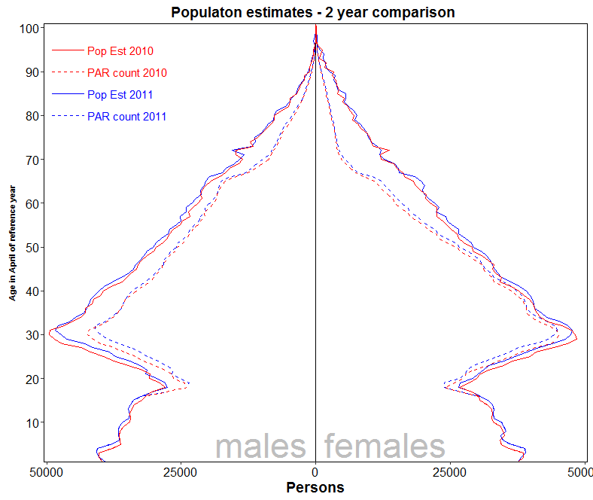

Slide 13
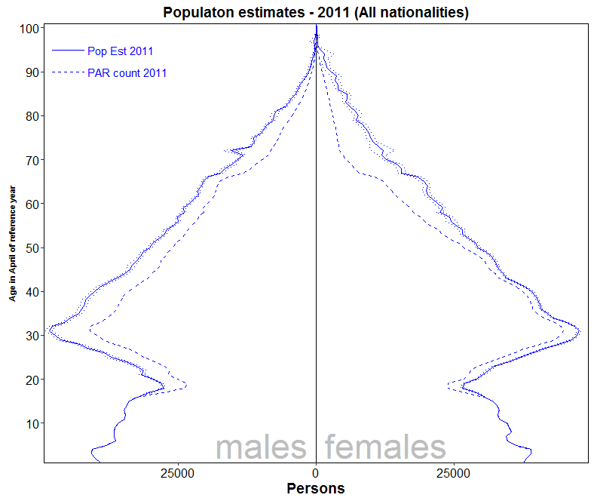

Slide 14
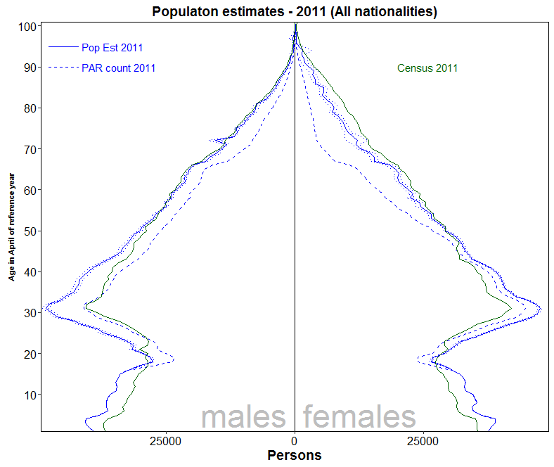

Slide 15
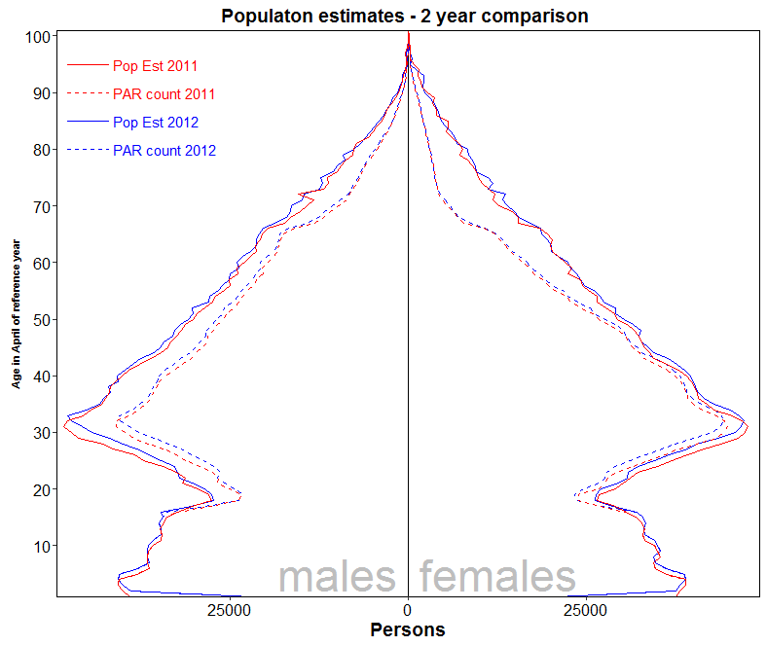

Slide 16
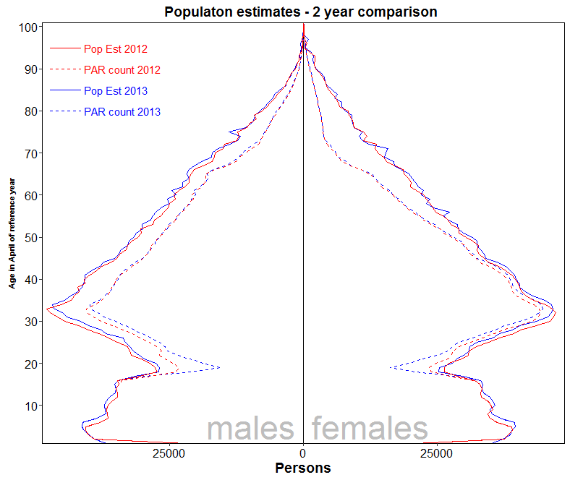

Slide 17
Next steps
Quality Profile
Census years
Time
Coverage on PAR to enhance quality
PCRS, Child benefit and State pension payments …..
Robustness - dependency on each data source
Bias – further investigate age group 20-40
Timeliness – strong partnerships with data providers

Slide 18
Extension to Migration (In and Out)
Good quality net migration from Population estimates
Estimating immigration and emigration not so easy
We can use DSE model to look at problem a differently

Slide 19
Population 1
Population 2
Outflow =
Deaths +
Emigration
Stayers
Inflow =
Births + Immigration

Slide 20
PAR1 ∩ PAR2
Population 1
Population 2
PAR2
PAR1
DL1
DL2
Estimating a
shared population – methodology Chao 2008
DL1 ∩ DL2

Slide 21
PAR1 ∩ PAR2
Population 1
Population 2
PAR1
DL2
DL1
PAR2
DL1 ∩ DL2 is NULL !!!!!

Slide 22
Population 1
Population 2
PAR1
DL2
PAR2
Stayers - Forward estimation

Slide 23
Population 1
Population 2
PAR1
DL1
PAR2
Backward estimation

Slide 24
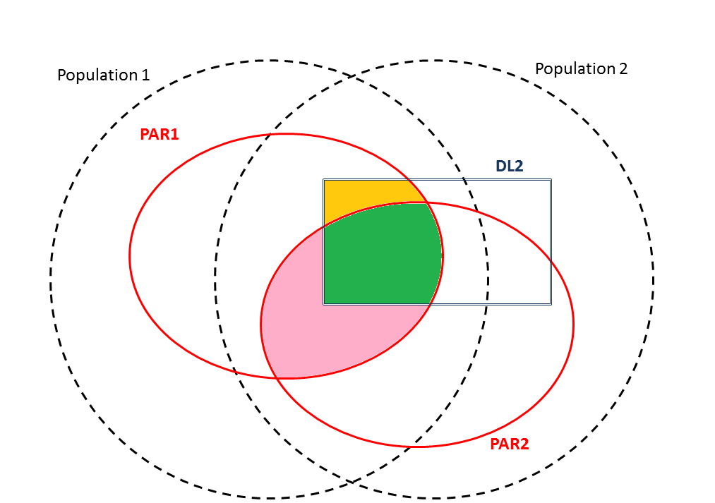
May still be possible to use DSE to estimate stayers

Slide 25
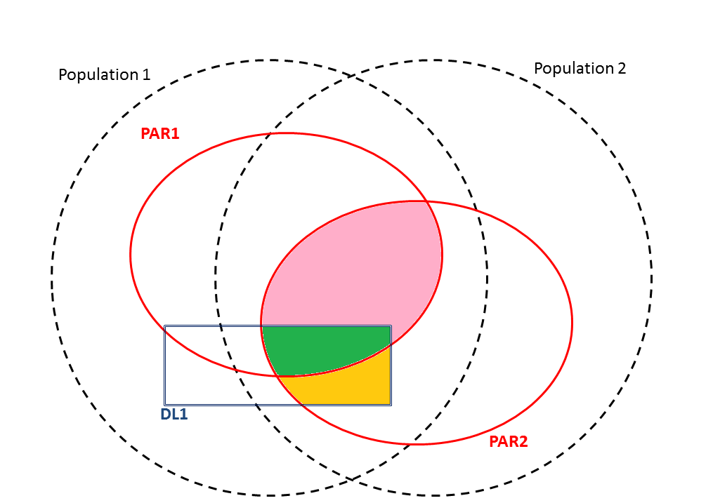
Two directions
Estimate stayers in PAR1
Gross up to Population 1
or
1. Estimate stayers in PAR2
2. Gross up to Population 2
Two methods
- DSE
- Based on Hypergeometric distribution using Par1, DL2 and Population 2 or PAR2, DL1 and Population 1
Preference for backwards
Direction (DL1) ?

Slide 26
Emerging census opportunity
Postcodes and small areas
Can other census attributes be derived from admin data sources and existing surveys
……

Slide 27
Concluding remarks
Only focussed on one aspect
Admin data = Many new possibilities
.. strong partnerships
.. change the way we look at problems
.. new methods, new tools
Trust and Responsibility

Slide 28
Background references
Chao et al (2008) ,The Petersen Lincoln estimator and its extension to estimate the size of a shared population, Biometrical Journal 50 (2008) 6, 957–970
Wolter (1986), Some coverage error models for census data, Journal of the American Statistical Association 81 338 – 346
Zhang and Dunne (2016),Trimmed Dual System Estimation, in Capture-recapture methods for the Social and Medical Sciences, forthcoming

