Slide 1

Energy Statistics
Energy Policy Statistical Support Unit

Slide 2





Overview
Background
Work Programme Areas
Development, Analysis, Publications
Summary

Slide 3
SEAI’s Role
Collect, process and publish energy statistics
Conduct statistical and economic analyses of energy services and sustainable energy options
Contribute to the development and promulgation of appropriate sustainability indicators

Slide 4
Work Programme Areas
Surveys
Renewables, CHP
Energy Supply and Prices
Business Energy Use
Reporting Obligations
IEA/Eurostat (EU Directives & Regulations)
UNFCCC, EPA
Analysis
Trends and policy issues arising
Indicators
Modelling – transport, households etc
Energy Statistics Development
CSO, CER, VRU, NCT etc
Eurostat Energy Committees, Odyssee Network, IEA
National Inventory System
Forecasting & Modelling
Supporting the modelling group
Policy Support
Evidence based assessment
Progress towards targets
etc

Slide 5
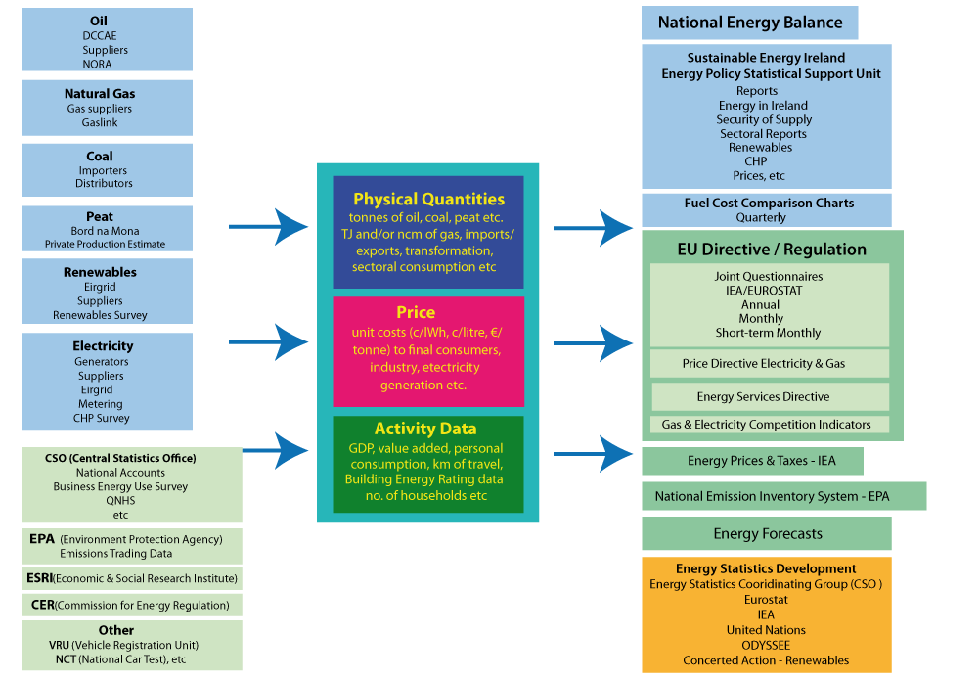
National Energy Statistical System

Slide 6
Questionnaires – Annual Energy Data Collection
Coal (and solid fuels)
Gas
Electricity and Heat
Oil
Renewables
Nuclear
Disaggregation (Eurostat only)
Currently households but plans for industry and services

Slide 7
Questionnaires – Monthly
Timeliness M-1
Natural Gas
Electricity
Oil and Petroleum Products
Timeliness M-2
Oil and Petroleum Products
Natural Gas
Timeliness M-3
Solid Fuels
Electricity

Slide 8
Questionnaires – Other
Electricity and Gas Price Regulation (Eurostat)
Energy Prices and Taxes (IEA)
SLT/CERT Annual Review of Energy Policies (IEA)
Energy Efficiency (IEA)
Combined Heat and Power (Eurostat)

Slide 9
Publications
Energy in Ireland, Energy Statistics, Key Statistics
Understanding Electricity & Gas Prices in Ireland
Profiling Energy Consumption & CO₂ Emissions in Industry
Energy in Transport
Energy Security
Combined Heat & Power in Ireland
Renewable Energy in Ireland
Energy-Related Emissions
National Energy Balance (provisional March, final October)
Fuel Price Comparisons (quarterly)
Energy Prices & Taxes (IEA – quarterly)
Online Energy Databank – CSO hosted
Notes:
Energy in Ireland in it’s 15th edition. 16th to be published in November.

Slide 10
Increasing Requirement / Demands
Energy union and its governance
Regulation on energy statistics
Regulation on energy prices (natural gas & electricity)
Quality reporting
Data revision policy
Data dissemination – new channels
Fuel Quality Directive

Slide 11
Energy End-Use Disaggregation
Current disaggregation
Households
Space heat, space cooling, water heat, cooking, other appliances
Surveys, modelling, estimation?
Proposed disaggregation
Industry
Services

Slide 12
Renewable Directive Targets
Combustible renewables
biomass (wood energy, biofuels, crops, etc)
biogas, landfill gas, sewage gas
energy from renewable waste
Renewables for electricity generation only
hydro energy and tidal power
wind energy
photovoltaics
Other thermal
heat pumps (ambient)
solar thermal
geothermal
Transport
biofuels (sustainability criteria)
electricity use (rail, car, freight)
gas (CNG, LNG, biogas)

Slide 13
Efficiency Targets
Increased level of detail required in energy statistics
Sub-sectoral disaggregation
Consumption by end-use
Coherence with economic and activity data

Slide 14
National Policy Support Demands
Decision support
Private car taxation options
Household retrofit cost benefit analysis
Renewable energy support – electricity, heat, transport
Sub-national energy consumption – localised emissions etc
Data centres – energy supply availability and security
Electric vehicles – how to track consumption and fossil fuel displacement?
Alternative fuels – sustainability, emissions avoided
Smart Metering – access to metered network data
Measure monitoring
Impact assessment – eg energy savings, emissions avoidance etc.
Renewable energy import avoidance
Estimates of value of avoided imports

Slide 15
Development
Business Energy Use Survey
CSO/SEAI
Household Energy End-Use
Modelling of building energy rating data and collaboration with CSO on national representativeness
Modal Split of Transport Energy Use
Modelling of RSA, NCT data
Emissions Trading Data
Electricity and Gas Prices
Increased data requirements following change from EU Directive to Regulation

Slide 16
Thank You http://www.seai.ie/

