Slide 1
Balance of Payments Collection and Compilation
23 Feb 2012
Central Statistics Office
Ireland

Slide 2
Introduction
Balance of Payments – Recording of cross border transactions
International Investment Position – Recording of cross border holdings
The CSO are the BoP Compilers
Collection is done using a survey system

Slide 3
Why?
So why do we collect this information?
Important indicators for the Irish economy
In particular as the Irish Economy is so open
In several areas our cross border activity is very large relative to our size

Slide 4
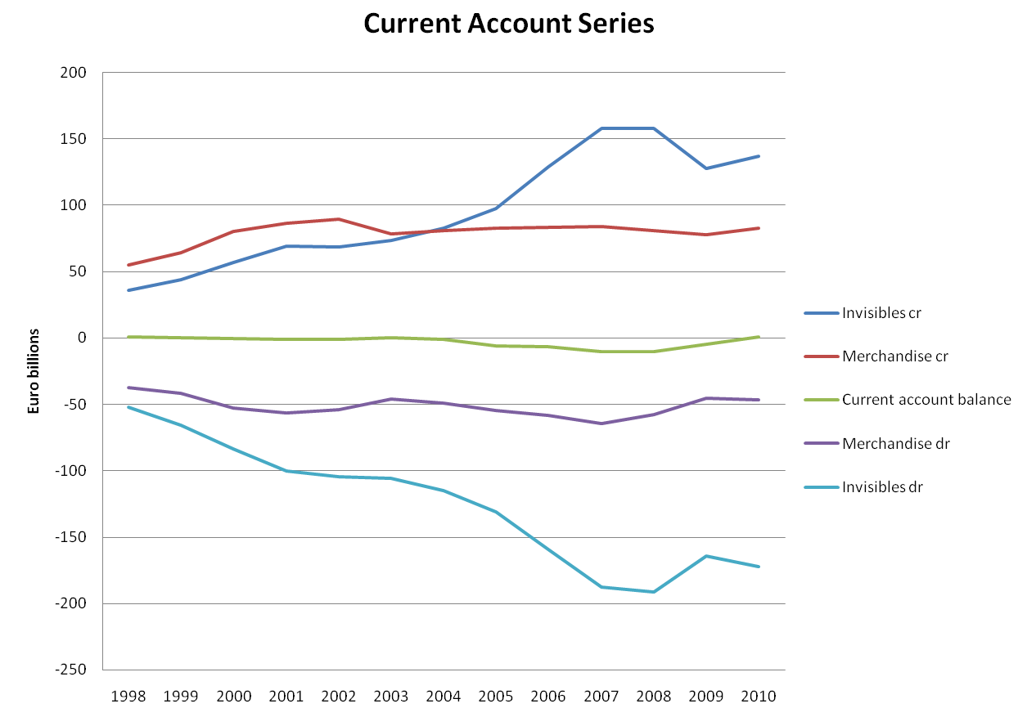
Why?

Slide 5
Why?
Increased focus on BoP/IIP aggregates as part of the Macro-economic Surveillance initiative
Also the Macroeconomic Imbalance Procedure Scoreboard
The data collected also contributes to the National Accounts GDP and GNI figures as well as the Sectoral Accounts

Slide 6
Why?
International Requirements determine the detail we are required to collect
In addition to our national releases we currently provide the following data files:
To the ECB – 2 monthly,7 quarterly, 2 half yearly, 3 annual
To the IMF – 2 quarterly, 3 annual
To Eurostat – 5 quarterly, 17 annual
To the OECD – 1 quarterly, 2 annual
To the World Bank – 1 quarterly
To the UNCTAD – 2 annual

Slide 7
Why?
An example of a data file would be the one we submit to the ECB quarterly which is used to compile Euro Area Aggregates
This provides quarterly transactions to countries outside of the Euro Area and split by various criteria
It contains 191 lines of data

Slide 8
Why?
Currently we collect and output data to satisfy the IMF Balance of Payments Manual (BPM) Version 5 and the OECD Benchmark Definition (BD) Version 3
By 2014 we will need to satisfy the requirements of Version 6 of the BPM and Version 4 of the BD
This will mean expanded detail in some areas of collection as well as changes to every aspect of our processing system

Slide 9
How?
So how is this data collected?
Surveys tailored to sector
Minimising response burden
Annual / Quarterly response
Use of pre-existing data (e.g. Trade Data)
Large Cases Unit
Joint surveys with the Central Bank of Ireland

Slide 10
How?
It was recognised that large companies were receiving a high number of survey forms from us
The Large Cases Unit was established to be the single point of contact for these larger companies
This reduces the burden on these companies but also allows us to check the consistency across all of the returns for a particular company

Slide 11
How?
How do we actually receive the data?
Forms can be sent in to us as paper forms
However most forms are now submitted electronically
Respondents also have several methods available to them for submitting forms securely
For data traffic between the Central Bank and the CSO we have a secure link

Slide 12
Who?
So who do we survey?
All BoP relevant entities across several sectors are surveyed
In the CSO we survey:
~ 850 entities annually
~ 470 entities quarterly
NTMA (National Treasury Management Agency), NAMA (National Asset Management Agency), Central Bank of Ireland

Slide 13
Who?
The sectors covered by the CSO include:
Non – Financial Corporations
Insurance Corporations
Investment Managers
Treasury Companies
Financial Intermediaries
Financial Auxiliaries
Leasing Companies

Slide 14
Who?
Credit Institutions and Funds are collected by the Central Bank
~ 70 Credit Institutions
~ 3700 Funds
The Data is then compiled by the CSO

Slide 15
What?
What data do we collect?
We include resident to resident data so that this form can meet BoP and National Accounts requirements
Detailed balance sheet and profit and loss data
Broken down into categories of assets and liabilities
Broken down geographically
Collect opening and closing positions, transactions and revaluations

Slide 16
What?
Collecting this level of detail allows us to do verifications on the submitted data
For example the data should be consistent across a line (for a particular entry the opening plus the transactions plus the revaluations should equal the closing)
Also the return as a whole should be consistent. For example the total liabilities should match the total assets

Slide 17
What?
Where possible we also use any other available data to verify returns
We would check against internal data such as Trade data and Services data as well as external data such as Revenue files
For example for the Non-Financial Corporations one of the checks would be against published accounts
For Funds we would check against the Net Asset Value data submitted separately to the Central Bank

Slide 18
What?
Funds and Credit Institutions are collected and compiled as a joint exercise with the Central Bank
It was recognised that in these two areas there were requirements for both the CSO and the Central Bank that would need similar data from respondents
In order to minimise burden on respondents it was decided to use just one form for Credit Institutions and one form for Funds to satisfy the requirements for the CSO and the Central Bank

Slide 19
What?
Funds and Credit Institution data collection is done by the Central Bank and the data is compiled by the CSO
The portfolio investment data is collected on a security by security basis which means that instead of reporting values of shares we get the number of shares held, the price and the code
Most securities reported have an ISIN code (International Securities Identification Number) and this allows us to get additional information on the security from the ECB’s Centralised Securities Database

Slide 20
Sectors Collected
Now we will look at the sectors collected
We will give the specific tailored form these are collected on as well as any key features

Slide 21
Non-Financials
Collected on the BoP10 and BoP40 Forms
This includes manufacturing, construction, retail trade
Large Multinationals are especially important
Larger companies are handled by the Large Cases Unit

Slide 22
Treasuries
Collected on the BoP44 Form
We cover all BoP relevant Treasuries

Slide 23
Investment Managers
Collected on the BoP30 Form
We cover all BoP relevant Investment Managers and this includes pension funds

Slide 24
Insurance Corporations
Collected on the BoP42 (Non-life Insurance) and BoP43 (Life Insurance)
This includes re-insurance
We cover all insurance companies
Cross border insurance figures are very large relative to other countries

Slide 25
Insurance Services 2010

Slide 26
Credit Institutions
Collected on the CRS1 Form
All Credit Institutions are covered
Data collected by the Central Bank of Ireland and compiled by the CSO
Portfolio investment is collected on a security by security basis and matched against the CSDB

Slide 27
Funds
Collected on the OFI1 Form
All Funds are covered
Data collected by the Central Bank of Ireland and compiled by the CSO
Portfolio investment is collected on a security by security basis and matched against the CSDB
Fund figures are very large relative to other countries

Slide 28
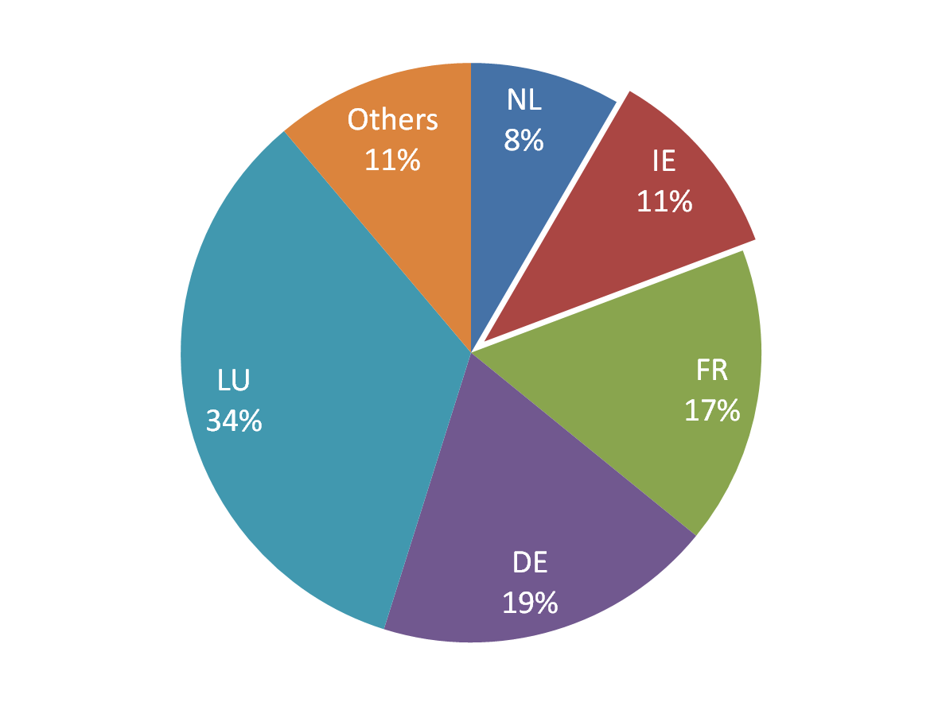
Q3 2011 Euro Area Investment Fund Assets

Slide 29
Others
Collected on the BoP45 Form
This form includes:
Other Financial Intermediaries
Financial Auxiliaries
Leasing Companies
Cross border operational leasing figures are very large relative to other countries

Slide 30
Operational Leasing Services 2010

Slide 31
Putting it all together
All of our data is entered into our BopFacts system which is a bespoke software system designed for compiling Balance of Payments
The data is grouped together by survey type
The system allows us to edit the data and run lots of automated checks, including across time periods
For example we can check previous closing for a particular item against the current opening to see if they match

Slide 32
Putting it all together
The Funds and Credit Institutions are handled slightly differently
They are initially loaded into our office wide Data Management System and once checked there they are outputted and loaded into BopFacts
It is done in this way due to the large volumes of data associated with security by security collection and also because we can then generate the extra outputs that are required by the Central Bank

Slide 33
Putting it all together
As the data is grouped by survey type we can use analytical tools to run checks on the data in a particular survey type as a whole
For example we look at data for a particular survey type across time periods
This allows us to see patterns in the data and identify data that may need to be verified by a respondent

Slide 34
Putting it all together
Also we analyse the data together as a whole
Again we look at patterns and time series to identify any data that may need to be verified
Once finished the BopFacts system can be used to generate the output files required
All outputs are also checked to ensure that no individual respondent’s input can be identified in the outputs to maintain confidentiality

Slide 35
Balance of Payments Collection and Compilation
23 Feb 2012
Thank You
Questions ?

