Slide 1
NISRA Tourism Statistics Branch
Methodology (J. Henderson)

Slide 2

LGD tourism figures 2011-2012
- Trips, Nights and Expenditure for All visitors to NI
Trips, Nights and Expenditure for External visitors (excluding NI)
Confidence Intervals
2 year rolling average (2011/2012)
Key Destination Areas

Slide 3
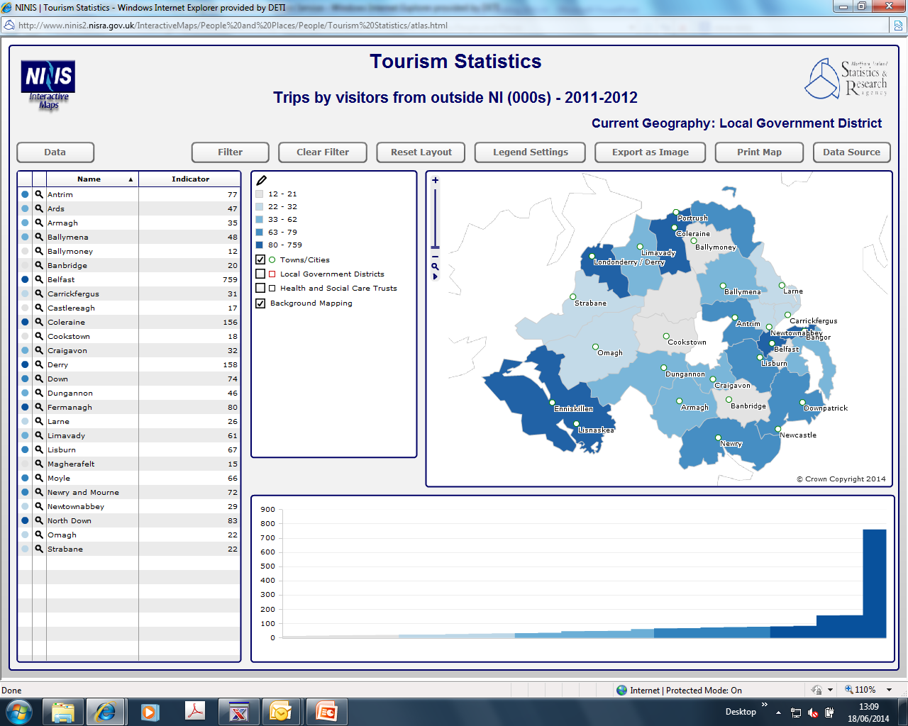
Notes:
All visitors
Belfast saw an average of 1.1 million overnight trips in 2011-2012, accounting for 27% of all overnight trips. At £232 million per year, Belfast also experienced the largest proportion of expenditure (35%).
Coleraine was the next most popular area accounting for 12% of overnight trips and average expenditure of £75 million. Down and Fermanagh each accounted for 7% of all overnight trips with 5% and 6% of expenditure respectively.
External visitors
When NI residents are excluded, Belfast’s share of overnight trips rose to 37% of the total and associated expenditure accounted for 41% of the total.
Derry LGD (8%) experienced the second largest share of the external visitor market with Coleraine LGD also providing 8% of the total overnight trips made by non residents. These LGDs experienced similar levels of expenditure (6% in Derry LGD and 7% in Coleraine LGD).

Slide 4
Methodology / Issues 2014-2015
LGD Publication
  2 yr rolling average
  Excluding NI residents
Assumptions
  HTS data provided at county level
  SOT data not available at LGD
  Confidence Intervals
Other LGD Requests
  ONS model for ‘Measuring Tourism Locally’
  New council areas
  Single year statistics
Notes:
NISRA published the LGD publication at end of December 2013 following user requirements
Previously results at this level were on 3 years rolling average, we felt we could move to 2 as we provided Confidence Intervals
We published results for the first time excluding NI residents
The HTS is provided at county level, so NISRA combined the CHS data as best can do at county level, found the proportions were similar to the HTS and on this basis estimated the proportions of overall HTS to each LGD based on the CHS
CONFIDENCE INTERVALS – I have bolded this as the LGD was the first publication were we combined confidence intervals, but we have adapted this in our quarterly and annual publications. We now provide a confidence interval using methodology of providing an estimated CI around the SOT data, based on the confidence interval of the NIPS and an estimated CI around the HTS based on the CHS
PCI/SOT – as discussed last year, there were requests for NISRA to start using the PCI data for the VIAS element to NI. However, the PCI was still in experimental stage with issues of each month.
NISRA has now put in a QIF bid to get assistance from methodological experts in ONS on how we could use the data as there is no back series, so they will be able to compare the SOTS to the PCI and see the benefits/drawbacks to this. Also as the PCI does not collect anything on expenditure, NISRA is seeking to get guidance on what to do
CRUISE SHIPS – We have had a ministerial request to gather more on the benefits of cruise activity in NI.
- Thanks for the papers sent from TI and FI. We are meeting with Harbour Commissioners to look at possibilities of survey/how many get off/average spend etc

Slide 5
Methodology/Issues 2014-2015 continued
QIF – PCI/SOT
Reasons why NI residents did not take an overnight trip
New questions on surveys
  TSA estimates on spending in NI before a trip (from April 2014)
  Which international airport is chosen? (from April 2014)
  Final destination
Seasonal Adjustment
Day Trips to NI
Notes:
Some of these topics you will recognise from the previous slide with ongoing methodology or issues that we have been looking at and we will continue to look at during the future year
QIF-as discussed
Cruise Ships-as discussed
LGD-new LGDs will be introduced in NI, so we are currently working on producing our statistics at these levels which should be more robust.
-due to a change in the methodology of the NIPS, the sample size of those who provide details on where they have stayed have increased so we are hoping to be in a position to produce LGD data for 2013 by Autumn.
Local Geography data
-one of the main outcomes to our user consultation as discussed earlier was that local authorities want some way to measure tourism at a smaller geographical level for local events. We are in the middle of scoping this work with ONS who have produced a similar report in England and Wales
No Trips taken because
One of the questions in our domestic module asks of NI residents if you havent taken a trip, why have you not. We hope to look at the answers to this question to see what is reportable and feel it will be of great use to a lot of people in this meeting today
New questions on our surveys
-CHS has added questions which should help to inform TSA on expenditure in NI before a trip
-CHS has also added some questions on the choice of airport NI residents have made and why. This is to inform our flight access policy team on the choice of airport and helps inform on tax duty, etc
-Both the NIPS and the CHS have questions incorporated to find out about the final destination of trips – this again is to inform the air access team on routes that might be required for NI passengers
Seasonal Adjustment
-As the AIG will remember, (or maybe not!), at the beginning of 2011- NISRA did some work along with ONS on a QIF at the time of moving the NIPS from NITB to NISRA to look at the seasonal adjusted data. This would take out the seasonal effects (eg. Easter falling into quarter 1 or 2/Christmas). The seasonal adjusted series would provide extra information about the short-term movements in the series. At the time, ONS recommended that NISRA would publish this information as soon as possible (particularly for the expenditure which was considered as high quality). So we hope in this year to update this series and review it, explain what it means and to publish it.
Occupancy Survey
We have been running 3 samples in our occupancy survey and are going to compare the results. These include the ‘original sample (good responders)’, a random selection and a random selection topped up by ‘good responders’
We are also looking at the methodology of weighting

Slide 6
Any Other User Needs?
Cruise Ships
Comparisons?
Topic Papers?
....?

