Slide 1

Using Business Registers to analyse Enterprise Demography and Employment in the Tourism Industries
Steve MacFeely
&
Jillian Delaney
http://www.cso.ie

Slide 2
Background
1st Tourism Policy Workshop, Dromoland Castle – May 6th, 2010
Tourism Renewal Implementation Group – March 23rd, 2011
ILO Worldwide Consultation – April, 2011

Slide 3
Motivation
Policy relevant
Broadening use of business statistics (Business Demography)
No additional burden
No additional cost (marginal only)

Slide 4
Definition - Employment
Employment in Tourism Industries
not
Tourism demand generated employment

Slide 5
Definition – Persons Engaged v Employee
Persons Engaged
  - includes: proprietors, partners, directors, casual & temporary workers...
Employee

Slide 6
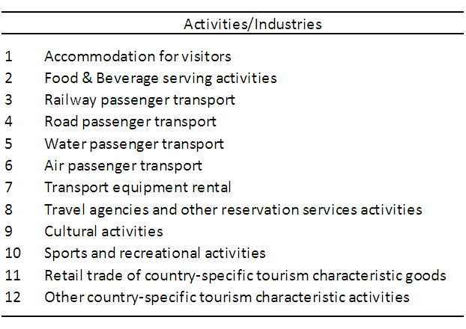
Definition - Tourism Industries (UNWTO – IRTS)

Slide 7
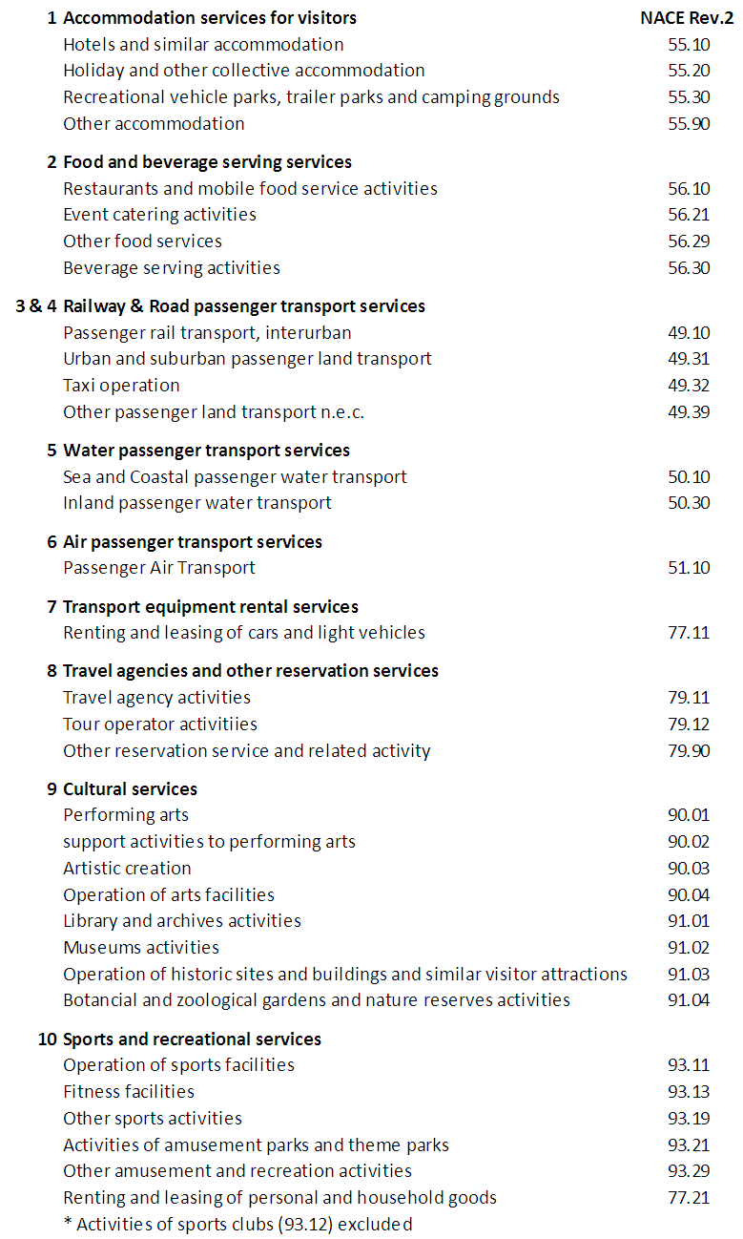
Definition - Tourism Industries (CSO)

Slide 8
Scope - Enterprises
All Business Enterprises
except for
Agriculture
Non-market sectors (health, education, defense...)

Slide 9
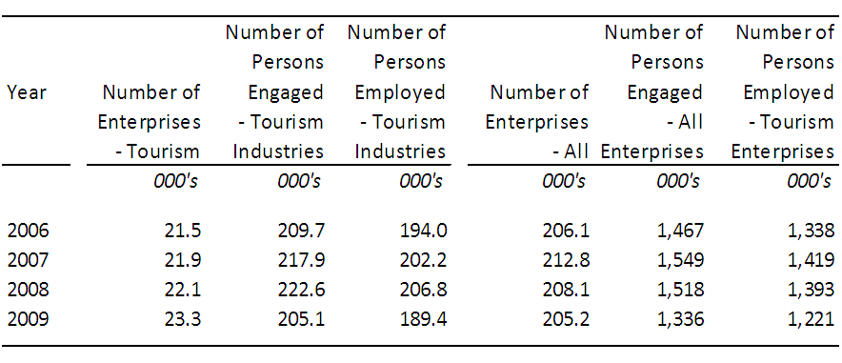
Enterprise & Employment demography, 2006 - 2009

Slide 10
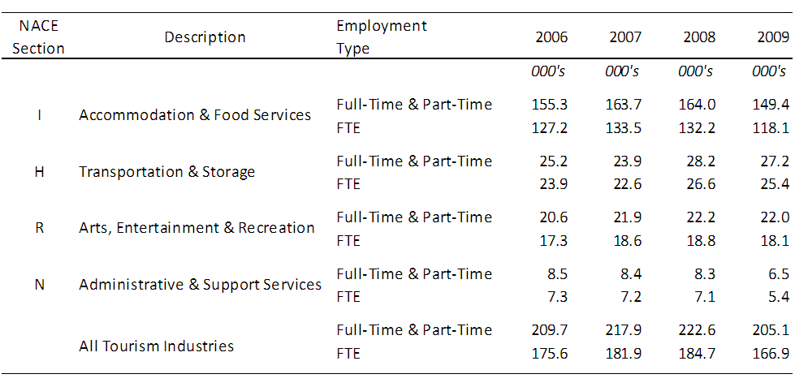
FTE labour input to Tourism Industries, 2006 - 2009

Slide 11
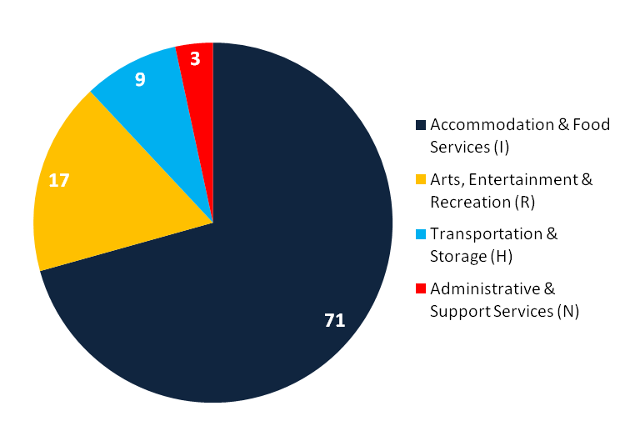
Tourism Industries by NACE (%) - 2009

Slide 12
Regional Enterprise demography - 2009

Slide 13
Tourism Dependency Ratios (Enterprises) - 2009

Slide 14
Regional Persons Engaged Business demography - 2009

Slide 15
Tourism Dependency Ratio (Persons Engaged) - 2009

Slide 16
Next Steps...
Earnings
  Tourism Dependency ratio?
  Quality of work indicators?
Age profile of Tourism Industries
  Deaths & Births
  Gazelles
  Survival since 2006
Job Churn
- Economic Sector
- Regional migration

