Slide 1
Northern Ireland Tourism Update
Northern Ireland Statistics and Research Agency, NISRA

Slide 2
Publications released
Annual 2017 statistics released 7th June 2018
Upcoming releases
  Tourism by local council area – July
  Domestic day trips – August
  Quarter 1 2018 – August
  Annual tourism publication
  External overnight trips
  Domestic overnight trips
  Visitor attraction survey
  Hotel Occupancy survey
  Guest house, B&B and other occupancy survey
  Self catering occupancy survey
  Air Passenger Flow statistics

Slide 3
Key results

Slide 4
Overnight Trips
2016: 4.6m
2017: 4.9m (+6%)
2016: 2.6m
2017: 2.7m (+3%)
2016: 2.0m
2017: 2.2m (+11%)
Notes:
2016 2017 % Change
2,586,708 2,657,887 3%
2016 2017 % Change (2016-2017)
1,984,392 2,193,428 +11 %
2016 2017 % Change (2016-2017)
4,571,100 4,851,315 6%

Slide 5
Spend by visitors on overnight trips
2016: £851m
2017: £926m (+9%)
2016: £613m
2017: £657m (+7%)
2016: £237m
2017: £270m (+14%)
Notes:
2016 2017 % Change (2016-2017)
850,358,144 926,129,203 9%
237,154,714 269,503,071 14%
613,203,430 656,626,133 7%

Slide 6
Reason for visit

Slide 7
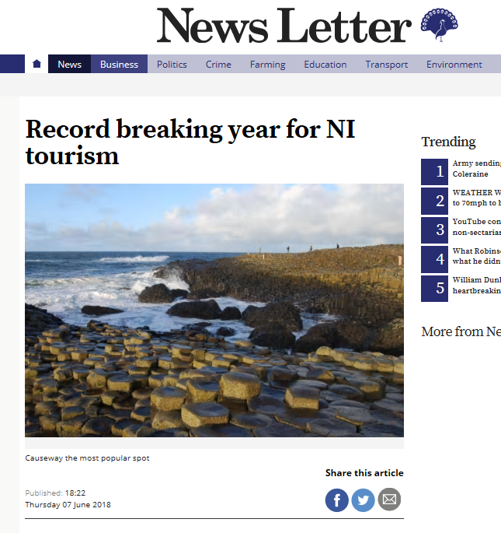
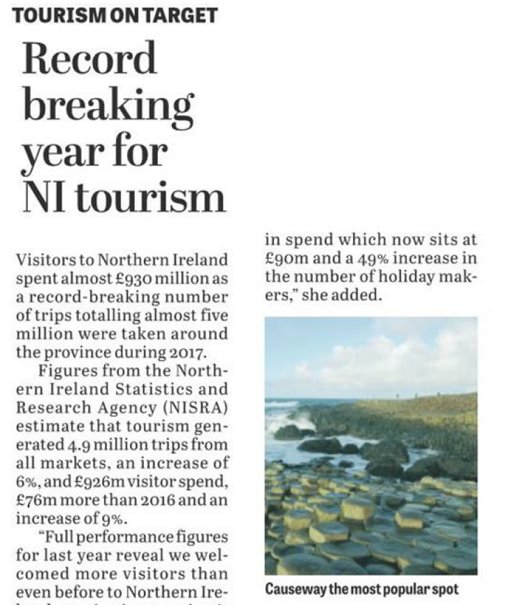
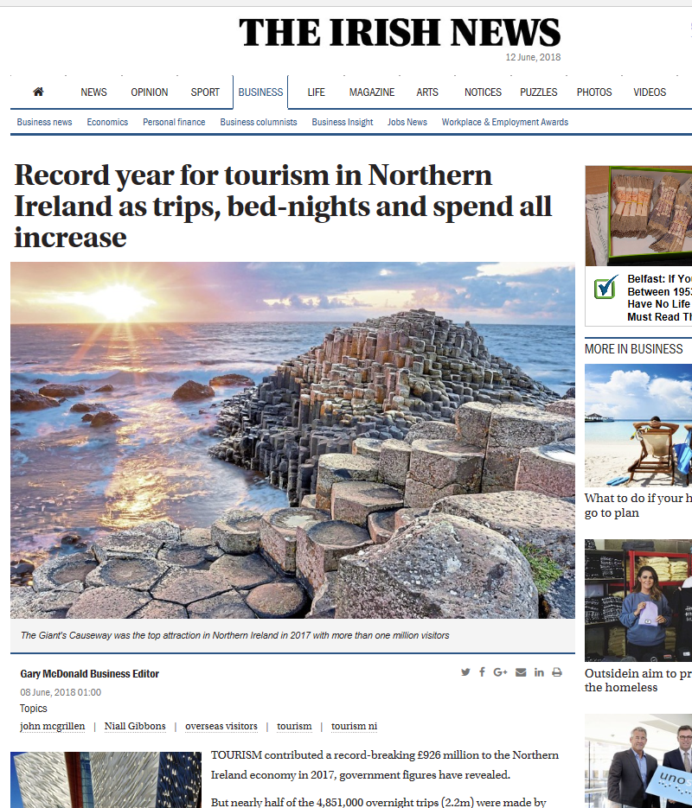
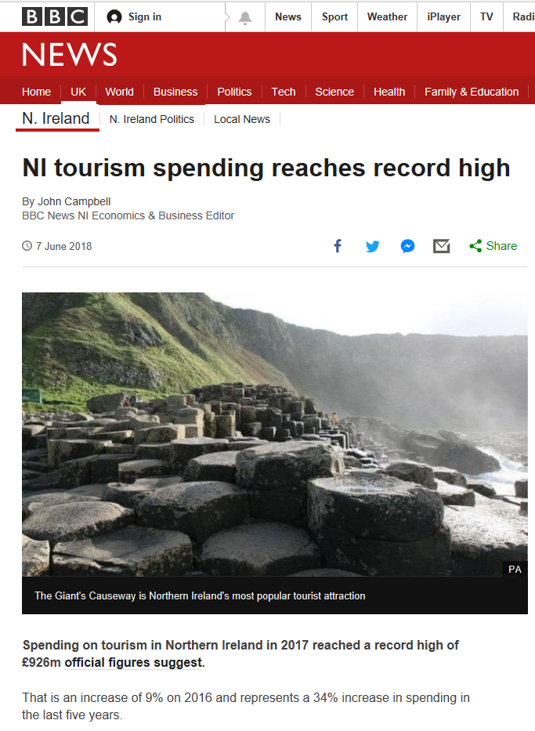
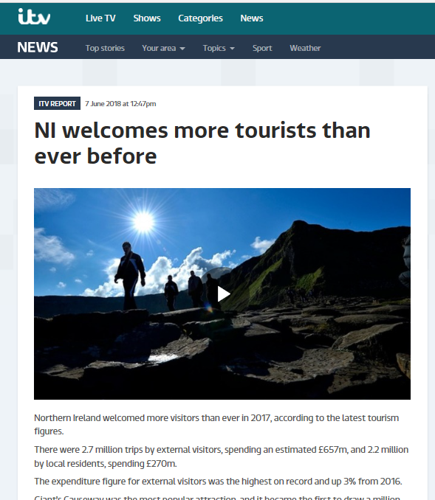
Notes:
Well received in the media

Slide 8
Overnight trips to NI by ROI residents

Slide 9
Spend by ROI residents in NI
Notes:
Strength of Euro vs Pound?

Slide 10
Trips taken by NI residents
1.3 million trips
Notes:
1.3 million to ROI

Slide 11
Hotel Performance
Notes:
About 5% increase in rooms sold.
Up to 1,000 more rooms in Belfast this year, 3,500 rooms were at various stages – double capacity

Slide 12
Cruise ships docking in NI ports
Notes:
Now at over 170,000 overall for passengers and crew, 156k in Belfast – an area where more research could be done

Slide 13
Updates on main surveys for 2018
Northern Ireland Passenger Survey
  BLAISE 5 software
    Improved presentation
    Easier to navigate
    Faster tablets
  Additional question about day trips to ROI
Continuous Household Survey
  BLAISE 5 software
  Simplification of some survey sections
    day trips
    activities questions
  Interviewer feedback meeting
    Clarity of notes in survey

Slide 14
Future development work
Increased user engagement
New statistics
  Domestic day trips
    Publish summer 18
  Northern Ireland residents visiting other countries
  Urban/Rural Statistics
  Market analysis
Methodology
  Domestic tourism review
  Confidence intervals
  Audit trails/process flows
Notes:
Refining methodology
Domestics tourism Outliers,Weighting,Sample sizes
Market analysis – looking at other data sources, such as visitor numbers to main attractions

Slide 15
Challenges
Sample sizes
  Increased demand for further breakdowns
Response rates for occupancy surveys
Confidence intervals
  Explaining real changes
IT software
Notes:
Confidence intervals – trying to explain to users about sampling variance
IT – SAS/ SPSS – NISRA move to R

Slide 16
Questions?

