Slide 1
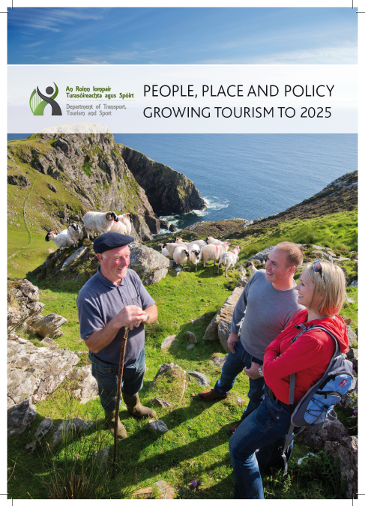
Tourism Policy Review - Dept. of Transport, Tourism & Sport
Minister Varadkar – priorities for 2013 – Review of Tourism Policy.
September 2013 – public consultation document launched in Dublin Castle.
Regional Seminars with Ministers in 2013.
170 responses received.
First Draft published in July 2014.
Further 73 submissions received – engagement with other Govt. departments and agencies.
Sign-off by Government January 2015 – formal launch in Kilkenny March 2015.

Slide 2
Tourism Policy Review - Dept. of Transport, Tourism & Sport
Three headline targets, to be achieved by 2025:
revenue from overseas tourism, excluding air fares and ferry charges, will be €5 billion per year by 2025, net of inflation. (The comparable figure for 2014 is €3.5 billion);
there will be 250,000 people employed in tourism by 2025, compared with approximately 200,000 at present; and
there will be ten million overseas visits to Ireland by 2025, compared to 7.6 million in 2014.

Slide 3
Tourism Policy Review - Dept. of Transport, Tourism & Sport
51 Policy Proposals in Total
Tourism Marketing
State investment in tourism marketing must be focused on those market segments that are most likely to provide revenue growth in the medium to long-term.
Protection of heritage and supporting investment in tourism
The Policy highlights the importance of maintaining and enhancing the quality of the visitor experience, through protection of natural and cultural assets and there is an objective to support capital investment in tourism for the purpose of improving the visitor experience.

Slide 4
Tourism Policy Review - Dept. of Transport, Tourism & Sport
Key policy areas (continued):
Continued key role in tourism for festivals and events
A new policy objective is that support for events will be weighted towards those that offset the seasonal nature of tourism and a repeat of the Gathering or another themed year, will be pursued further when drawing up the Tourism Action Plan.
Training and skills development in tourism
The Department of Education and Skills, Fáilte Ireland, and SOLAS will work together on the design of training programmes for the tourism sector.
Competitiveness in tourism
Maintenance of the special 9% VAT rate in the tourism sector is conditional on continued moderation in prices.

Slide 5
Tourism Policy Review - Dept. of Transport, Tourism & Sport
Key policy areas (continued):
The role of communities and Local Authorities
Local Authorities will have a key role in supporting communities in tourism, as they have done in many cases, but this is now recognised at policy level and the Policy acknowledges the importance of tourism as a driver of economic and social development in rural areas.
Governance model for tourism
Support for the existing two-agency model (Fáilte Ireland as the development agency for tourism in the State, Tourism Ireland as the North-South body with responsibility for overseas promotion) and commits to ongoing north/south cooperation in tourism.

Slide 6
Tourism Policy Review - Dept. of Transport, Tourism & Sport
Tourism Research Forum
The need for high quality statistical information and academic research is recognised in the statement.
DTTAS will establish a forum to identify key areas, and ways in which additional sources of data can be harnessed to provide enhanced understanding of tourism performance and its economic contribution.
DTTAS will invite the CSO, tourism agencies, universities and institutes of technology to contribute to the forum.

Slide 7
Tourism Policy Review- Dept. of Transport, Tourism & Sport
Next Steps
Minister to announce Tourism Leadership Group with representatives from industry, agencies, local authority sector.
Tourism Action Plan for 3 year period based on agreed policies.
Meetings with relevant agencies and stakeholders in second half of 2015.
Action Plan Published by end 2015 (?)

