Slide 1

Proposal for a Joint Publication on Tourism
Central Statistics Office Ireland
&
Northern Ireland Statistics & Research Agency

Slide 2
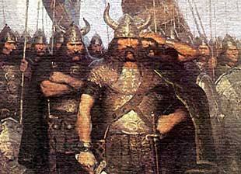
Importance of Tourism
Long Tradition of ‘Tourists’
from this

Slide 3
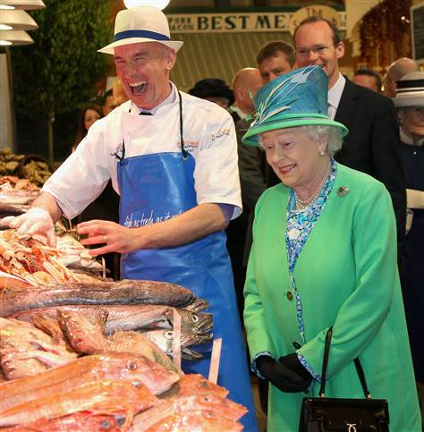
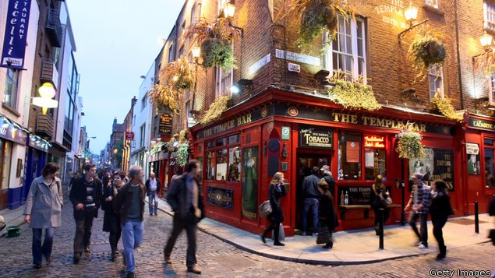
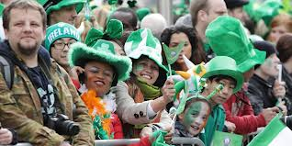


To this

Slide 4

North/South Cooperation
Tourism Ireland
Tourism Ireland is responsible for marketing the island of Ireland overseas as a holiday and business tourism destination.

Slide 5
Tourism Ireland
Combines North/South data to an overview for the whole island
Overseas Visitors to the Island of Ireland
Facts & Figures 2013

Slide 6
Propose a joint CSO/NISRA publication
Different focus and not in competition with Tourism Ireland
Once every 3 years
Approval North/South Ministerial Council

Slide 7
Census 2011 Ireland and Northern Ireland
June 2014
The Central Statistics Office (CSO) and the Northern Ireland Statistics and Research Agency (NISRA) today published a special census report titled Census 2011 Ireland and Northern Ireland, the first time comprehensive census results for both parts of the island of Ireland have been brought together in a single report.
close collaboration between the statistical services in both jurisdictions

Slide 8
Title:
Overseas Visitors to Ireland and Northern Ireland
Content
Use of graphics
Size of publication
Paper or electronic publication
Analysis

Slide 9
Initial Ideas
Not just a total but more analysis of the differences in the two overseas markets
Key overseas markets
Purpose of Visits
Average expenditure
Duration

Slide 10
Initial Ideas
Cruise ships
Ports of entry – airports/seaports on the island
Tourism Employment – Tourism Industries
Key routes by mode

Slide 11
HLR 30% Expenditure NI
52% Expenditure Ireland
VFR 51% Trips NI
29% Trips Ireland
Markets 69% GB NI
42% GB Ireland

Slide 12
2013 Data – Initial Analysis
Very different markets

Slide 13
Complimentary to existing data
Welcome any comments/suggestions

