Slide 1
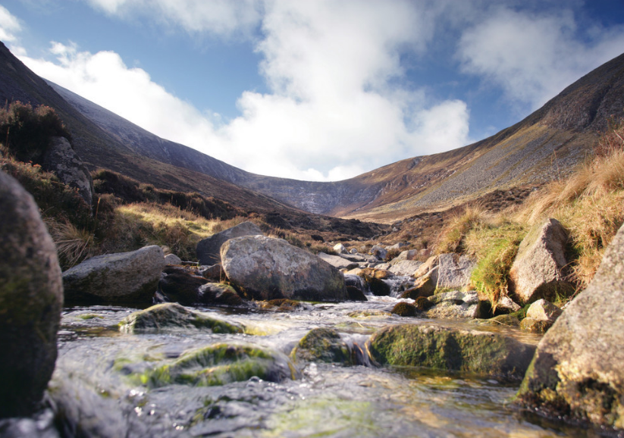

Tourism 2025: A Ten Year Strategy for Tourism in Northern Ireland
Lorraine Fleming
Head of Tourism Liaison Branch
16 June 2016
Notes:
#[TitlePage]

Slide 2
1. Overview of the Process

Slide 3
NI Tourism Strategy to 2025
Overview of Process
Timeframe
Engagement & Regional workshops | January – February
Key messages / testing & setting direction | March
Action Planning (inc. workshops this week) | April - May
Steering Group | May
Minister | June - July
Public Consultation | Autumn 2016
Strategy Publication | End 2016

Slide 4
2. Vision & Mission

Slide 5
Vision
Northern Ireland will become an internationally competitive and inspiring destination of which we are all proud
Mission
Working together to accelerate the growth of the tourism industry, to generate wealth, create jobs and sustain communities
Visitor
focused
Six themes in outer ring
People
Digital
Our Capabilities
Go to Market
Experience
based
Locally
delivered
£1bn Export Industry by 2025
Importance of the ‘export’ word
Cross-cutting capabilities
Product
ready
Industry
led
Government
enabled

Slide 6
3. Action Plan – Top 10 Actions

Slide 7
Action Plan
Top 10 Actions
  Scope and implement an approach to data analytics to improve understanding of current and potential visitors and to drive our competitiveness at the regional level
  Invest in the development and communication of an inspiring marketing proposition that will provide international standout for Northern Ireland
  Increase the presence, targeting and sales readiness of our industry in out of state markets
  Invest in improving the industry’s digital sales and marketing capability
  Invest in experiences and products (see capital investment opportunities below) that will give out of state visitors new reasons to holiday and stay longer in Northern Ireland
  Deliver a Skills Action Plan to address skills gaps and develop tourism career pathways
  Create a policy environment that enables faster growth of the tourism industry by reviewing regulation and licensing requirements
  Maximise the benefit of existing direct air access and grow direct air access with our key overseas markets through initiatives such as the Enhanced Cooperative Marketing Fund
  Deliver events of scale (e.g. the 2019 Open Championship and the 2023 Rugby World Cup) that can attract out of state visitors and enhance our international reputation and attractiveness as a destination
  Refocus the events strategy to drive the development of indigenous events with international appeal

Slide 8
NISRA Actions
Visitor Focussed:
To devise an Action Plan to address accessibility, scope and speed of publication of tourism statistics
Government Enabled:
  To provide more extensive, robust and timely industry data

Slide 9
4. Thinking through the £1billion export industry target

Slide 10
NI Tourism Strategy to 2025
Stepping back
Hunter Review highlighted the need for stretch targets
Stakeholders in our engagement – believed we (NI) should be more ambitious…also highlighted the need to be taken seriously as an economic driver / sector
The £1bn is almost double current out of state spend
UNWTO projecting approx. 3% growth rate
  Wide agreement that we have a very low base position
  Evidence from the rest of the island that you can grow faster than the market
£1bn is a stretch target

Slide 11
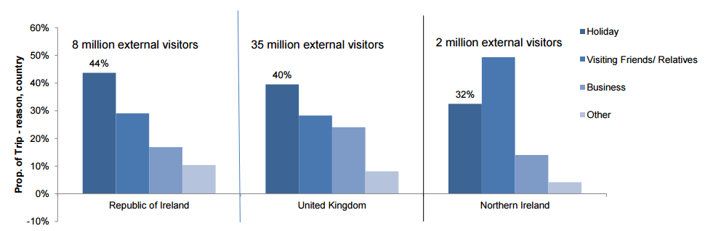
NI Tourism Strategy to 2025
We can only grow / influence certain visitor types
Holiday and a minority of business can be influenced. These are smaller proportions in NI than UK / RoI.

Slide 12
NI Tourism Strategy to 2025
Achieving the Target: £1bn Export Industry
Scenario 1: Achieving projected visitor numbers, over inflation spend growth in commercial holiday makers
Scenario 2: Achieving higher than projected visitor numbers, over inflation spend growth in commercial holiday makers
 | 2015 Position | Compound Growth Factor | 2025 Position
Trips | 2,284,888 | 5.0% | 3,076,570
Nights (Average) | 3.18 | 2.0% | 3.87
Spend | 540,754,088 | 3.2% | £1,003,511,117
 | 2015 Position | Compound Growth Factor | 2025 Position
Trips | 2,284,888 | 6.3% | 3,228,148
Nights (Average) | 3.18 | 2.0% | 3.87
Spend | 540,754,088 | 2.0% | £1,000,855,704

Slide 13
5. Closing Comments

