Slide 1

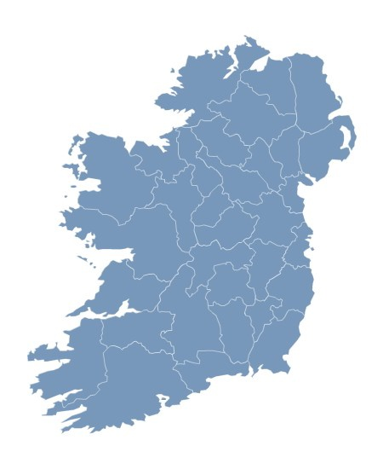

The story behind the numbers
Notes:
Steve MacFeely, Director of Business Statistics & Methodology
Padraig Dalton, Assistant Director General with responsibility for Social & Demographic Statistics
Michael Connolly, Senior Statistician with responsibility for National Accounts Integration
I would to thank the Houses of the Oireachtas Services, in particular Peter Finnegan and his colleagues from the Library and reserach unit for affording us this opportunity to talk to you this morning.
The CSO is an independent office, mandated by the 1993 Statistics Act to collect, compile, extract and disseminate, for statistical purposes of information, that relate to economic, social and general activity and conditions in the State.
The CSO compiles and disseminates a wide range of information from the most popular baby names to
Although these data are presented separately, in individual reports, they are all (with the possible exception of the baby names) all interconnected. What happens in the business economy affects the wider macro-economy and this in turn impacts on households and the individual citizen.
So, over the next 25 – 30 minutes, I hope to do 2 things:
Give you a small flavour of the data available, and
illustrate how all of these different facts are all connected and part of the same big picture.

Slide 2
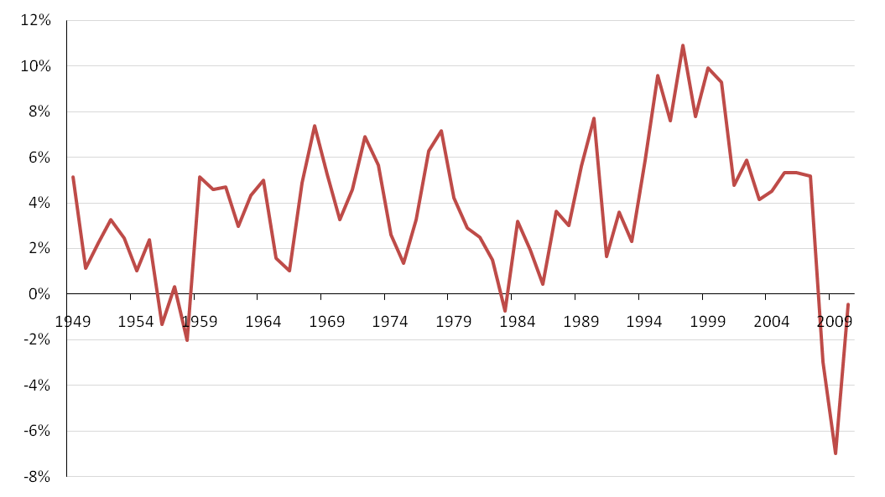
Volume GDP (annual % Changes)
1948 – 2010
Notes:
Historical context
Main message – current downturn severe and sudden

Slide 3
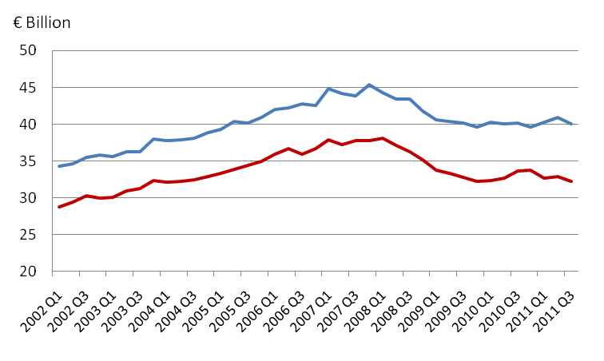
GDP & GNP (Seasonally Adjusted)
Q1 2002 – Q3 2011
GDP
GNP
Notes:
GDP (output measure) - Steady downturn in economy is apparent from early 2008. Since Q2 2009 trend is pretty much flat, with a very slight tick upwards in more recent quarters.
GNP (income measure) - This is where the impact of MNEs are removed from the data. Similar pattern, steady downturn since 2008 but continues longer than GDP, doesn’t plateau until early 2010. Overall, pattern is pretty flat since then, but with a bit more volatility.
Difference between GDP and GNP growing slowly
The current levels of GDP and GNP are broadly equivalent to 2005 levels (constant prices – 2009 rates)

Slide 4
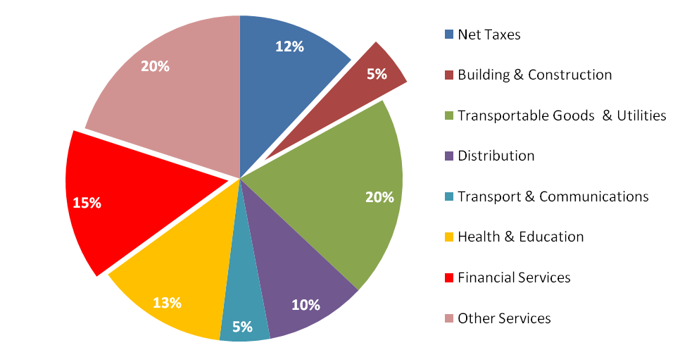
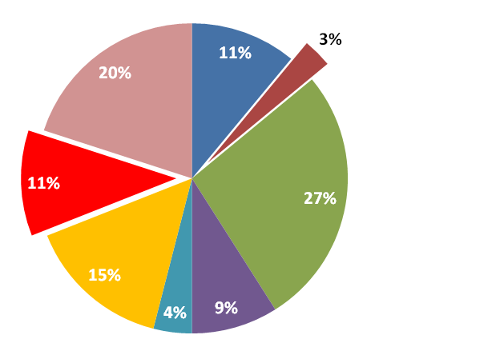
Sector Composition of GDP
2007
2010
Notes:
Between Q4-2007 and Q4-2010, the economy as measured by GDP contracted by 13%
During that time, overall composition of GDP (or the structure of the economy) hasn’t changed dramatically.
Nevertheless, some notable features:
Net taxes contributing less.
Both the financial and construction sectors contracted. So did Retail, Transport and Communications.
Public sector contracted in real terms, but in relative terms, the contribution of Health and Education has
increased.
Transportable goods and utilities sector share as grown significantly

Slide 5
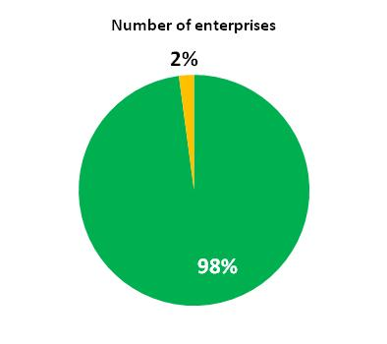
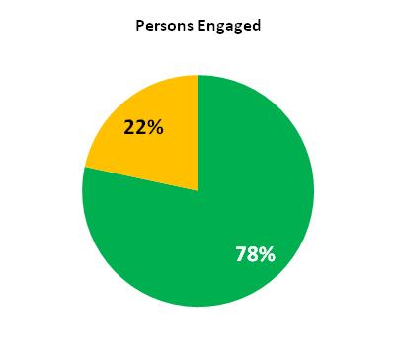
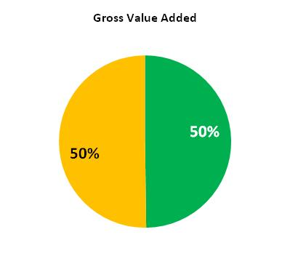
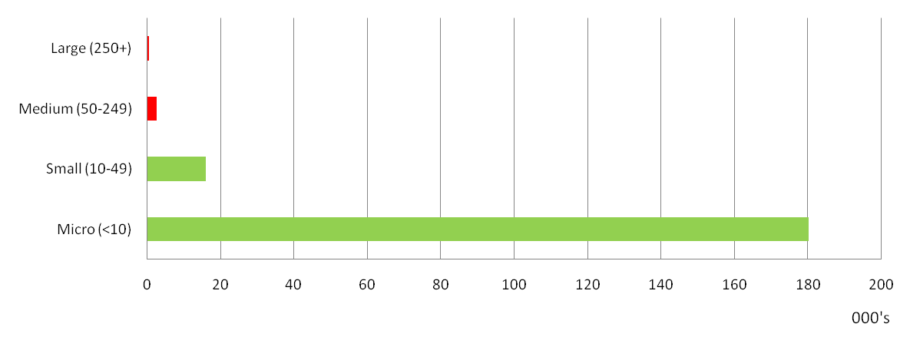
Importance of MNEs
Number of Enterprises by Size Class
Notes:
There are roughly 200,000 enterprises operating in Ireland
90% of these are Micro enterprises – engage less than 10 persons.
Less than 500 are large.
Large and medium sized enterprises – those that engage more than 50 persons, only account for 2% of the enterprise population and many of these are MNEs.
So MNEs, although they account for only 2% of enterprises, account for 22% of persons engaged in the business economy (13.5% of total employment) and half of the GVA generated within the business economy (28% of total economy GVA).
Many of these enterprises are in the Pharma-Chem and ICT/Software sectors.

Slide 6
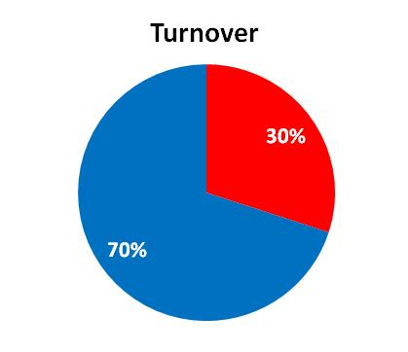
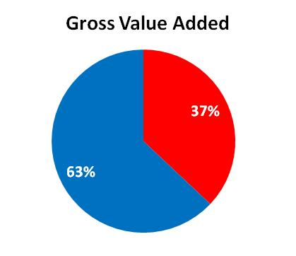
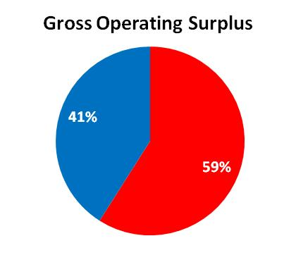
Importance of Top 50 enterprises
Notes:
Just to emphasise how important large enterprises are to the economy
200,000 enterprises – this is impact of top 50
Gross Operating Surplus is broadly analogous with profit

Slide 7
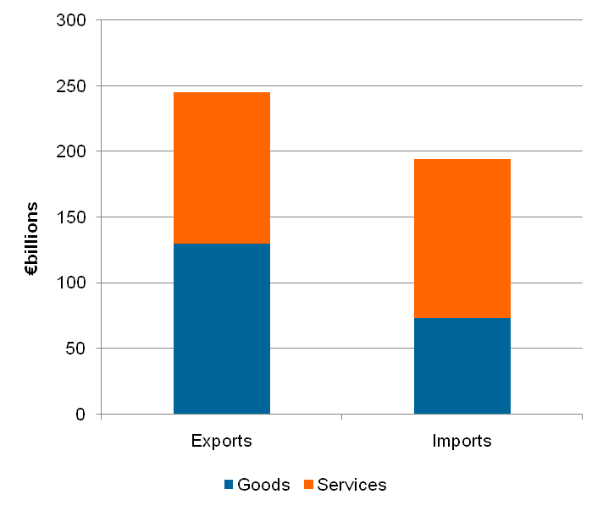
Imports, Exports &Trade Balance (Jan – Sept 2011)
Notes:
In first 9 months of 2011, Ireland ran a trade surplus (approx €51bn). This surplus was generated primarily from trading (exporting) goods.
Trade balance for services is approx - €2.5 billion (almost in equilibrium).
Over 60% (€32bn) of this trade surplus was generated by the Chemical sector.
Computer Services also made a significant contribution to the positive trade balance (€23bn).
However the corresponding purchases of royalties and licences (€20bn) and Business Services (primarily by MNEs in the Chemical and Computer Software sectors) are recorded in the BoP as imports, which cancel out the net exports of services, leading to pretty balanced trade for services (- €2.5bn)

Slide 8
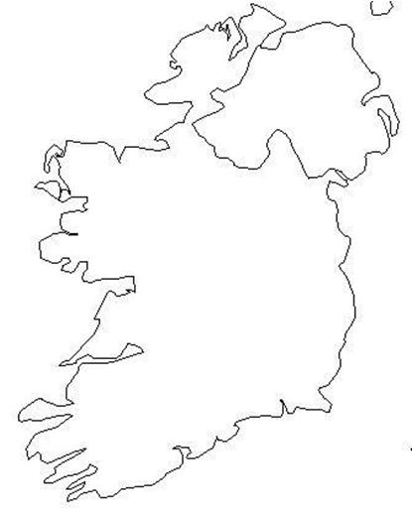
Outflows (€ Billions) – Goods, Services & Profits
2007 2010
Royalties/Licences €18.6 €28.5
Profits €26.5 €27.8
Notes:
The economic structure of Irish economy, very open and highly globalised. MNEs playing a significant role
Consequently:
MNEs repatriate profits – very considerable €28 billion in 2010.
MNEs also repatriate income through the purchases of business services and royalties/licences from their HQs. As we have already seen this has a significant impact on the balance of payments. The value or price of royalties and licences imported into Ireland has been growing steadily in recent years.

Slide 9
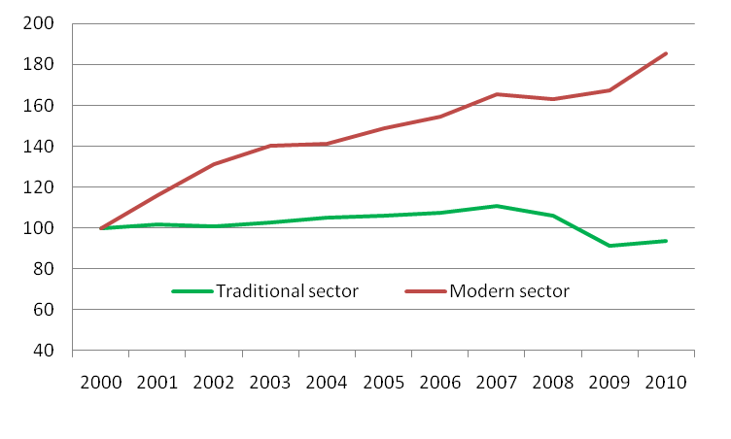
Two speed economy
Industrial Production (Base: Year 2000 = 100)
Notes:
Within Ireland there are 2 sub-economies
Using the industrial sector as an example, we can see the traditional sectors, more or less flat
In contrast, the modern sectors are experiencing significant growth. The modern sectors, are dominated by MNEs – these sectors are exporting.
Crucially, the traditional sectors account for most of the employment in Ireland.

Slide 10
Employment and Unemployment
Notes:
Employment peaked mid-2007 (2.2 million),
Collapse in construction had a dramatic impact (predominantly males) – as the wider global recession took hold, the decline rippled out through all sectors of the economy. Employment now stands at 1.8million.
From 2000 – 2006 we experience natural unemployment rate. Unemployment held at less than 4.5% - Q2 2007 (103,000) but thereafter begins to increase. By Q3 2011 unemployment rate at 14.4% (315,000). This change happened very quickly – the bulk of this change occurred within 24 months.
Perhaps the more important issue, is the structural or compositional change from short-term to long-term unemployed (unemployed for more than 1 year). LTUR now account for over half of the 315,000 persons unemployed.

Slide 11
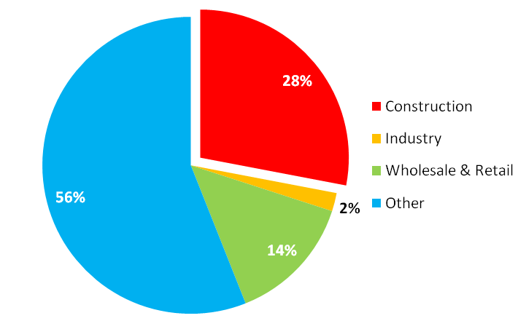
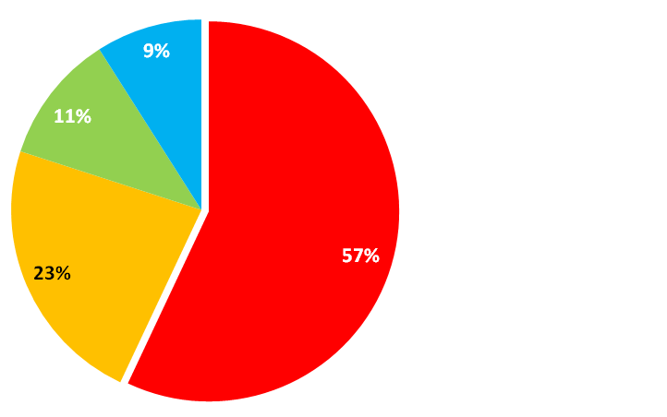
Employment change by sector
Growth in Employment
2004 – 2007
Loss in Employment
2007 – 2011
Notes:
During the 2004 – 2007 period, Construction made a very significant contribution to employment growth (grew by 42%), accounting for more than 30% of all employment growth.
“Other” includes public sector, tourism sector and business services. The growth in “Other” also reflects increased female participation, so much of the growth here was female.
During the 2007 – 2011 period, over 57% of the jobs lost were construction. This loss happened very quickly, and predominantly effected males.
During the same period Industry also experienced significant job losses – this is something I will return to, when I discuss how enterprises have cut labour costs.

Slide 12
Unemployment Rates (%) by Region
Notes:
SE - Carlow, Kilkenny, South-Tipperary, Wexford and Waterford

Slide 13
Unemployment Rates (%) 2007 vs 2010
Notes:
In 2007
Ireland was at full employment, and shared the 2nd lowest employment rate of 4% with NL.
Only Norway had lower unemployment 3%
Both the EU and Eurozone averages were 8%
Unemployment in both Germany and France was 9%.
In 2010
Unemployment in Ireland had risen to 13%, 6th highest rate in EU
Unemployment in Germany remained static at 8%, whereas in France it had increased to 10%
EU and Eurozone unemployment rates increased to 10% and 11% respectively

Slide 14
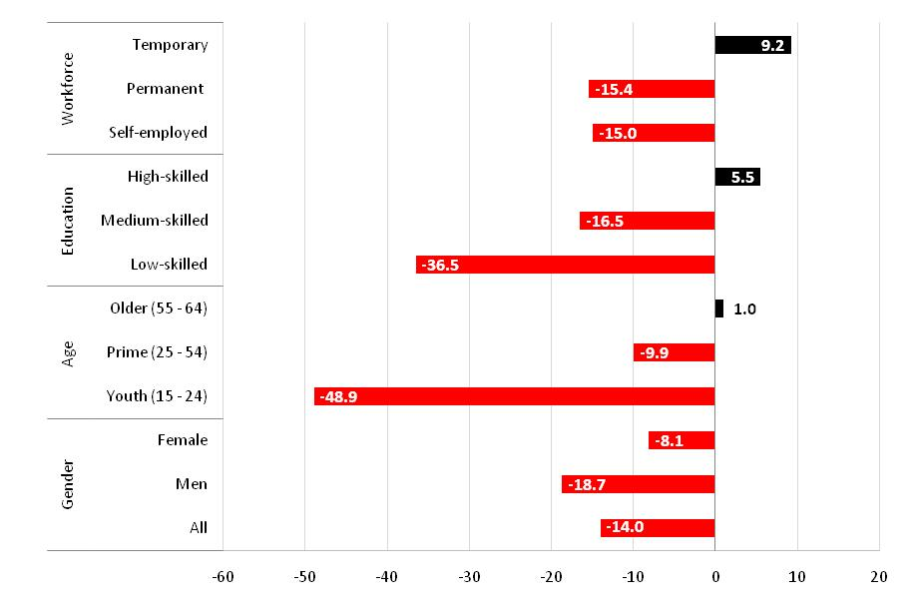
Who has been effected most by employment loss?
% Change Q2 2008 – Q2 2011
Notes:
Shift from permanent to temporary employment – this is a combination of voluntary and enforced – again I will return to this point later, when I discuss how enterprises have reduced their labour costs. Also self-employed has been hit quite hard – related to the decline in the construction sector.
Unskilled and medium-skilled labour hit hardest. This reflects, to a large extent, the compostion of labour in the construction sector, but also composition some industrial sectors. High-skilled employment has continued to grow.
The chart highlights the in proportional terms, youth labour (15 – 24) has suffered the greatest loss in employment. However in absolute terms, the most significant losses have been in the 20 – 34 age cohort.

Slide 15
Regions most affected by employment loss
Notes:
Jobs lost on the basis of “place of residence” (as this is how the survey data are collected) rather than region where actual jobs were lost.

Slide 16
How enterprises have reduced Wage Bill
2008 – 2009
Employment
Average Hourly Earnings
Average Hours
65%
54%
12%
20%
13%
37%
9%
29%
4%
4%
3%
Notes:
Between 2008 and 2009 65% of enterprises reduced their wage bill by more than 2% (and 35% did not)
A combination of 3 strategies were used:
Employment was reduced
Hours were cut
Actual wage rate/average hourly earnings were cut
54% of all enterprises reduced employment
37% of all enterprises reduced hours
29% cut hourly wage rate
Of which, some used either 2 or 3 options
Earnings statistics show there has been little or no fall in average hourly wages in private sector

Slide 17
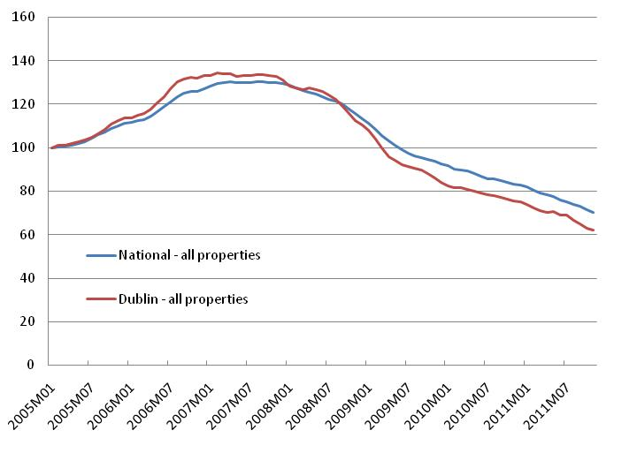
Residential Property Prices
(Base: Jan 2005 = 100)
Notes:
Year-on-Year Decline (Nov 2011 – Nov 2010)
RPPI National - 15.6%
RPPI Dublin - 17.6%
RPPI ROI - 14.5%
Rate of decline, has accelerated slightly in later half on 2011
Overall Decline
Dublin house prices are 52% lower than peak (early 2007)
Dublin apartments are 58% lower than peak (February 2007)
Dublin RPP are 54% lower than Feb 2007 peak
ROI RPP are 46% lower than 2007 peak

Slide 18
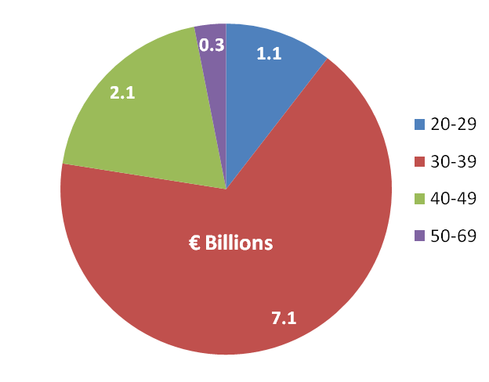
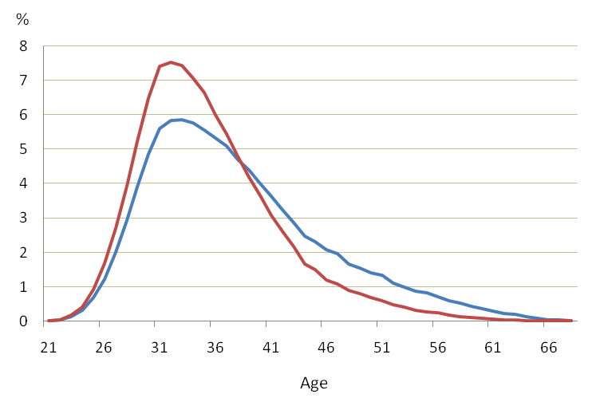
Negative Equity by age cohort & size
Negative Equity
Age
Negative Equity
Mortgage
Notes:
These are not official statistics
Primary residential property (funded by mortgages), purchased during 2005 – 2010 period, worth €101 billion at time of purchase (which €72.8 billion was borrowed – the residual may have been equity or other borrowings – we don’t know!
Total loss in value is estimated at €31.4 billion, (on assumption that mortgages are being repaid as per conditions set at drawdown - arrears will accentuate problem) of which: €10.2 billion lost by First Time Buyers
Negative equity is estimated at €10.6 billion (loss on € 72.8 bn)
Affecting 187,000 mortgages, corresponding to 60% of all mortgages for primary residential properties taken out during 2005-2010
Key message – those aged 30 – 39, many of whom are FTBs holding almost 70% of NE – “trapped generation”

Slide 19
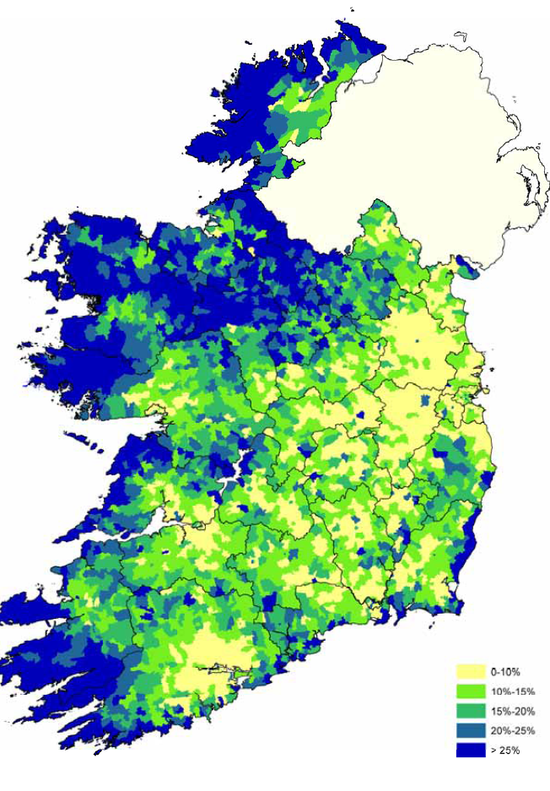
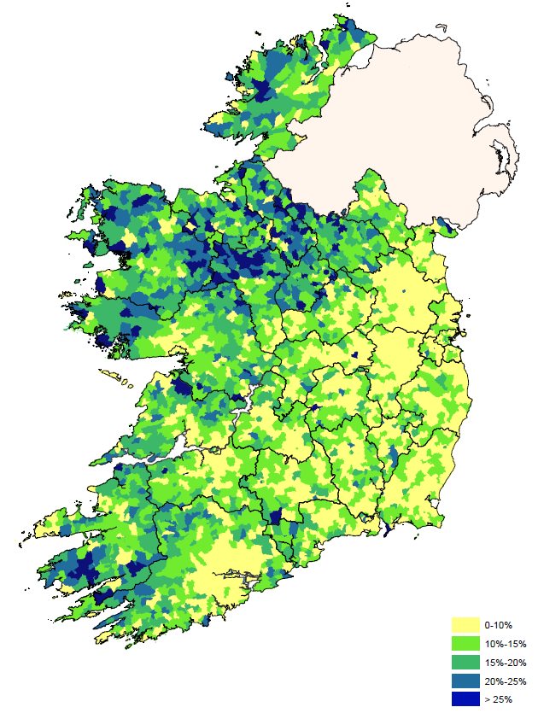
Dwelling vacancy rates
Vacant dwellings & Holiday Homes
Vacant dwellings only
Notes:
One of the great advantages of the Census of Population is that it allows us to compile robust small area statistics. These are based on preliminary 2011 CoP data so are very current – final figures will be available end of March.
13.3% increase in dwellings between 2006 and 2011 (234,000) – increase of 47,000 on average PA.
So for example, we can see the distribution of vacant dwelling and holiday homes around the country. There are 2 million dwellings in the state, of which 294,000 are vacant – so approximately 14.7% (down from 15% in 2006) of all dwellings are vacant/or holiday homes.
The majority of the vacant dwellings are situated in the BMW region, with the exception of Kerry, where there are also significant numbers. Equally, holiday homes (by deduction) are clearly clustered along the coasts and along the shannon as one would expect. But the penetration in NW and SW is very pronounced.
Highest vacancy rates:
Leitrim 30%
Donegal 29%
Kerry 27%
Mayo 25%
Dublin 10%
Definition of dwelling
In identifying vacant dwellings, enumerators were instructed to look for signs that the dwelling was not occupied e.g. no furniture, no cars outside, junk mail accumulating, overgrown garden etc., and to find out from neighbours whether it was vacant or not. It was not sufficient to classify a dwelling as vacant after one or two visits. Similar precautions were also taken before classifying holiday homes.
Dwellings under construction and derelict properties are not included in the count of vacant dwellings. In order to be classified as under construction, the dwelling had to be unfit for habitation because the roof, doors, windows or walls had not yet been built or installed.

Slide 20
Household Savings
Notes:
Income and expenditure peaks 2008
Savings ratio peaks 2009 and now down of those high levels

Slide 21
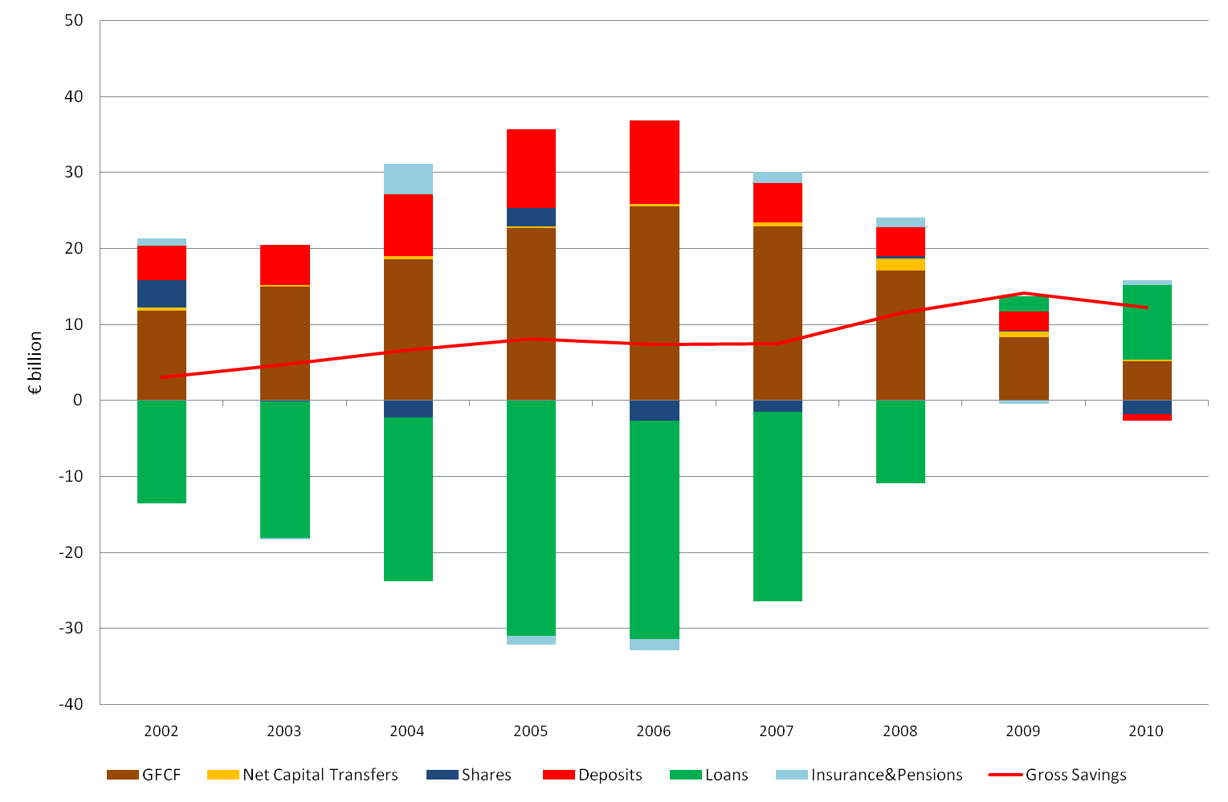
Household Investments & Savings
Notes:
Flows rather than stocks.
What may not be fully understood is what is meant be consumption expenditure. This does not include paying off loans or mortgages.
So, this chart illustrates where households place their savings (and where they invest)
3 key messages:
Loans to households peaked in 2006 and thereafter began to decline. From 2009 we can see households (at an aggregate level) stopped borrowing and start paying off loans on a net basis.
Most of the borrowing was to fund GFCF - property
Rate of savings as deposits (what many might typically associate with savings) in decline since 2006. Deposits actually fell reduced by €-759m (7%) between 2009 and 2010

Slide 22
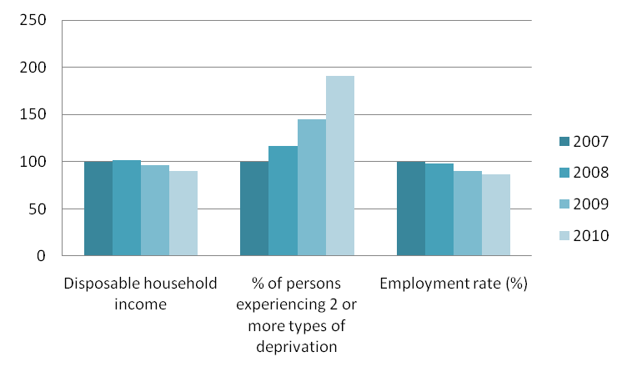
Impact on Well-being
(Base: Year 2007 = 100)
Notes:
Stiglitz-Sen-Fetoussi “Beyond GDP” report on “wellbeing” - no internationally agreed definition of what constitutes wellbeing as yet, but within the international literature, a growing consensus appears to be emerging that:
Income
Deprivation
& employment
are key components of wellbeing. These components are presented here.
Between 2007 – 2010:
Disposable income fell by 10%
Deprivation increased by 91%
Employment rate fell by 13%
There are some important points to note here –
Income inequality increased, particularly between 2009 and 2010. Top 20% of earners had a disposable income 5.5 times those of the bottom 20%.
Traditionally deprivation was seen amongst the lowest income earners (bottom 20%) but in 2010 the figures showed that deprivation is now being experienced not just low income earners but also middle income earners.

Slide 23
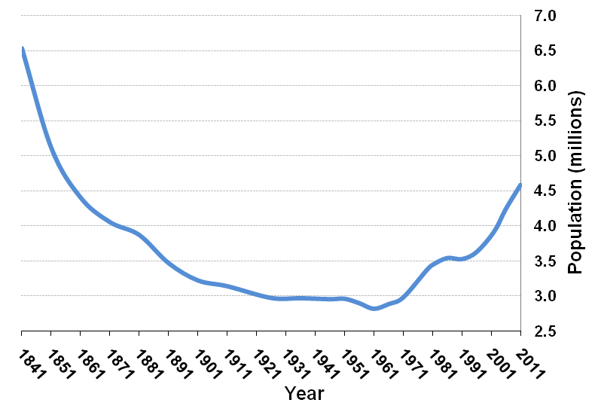
Overall Population Change
Notes:
Population - 4.58 million
Highest since 1851
Increase > 341,000
(8.1%) since 2006
1.6% per annum
Why is this important? Some examples…
Planning for the future – education, health and other local services
Driving economy, consumer demand
Future supply of labour
Changing dependency rates – welfare and pension provision
Balanced regional development

Slide 24
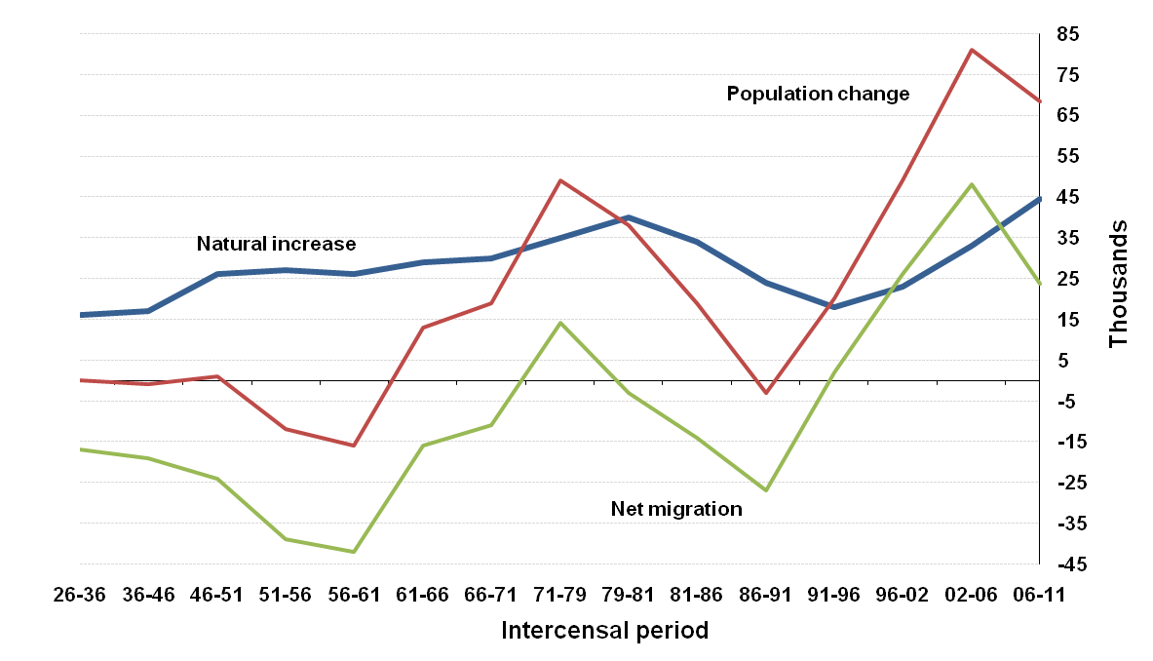
Components of Population Change
Notes:
Population change driven primarily by net migration. Between 2006 – 2011 long term gross flows of people was approx 600,000 persons (i.e. Immigrant or emigrant). Short term flows were even larger. Given a population of 4.6 million, these are very significant movements.
This highlights the importance of a CoP in an Irish context. Migration is very difficult if not impossible to measure accurately. So the census provides an accurate benchmark every 5 years. This is important, not only for understanding changes in Ireland’s demography and labour market but also for estimating per capita estimates (e.g. Per capita GDP) which are the basis on which net contributions or receipts of EU structural and cohesion funds are based.
Labour Supply
Without migration labour supply would be declining y-o-y, this is down to demographics, births peaked in 1980 and fell in every successive year until 1994 – those born in 1994 are now 17, but typical labour market entry is pushing out to 19 – 21 years old. That’s why are growth in labour supply during the boom was supplied by foreign nationals.
In the past 4 years we’ve experienced a significant increase in the number of births, exceeding the peak of the 1980s ~ 72,000 (>74,000 in 2011). Obvious implications in the short term for provision of health and education services. Deaths stable at 27,000. - so people living longer with implications for health, welfare and pension provision.

Slide 25
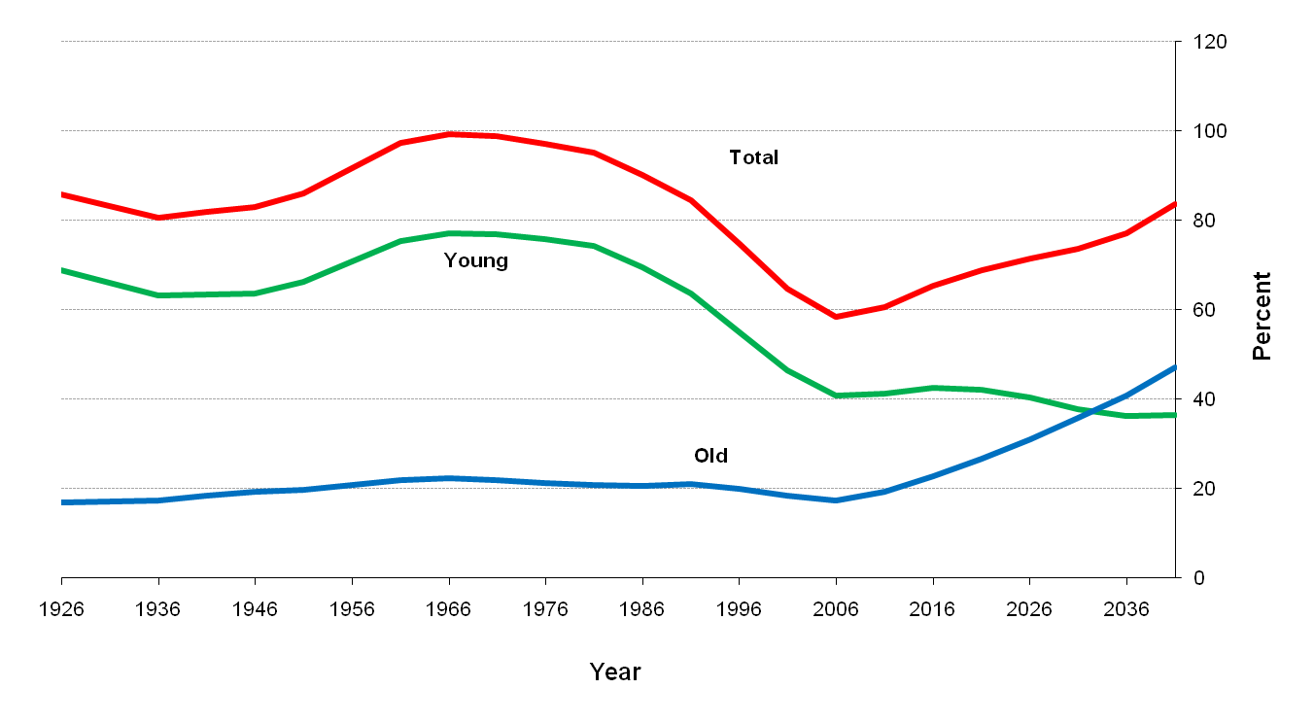
Actual and Projected dependency ratios
Projections based on M0F1 assumptions
Notes:
6 different scenarios are published after Census 2006 (M0F1 – zero net migration, high fertility)
Dependency ratio = dependents / productive population
Youth Dependency Ratio - Young (0 – 18) expressed as % of productive population (19 – 64)
Old (65 +) expressed as % of productive population.
This scenario shows the impact of demographic changes on dependency ratio over next 25 years. If this scenario is correct, then we can expect an increase from around 60% (now) to in excess of 80% in 2035. Again this has obvious implications for planning of services and funding (welfare and pensions).
Although the dependency ratio is lower than that experienced in the 1960s and 1970s, the composition is very different. In the 1960s and 1970s the high dependency ratio was driven by a relatively large young population. In contrast, the growing dependency ratio now is being driven by a relatively large older population, which is likely to be more expensive.

Slide 26
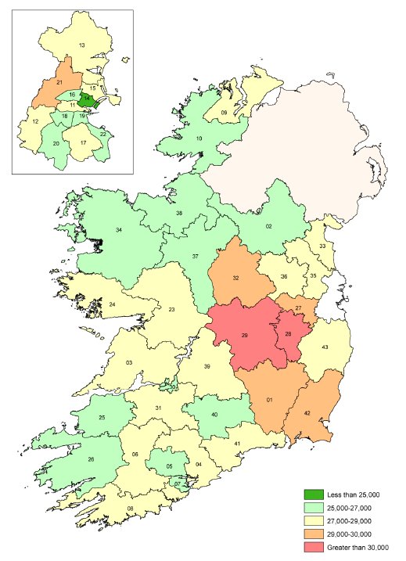
Constituency populations 2011
Notes:
Dublin North-Central only constituency with fall in population since 2006
2 constituencies now above 30,000 population (Laois-Offaly and Kildare South)
5 others between 29,000 and 30,000
Carlow-Kilkenny
Dublin-West
Kildare-North
Longford-Meath
Wexford
These are from the preliminary Census, so final numbers may be slightly different. So population for some constituencies may change, e.g. Kildare-South and Kildare-North

Slide 27
Key message
Everything is inter-connected
Macro
Economics
Social
Statistics
Business
Statistics
Notes:
Virtuous or vicious circle?
The macro-economy, the micro-economies and sectors (like households) are all inter-connected, either directly or indirectly.
Declines in one sector, ripple out to affect other sectors and the wider macro-economy. In turn this has impacted directly on households and the citizen.
So, while the CSO publishes many statistics in individual or isolated format, when assembled together, we see they are supporting the same narrative.

Slide 28

Take a closer look
www.cso.ie

Slide 29

Dates for your diary
Balance of Payments Seminar
Coach House - Dublin Castle
23rd February, 9.30am
Register: corporate.support@cso.ie
How Enterprises changed their wage bills in the downturn
By Kieran Walsh, CSO
Statistical and Social Inquiry
Society of Ireland
Royal Irish Academy, 9th February, 6pm

