Slide 1

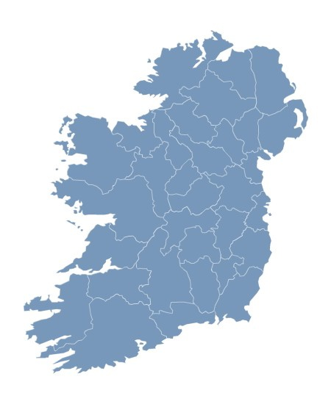

The story behind the numbers
2013
Notes:
Steve MacFeely, Assistant Director General with responsibility for Social & Demographic Statistics
Michael Connolly, Senior Statistician with responsibility for National Accounts Integration
I would to thank the Houses of the Oireachtas Services, in particular Maria Fitzsimons and her colleagues from the Library and research unit for affording us this opportunity to talk to you this morning.
The CSO is an independent office, mandated by the 1993 Statistics Act to collect, compile, extract and disseminate, for statistical purposes of information, that relate to economic, social and general activity and conditions in the State.
The CSO compiles and disseminates a wide range of information
Although these data are presented separately, in individual reports, they are all interconnected. What happens in the business economy affects the wider macro-economy and this in turn impacts on households and the individual citizen.

Slide 2
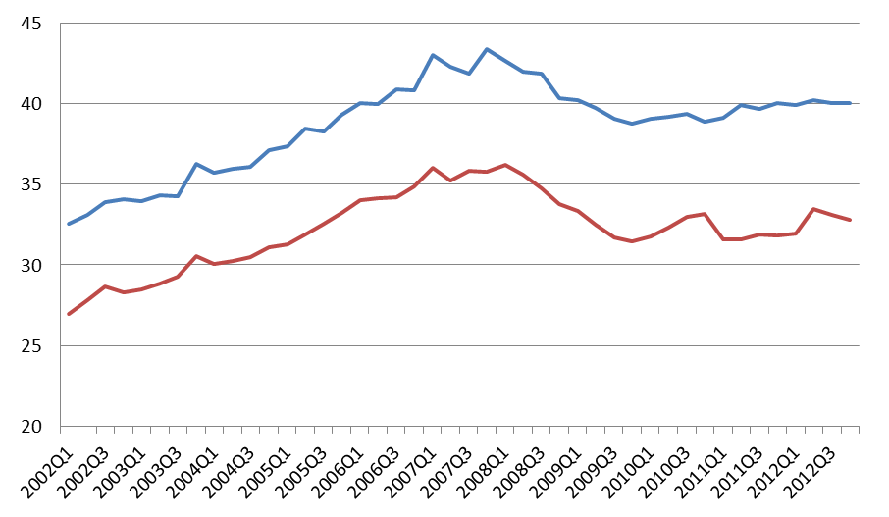
GDP & GNP (Constant Prices - Seasonally Adjusted)
Q1 2002 – Q4 2012
€ Billion
GDP
GNP
Notes:
Broadly similar to what I presented last year…
GDP (output measure) - Steady downturn in economy is apparent from early 2008. Since Q2 2009 trend is pretty much flat. Since Q1 2012 new plateau at a slightly higher level.
GNP (income measure) - This is where the impact of MNEs are removed from the data. Similar pattern, steady downturn since 2008 but continues longer than GDP, doesn’t plateau until early 2010. Overall, pattern is pretty flat since then, but with a bit more volatility.
Difference between GDP and GNP expands and contracts but overall trend is growing divergence
The current levels GDP is broadly equivalent to 2006 levels, current level of GNP broadly equivalent to 2005 levels

Slide 3
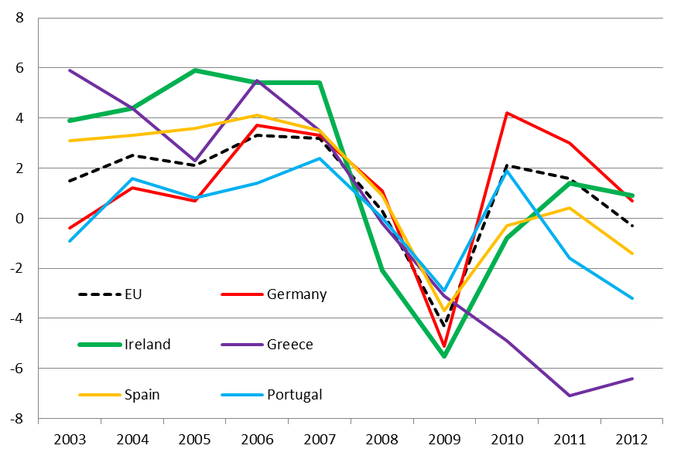
International Growth Rates (% GDP) for selected countries
% change
Notes:
Limited selection – otherwise chart gets too cluttered. Pattern all around Europe very similar.
From 2003 to 2007 Ireland had average GDP growth of approx. 5% compared with average EU growth of 2.5%
From 2008 to 2012 Ireland had average GDP growth of -1.2% compared with average EU growth of -0.1%
Irelands growth returned to positive growth in 2011 (+1.4%), in 2012 in moderated slightly to +0.9%. Greece, Spain and Portugal still experiencing negative GDP growth.
Decline in Greek economy less steep, but much deeper than Ireland’s. Currently at -6%

Slide 4
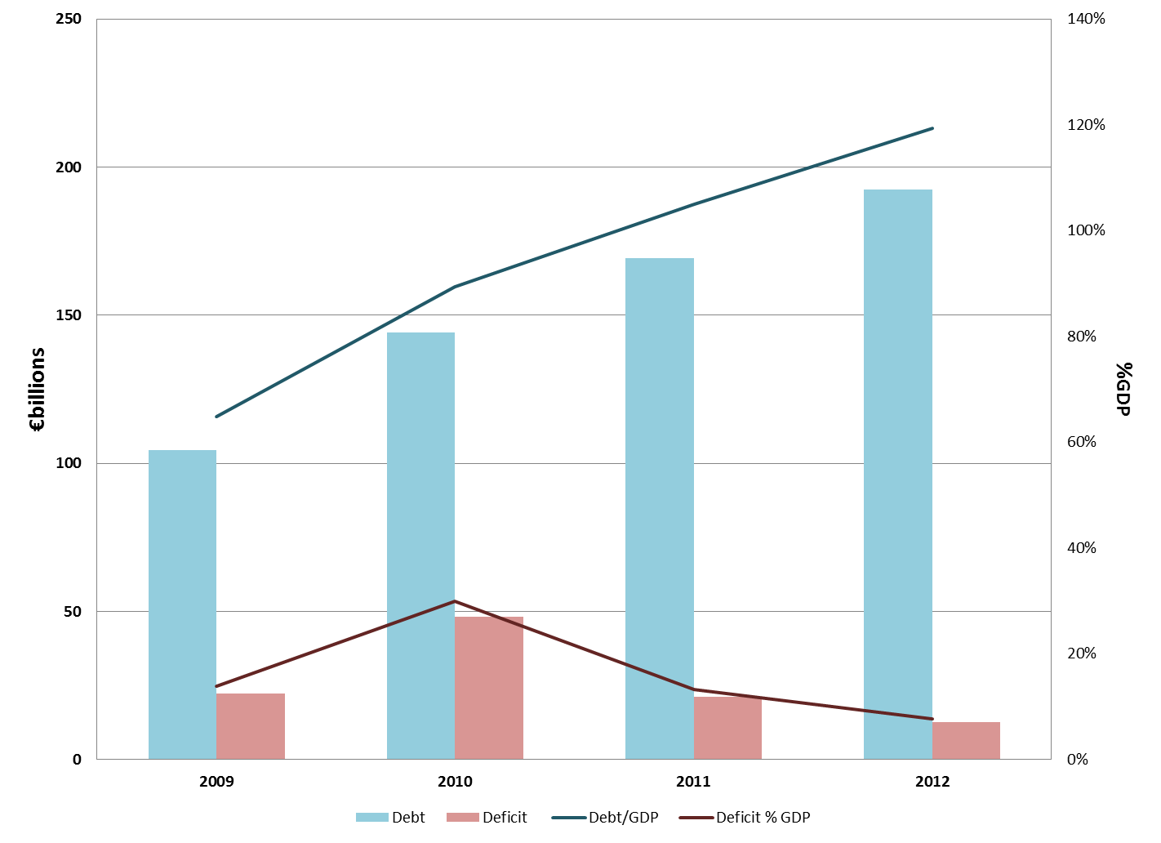
Debt & Deficit
Notes:
Govt. debt has increased from just under €105bn in 2009 to €192bn in 2012 (an increase of 83%).
The Debt/GDP ratio has increased from 65% in 2009 to 119% in 2012.
In 2009 72% (€105bn) of Govt. Debt was external or foreign owned.
In 2012, 94% (€181bn) of Govt. Debt was external. Of this, €56bn or 29% was ‘bailout’ or programme funding.
The deficit (i.e. when expenditure exceeds income) doubled from €22bn in 2009 to €48bn in 2010 before falling back to just over €12bn in 2012. The jump in 2010 coincides with funding injections to banking sector – this was treated consumption rather than investment and consequently impacted on deficit.
In 2012 the deficit was the equivalent of 8% of GDP. The EU target is 3%.

Slide 5
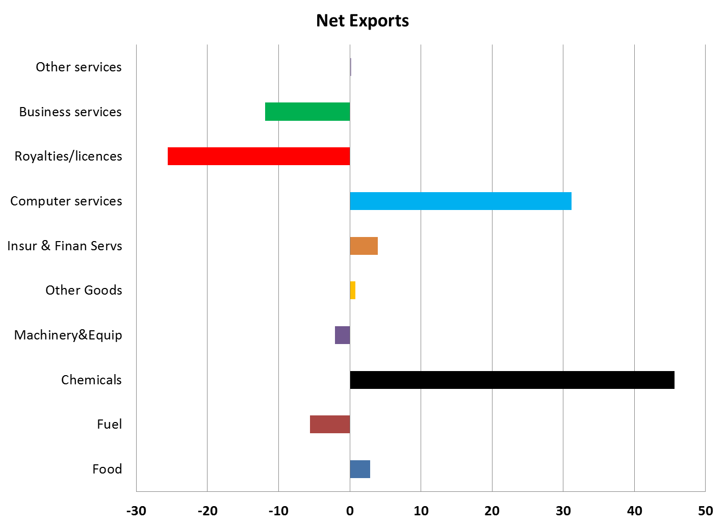
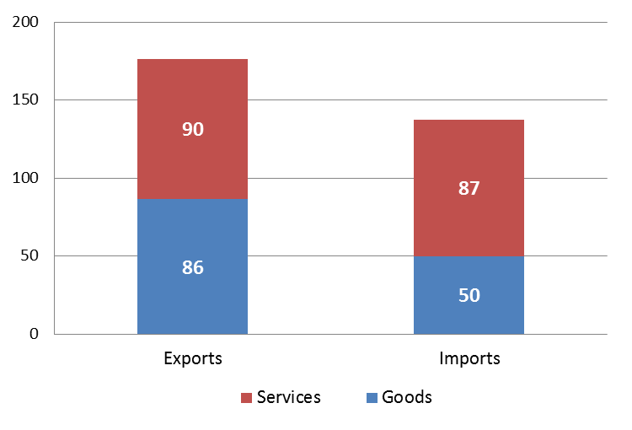
Imports, Exports &Trade Balance (2012)
€ billion
€ billion
Notes:
In 2012, Ireland ran a trade surplus (approx. €39bn). Exports were 177bn V Imports of 137bn
Although Services exports now exceed merchandised (goods) exports, 92% of this surplus was generated from trading (exporting) goods. Net exports from the Chemical sector (€46bn) was the main contributor.
Services ran a modest trade surplus – approx. €3 billion. Although net exports from the Computer Services were €31bn, the corresponding net importation of royalties and licences (€26bn) and Business Services €12bn (primarily by MNEs in the Chemical and Computer Software sectors) which are recorded in the BoP as imports of a service, almost cancelled out services exports.

Slide 6
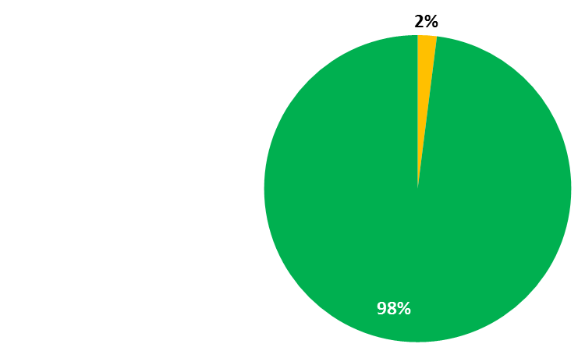
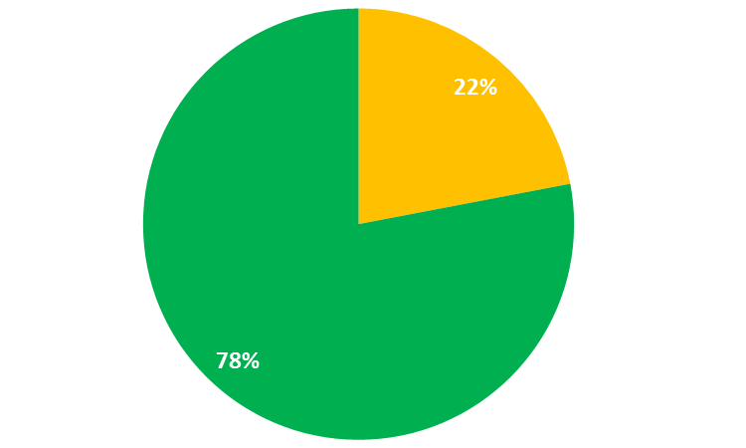
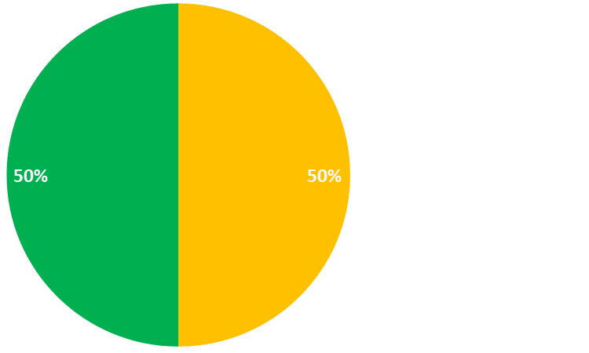
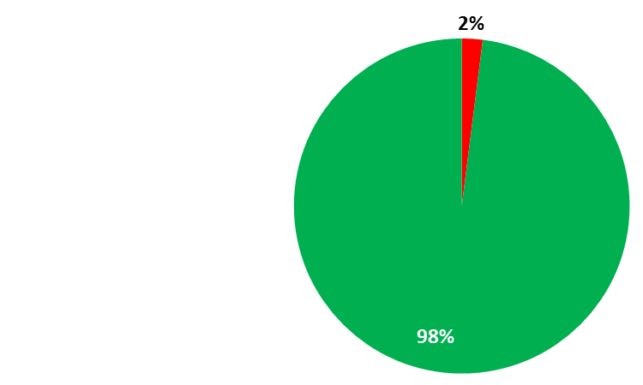
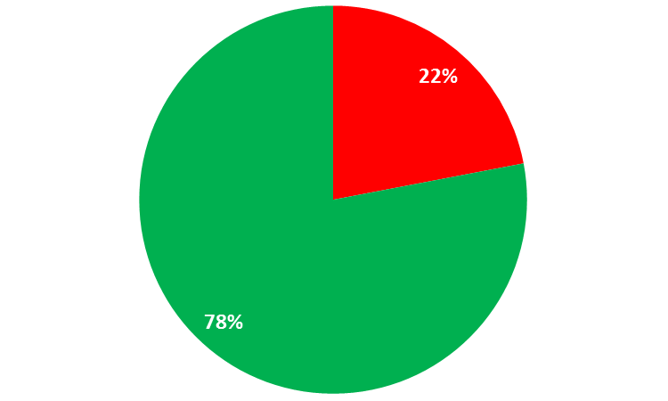
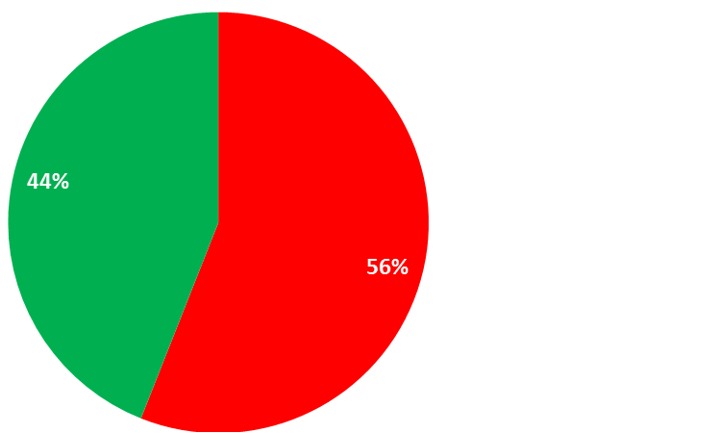
Importance of MNEs
Number of Enterprises
Number of Persons Engaged
Gross Value Added
2009
2010
Notes:
There are roughly 200,000 enterprises operating in Ireland
90% of these are Micro enterprises – engage less than 10 persons.
Less than 500 are large.
Large and medium sized enterprises – those that engage more than 50 persons, only account for 2% of the enterprise population and many of these are MNEs.
In 2009 MNEs, account for 2% of enterprises, 22% of persons engaged in the business economy and half of the GVA generated within the business economy (28% of total economy GVA).
In 2010 MNEs still only accounted for 2% of enterprises, and for 22% of persons engaged in the business economy but their share of GVA had increased to 56% of GVA generated within the business economy. They are less exposed to domestic economy and thus have outperformed Irish enterprises.
Many of these enterprises are in the Pharma-Chem and ICT/Software sectors.

Slide 7
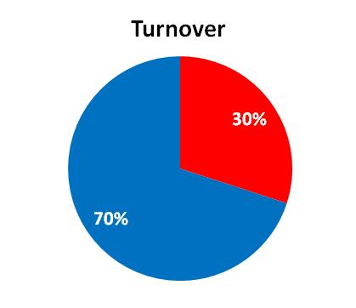
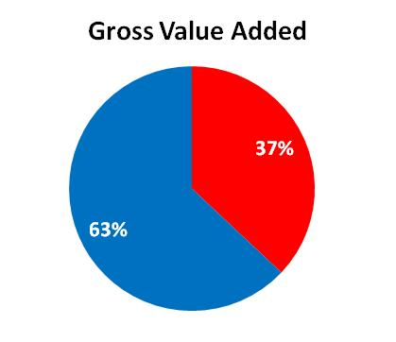
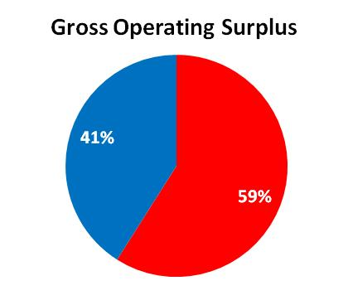
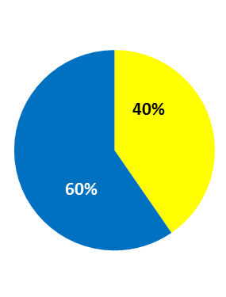
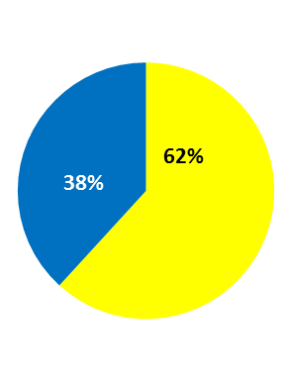
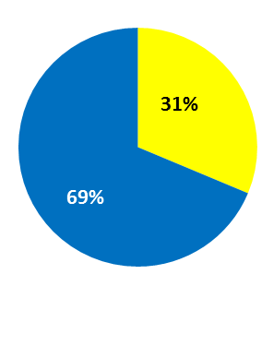
Importance of Top 50 enterprises
2009
2010
Notes:
Just to emphasise how important large enterprises are to the economy
200,000 enterprises – this is impact of top 50
Gross Operating Surplus is broadly analogous with profit
The importance of the top 50 has increased between 2009 and 2010. These are typically large MNEs, trading internationally, and less dependent on domestic economy. They have weather recession better and hence their relative importance has increased.
Top 50 enterprises:
Share of total turnover, has increased from 30 to 31%
Share of total GVA has increased from 37 to 40%
Share of total GOS has increased from 59 to 62%

Slide 8
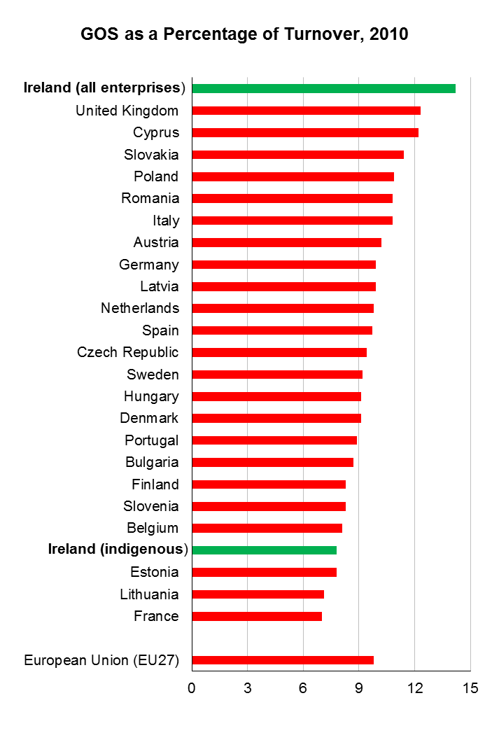
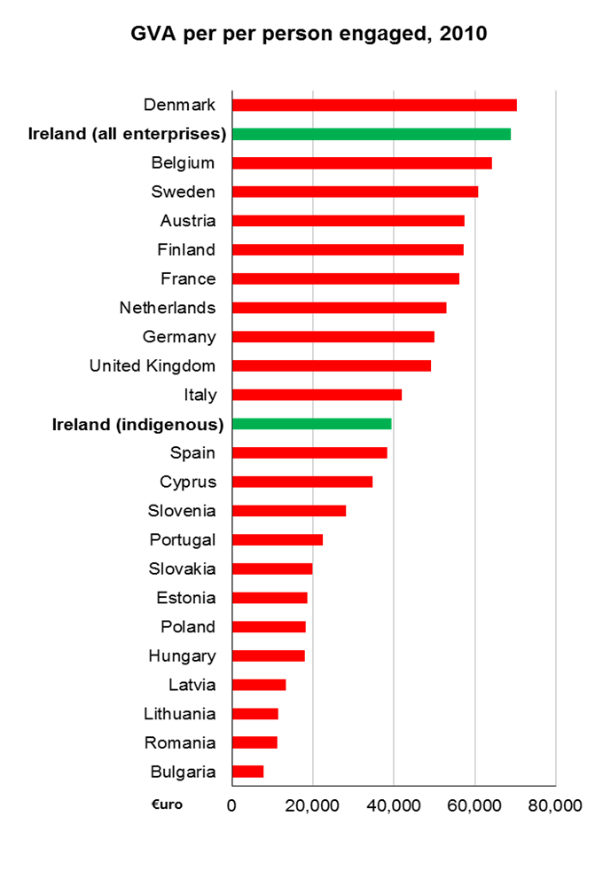
Distortionary impact of MNEs
Notes:
Gross Operating Surplus (is GVA – personnel costs)
Relative to turnover, Irish enterprises appear very profitable by international standards. However when MNEs are subtracted – remember 2% of enterprise population – we can see that our domestic enterprises don’t perform as well.
A similar story appear when we compare GVA per person employed (a measure of labour productivity). The headline figures suggest that Irish workforce is very productive. When MNEs are removed, Irish performance is still good but less stellar.

Slide 9
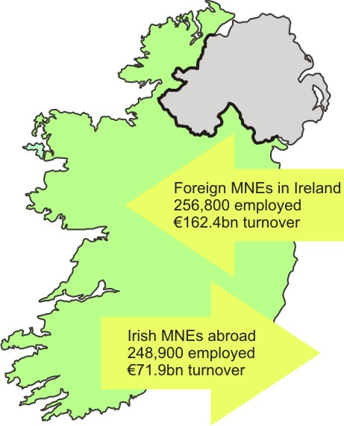
Foreign & Irish owned MNEs (2010)
Notes:
Outward FATS
156,000 jobs EU27 (63%)
92,000 jobs non EU27 (37%)
73,000 jobs (UK)
55,000 jobs (USA)
€48bn EU27 (66%)
€24bn non EU 27 (34%)
€28.0bn (UK)
€13.7bn (USA)
Inward FATS
MNEs account for about 22% of jobs in business economy or roughly 13% of total employment
UK enterprises account for about 30% of all MNE jobs in Ireland
USA enterprises account for about 39% of all MNE jobs in Ireland or 5% of total employment.
MNEs in Ireland account for 56% of Turnover (€161bn)
UK enterprises account for almost 10% of total MNE turnover (€15bn)
USA enterprises account for 72% of total MNE turnover (€116bn) or 41% of total turnover generated in Ireland in 2010

Slide 10
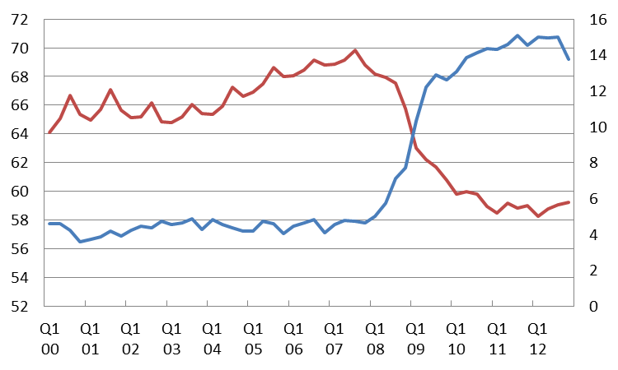
Employment and Unemployment Rates (%)
2000 - 2012
%
%
Employment rate
Unemployment rate
Notes:
Employment peaked mid-2007 (2.2 million), with an employment rate of 69.8%
Collapse in construction had a dramatic impact (predominantly males) – as the wider global recession took hold, the decline rippled out through all sectors of the economy. Employment now stands at 1.85 million.
From 2000 – 2007 we experience natural unemployment rate – continually less than 5%. Fell as low as 3.6% (64,000) in Q4 2000
Unemployment begins to climb steadily after Q4 2007. By Q3 2011 unemployment rate at 15.1% (328,000). This change happened very quickly – the bulk of this change occurred within 24 months.
Unemployment rate Q4 2012 - 13.7% (295,000)
Perhaps the more important issue, is the structural or compositional change from short-term to long-term unemployed (unemployed for more than 1 year). LTUR now account for 60% of the 295,000 persons unemployed.

Slide 11
Labour Market – Current Situation
Notes:
Numbers employed have fallen from 2.2 million in Q4 2007 to 1.8 million in Q4 2012 – a fall of 307,000.
Over the past year we have seen a small increase in employment (approx. 10,000). Part-time has become relatively more important, now accounting for almost a quarter of all jobs (up from 18% in 2007). So real decline in labour employed is greater than headline numbers would suggest. Almost all of the increase in part-time work has been for males workers – the number of female part-time workers is more or less unchanged since 2007.
Unemployment rate increased from 4.6% in Q4 2007 to 13.7% in Q4 2012. This equates to an increase from 105,000 to 295,000 – an increase of 190,000 people (or 180% increase). In the past year unemployment has fallen from 14.5% to 13.7% - or by 19,000 people.
In 2007, Long-term unemployed accounted for a third of all unemployed. In 2012, they accounted for 60%.
In 2007, Youth unemployment accounted for 30% of all unemployed. In 2012, this has fallen to 20% of total unemployment

Slide 12
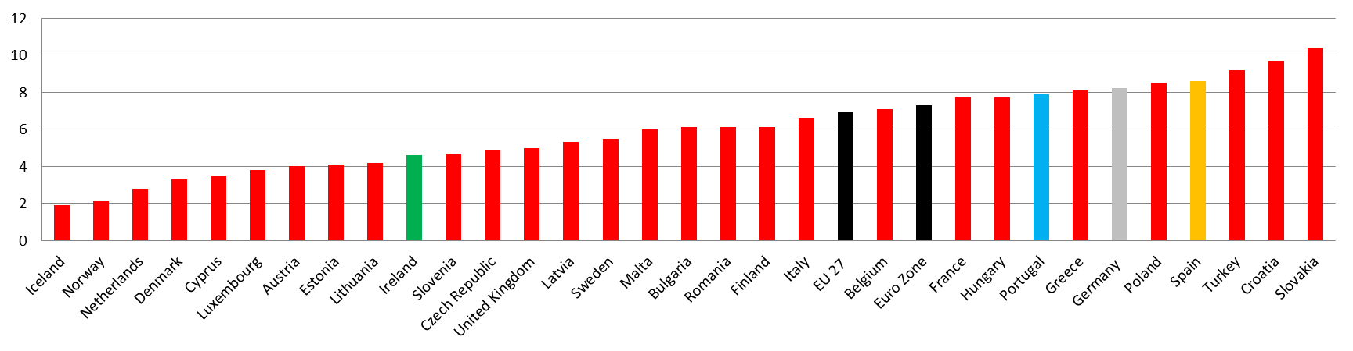
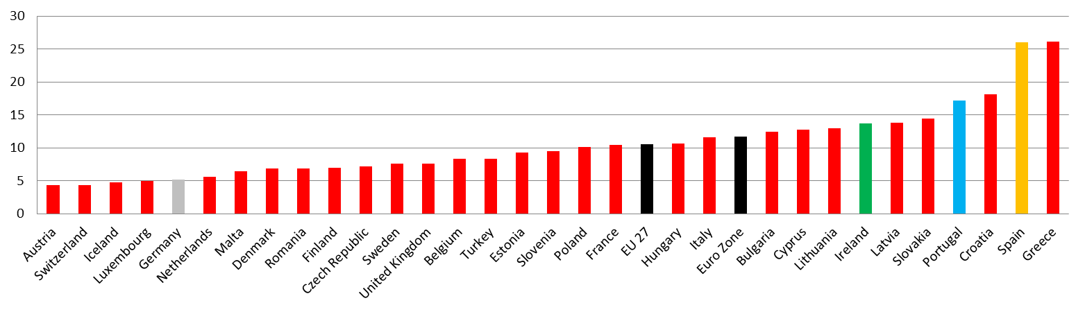
European Unemployment Rates (%) Q4 2007 vs Q4 2012
Q4 2007
Q4 2012
Notes:
In Q4 2007
Ireland was at full employment. Unemployment rate was 4.6%. Ireland below EU average (6.9%) and Euro Zone average (7.3%)
Germany 8.2%
Spain 8.6%
Portugal 7.9%
Greece 8.1%
Iceland 1.9%
UK 5.0%
In Q4 2012
Unemployment in Ireland had risen to 13.7% - 7th highest in EU. Ireland below EU above (10.6%) and Euro Zone average (11.7%)
Germany 5.2%
Spain 26.0%
Portugal 17.2%
Greece 26.1%
Iceland 4.8%
UK 7.6%

Slide 13
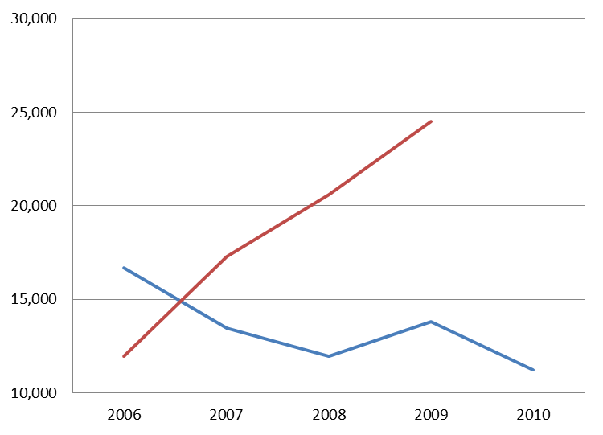
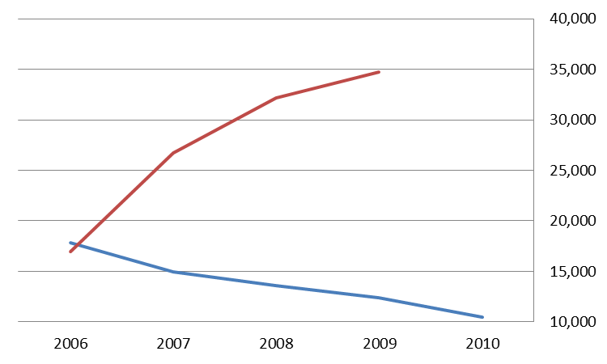
Enterprise births, deaths & impact on employment
Enterprises
Persons Engaged
Jobs lost
Deaths
Births
Jobs created
Notes:
This excludes agriculture and traditional ‘non-traded’ sectors (education, health…)
Enterprise births (set-ups) exceeded deaths (failures) in 2006 – 16,700 births v 11,900 deaths. Trend reversed after 2007
‘Statistical’ deaths like longer to determine, so data always lags births by a year.
So 2009 latest available. But between 2006 and 2009, deaths had more than doubled, from 11,900 to 24,500. Between 2006 and 2009 over 74,000 enterprises failed. During the same period 56,000 new enterprises were established.
Births fell by a third from 16,700 in 2006 to 11,200 in 2010. Between 2006 and 2010
Enterprise failures tend to have a greater impact on employment than enterprise creations at the time of the event. Newly created enterprises, in their first year of employment typically employ between 0.9 and 1.1 persons. Failed enterprises employ an average of 1.5 persons.
Enterprise deaths between 2006 and 2009 accounted for the loss of 110,000 jobs. Enterprise births during the same period created 59,000 jobs.

Slide 14
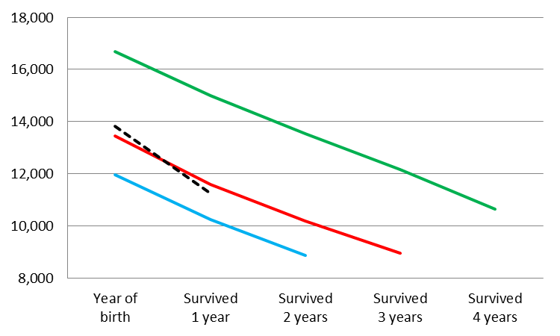
Enterprise survival
Enterprises
Persons Engaged
Born in 2006
2009
2008
Born in 2007
Notes:
Of the 16,700 enterprises born in 2006, only 10,600 still existed in 2010 (63% survival rate)
If we compare 1 year survival rates, we can see they are deteriorating from:
2006 – 2007 90%
2007 – 2008 86%
2008 – 2009 86%
2009 – 2010 81% (note angle of dotted line)
Obviously survival rates can differ greatly by sector
In terms of employment, or persons engaged, an interesting life cycle is evident. Enterprises begin with low employment (typically 1 person) then increase employment to 2 or 3 persons in 2nd and 3rd years, but thereafter employment falls back.
So for example, enterprises that commenced operations in 2006 created employment initially of 17,900, this rose to around 32,000 in the 2nd and 3rd years of trading before falling back to 15,000 in 2010. So average employment went from 1.1 persons in 2006, to 2.4 in 2008, to 1.4 in 2010.

Slide 15
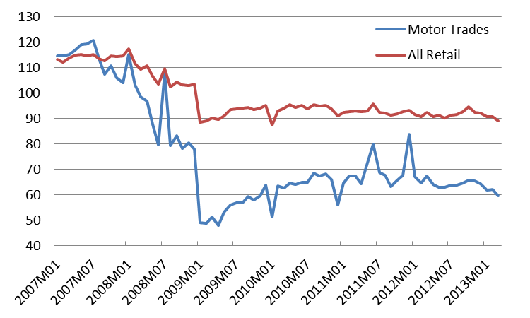
Retail Sector
Retail Sales Index
Seasonally Adjusted Volume
(Base: Year 2005 = 100)
Notes:
Year-on-Year Change
RSI (all businesses) -3.6%
Motor cars - 11.4%
Change since peak
RSI (all businesses) -24% since January 2008
Motor cars - 50.5% since July 2007
Between December 2008 and January 2009 all businesses index fell by -14.4% and the Motor Trades index fell by 37%.
Between January 2008 and January 2009 all businesses index fell by -24.5% and the Motor Trades index fell by 57% (biggest falls on record)
Annual turnover in retail and motor trades fell by roughly €26 bil - from €68 bil in 2008 to €42 bil in 2009.
Today retail/wholesale sector employs roughly 274,000 people (just under 7% of those employed). Fallen from a peak of 320,000 in Q1 2008
27,000 jobs lost in 2008
16,000 jobs lost in 2009

Slide 16
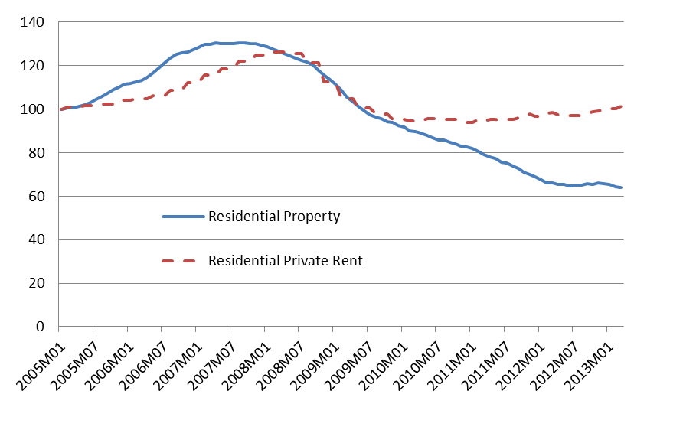
Residential Property & Rent Prices
(Base: Jan 2005 = 100)
Notes:
Year-on-Year Change (Mar 2013 – Mar 2012)
National RPPs - 3.0%
Dublin RPPs + 1.4%
Private Rent (CPI) + 2.9%
Overall Change
National RPP are 51% lower than September 2007 peak
Dublin RPP are 56% lower than February 2007 peak
National private rent is 20% lower than April 2008 peak, and has increased by 7% since trough in spring 2010.
The volume of property transactions remains low. According to Revenue Stamp duty data, there were roughly 28,600 transactions in 2012, of which 24,300 were ‘full value market transactions’. A transaction might refer to more than one dwelling.
The new PRTB index shows a very similar picture to the CPI rent index.
In 2006, 10% of households were in private accommodation, in 2011, almost 19% are in PRA (source Census of Population – 2006 and 2011)

Slide 17
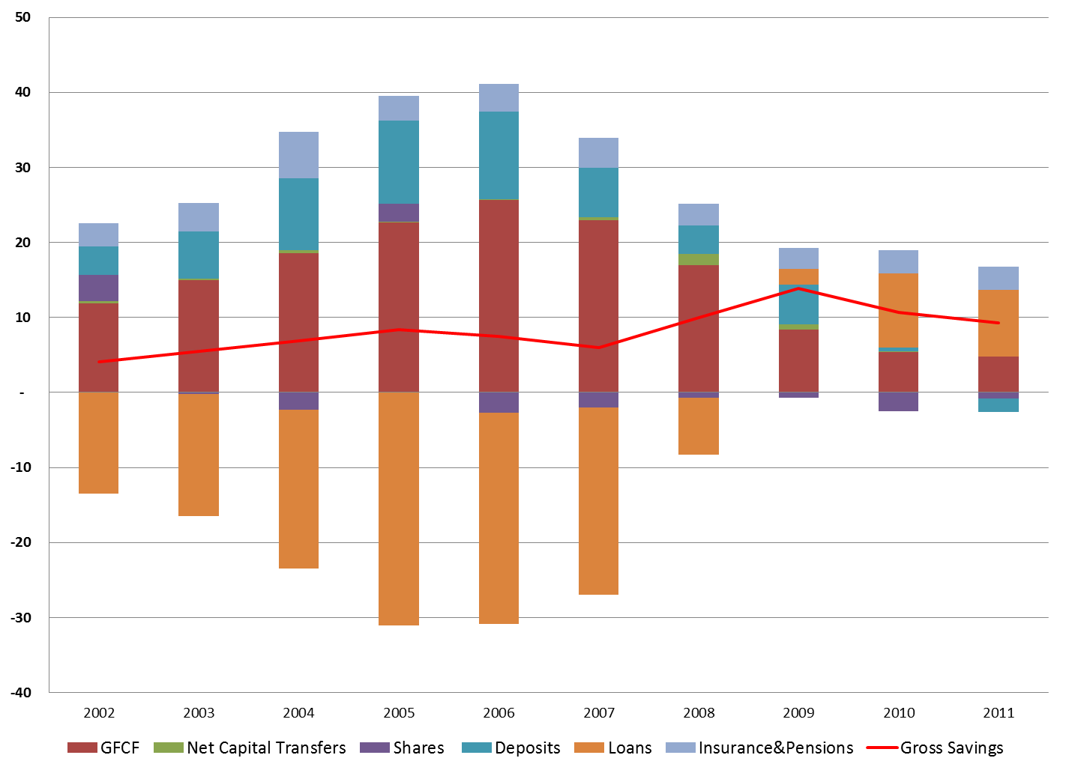
Household Investments & Savings
€ Billion
Notes:
Flows rather than stocks.
Gross Savings (the difference between income and consumption expenditure) peaked in 2009 at €14bn but by 2011 had fallen back to €9bn (a fall of 36%). Consumption Expenditure is often misunderstood - this does not include paying off loans or mortgages.
So, this chart illustrates where households place their savings (and where they invest)
key messages:
Loans to households peaked in 2005 (31bn) and thereafter began to decline. From 2009 we can see households (at an aggregate level) stopped borrowing and start paying off loans on a net basis (paid off 10bn in 2010 and 9bn in 2011).
Most of the borrowing was to fund GFCF (or property). GFCF since 2009 is not being funded by loans but from savings.
Flow into deposits (what many might typically associate with savings) has been falling 2006.
In 2011 stock of deposits fell for the first time - deposits were eroded by €2bn.
Stock of deposits in 2007 was €116bn, peaked in 2010 at €126bn then fell back to €124bn in 2011.

Slide 18
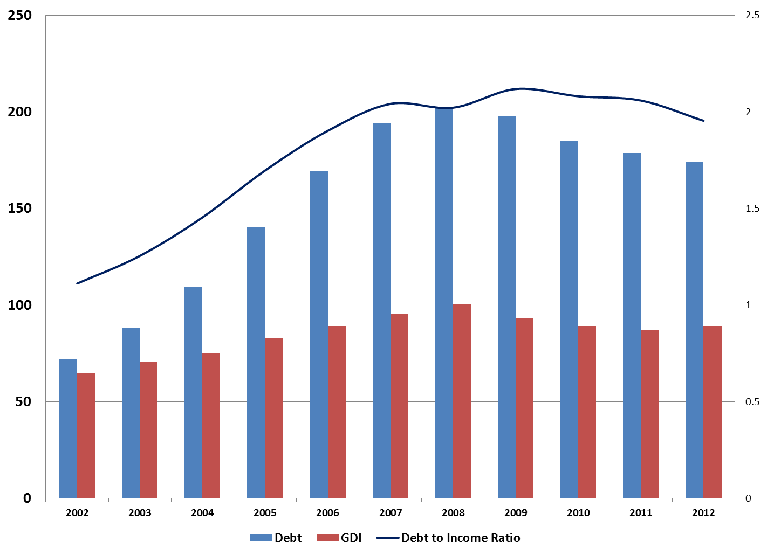
Household indebtedness
€ Billion
Notes:
Household indebtedness increased steadily between 2002 and 2008, from €72bn to €203bn (an increase of 182%) and then began to decline to €173bn in 2012 (a fall of 14% from 2008 peak).
Irish households remain highly indebted. Households are deleveraging but income is also falling, so ratio of debt to Income is staying fairly flat at around 2 (1.95) i.e. current debt is over twice gross income. Typically mortgages account for the largest share of household debt.
Households will need to experience increases in income before debt/income ratio will improve. High ratio is often interpreted by markets as a sign of financial vulnerability and may result in higher financing costs or difficulties accessing additional finance.
Some 2011 comparisons:
Euro Zone 0.99
Germany 0.86
Spain 1.25
Italy 0.65
Portugal 1.26
UK 1.39
But there countries with higher ratios: Denmark (2.68) and Netherlands (2.50)

Slide 19
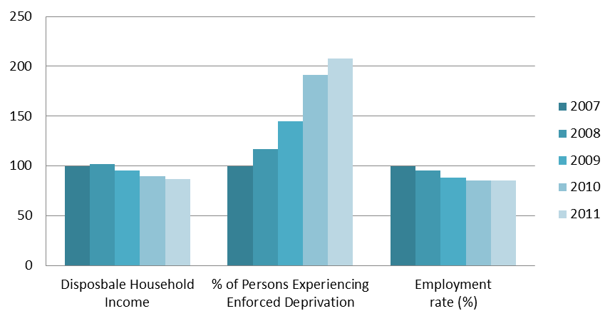
Impact on Well-being
(Base: Year 2007 = 100)
Notes:
No internationally agreed definition of what constitutes wellbeing as yet, but within the international literature, a growing consensus appears to be emerging that: Income; Deprivation & employment are key components of wellbeing. These components are presented here.
Between 2007 – 2011:
Disposable income fell by 13%
Enforced deprivation more than doubled to increase by 108%
Employment rate fell by 13% (but holding steady since 2010)
There are some important points to note here –
Income inequality holding more or less constant. Top 20% of earners had a disposable income roughly 5 times higher than those of the bottom 20%.
Traditionally deprivation was seen amongst the lowest income earners (bottom 20%) but in 2010 the figures showed that deprivation is now being experienced not just low income earners but also middle income earners.

Slide 20
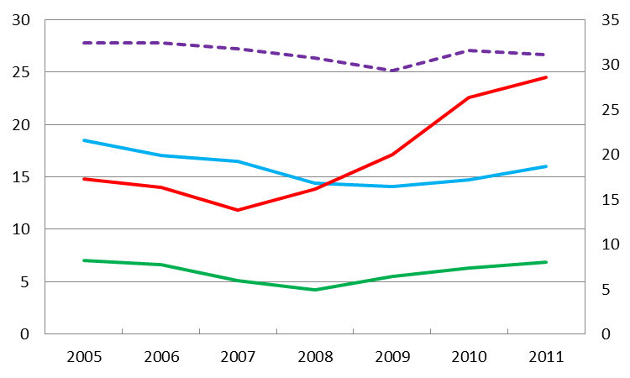
Poverty, Deprivation & income inequality rates
%
%
Gini coefficient
At Risk of Poverty
Deprivation
Consistent Poverty
Notes:
At Risk of Poverty Rate is measured as 60% of median income. AROP threshold back to 2006 levels (more or less), although 2011 rate (16%) is only back to 2007 levels (16.5%).
Deprivation rate (i.e. those experiencing two or more types of enforced deprivation) has more than doubled since 2007 – from 11.8% to 24.5%. Enforced deprivation not just affecting income poor or those AROP but now evident in middle income households.
Consistent poverty (those ARoP and Deprived) rising since 2007. Back to 2007 levels.
Declines before recession now being reversed. Gini coefficient which is a measure of income inequality is holding more or less flat, suggesting that income inequality has not deteriorated since recession.

Slide 21
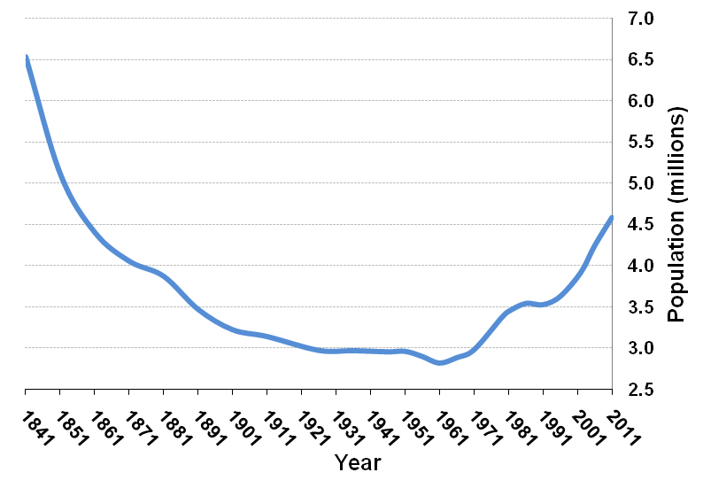
Overall Population Change
Notes:
Population - 4.58 million
Highest since 1851
Increase 341,000 (8.1%) since 2006
Why is this important? Some examples…
Planning for the future – education, health and other local services
Driving economy, consumer demand
Future supply of labour
Changing dependency rates – welfare and pension provision
Balanced regional development

Slide 22
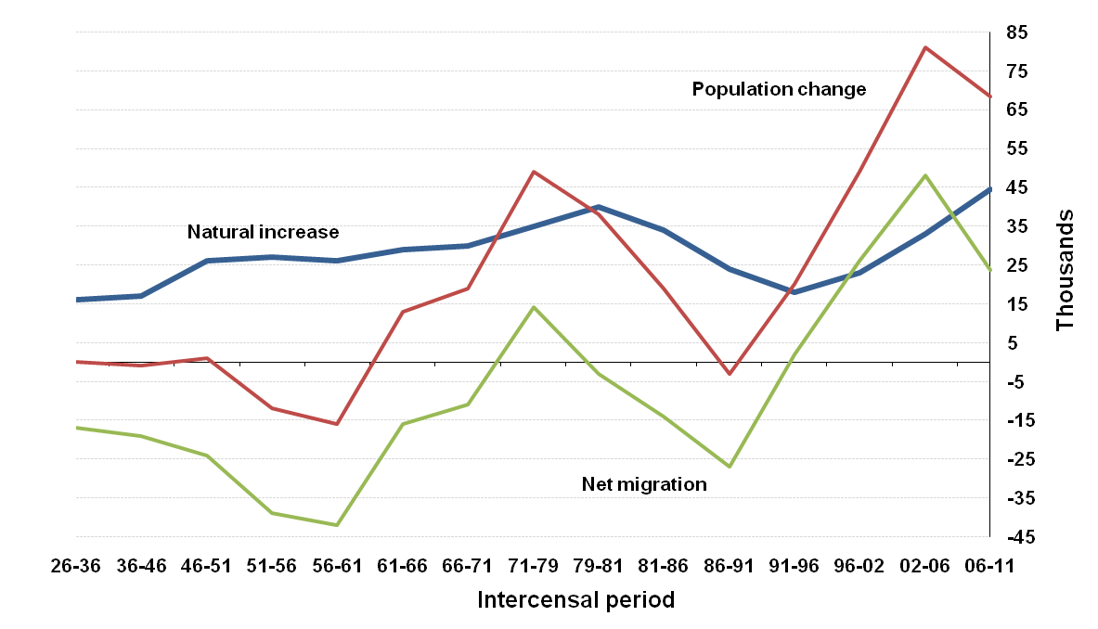
Components of Population Change
Notes:
Population change driven primarily by net migration. Between 2006 – 2011 long term gross flows of people was approx 600,000 persons (i.e. Immigrant or emigrant). Short term flows were even larger. Given a population of 4.6 million, these are very significant movements.
This highlights the importance of a CoP in an Irish context. Migration is very difficult if not impossible to measure accurately. So the census provides an accurate benchmark every 5 years. This is important, not only for understanding changes in Ireland’s demography and labour market but also for estimating per capita estimates (e.g. Per capita GDP) which are the basis on which net contributions or receipts of EU structural and cohesion funds are based.
Labour Supply
Without migration labour supply would be declining y-o-y, this is down to demographics, births peaked in 1980 and fell in every successive year until 1994 – those born in 1994 are now 17, but typical labour market entry is pushing out to 19 – 21 years old. That’s why are growth in labour supply during the boom was supplied by foreign nationals.
In the past 4/5 years we’ve experienced a significant increase in the number of births, exceeding the peak of the 1980s ~ 72,000 (>74,000 in 2011). Obvious implications in the short term for provision of health and education services. Deaths stable at 27,000. - so people living longer with implications for health, welfare and pension provision (note increase in suicides in recent years).

Slide 23
Births: 1970 - 2010
Notes:
Slide shows percentage of births by age of mother, grouped into two age cohorts - 20-24 and 35-39
Delay or postponement of child bearing in recent years is evident. In 2011, 3 out of 4 births were to women in their 30’s. Almost double the rate 20 years previously.

Slide 24
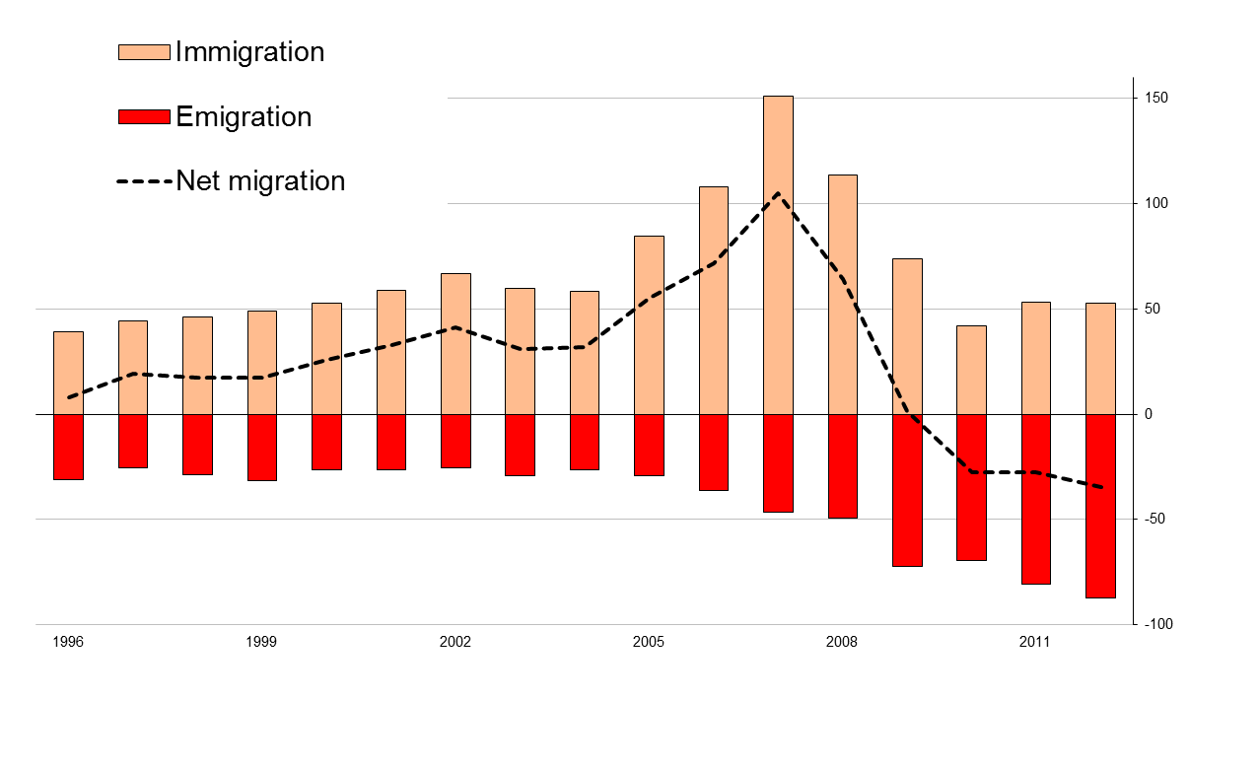
Migration: 1996 - 2012
000’s
Notes:
Ireland had net positive migration until 2009. This peaked in 2007 at 105, 000.
In 2012, 87,000 people emigrated from Ireland, 53,000 people immigrated to Ireland, resulting in net negative migration of -34,000.
41% of emigrants were aged 15 – 24. 45% were aged 25 – 44.
22% emigrated to the UK. 41% emigrated outside EU-27 & USA.
Over half of the 87,000 emigrants were Irish. They were almost 50/50 male/female.
49% of the immigrants were aged 25 – 44.
47% immigrated from outside EU-27. In 2006, only 25% immigrated from outside EU-27.
39% of immigrants in 2012 were Irish.

Slide 25
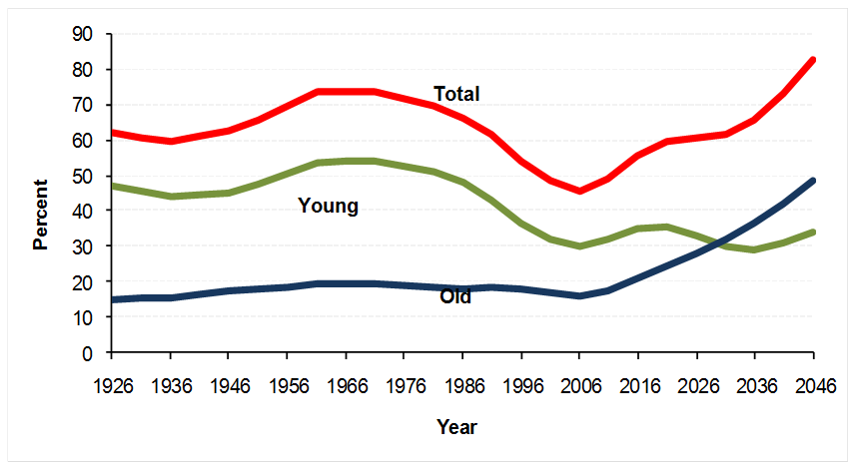
Actual and Projected dependency ratios
Projections based on M3F1 assumptions
Notes:
Revised Population projections published in April 2013. 6 different scenarios are presented (M3F1 – negative net migration, high fertility of 2.1)
Dependency ratio = dependents / productive population
Youth Dependency Ratio - Young (0 – 18) expressed as % of productive population (19 – 64)
Old (65 +) expressed as % of productive population.
This scenario shows the impact of demographic changes on dependency ratio over next 25 years. If this scenario is correct, then we can expect an increase from around 60% (now) to in excess of 80% in 2035. Again this has obvious implications for planning of services and funding (welfare and pensions).
Although the dependency ratio is lower than that experienced in the 1960s and 1970s, the composition is very different. In the 1960s and 1970s the high dependency ratio was driven by a relatively large young population. In contrast, the growing dependency ratio now is being driven by a relatively large older population, which is likely to be more expensive. Projections also suggest population growth will have more immediate impact for education system, but a longer term and greater impact for pension, and health care services.

Slide 26

Take a closer look
www.cso.ie

