Slide 1
This is Ireland
Part 2
Highlights from Census 2011
4th July 2012

Slide 2
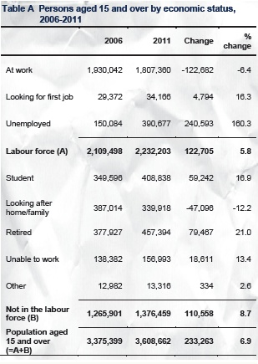
Economic Status
Over 14s increased by 6.9%
Labour force up 5.8%
1.1% per annum since 2006
Outside labour force up 8.7%
Students rose by 16.9%
Retired up 21%
Looking after home down 12.2%

Slide 3
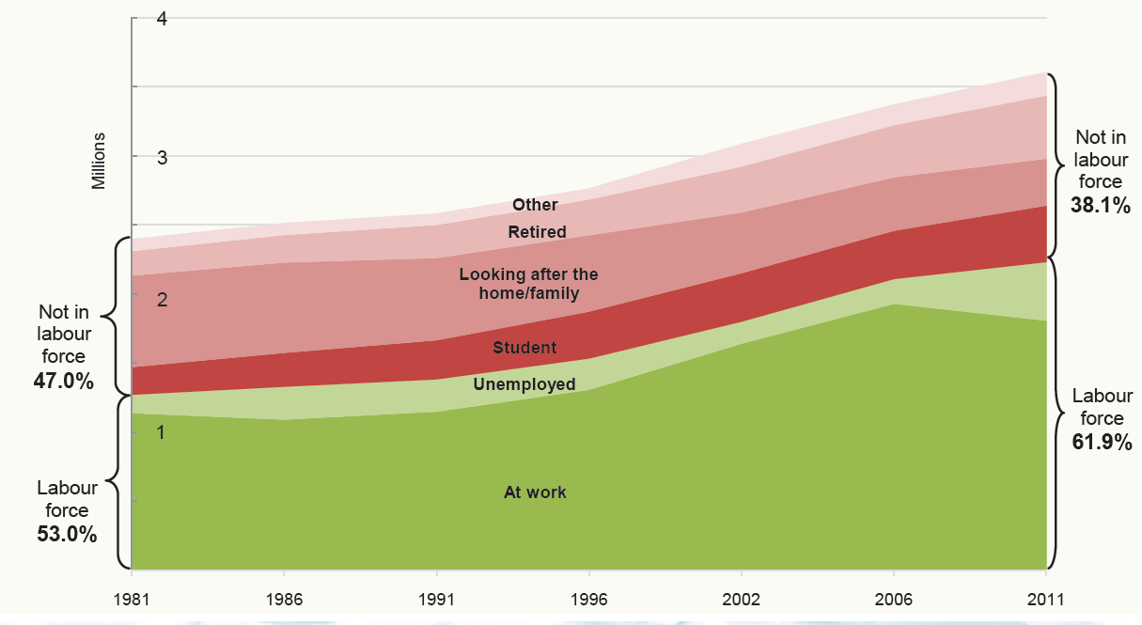
Economic status of persons over 14, 1981 - 2011

Slide 4
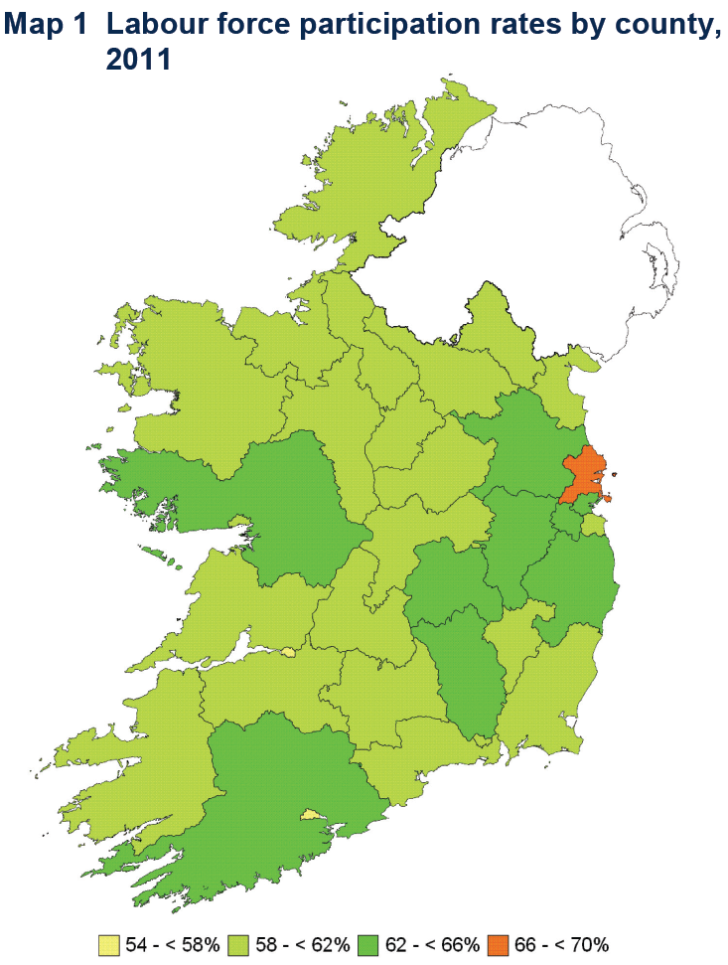

Slide 5
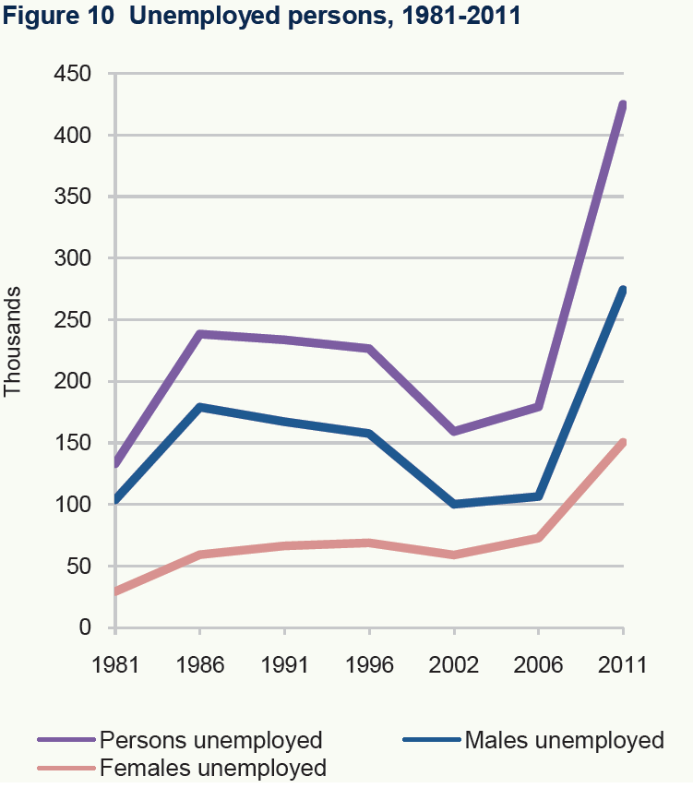
Unemployment
424,843 (19%)
274,327 (22%)
150,516 (15%)

Slide 6
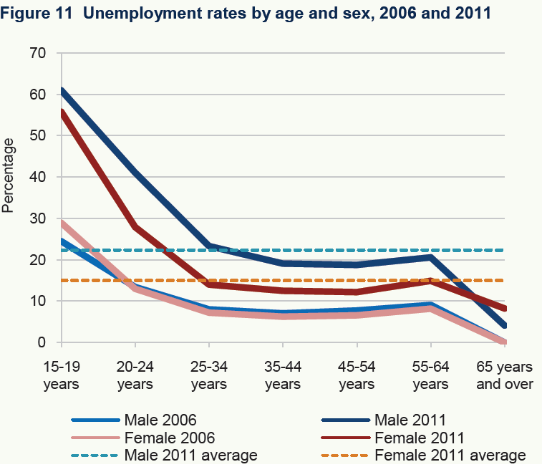

Slide 7
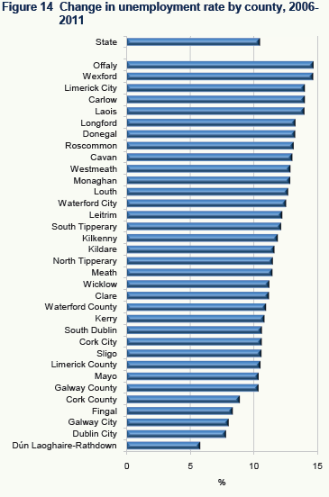
Unemployment by County
Limerick City 28.6%
Dún Laoghaire-Rathdown 11.2%
Changes since 2006
  Offaly 8.5% - 23.2%
  Wexford 9.3% - 24%
  DLR 5.4% - 11.2%

Slide 8
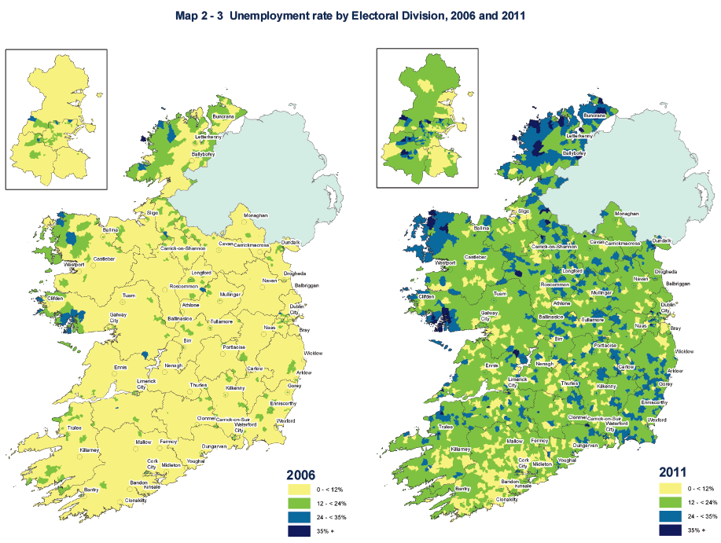

Slide 9
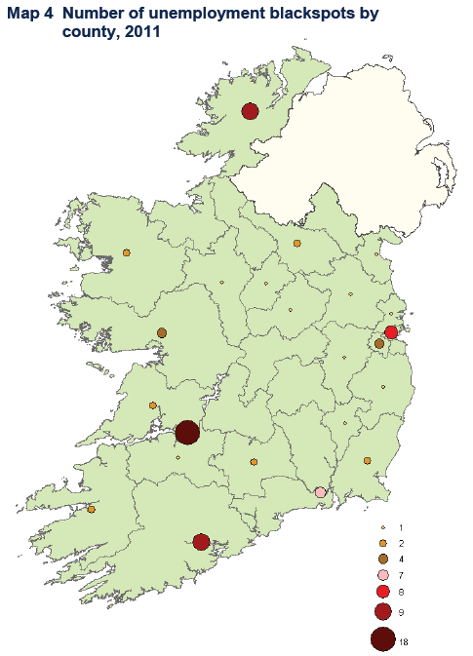
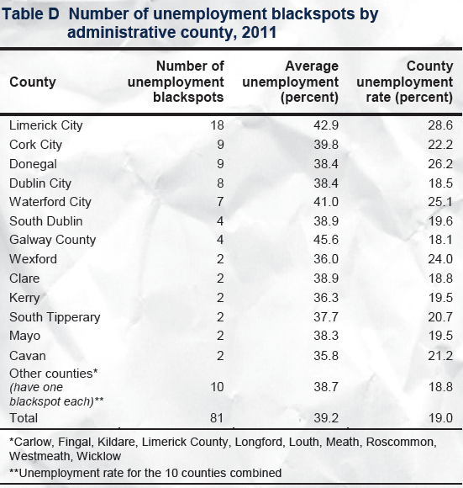
Unemployment Blackspots

Slide 10
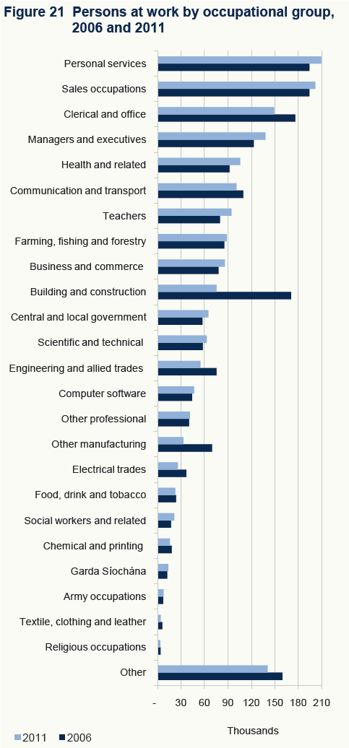

Slide 11
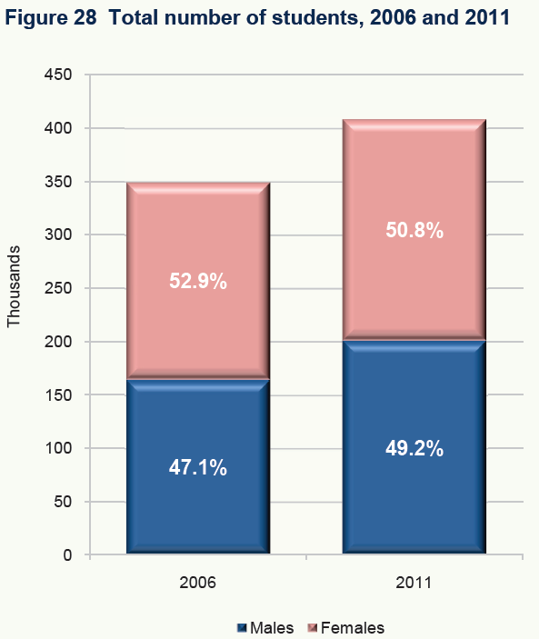
Education
Large increase in student numbers
Males gaining share
62% of increase males
59,242

Slide 12
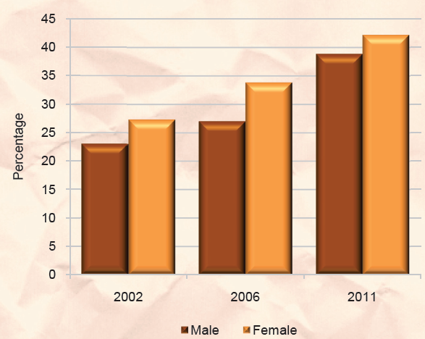
Education
Education participation rates 2002 – 2011
  19-24 year olds

Slide 13
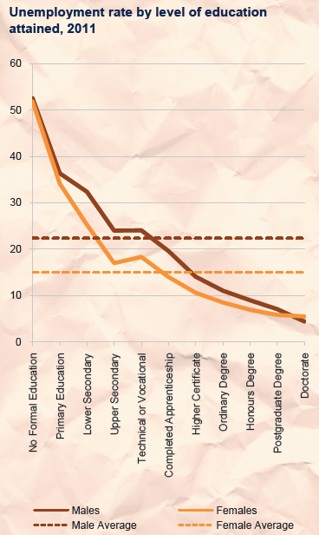
Level of Education
Education and
unemployment
Technical /Vocational tipping point
Honours degree 7.3%

Slide 14
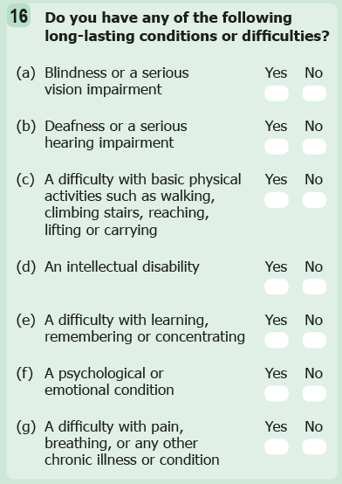
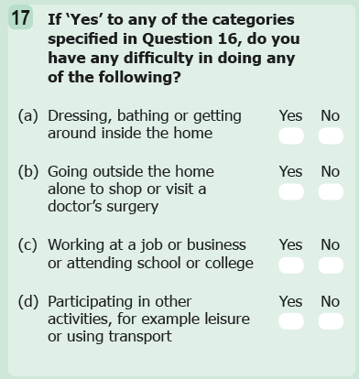
Disabilities

Slide 15
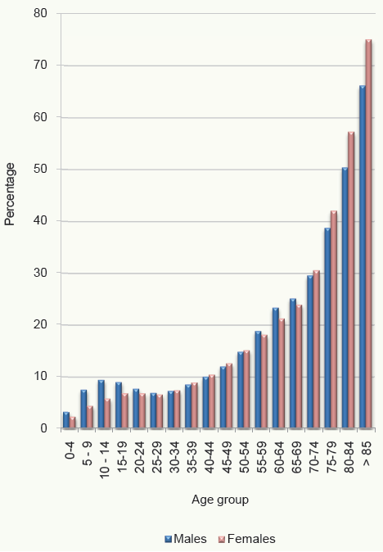
Disabilities
595,335 people had at least one disability in 2011
Up from 393,785 in 2006
  Questionnaire effect?
Increased with age
More men than women
for young and middle-aged
More women than men
among elderly

Slide 16
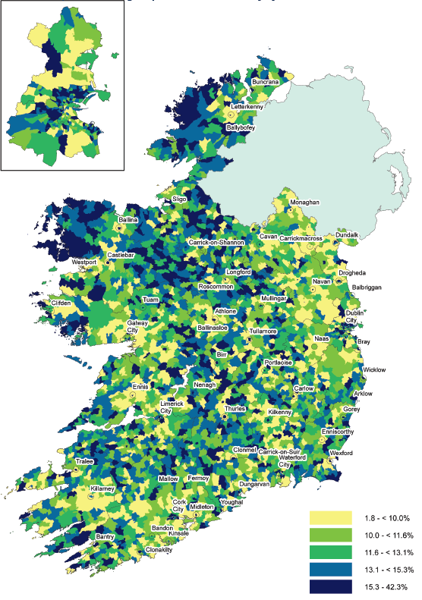
Disabilities
Eastern seaboard lower rates
Higher rates in the west
Influence of age

Slide 17
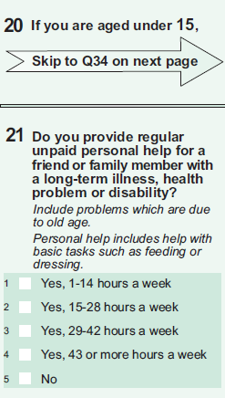
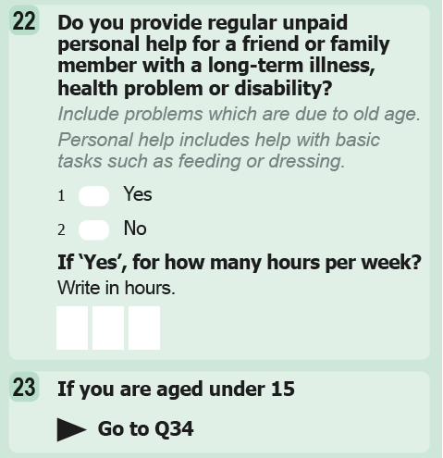
Carers
Change to question since 2006
2006 2011

Slide 18
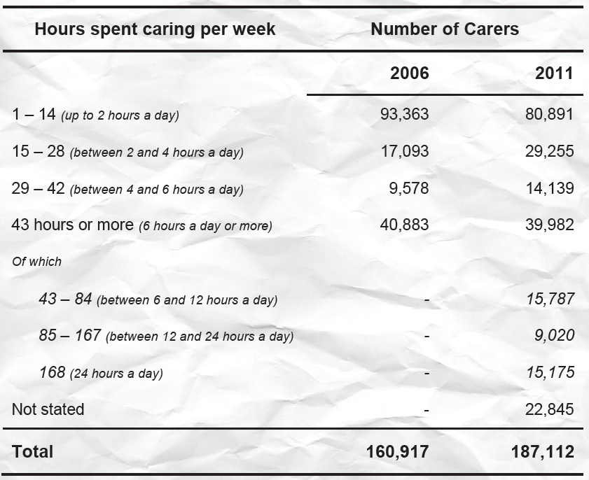
Carers

Slide 19
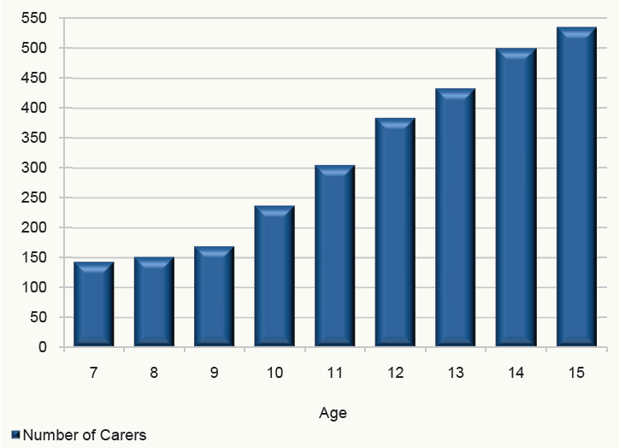
Young carers

Slide 20
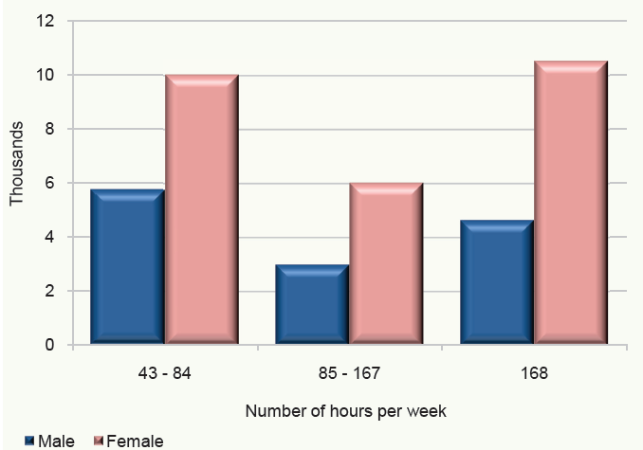
Carers

Slide 21


SAPS–Tuesday 31st July 2012
Small Area Population Statistics
90% between 55-130 households
Within ED boundaries
15 Thematic areas

Slide 22
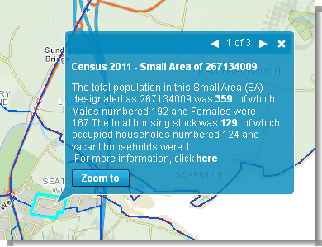

SAPS – Where to find them
SAPS on WWW.CSO.IE/Census
  Address search/map drill to find your location
  Choose geography, Click on area to get basic counts
  Drill down to get full report for that area
  Download to excel or PDF
  Full download of SAPS
SAPS on AIRO website
  Map a particular SAPs variable derived variable thematically
  Census mapping module
  Data visualisation/graphing module

Slide 23
Further details....
Full publication & analysis www.cso.ie/census
8 further publications in 2012
Next up....
Profile 3 – At work – Employment, occupations and industry in Ireland – Thursday 26 July
Publication schedule in publication page 163 and on www.cso.ie

Slide 24

Questions

