Slide 1
Measuring global value chains
The data gaps and how to fill them
Dr. Timothy J. Sturgeon, Industrial Performance Center, MIT
18 April 2013
Eurostat Seminar:
Global value chains and economic globalization: The Eurostat initiative
Trinity College, Dublin Ireland

Slide 2

Global Value Chains and Economic Globalization
Towards a New Measurement Framework
Report to Eurostat by Dr. Timothy J. Sturgeon,
Industrial Performance Center, Massachusetts Institute of Technology

Slide 3
This report and today’s presentation reflects solely the views of the author and are not meant to represent the views of Eurostat or the Massachusetts Institute of Technology.

Slide 4
Today’s presentation
From internationalization to economic globalization
Enablers of economic globalization
Global Value Chains – a conceptual map to assess needed data resources
The challenges of economic globalization for statistical measurement
Assessing the data gaps in Europe
Filling the data gaps
Taking micro-data mainstream
International integrated data platform (IIDP)
Europe’s “natural” leadership in internationally integrated statistics
The priorities

Slide 5
From Internationalization to Economic Globalization

Slide 6
Internationalization
Largely driven by two mechanisms:
  1) the spatial expansion of markets through arms-length trade, and
  2) an expansion of the internal structures of multinational enterprises (MNEs), mainly through:
    foreign direct investment (FDI) and
    the intra-firm trade that results between parents and foreign affiliates.

Slide 7
Economic Globalization
An additional mechanism:
  Global sourcing
    Sourcing to non-affiliated offshore business partners
    “Non equity ties”
    Sourcing with explicit coordination
    An “unmeasured” 3rd form of international trade
      Cannot be differentiated from arms-length and affiliated trade in current statistics
    Lowers barriers for global integration

Slide 8
Globalization Enablers (I)
Value Chain “Modularity”
  Computerization
    Design
    Production
    Distributed business processes
  Standardization
    Design software
    Production equipment
    Enterprise software
    Logistics and RFID
    The Internet

Slide 9
Globalization Enablers (II)
Outsourcing in the 1990s
  The great unbundling
  Focus on core competence
  Ideas from business school “gurus”
  Shed fixed costs, keep variable costs
  Pressure from financial markets
The new global supply base
  Fewer, larger suppliers in more locations

Slide 10
Global suppliers and the new global supply-base:
Flextronics International example, global electronics contract mfgr:
- 88 facilities, seven huge industrial parks with full package capabilities
Gdansk, Poland, 229,273 square feet
Sárvár-Zalaegerszeg and Nyíregyháza, Hungary, 542,410 square feet each
Doumen, China
1,299,347 square feet
Guadalajara, Mexico
698,438 square feet
Sorocaba, Brazil
381,574 square feet

Slide 11
Globalization Enablers (III)
Capabilities increasing in low cost geographies
  Enterprise capabilities
  Trade infrastructure
  Finance
  Government capabilities (the return of industrial policy)
INCLUDING SERVICES! (another doubling?)

Slide 12
Why are better statistics on economic globalization needed?
To develop a full set of enterprise characteristics, including the enterprise’s global engagement.
To gauge how pervasive global engagement is and what the trends are.
To better understand the impact of global engagement on the quantity and quality of employment
To better understand the impact of global engagement on innovation

Slide 13
Global Value Chains – a conceptual map to assess needed data resources

Slide 14
A simple value chain
Inputs
Production
Marketing, Sales, Distribution, and After-sales Service
Research, Design and Product Development
Recycling
The Supply Chain
End Use
Disposal
…the value cycle?

Slide 15
International flows in four sourcing options
FDI
Sourcing
mix?

Slide 16
A simple value chain with four sourcing options
Inputs
Production
Marketing, Sales, Distribution, and After-sales Service
Research, Design and Product Development
Four sourcing options
Domestic
intra-group sources
International intra-group affiliates
Domestic external suppliers
International
external suppliers
Four sourcing options
Domestic
intra-group sources
International intra-group affiliates
Domestic external suppliers
International
external suppliers
Four sourcing options
Domestic
intra-group sources
International intra-group affiliates
Domestic external suppliers
International
external suppliers
Four sourcing options
Domestic
intra-group sources
International intra-group affiliates
Domestic external suppliers
International
external suppliers
…international sourcing

Slide 17
International flows in four sourcing options
Home (compiling) country GVC partner country
Four sourcing options
Domestic intra-group
International intra-group affiliates
Domestic external suppliers
International external suppliers
Four sourcing options
Domestic intra-group
International intra-group affiliates
Domestic external suppliers
International external suppliers
Four sourcing options
Domestic intra-group
International intra-group affiliates
Domestic external suppliers
International external suppliers
Four sourcing options
Domestic intra-group
International intra-group affiliates
Domestic external suppliers
International external suppliers
Four sourcing options
Domestic intra-group
International intra-group affiliates
Domestic external suppliers
International external suppliers
Four sourcing options
Domestic intra-group
International intra-group affiliates
Domestic external suppliers
International external suppliers
Four sourcing options
Domestic intra-group
International intra-group affiliates
Domestic external suppliers
International external suppliers
…economic globalization involves a complex web of flows and business linkages

Slide 18
Assessing the Data Gaps in Europe

Slide 19
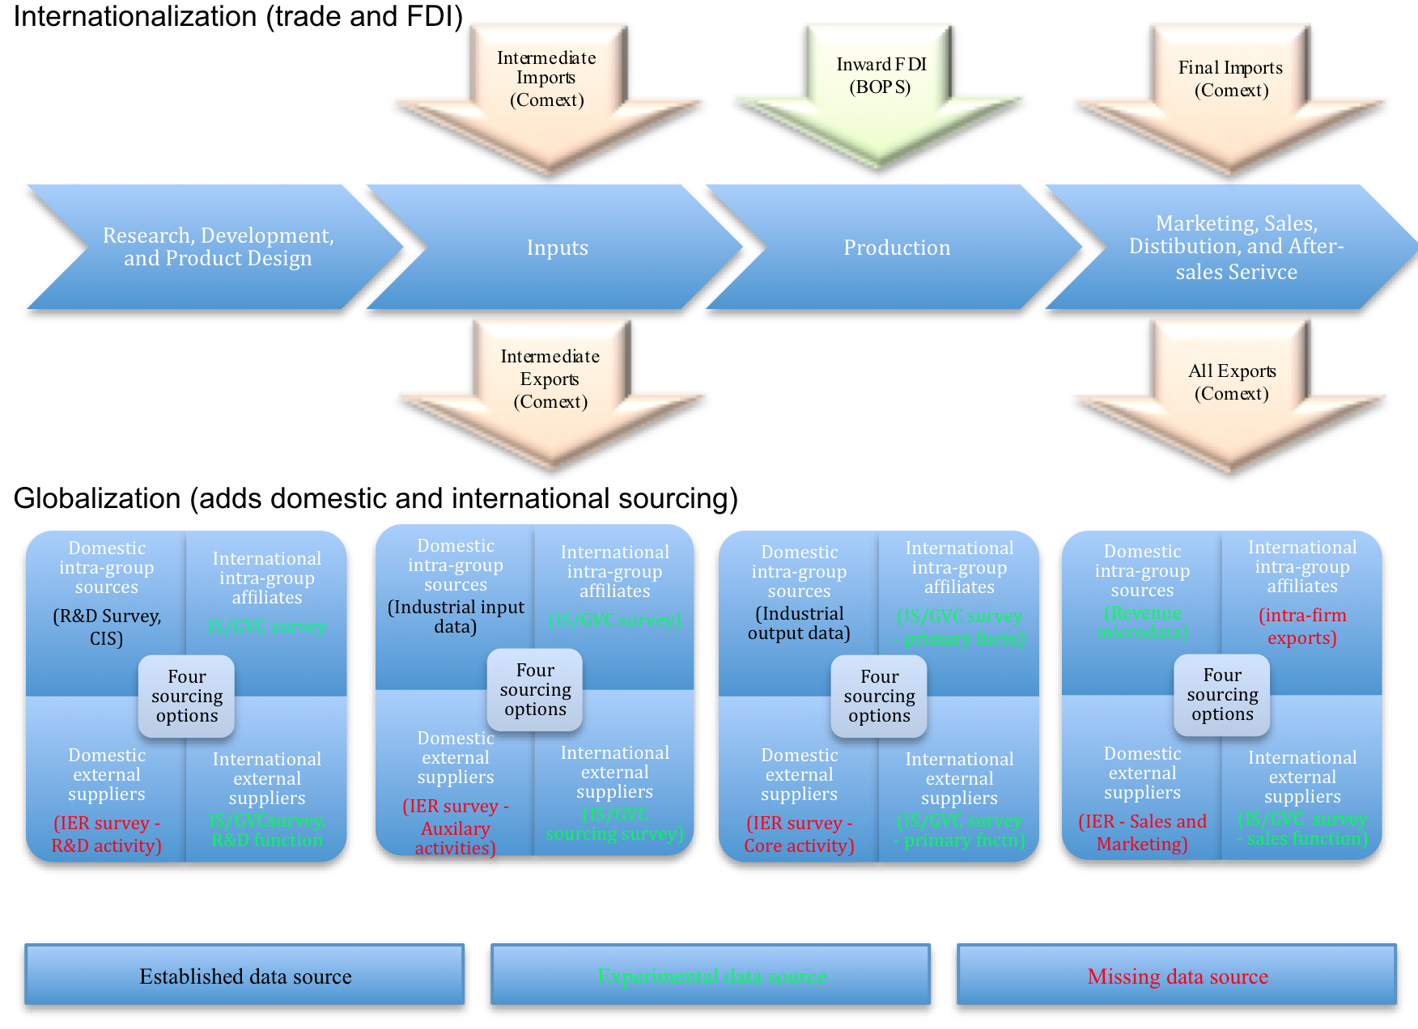
Mapping Europe’s data resources

Slide 20
Information required for measuring the GVC engagement of enterprises (inward and outward flows)

Slide 21
Existing data sources and missing variables

Slide 22
What we don’t know about international trade
Some data we would like to see (these are made up!)

Slide 23
Why data on affiliated trade is important (Europe example)
Concentration of exporters in total manufacturing exports (percent), selected European countries, 2003
Source: Mayer and Ottaviano, 2007, p. 8.
Note: France, Germany, Hungary, Italy and the UK provide figures on large firms only; Belgian and Norwegian data is exhaustive. Numbers in brackets for France are percentages from an exhaustive sample

Slide 24
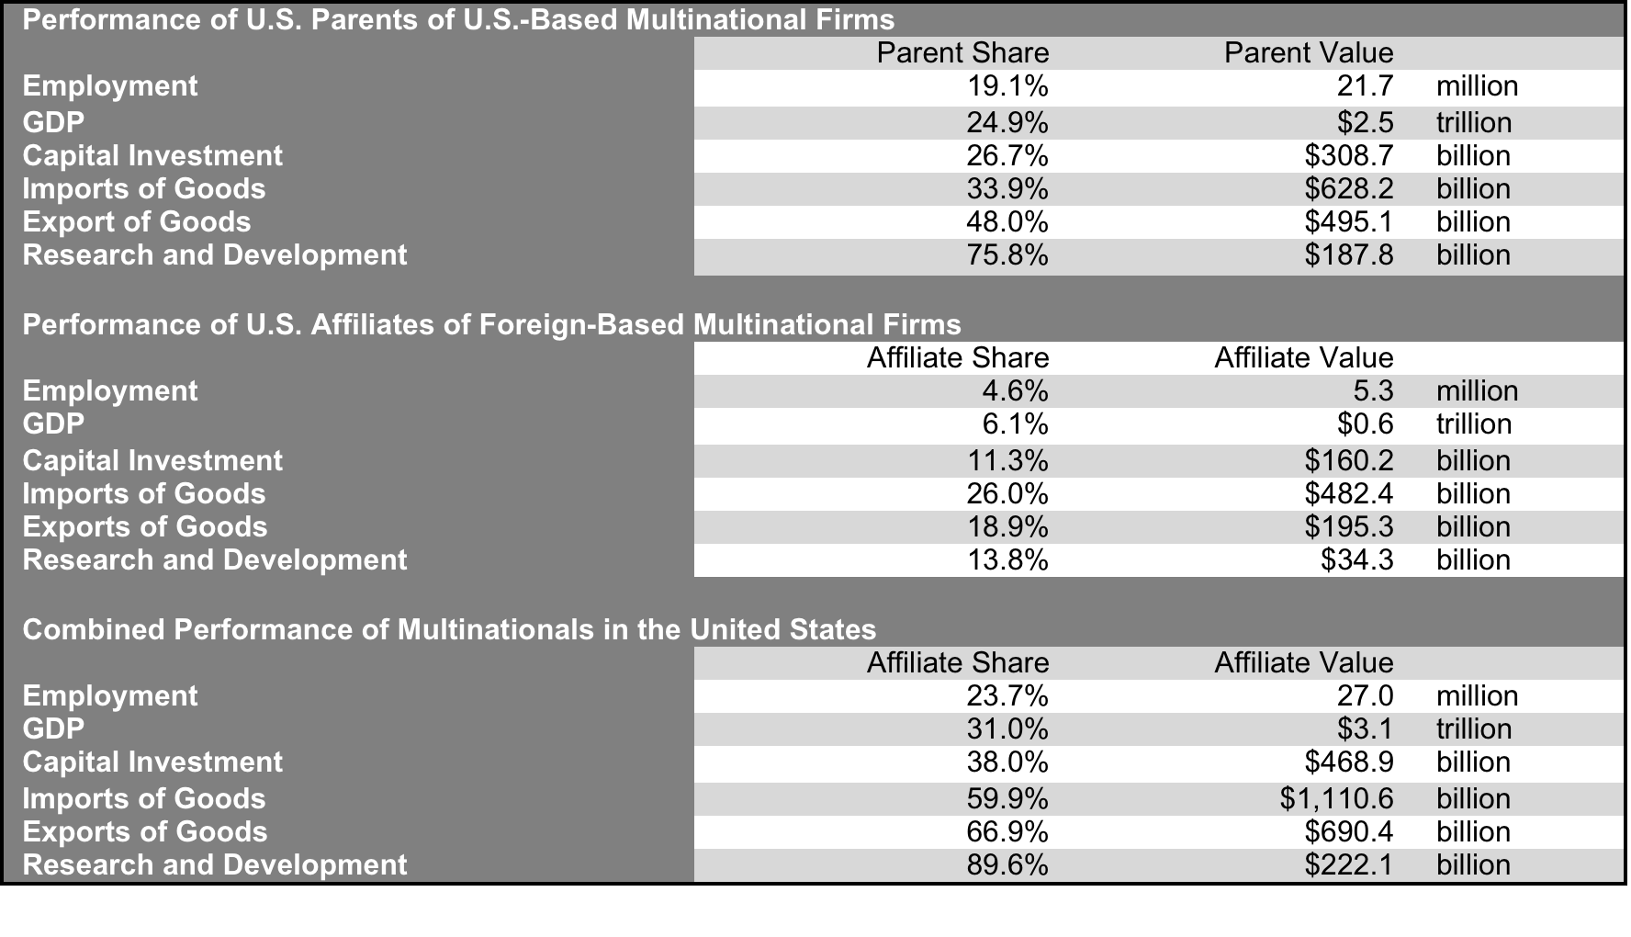
Why data on affiliated trade is important (U.S. Example)
Contributions of MNEs the US Economy, 2006
Source: Slaughter, 2009, p. 9.

Slide 25
Progress on Filling the Data Gaps
The Eurostat International Sourcing Survey (GVC/IS)
  International sourcing by business function
Trade by Enterprise Characteristics (TEC)
    Importers, Exporters, Two-way traders, Enterprises with foreign affiliates, Foreign affiliates
European Statistical System Network (ESSnet) on Profiling
  Identification of “most important” enterprises at the EU level
Nature of Transactions (NoT)
  e.g., contract assembly and goods for processing

Slide 26
The Challenges of Economic Globalization for Statistical Measurement
Barriers to international and inter-agency data sharing
  legislation related to confidentiality
  institutional inertia and inter-agency competition
  lack of leadership, funding, political will
If data and data infrastructure can be more easily linked across countries and regions, more can be done with existing data
Information on intra-group trade is missing
  Ownership matters: when and where further investments are made, where technological capabilities and intellectual property truly lie, where profits are taken: “trade in income”???
External international sourcing
  cannot be differentiated from arms-length or affiliated trade in current statistics
  represents a largely unmeasured third form of trade
Data on traded services is weak
  large-scale trade in services is relatively new
  services trade is difficult to account for
The vastly expanded trading system has brought in countries with poorly developed statistical resources
  Systematic effort is needed to help these countries improve their statistical systems.
Europe, by necessity, is better at sharing data than other places, and
Europe has Eurostat…
A European system of business registers (ESBRs) is under development…
Eurostat is developing the EuroGroup Register (EGR)…
Eurostat is fielding GVC/International Sourcing surveys (2007, 2012)…
Eurostat publishes far more product detail in traded services than others…
More could be done…NOT simply altruistic!

Slide 27
But, only filling gaps will not provide full answers to questions such as these:
How pervasive is global engagement is and what are the trends?
What impact does global engagement on the quantity and quality of employment?
What Impact does global engagement have on innovation?
To get policy-relevant answers…

Slide 28
…enterprise level data on economic globalization…
Data on economic globalization
  Is the enterprise domestic or foreign-owned?
  Is the enterprise part of an MNE or non-equity business network?
  What products and services does the enterprise make itself or and what does it source domestically or internationally?
  What is the volume and character of intra-firm trade?
  What is the volume and character of global sourcing?

Slide 29
These enterprise-level data are generally confidential and reside in administrative systems: micro-data!
…need to be linked to a full set of enterprise characteristics
Firms births and deaths (business demographics)
Employment (hiring and firing)
Turnover
Wages paid
Occupational employment
  Skills
  Education and training requirements
Performance
  Growth
  Profits
  Market share (Not in any public dataset!)
R&D and Innovation
  R&D spending and employment
  % of revenues from new products
  Patents

Slide 30
Taking Micro-data Mainstream

Slide 31
Confronting the challenges of micro-data use
Disappearing data
Incompatible data
Time series data are difficult to construct
Confidentiality blocks usage across agencies and borders

Slide 32
Steps needed to improve micro-data resources
  Initiate programs to archive and maintain key micro-data resources
Consistent use of statistical units (most typically, the enterprise).
A system to identify and link enterprises across the different datasets.
  unique identification numbering system
Coordinate sampling across surveys to ensure that a representative sample of enterprises is included in all samples.
  specific enterprises are sometimes excluded from multiple or successive surveys
Upgrade systems of administration for statistical purposes
  Unified tax and statistics legislation
  Software provided by member states with design input from Eurostat
Do not ignore the need to include information on fully domestic enterprises in micro-datasets.

Slide 33
Institutional Structure for Filling Data Gaps and Improving Micro-data Resources in Europe
ESSnet on Globalization Statistics
  International sourcing surveys
  Trade by enterprise characteristics
ESSnet on Consistency Project
  Consistency in target populations, sample frames, reference periods, classifications and their applications, as well as characteristics and their definitions
European System of Business Registers (ESBRs)
  within framework of the European Statistical System Vision Implementing Programme (ESS.VIP)
ESSnet on Micro Data Linking and Data Warehousing in Statistical Production
Framework Regulation Integrating Business Statistics (FRIBS)
Modernization of European Enterprise and Trade Statistics (MEETS)

Slide 34
Needed?
An International Integrated Data Platform (IIDP)
Solutions are incremental and only partial
Respondent burden could be ratcheted upwards
European harmonization is not the same as global harmonization
A vision for an integrated solution is needed that:
fully leverages existing resources,
uses an internationally harmonized data structure,
brings in new data sources and analytic tools, and
flexibly produces up-to-date, disclosable statistics and indicators that can be tailored to the needs of policy makers and researchers on an as-needed basis

Slide 35
International Integrated Data Platform (IIDP); Key Elements
A full and accurate sample frame
Links to full and consistently defined administrative data
Links to improved statistics on international trade and FDI
Links to improved business surveys that collect data on domestic and international sourcing by business function
Links to business demographics covering enterprise dynamics (births and deaths)
Unique enterprise identifiers or crosswalks to tie all of the data sources together
Data normalization: e.g., cleaning, consistency, etc.
A “virtual” International Statistical Data Warehouse (IS-DWH) to link data: this will be a “virtual” IIDP
Structural meta-data to enable the application of analytic tools that can output descriptive metadata (i.e., meta-content) to ensure that only disclosable statistics are provided to users

Slide 36
International Integrated Data Platform (IIDP): Inputs and Outputs
Inputs
  Existing business statistics (improved)
  Existing trade statistics (improved)
  Administrative data (improved)
  Private data (logistics, ERP, etc.)
Outputs
  Published indicators of economic globalization
    Global engagement by enterprise characteristics, industry, and geography
    Ownership; role of affiliates
    Effects on jobs and wages
    Effects on innovation and innovation’s impact
  Predetermined tables
  User-defined tables of disclosable statistics
  Resources for researchers

Slide 37
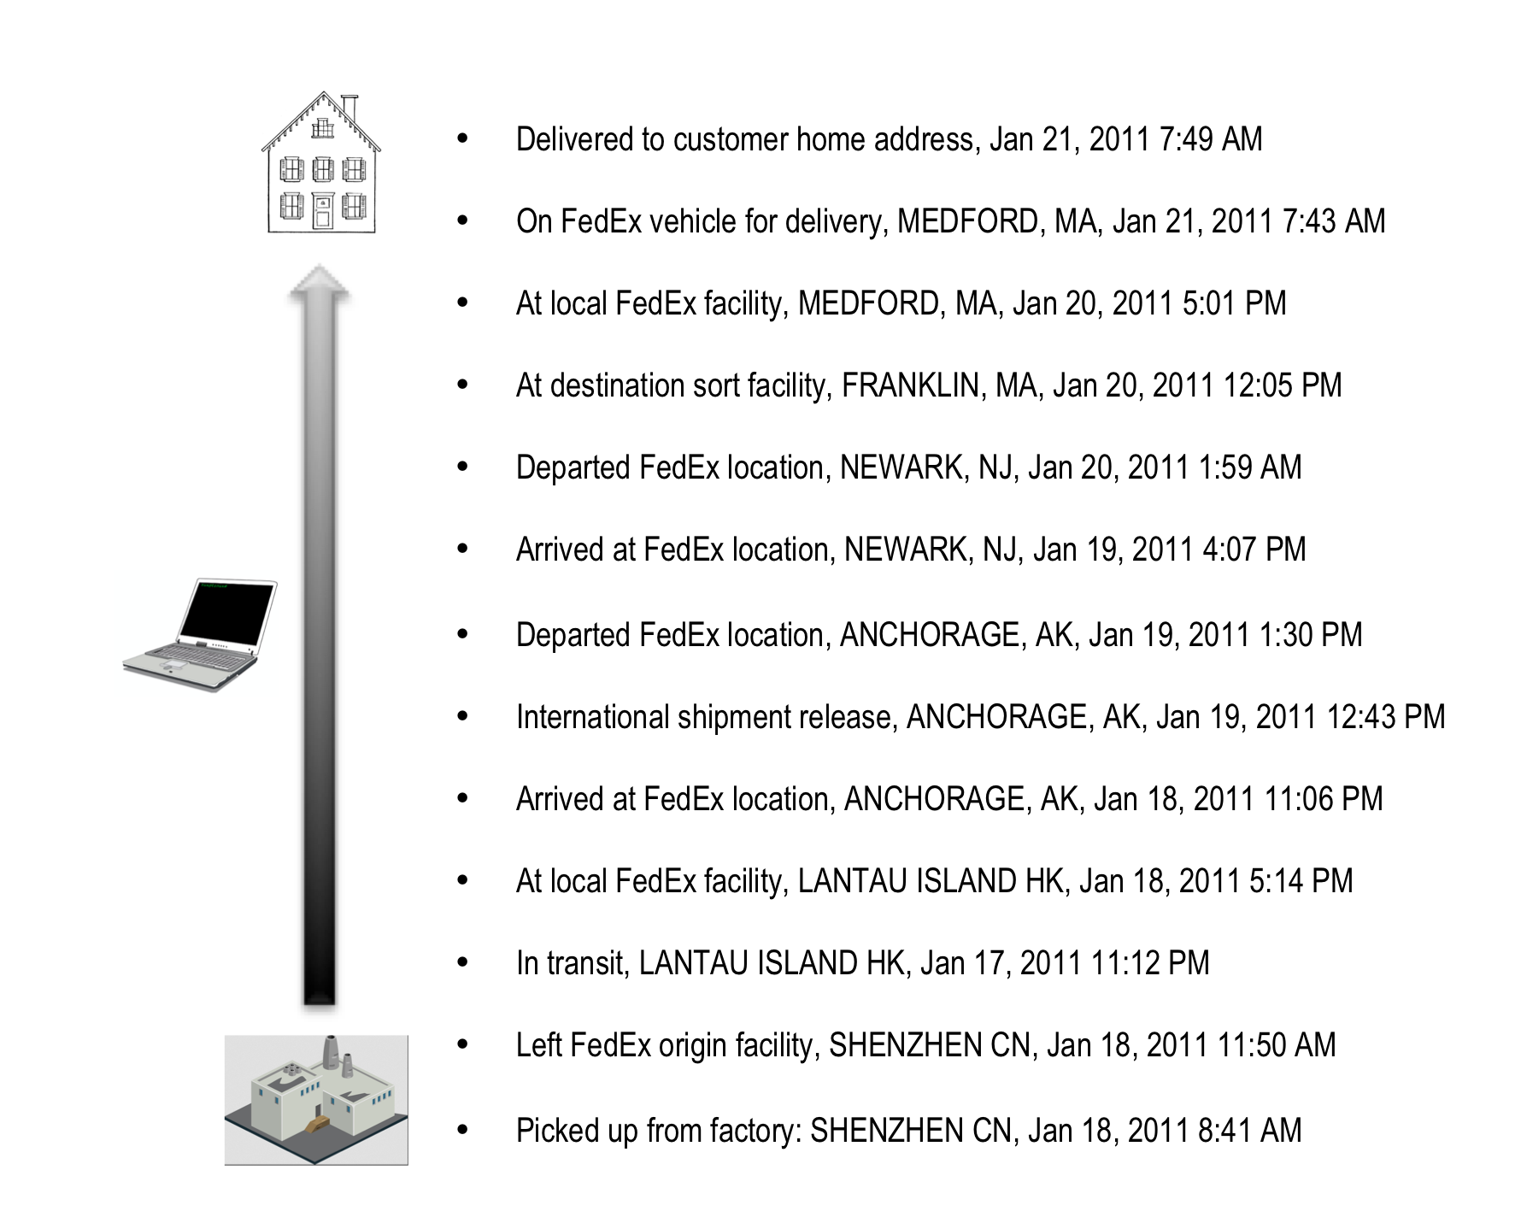
Detail in private enterprise systems, an example
Actual tracking records for a notebook computer making its way from a factory in China to the home of its ultimate customer in Medford, Massachusetts; Shipped by FedEx, January 18-21, 2011

Slide 38
Europe’s “Natural” Leadership in International Statistics
Eurostat, as a regional umbrella organization linking independent National Statistical Institutes, leads the practice of integrating economic statistics across borders
Europe can innovate best practice, and is closer to an IIDP than any other entity – a natural test bed and innovative engine
A European IIDP can demonstrate the feasibility of a Global IIDP
  Successful sharing of confidential data among fully independent National Statistical Institutes
  Usefulness of statistics
  Successful incorporation of private data
As globalization accelerates, there is a growing information gap between the private and public sectors
  Some MNEs have good global data about their own operations, and sometimes the operations of their suppliers, but could benefit from seeing the larger picture
  Some MNEs have a LOT of external data, and could be brought into to the system of economic statistics without compromising their competitive position of privacy of clients and members

Slide 39
The Priorities
Develop the (virtual) IIDP
Establish R&D capacity at Eurostat in the areas of software development and “big data analytics”
Ensure that and new statistical resources related to economic globalization are designed with micro-data linking in mind, including future iterations of existing surveys
Improve the unique enterprise identifier system for Europe for use in a matrix for linking country enterprise IDs
Accelerate efforts to fill in the EuroGroup Register and link it to a fully interoperable European System of Business Registers (ESBRs)
Develop new information about intra-group trade by including a related party flag on all customs forms and international transactions records
Improve and institutionalize international sourcing surveys
Continue to improve information on trade in services; include related-party trade
Explore the feasibility of leveraging data from private companies in the official statistical system
Work with international agencies and NSIs outside of Europe to disseminate the best practice and related surveys to Europe’s trading partners

Slide 40
Thank you!

