Slide 1
GFS Seminar
Classifications
Norita Murphy

Slide 2
Structure of Classifications
Economic Statistics Directorate
Government Accounts Classifications
Register of Public Sector Bodies
Central & local government surveys
Classification reviews

Slide 3
The Institutional Sectors
S.1 – Domestic economy
S.11
Non-financial corporations
Private
S.12
Financial corporations
Private
S.13
General Government
Public
S.14 Households
Private
S.15
NPISH
Private
Market
Public
Public
Non-market
Non-market
Market

Slide 4


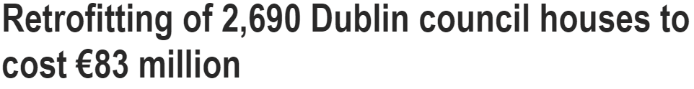

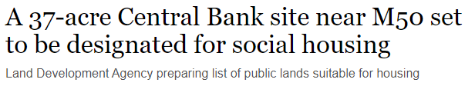
Land Development Agency plans 26,000 new social and affordable homes
State’s stake in AIB Bank dips below 71%
Carillion: Why did it collapse and what happens next?
Irish Water to become single national utility
Eurostat cites low rents for putting housing bodies on State’s books

Slide 5

Significant deliverables
Housing
Health services
Climate Action
Infrastructure
Legislation

Slide 6
Sector classification
Key part of GFS work to ensure adherence to ESA2010 standards
Register of public sector bodies (government and public market producers) updated post each EDP notification (Apr and Oct)
Periodic reviews may take place on CSO’s own initiative, on request from department (including ex ante) or on request from Eurostat
For material/complex cases assessment is on an individual basis
  may be block assessment for small very similar entities
CSO Guidelines for provision of classification advice published

Slide 7
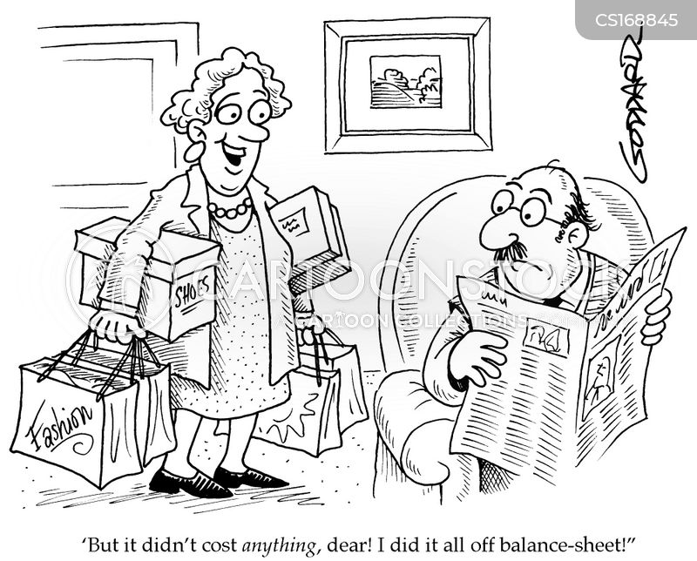
“…on/off balance sheet…”
Term frequently used for classification in GG sector (on) or outside GG sector (off)
Applies to assets/liabilities and transactions as well as organisations
Financial and other transactions or instruments may be classified to GG in statistical terms even if regarded as under private ownership/control in non-statistical terms

Slide 8

Financial crisis…new institutions
NAMA in general government (GG)
  National Asset Management Agency Act Nov 2009
  NAMA Investment Limited (NAMAIL) outside GG until mid 2020
IBRC in GG
  Eurostat decision-2014(ESA 2010) back to mid 2011
  Anglo Irish Bank & Irish Nationwide Building Soc
  Liquated in 2013
  Extension to end 2024

Slide 9

Financial crisis…capital injections
AIB & BOI
  preference shares 2009
  ordinary shares 2012
Educational Building Society (EBS)
  investment shares 2010
Irish Life and Permanent

Slide 10
Classifications process
Submission to D/ Finance statistical queries form
Discussion at the PPP expert group
Informal feedback/consultation with CSO with DFIN and stakeholders
Formal request (incl. ex-ante) to CSO
Timely provision of all documents
CSO response
(provisional if ex ante)
Speed of advice
resources, prioritisation, materiality, complexity
Formal CSO request to Eurostat
Eurostat decision –
the final arbiters
Publication of final decision by CSO and Eurostat
Additional information gathering / clarification

Slide 11
Examples of classification decisions
Bodies providing health and personal social services
Universities
Approved Housing Bodies
Irish Water
Strategic Banking Corporation of Ireland

Slide 12
Classifying an organisation/body
Detailed rules set out in ESA 2010 and MGDD
Control – public/private
Autonomy – “institutional unit”
Market/non-market – commerciality

Slide 13
Control / autonomy – typical examples
Government legislation establishes body
  Composition of board
  Key functions, personnel
Activities closely aligned to government function/policy through contracts or agreements
Providing government services or services exclusively to government
Majority financed by government
Ability to acquire assets / incur liabilities

Slide 14
Market/non-market
Qualitative and quantitative criteria
Qualitative
  Economically significant prices?
  Selling to government only?
Quantitative
  At least 50% of operating costs covered by sales over a sustained period

Slide 15
Projects / contracts
Public Private Partnerships (PPPs)
Concessions
Leasing contracts
Energy Performance Contracts (EPCs)

Slide 16
Assessing transactions/contracts
PPPs and concessions
  MGDD Guidance and PPP Guide (16 themes covering contract clauses)
Leases – financial or operating lease
  Risk/reward, maintenance, duration Vs economic lifetime of asset, options at end of lease
Sales of assets
  Claw-back clauses, leaseback, other conditions on sale
EPC guidelines 2018
Other contracts – assessed based on general control criteria, may draw on PPP or other guidance if appropriate

Slide 17

Common misconceptions
It will be “off balance sheet” because:
  it is independent / makes own decisions
  there is no/minor Exchequer funding
  the Minister does not appoint the board/CEO
  it is “commercial”
  it is a charity
  it is a company
None of the above is a guarantee of an “off balance sheet” status

Slide 18
Collaboration
To ensure correct classification of projects/contracts collaboration between the CSO and stakeholders is critical
CSO works with departments and agencies
GFSLC Public Private Partnership & Capital Investment Expert Group
CSO are here to advise on any queries relating to the guidelines
With Eurostat –
  Ongoing methodological discussions/updating guidelines
  Upcoming Dialogue Visit 11-13 May 2022

Slide 19
Key takeaways
Off-balance sheet classification is increasingly difficult to secure when activities are seen to be “governmental” in nature
There is no checklist – each case assessed in holistic manner
Procedures are published – help us to help you
The process takes time – the earlier you consult the better for your planning – timely provision of all relevant information
CSO will not assist in designing activities/making policy
CSO will assist departments/agencies in interpreting the classification rules
CSO and Eurostat can be consulted in advance (ex-ante) but final decision only comes after the fact (ex-post)

Slide 20
More Information:
CSO Classifications Information www.cso.ie/en/methods/governmentaccounts/classificationdecisions/
CSO Government Accounts Classifications Division gfs_classifications@cso.ie
CSO Government Accounts Compilation and Outputs Division gfs@cso.ie
Department of Finance - Statistical Queries Form statistics@finance.gov.ie

