Slide 1



Setting up a simple
PX-Web environment
by Lorenzo Bruni < lorenzo.bruni@cso.ie >
IT Dissemination Systems Manager at CSO - Central Statistics Office

Slide 2
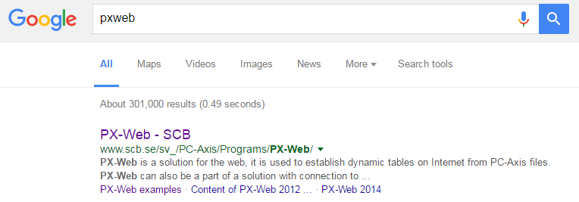


Slide 3


PX-Web is free of charge from 1 January 2016 for Swedish government agencies and municipalities, international NSI’s and international organizations in statistics.

Slide 4
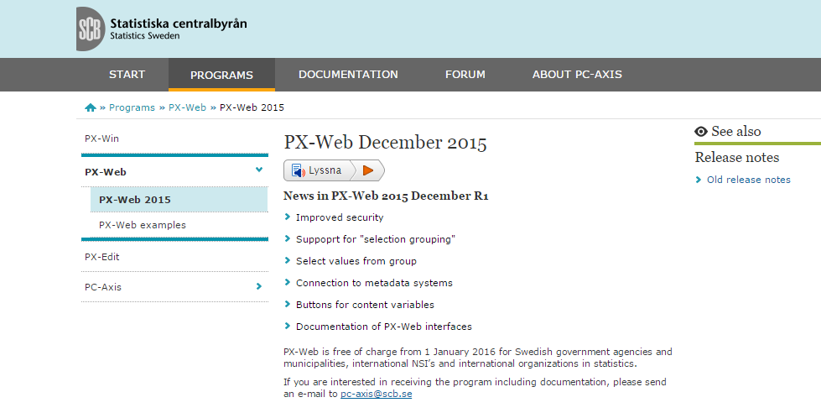
pc-axis@scb.se

Slide 5

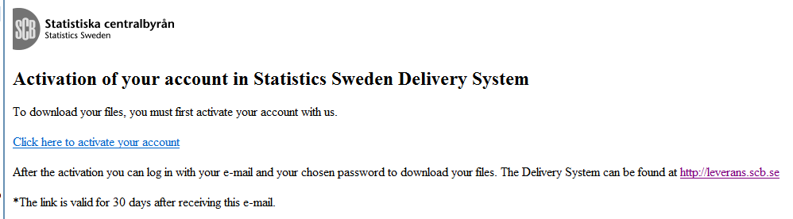
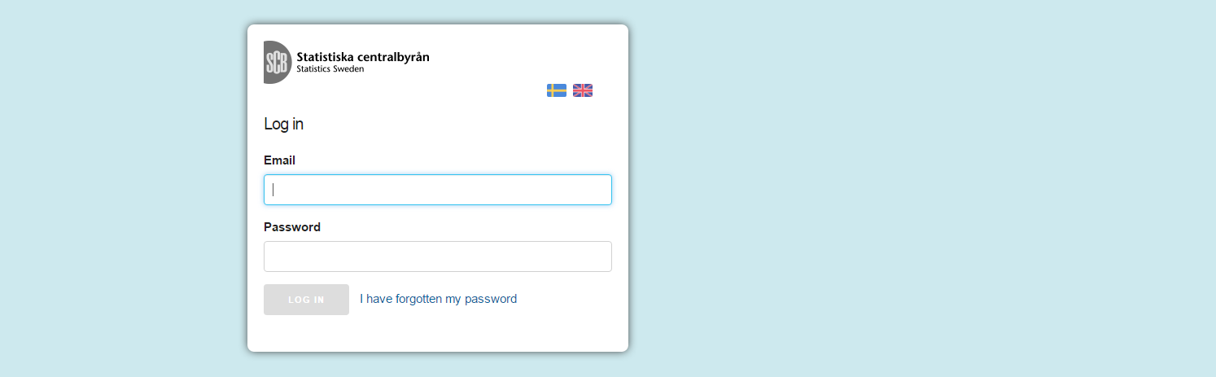



Slide 6


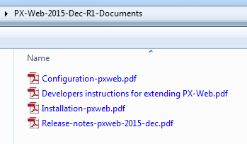

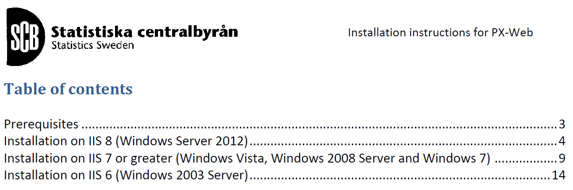

Slide 7


Slide 8

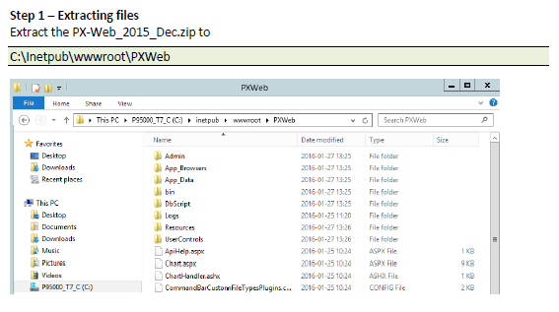
1
Unzip and move to inetpub/wwwroot

Slide 9
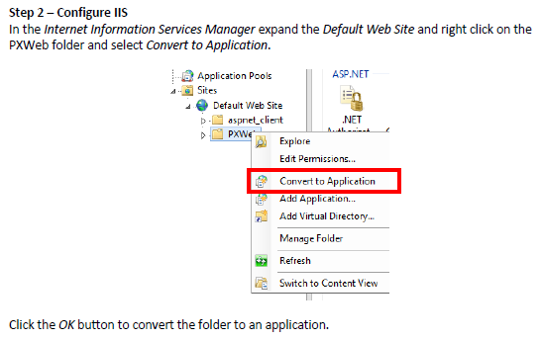
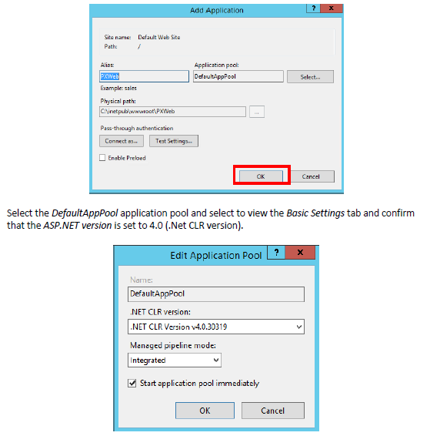
2
Convert to App and set the Application Pool

Slide 10
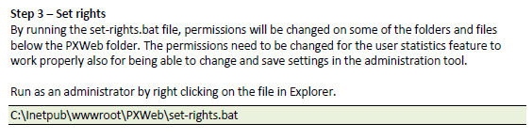
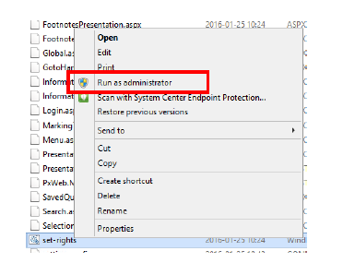
3
Run bat file to set rights

Slide 11
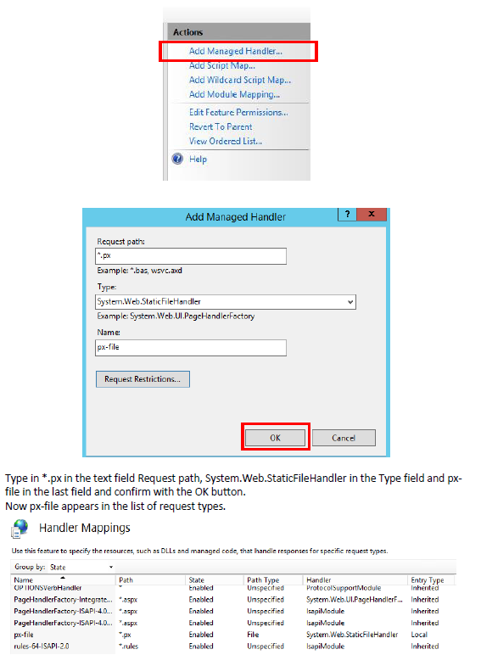
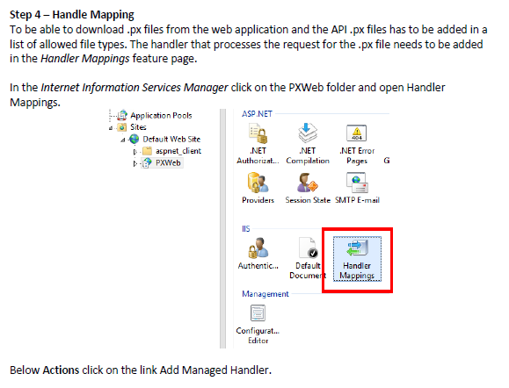
4
Add .px file handler

Slide 12

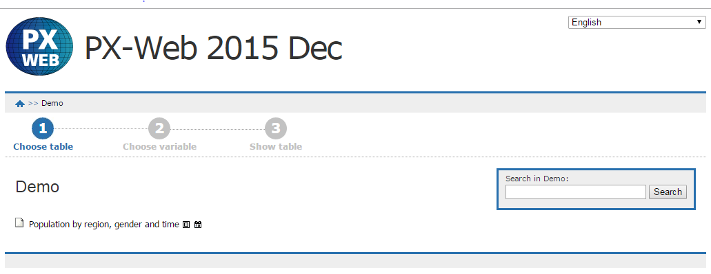
5
Browse to http://localhost/PXWeb

Slide 13

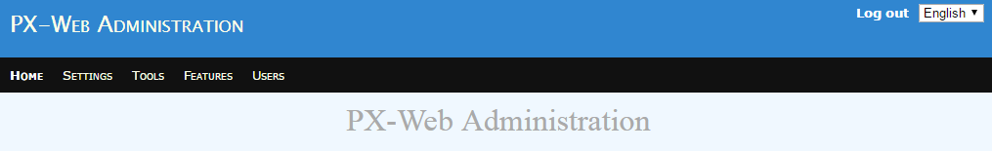
…are you an
Administrator?
Browse to
http://localhost/PXWeb/admin

Slide 14

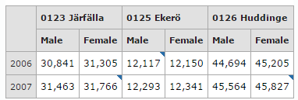
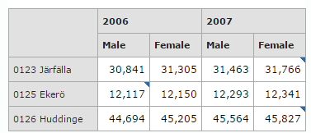
Main features
Free license
Easy to install & use
Strong community
White label
Multi databases
  PX files
  CNMM over SQL-Server
Indexing
Charting
Caching
Exporting
API
“Slice and dice”

Slide 15

Setting up a simple
PX-Web environment
by Lorenzo Bruni < lorenzo.bruni@cso.ie >
IT Dissemination Systems Manager at CSO - Central Statistics Office
27/09/2016
CSO - Central Statistics Office (C) 2016
15

