Slide 1
R infrastructure
Eoin O’Connell
Department of Justice & Equality
CSO Data Analysis Workshop
29th Sept 2016
Notes:
Agenda
Nature of open source & reproducibility
Shared analysis environment
Licensing options
Dashboard infrastructures

Slide 2























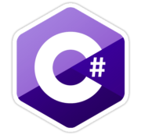




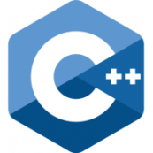



open_source > free
+ Free
- Unsupported
- No warranty
+ Modular
+ Adaptable
+ Transparent
- Erratic updates
Notes:
Free – R is open source and free, but enterprising companies (RStudio, Microsoft, Oracle and others) are using the R language in proprietary software that comes with a license, support and warranty.
Unsupported – open source R is extremely well-supported by the active and enthusiastic community. Unsupported just means there isn’t any specific person you can call if things aren’t working.
No warranty – no official warranty if something is calculating incorrectly but this is partially addressed by the code being transparent. Bugs and errors are usually found and fixed quickly.
Modular – you can add in chunks of code (called packages) that someone else has already written. These are usually for reading Excel/SAS/SPSS/Stata/csv/px/json/XML files, connecting to various SQL and noSQL databases, drawing special graphs and maps, creating specialised mathematical models, or just generally making your code easier and faster to write.
Adaptable – you can make changes to the code.
Transparent – you can see and check exactly what the code is doing.
Erratic updates – related to being modular, developers work independently on their own little bit of code and issue updates whenever they find time. This means an erratic update schedule – compare how often you updated your laptop software programs in the early 2000s to how often your phone apps have at least one update currently. That can be a problem when you have written code using packages with a lot of dependencies and one of those dependencies has a major update. This can be mostly dealt with by using dated snapshots.

Slide 3
Reproducibility (1/2)
SPSS Version 10.1
SAS Version 9.4
Stata SE Version 14.0
R Version ?
RSQLite (1.1)
RMySQL (6.0)
plyr (4.2)
htmltools (2.4)
DBI (1.2)
Rcpp (1.1)
digest (2.6)
base R (3.0)
Notes:
If you have SPSS, SAS, Stata installed on your computer (or any piece of self-contained software like Excel, Word, even open source programs like Firefox or OpenOffice) you know which exactly which version you have. There’s a manual and all the functions are fixed at a point in time to work a certain way, with a certain syntax and arguments.
One of the best things about R is you can throw almost any problem at it and it has a package to deal with it - it is modular.
If you need to read in files of a certain kind, do certain types of analysis, or output special types of files, with very few exceptions, there is a package out there.
Unlike self-contained software, some of these packages are not written by the same team working on the base R updates.
This can present a difficultly when it comes to reproducibility and versioning.

Slide 4
Reproducibility (2/2)
Your R
RSQLite (1.1)
plyr (4.2)
DBI (1.0)
Rcpp (1.1)
base R (3.0)
My R
RMySQL (6.0)
htmltools (2.4)
DBI (1.2)
Rcpp (1.2)
digest (2.6)
base R (3.3)
Notes:
There is no one name or number for my version because it is specific to my installation, the packages I installed and when I installed them will matter.
There are thousands of packages for R so it’s impractical to simply install them all and update every day.

Slide 5
Enter Microsoft...
Microsoft R Open 3.0
R Version at 1st May 2016
RSQLite (1.1)
RMySQL (6.0)
plyr (4.2)
htmltools (2.4)
DBI (1.2)
Rcpp (1.1)
digest (2.6)
base R (3.0)
Notes:
Microsoft have daily snapshots of the R package repository available on their website.
Using R 3.0 as at the 1st May 2016 means knowing the versions of all packages.
Or we can use Microsoft R Open 3.0 with the default snapshot, with the same effect.
Two small issues remain:
1 – A user might still get a message that they need to install a particular package from that snapshot.
2 – A user can change their snapshot date.
At Justice, we addressed this by having just one installation of R on our local intranet that users can access through a browser interface.

Slide 6
A single, shared installation
R Version – DoJE
RStudio Server (Pro)
Microsoft R Open 3.2.5 + packages
RHEL 7 VM
Notes:
A virtual machine running Red Hat Enterprise Linux with about 30 GB of memory, we put Microsoft R Open 3.2.5 on that computer along with a specific set of packages at the outset. Whenever we install new packages though, we are always referring to the snapshot from a particular date, ensuring consistency between the packages.
So now we have a single R version for everyone to use and package installations are centrally-done, system-wide and available to all users.
The reproducibility issue is now largely solved, we can keep back up of the machine every night and restore it if it fails.
RStudio Server (Pro) is the software that allows us to access our single R installation by browser over intranet. It also adds a more traditional interface to R with plenty of useful tools like code completion, help files, variable/object views, a dedicated plotting area and so on. In the licensed version, we can also share projects AND work on them in real time.

Slide 7
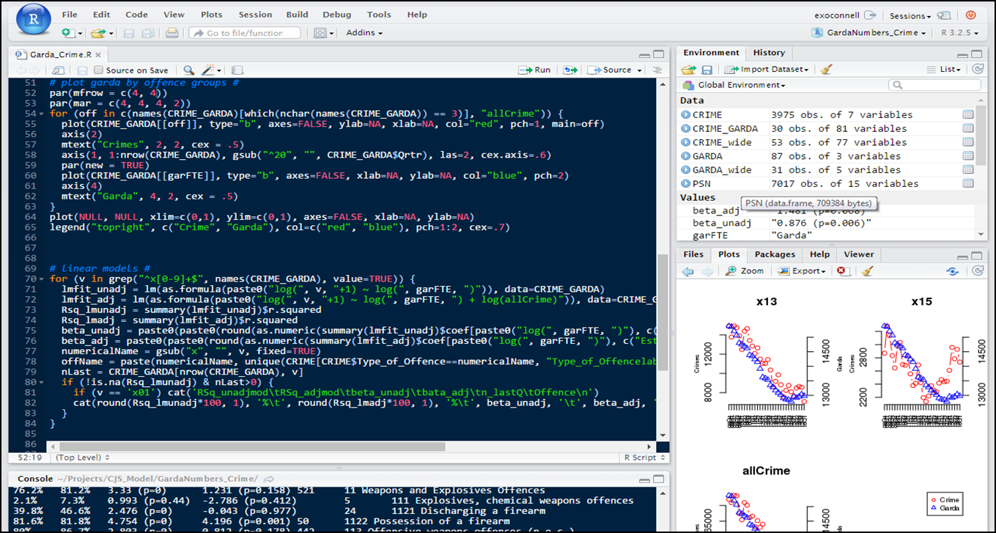
png(rstudio_server)
Notes:
https://www.rstudio.com/products/rstudio-server/
We have the licensed version of this, which adds security, support, project sharing and performance tuning.

Slide 8
R/RStudio Software
 | Open Source | Licensed / Pro
R engine | ● base R ● all packages [● Microsoft – snapshots, maths] | ● validR – validated base + selected packages
Rstudio [one user] | ● Code completion + other helpful tools | Open Source + ● Supports + SLAs
RStudio Server [many users] | ● One central R version ● Used through browser ● Efficient use of hardware | Open Source + ● Real-time Project Sharing ● Parallel Sessions ● Multiple central R versions ● Monitoring + Tuning ● Enhanced Security ● Support + SLAs
Notes:
Overview of the open source and licensed versions of various R-based software.
With no outlay, you could: Set up a virtual machine, install R and RStudio Server on it and serve it as a web application on your intranet.
If you want a licence, extra tools and support, you can go for the licensed version of RStudio Server called RStudio Server Pro. There is no difference in the install, set-up or system requirements.
Microsoft are also now offering Server software to rival RStudio Server called Microsoft R Server.

Slide 9


infrastructure[analysis]
Key
Internet
External access
Internal access
File Server / Data Store
Required VM machines (x4)
Single Database stores
Analyst
Admin
All system packages installed from internal RPM repository
SPR
System Package Repository
Analysis
RSS
VCS
RStudio Server Pro
Dedicated machine for external data gathering
Database
cluster
DS1
DS2
DS3
DS4
DSE1
File Store
Data Store
Data Store
Data Store
File Store
DS1 and DSE1: File server containing various data file formats
Notes:
If you have common external data sources (like DB2, MS SQL, MySQL, MS Access) to which you need to connect and also file-based stores (Excel, SQLite, px, JSON, XML), here’s what your infrastructure might look like.
The data stores and file stores are separated out for a) security, b) size considerations, c) some are unavoidably separate because they are an actual database server or map server.
There is still only one R virtual machine to maintain and version control can be done on that machine.
Our infrastructure at Justice is, and will be, a little more complex because our primary aim was to deploy dashboards.

Slide 10
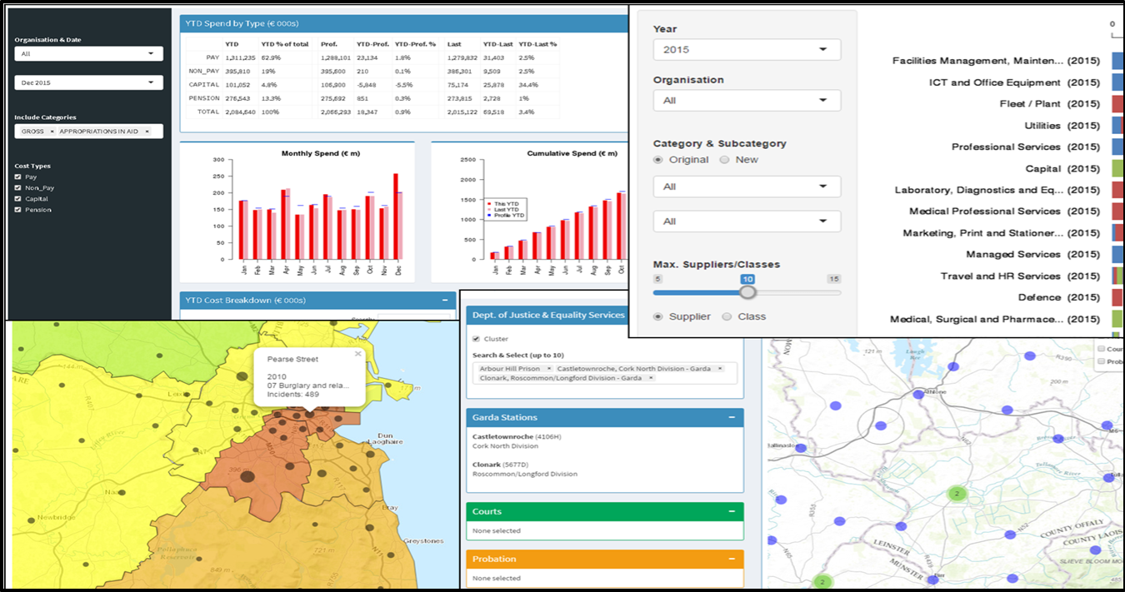
runApp(ui, server)
Notes:
https://www.rstudio.com/products/shiny/shiny-server/
Whether you want to serve up dashboards is an important decision, because it means a good deal of additional infrastructure and another set of licenses for the machine that serves them up.

Slide 11
R Software
 | Open Source | Licensed / Pro
R engine | ● base R ● all packages [● Microsoft – snapshots, maths] | ● validR – validated base + selected packages
Rstudio [one user] | ● Code completion + other helpful tools | Open Source + ● Supports + SLAs
RStudio Server [many users] | ● One central R version ● Used through browser ● Efficient use of hardware | Open Source + ● Real-time Project Sharing ● Parallel Sessions ● Multiple central R versions ● Monitoring + Tuning ● Enhanced Security ● Support + SLAs
Shiny Server | ● Deploy Dashboards | Open Source + ● Monitoring + Tuning ● Enhanced Security ● Support + SLAs
Notes:
Software overview with Shiny Server added.

Slide 12
infrastructure[preproduction]
Key
External access
Internal access
File Server / Data Store
Required VM machines (x2)
Single Database stores
All system packages installed from internet
Internet
Developer
Admin
App Tester
Report User
SharePoint
Development
Machine
Shiny
UAT
Dashboard
Machine
RSS
RStudio Server Pro
SSP1
Shiny Server Pro
Pam authentication
Open authentication
ftp server to update dashboards
Notes:
Here is the most basic of set-ups and where we started at Justice for the proof-of-concept.
For the dashboards, files are securely transferred to the Shiny Server Pro, where they are immediately served up as an active dashboard with a known intranet address.
Pages on our Sharepoint site then point to each dashboard.
Having a system admin is important to keep your machines consistent and up to date.

Slide 13
infrastructure[skeleton]
Key
External access
Internal access
File Server / Data Store
Required VM machines (x4)
Single Database stores
All system packages installed from internet
Internet
Developer
Admin
App Tester
Report User
SharePoint
Development
Dashboards
RSS
RStudio Server Pro
SSP1
Shiny Server Pro
Scheduled app & R package updates
DB/File access from all data sources to all application servers
Apps
Data
DS1: File server containing various data file formats
VCS
RPR
DS1
Shiny App Store
Data Store
Notes:
SSP1 needs a chunk of RAM (32+GB) and a good set of CPU cores, it doesn’t need a lot of storage because R holds all its data in memory.
DS1 needs a lot of storage (2+ TB) but not much RAM or CPU power because it only needs to hold the data files and transfer data relatively infrequently.
This set-up has the advantage that both the RStudio Server (development workspace) machine and the Shiny Server (dashboard deployment) machine are accessing exactly the same data files in the same location.
We also have an app store, where work in development and work in production both sit. It includes the local package repository and version control software such as GIT or subversion, to ensure we can always roll code back to a earlier version.
Very little data should need to be kept on the RStudio or Shiny Servers. The definitive versions of applications sit on the app store. Data sits in the data store.

Slide 14
infrastructure[production]
Key
External access
Internal access
File Server / Data Store
Required VM machines (x12)
Single Database stores
Internet
Developer
Admin
App Tester
Report User
All system packages installed from internal RPM repository
SPR
System Package Repository
SharePoint
Development
UAT
Dashboards
LB
Nginx Load balancer
CI
RSS
SSP0
Continuous Integration
RStudio Server Pro
Shiny Server Pro
SSP1
SSP2
Dedicated machine for external data gathering
Shiny Server Pro
Shiny Server Pro
Apps
Database cluster
VCS
RPR
DS1
DS2
DS3
DS4
DSE1
Version Control
R Package Repo
File Store
Data Store
Data Store
Data Store
File Store
DSB1
DSB2
DSB3
DSB4
DS1 and DSE1: File server containing various data file formats
Backup/
Fail-over
Backup/
Fail-over
Backup / Fail-over
Backup / Fail-over
Notes:
Future infrastructure at Justice. Load balancers, package repositories, version control systems and backups/failovers for all active machines to ensure high availability of our dashboards.
We’ve also added a second production Shiny Server and another machine to balance the load between these two machines, each acting as the other’s backup. This is where it gets a bit more expensive licence-wise because now we have three shiny servers. We do have many more virtual machines running but once that hardware is already bought, it doesn’t represent any additional cost. We’ve also added backups for all of our data stores, so now if the primary server for any of our data bases goes down, we can instantly switch to its clone.
This is the high availability set-up, the whole point of which is to ensure that the dashboards are always* available.
If a server crashes, our infrastructure doesn’t crash, it re-routes while we fix the problem.
* - as close to always as possible

Slide 15
Eoin O’Connell
Department of Justice & Equality
exoconnell@justice.ie

