Slide 1

Creating
PX Files
Paul Rockley
FSLG - 29th September 2016

Slide 2

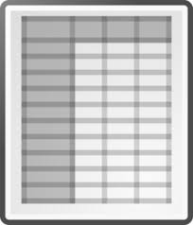
PX-file
First steps
Moving to Automation
PX file composition
Program workflow

Slide 3
First Steps
Options for Manual Creation
  PX-Make (Statistics Denmark)
  PX-Edit (Statistics Finland)
R Software
  pxR Package
Advice
  Statistics Finland site
    http://tilastokeskus.fi/tup/pcaxis/lataus_tyokalut_en.html

Slide 4
Why Automate?
Input Errors reduced
Speed
Reproducibility

Slide 5
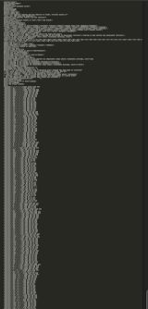
PX File - Composition
Two Parts…
Header
Data

Slide 6
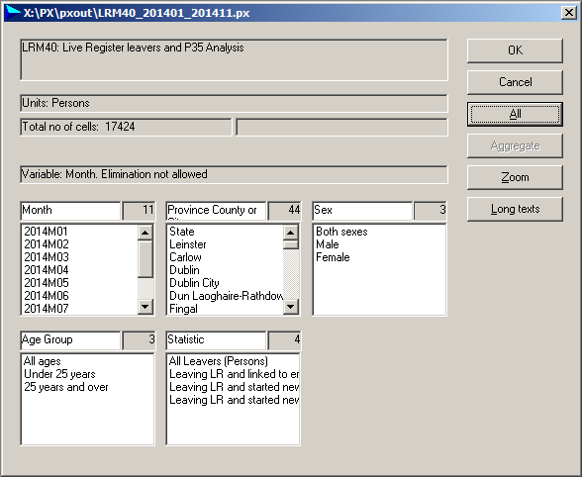
PX file example used in presentation…
Month
Location
Sex
Age Group
Statistic

Slide 7
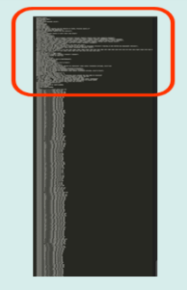
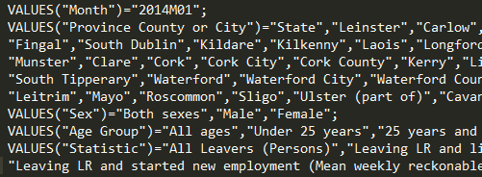
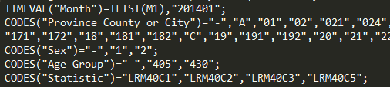
PX File - Header
Coding of Variables…

Slide 8
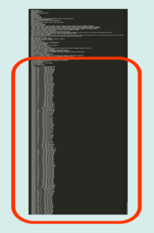

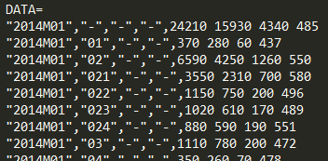
PX File - Data
HEADER
DATA

Slide 9


Program Workflow
Summarise
Merge
Create PX file
PX

Slide 10
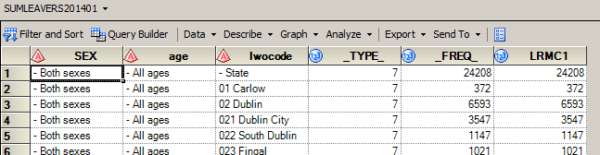
Process 1
Summarise

Slide 11
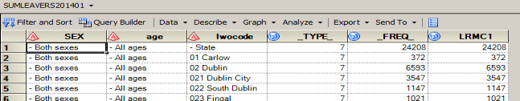
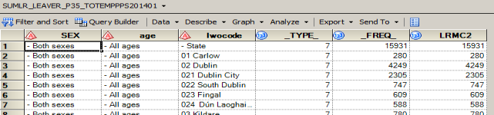
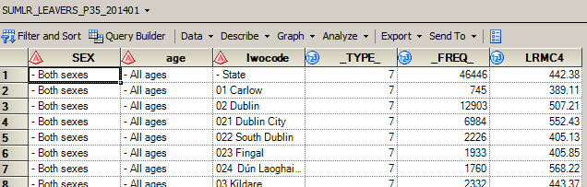
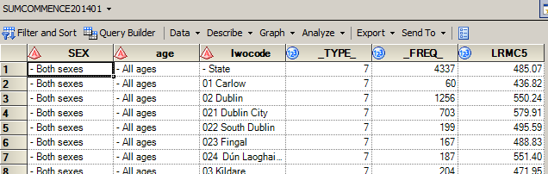
Process 1 –
Summarise

Slide 12
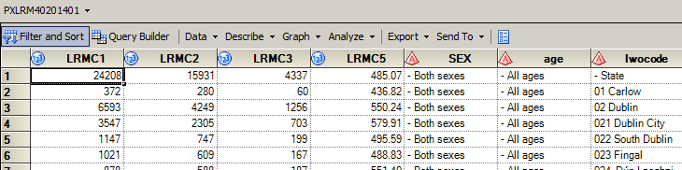
Process 2
Merge
Merge on composite key

Slide 13
Process 3
Create PX file
PX
Create blank PX file
Header - read in PX header template and replace marker text
Data - write to file after formatting and confidentiality checks

Slide 14
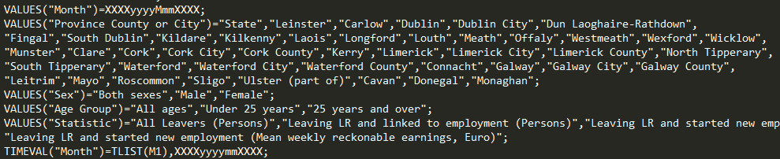
Detail –
2) Read in PX header template and replace marker text
Process 3 –
Create PX file

Slide 15
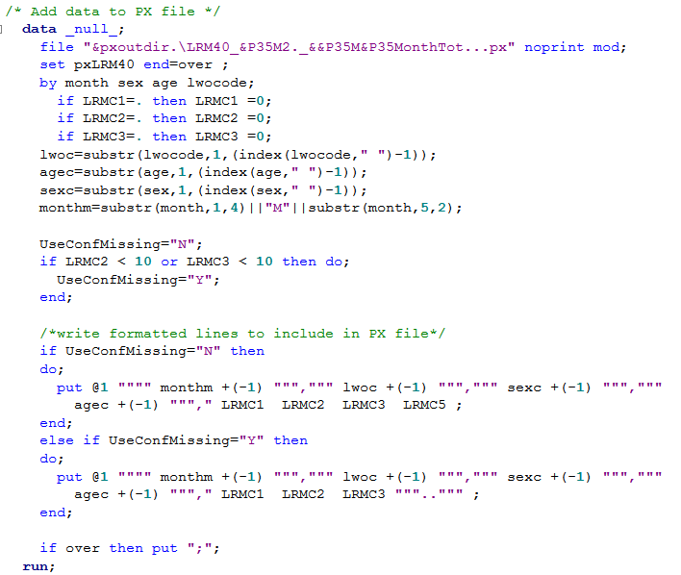
Detail – 3) Write data to PX file
Process 3 –
Create PX file

Slide 16
Detail – 3.1) Formatted Output
Process 3 –
Create PX file

Slide 17
Detail – 3.2) Confidentiality
Process 3 –
Create PX file

Slide 18
PX-file

Slide 19

Thank you

