Slide 1

Update to Statistical Boundaries following Census 2022
Briefing Session Monday, 19th June 2022
Dr. Paul J. Alexander
(Formerly) Census Geography and Real Time Operations

Slide 2
Overview
Agenda
Statistical Geographies and Defining “urban”
Statistical Product overview (1) “Settlements”
Statistical Product overview (2) “Built Up Areas”
Demonstration of Comparison Tool (closed Beta)
FAQs and Q&A

Slide 3
Part 1 a) Official, Unofficial and Statistical Geographies b) Defining Urban

Slide 4
Section A – Geographies in Ireland

Slide 5
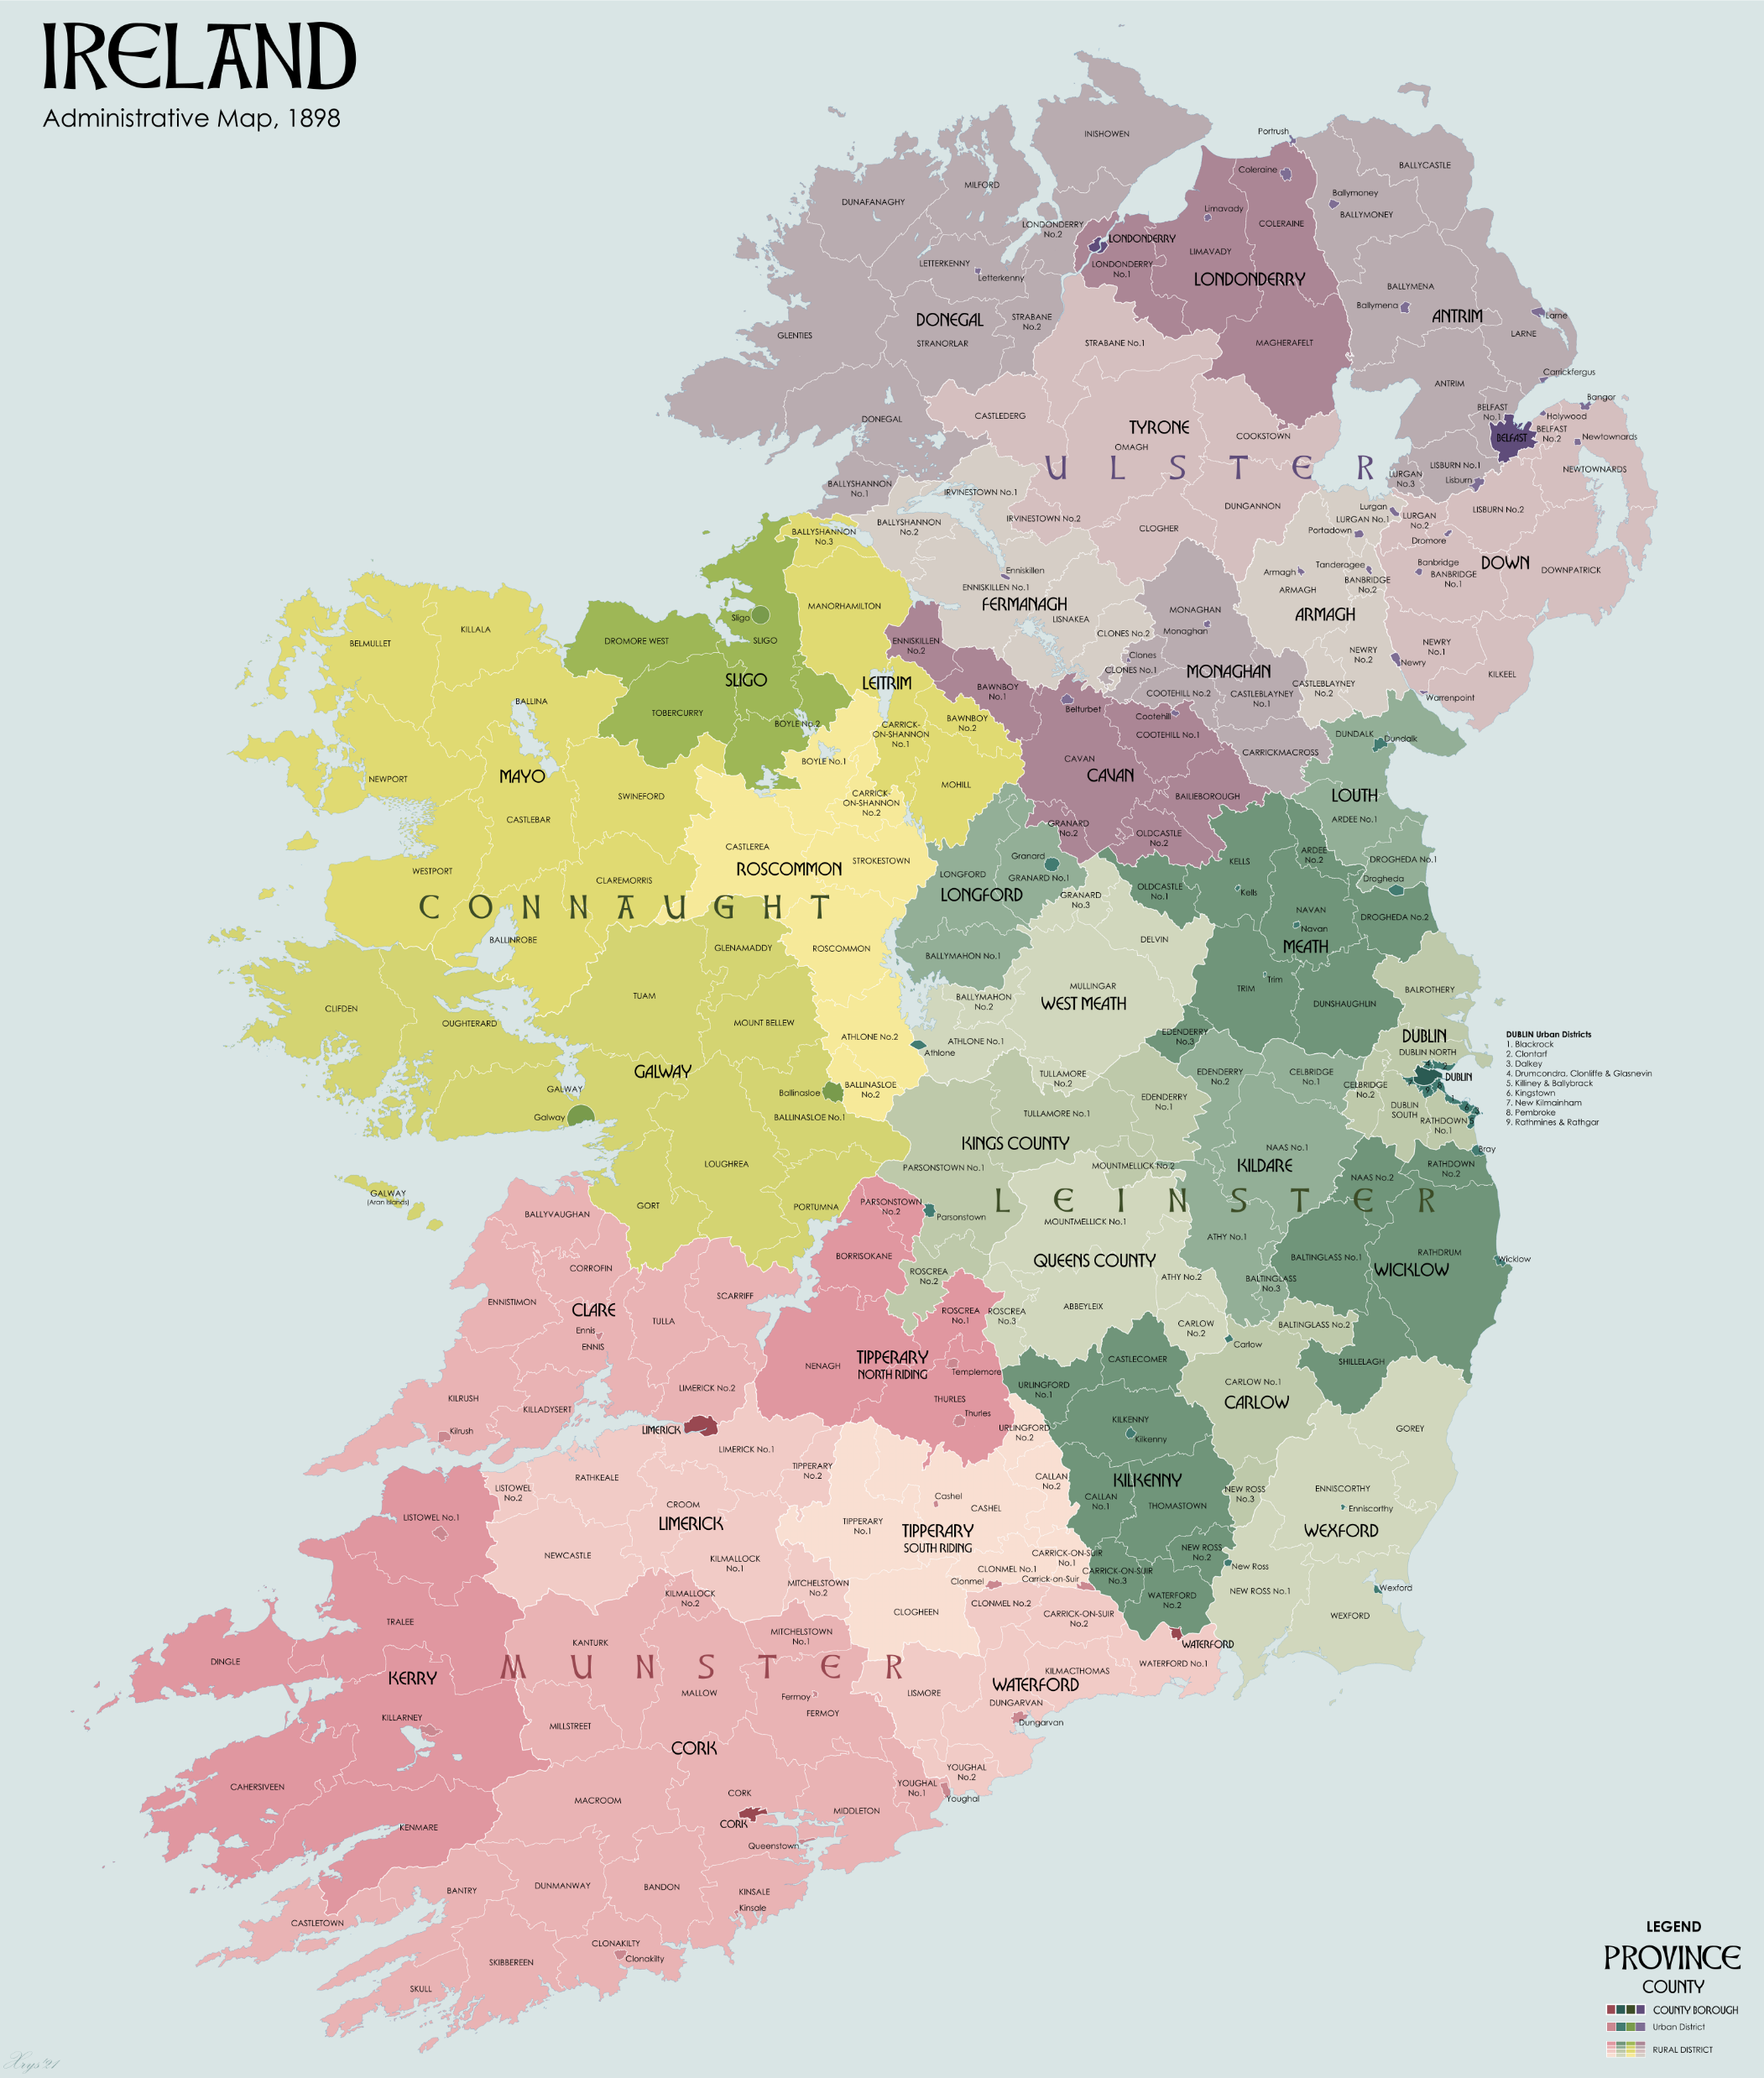
Difference Between “Statistical” and “Official” Geographies
Official Geographies
Boundaries / Areas defined via legislation and/or statutory instrument
e.g. Administrative Counties - Local Government (Ireland) Act, 1898, amended by the Local Government (Reform) Act, 2014 and again in The Local Government Act, 2019
Electoral Divisions, Local Electoral Areas, Constituencies, Gaeltachtaí – all “legal” (official) boundaries
CSO provides Statistics for most official boundaries, but does not define them

Slide 6
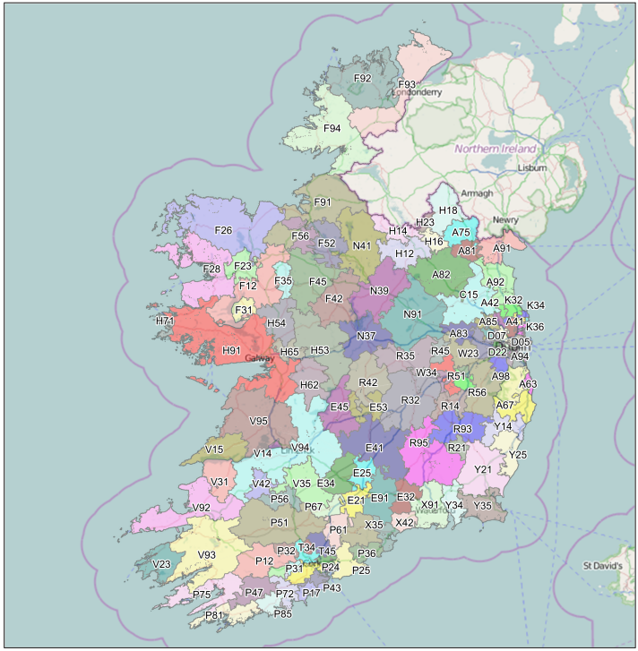
Difference Between “Statistical” and “Official” Geographies
Unofficial Geographies
There are also many unofficial geographies in Ireland also, examples include (but are not limited to):
Routing Key Regions, Health Planning Areas, School Planning Areas etc.
CSO provides statistics for some of these geographies, but they are not defined in legislation nor do CSO define them

Slide 7
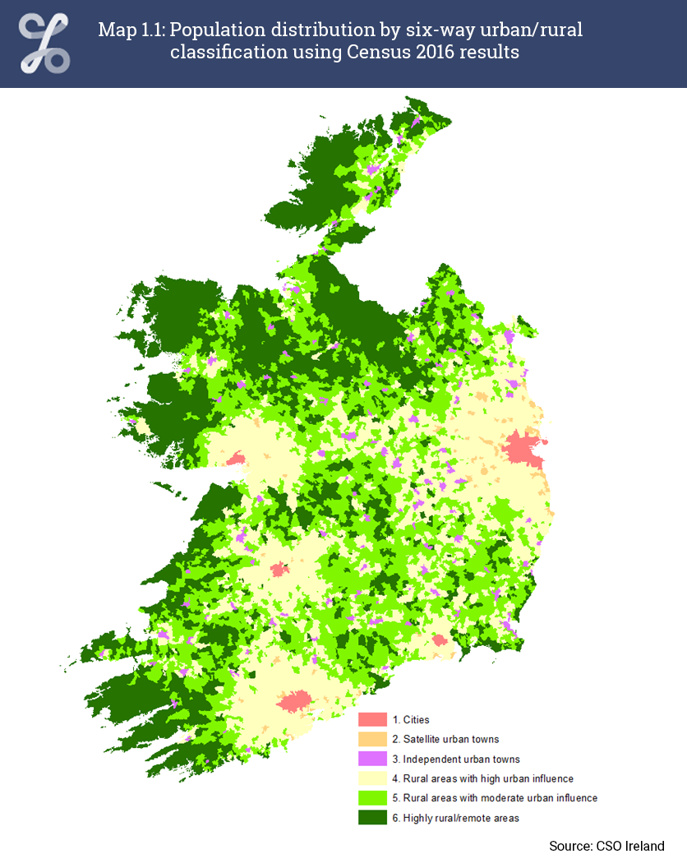
Difference Between “Statistical” and “Official” Geographies
Statistical Geographies
Those geographies that are defined by CSO for the provision of statistical information.
Key difference from unofficial is:
The tend to align to official boundaries in so far as possible
They have defined “statistical” limits and are intended for the collection/dissemination of statistical data
They “nest” to form a geographical hierarchy and reduce the risk of disclosure due to geographic differencing
Like unofficial geographies, it is important to remember Statistical Geographies are not legally defined

Slide 8



Difference Between “Statistical” and “Official” Geographies
“nesting” means to calculate a value for an area (say total population) you add the totals from other smaller areas…
The only statistical geography that does not nest is CSO Settlements
10
6
7
4 2
16

Slide 9
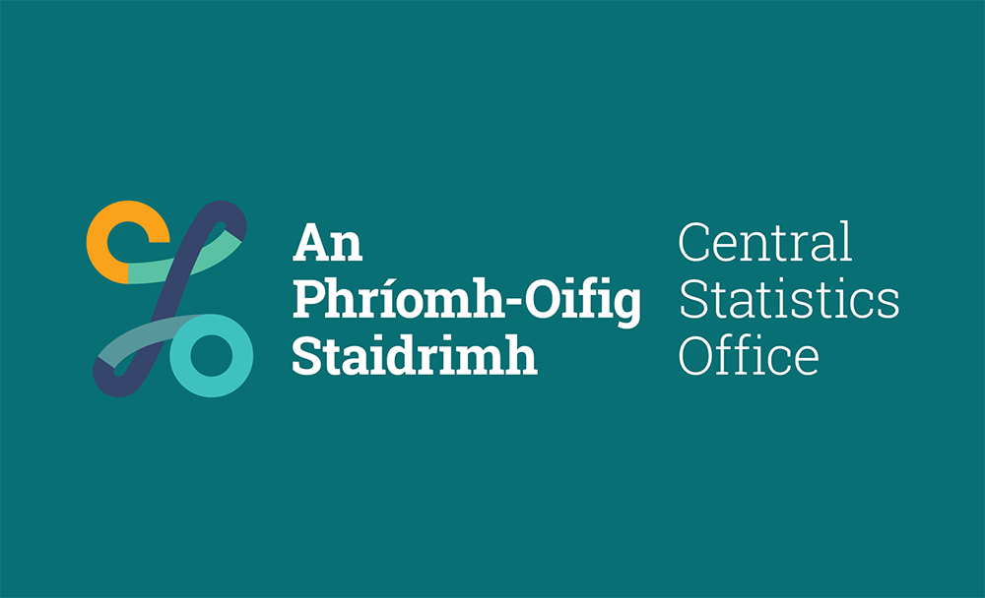

Playing our part

Slide 10
Section B – Defining “Urban”

Slide 11
Where do you live?
Example 1 | Example 2 | Example 3 | Example 4 | Example 5
35 Cashen Court, Dun Álainn, Clieveragh, Listowel, Co. Kerry | 111 Mourne View, Skerries, Co. Dublin | Carrowkeel, Turlough, Castlebar, Co. Mayo | Christian Brothers Monastery, New Road, Ennis, Co. Clare | 42 Willsgrove, Cahircalla, Ennis, Co. Clare

Slide 12
Where do you live?
Example 1 | Example 2 | Example 3 | Example 4 | Example 5
35 Cashen Court, Dun Álainn, Clieveragh, Listowel, Co. Kerry | 111 Mourne View, Skerries, Co. Dublin | Carrowkeel, Turlough, Castlebar, Co. Mayo | Christian Brothers Monastery, New Road, Ennis, Co. Clare | 42 Willsgrove, Cahircalla, Ennis, Co. Clare

Slide 13
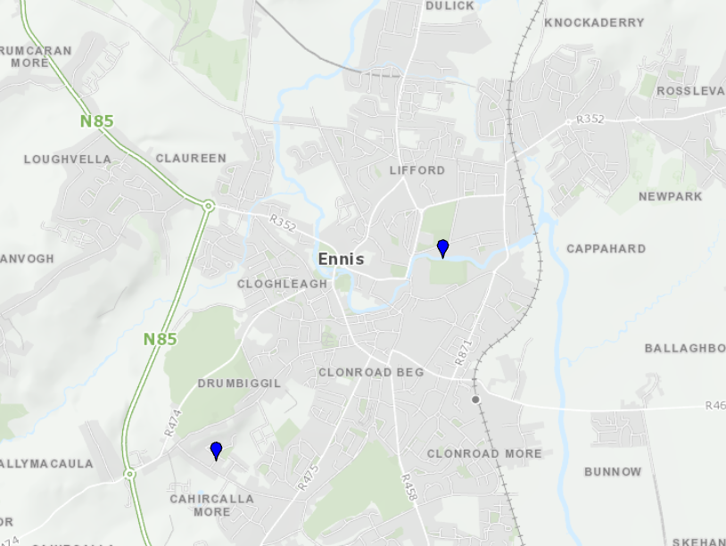
Both Addresses do appear to be in or around “Ennis”
But what about here?
… or here?
… or here?
… or here?!

Slide 14
Where does an urban area start and end?
And until we know that… how can we say the Population of “Town A” is XXX?

Slide 15
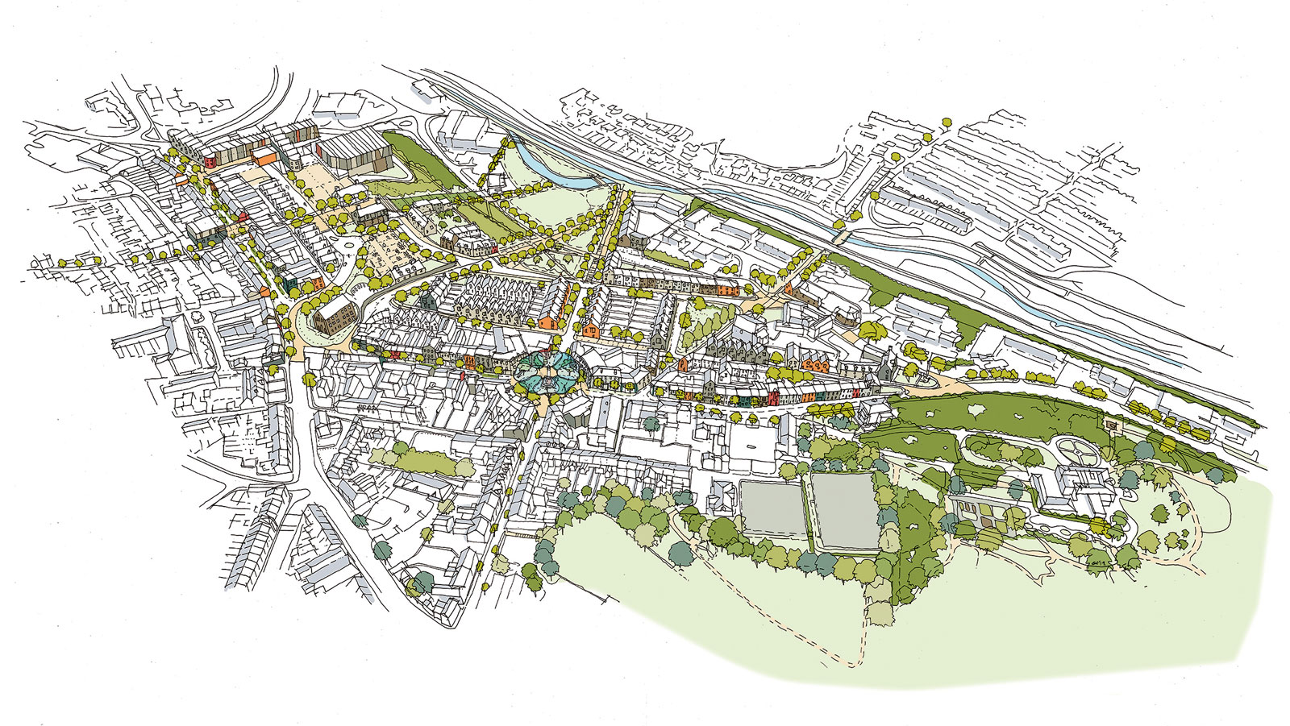

Slide 16

Two “Common” ways to define “urban”
Land Cover
Population
Land cover is commonly defined as the vegetation (natural or planted) or man-made constructions (buildings, roads, artificial greenspaces etc.) which occur on the earth surface.
…so: the “urban area” simply demarcates areas that have urban land cover from non-urban land cover
Unambiguous
UNECE: An urban area, built-up area or urban agglomeration is a human settlement with a high population density and infrastructure of built environment… USA: Urbanized Areas (UAs) are a continuously built-up area with a population of 50,000 or more. It comprises one or more places—central place(s)—and the adjacent densely settled surrounding area—”urban fringe”—consisting of other places and nonplace territory.
… so: much fuzzier idea! What is a “high” population density? Seems to mix with land cover? Continuously built up? Why 50,000? How far out is the urban fringe?
Urban… … Not Urban

Slide 17
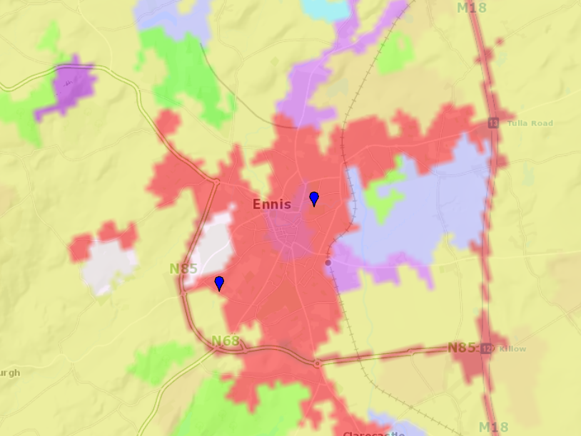
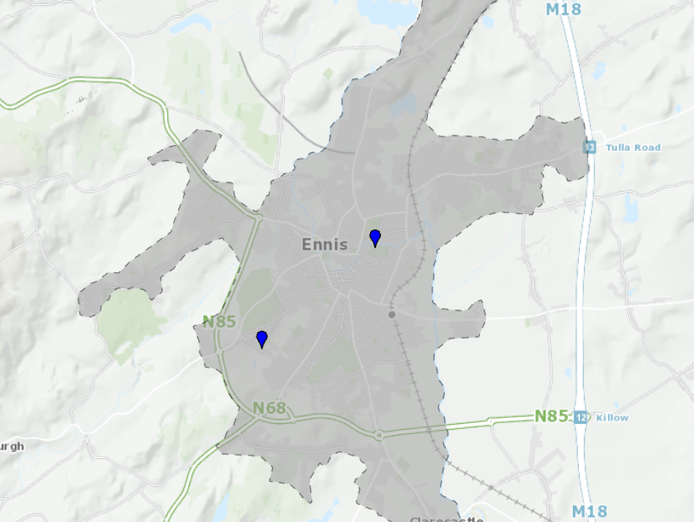
Two “Common” ways to define “urban”
Land Cover
Population

Slide 18
Both Addresses do appear to be in or around “Ennis”
But what about here?
… or here?
… or here?
… or here?!

Slide 19
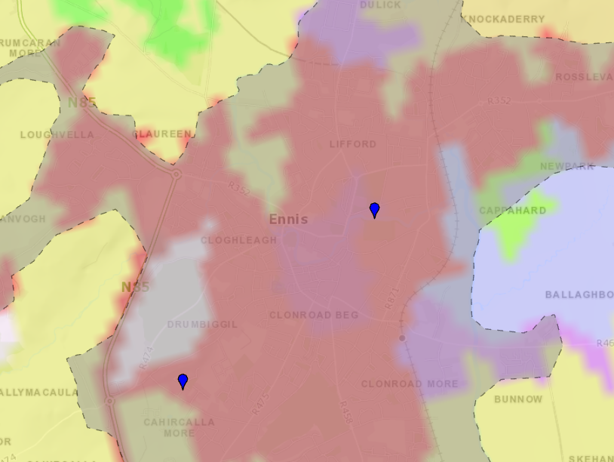
Both Addresses do appear to be in or around “Ennis”
Land Cover? No
Population? Yes
Land Cover? Yes
Population? Yes
Land Cover? No
Population? Yes
Land Cover? No
Population? No?

Slide 20
Take-Away Messages:
“Where do you live?”
  Not so straight forward: the address and location sometimes don’t reflect the reality on the ground…
“How do you define urban?”
  Depends who is asking: landcover is generally a more objective (“Data-driven”) way of delineating urban areas from non-urban, Population-based definitions are far more fuzzy and inconsistent across jurisdictions

Slide 21
Statistical Products overview

Slide 22
Reviewing of Statistical Boundaries
Done after each census cycle (i.e. every 5 years)
Check areas within geographies still within threshold
  Those that are over are split
  Those that are under are merged
  If official boundaries change in the interim – redraw to align
Done by CSO census geography team, with input from census dissemination, and in partnership with Tailte Eireann
CSO carries out edits
GUIDs assigned by Tailte and Reviewed by Tailte

Slide 23
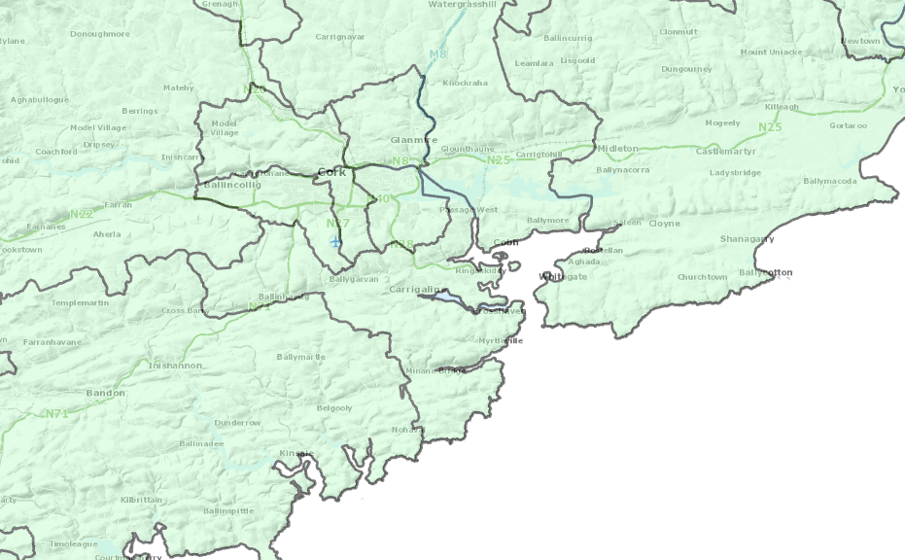
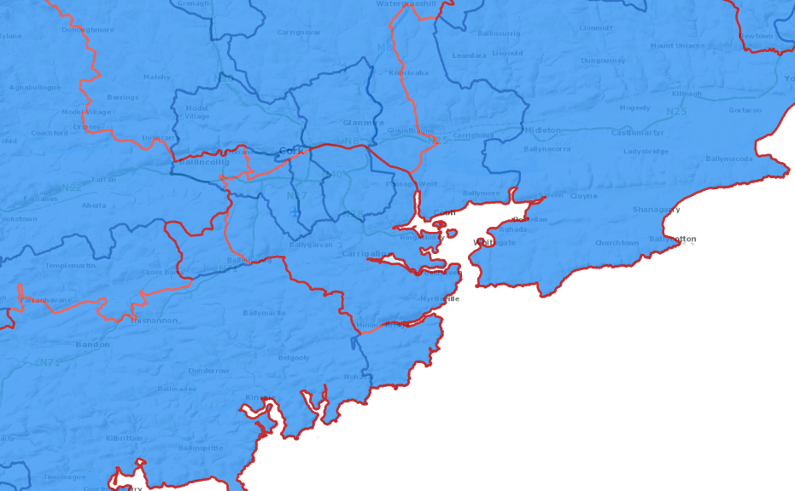
Statistical Products (Non-CSO)
Local Electoral Areas Constituencies
RY 2019 2017
n 166 39

Slide 24
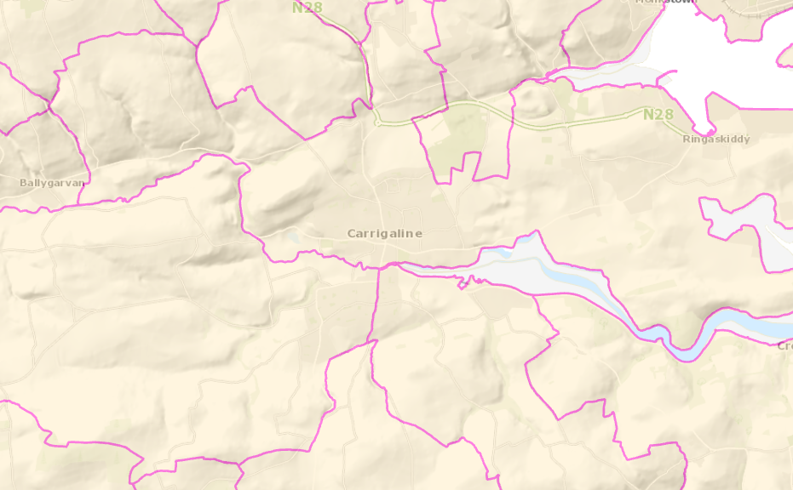
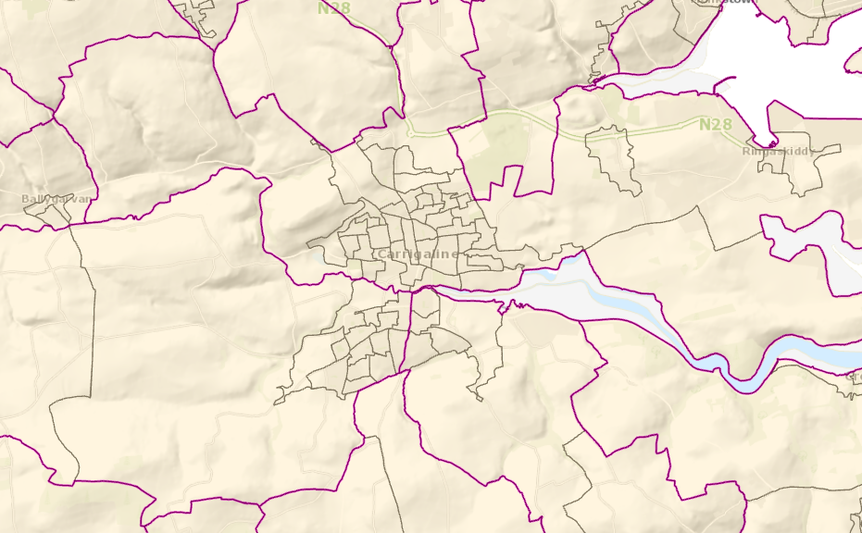
Statistical Products (CSO Defined)
Electoral Divisions Small Areas
CY 2016 2022 2016 2022
n 3,409 3,419* | 18,641 18,919

Slide 25
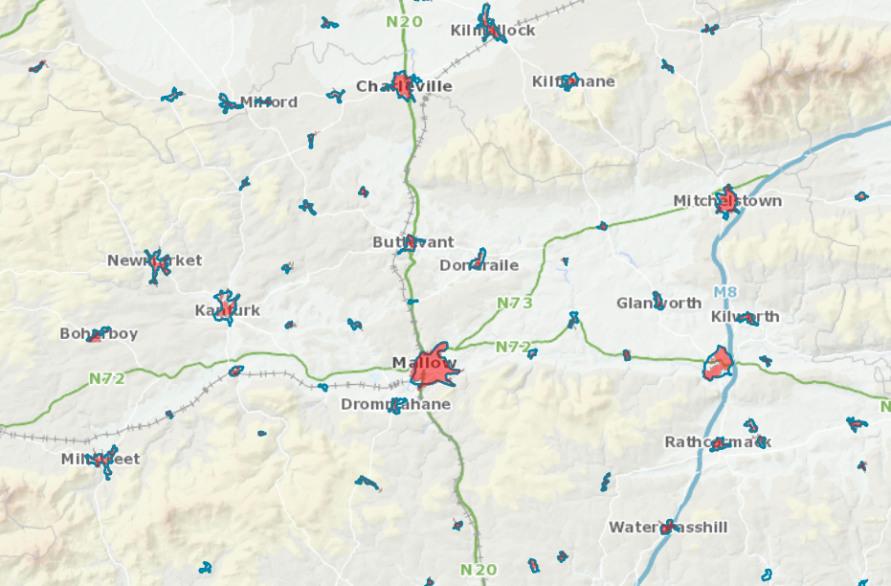
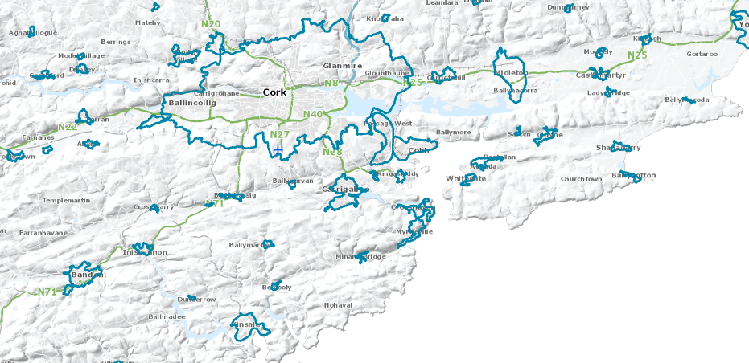
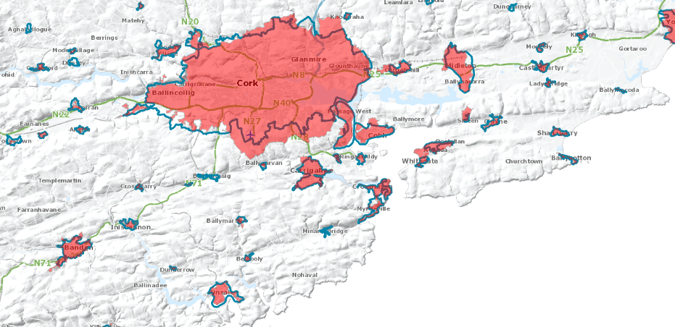
Statistical Products (CSO Defined… “kind of”)
Settlements Urban Areas
CY 2016 2022 2016 2022
n 846* 941* (+68) | --- 866

Slide 26
Statistical Product overview (1) Settlements
Historically, for the censuses of 1926 to 1951, a census town was defined simply as a cluster of twenty or more houses and the precise delimitation of the town was left to the discretion of the individual enumerator concerned.
As part of the general review of towns for the 1956 Census, the boundaries for the census towns were drawn up in consultation with the various Local Authorities applying uniform principles in all areas of the country.
The definition of a census town was changed at the 1956 Census, from twenty houses to twenty occupied houses; this definition was also applied at the 1961 and 1966 Censuses.
1926
1936
1951
1991
1956
1961
1966
1971
1979
1981
1986
1946
1996
2002
2006
2011
2016
2022
Notes:
Ad-hoc Phase: In this initial phase, the definition of urban areas is characterized by a haphazard and arbitrary approach. There is no clear framework or set criteria for classifying areas as urban or rural. Decisions are made on an individual basis or based on local customs and traditions. The lack of a standardized definition leads to inconsistencies and variations in how urban areas are identified and delineated.
Semi-structured Phase: As the need for more consistent and reliable urban definitions becomes apparent, the semi-structured phase emerges. During this phase, some basic criteria or guidelines are established to define urban areas. These criteria may include population size, density, infrastructure development, and economic activities. While there is some level of structure, the criteria are often open to interpretation, and there may still be regional or local variations in their application.
Structured Phase: In the structured phase, a more systematic and standardized approach to defining urban areas is implemented. Clear and specific criteria are established, and a formal methodology is developed to assess whether an area qualifies as urban or rural. This phase aims to bring uniformity and consistency to the classification of urban areas across different regions or jurisdictions. The structured definition provides a foundation for urban planning, policy-making, and statistical analysis.
Evolving Phase: In this phase, the structured definition of urban areas is being contested or questioned. Various factors, such as changing demographics, evolving urban dynamics, and new understandings of urbanization, challenge the existing definition. Different stakeholders may have divergent perspectives on what constitutes an urban area, leading to debates and discussions about the relevance and adequacy of the current definition. This phase reflects a period of reevaluation and potential revision of the structured definition in response to emerging complexities and evolving urban realities.
Refined Phase: Following the Evolving Phase, the definition of urban areas enters the Refined Phase. In this phase, stakeholder feedback and input are taken on board. Experts, policymakers, urban planners, and community members contribute their insights and perspectives to refine the definition. The aim is to incorporate a broader consensus and a more comprehensive understanding of the diverse needs and viewpoints of different stakeholders. This phase signifies an iterative process of refining and adjusting the definition to make it more inclusive, accurate, and reflective of the evolving urban landscape.
These four phases illustrate the progression from an ad-hoc approach to a structured definition, followed by a phase of challenge and reconsideration, leading to an iterative refinement process based on stakeholder feedback.

Slide 27
Statistical Product overview (1) Settlements
From 1971 to 2006, Census towns were defined as a cluster of fifty or more occupied dwellings where, within a radius of 800 metres there was a nucleus of thirty occupied dwellings (on both sides of a road, or twenty on one side of a road), along with a clearly defined urban centre e.g. a shop, a school, a place of worship or a community centre.
Census town boundaries were extended over time where there was an occupied dwelling within 200 metres of the existing boundary.
The proximity criteria for extending existing 2006 Census town boundaries was amended to include all occupied dwellings within 100 metres of an existing building.
Other information based on OSi mapping and orthogonal photography was also considered when extending boundaries. Boundary extensions were generally made to include the land parcel on which a dwelling was built or using other physical features such as roads, paths etc.
1926
1936
1951
1991
1956
1961
1966
1971
1979
1981
1986
1946
1996
2002
2006
2011
2016
2022

Slide 28





Statistical Product overview (1) Settlements
Next census
Next census
Next census
Where the boundary line lies matters!
Land parcel

Slide 29
Statistical Product overview (1) Settlements
As of 2016…
Max distance between “Centre of Settlement” and farthest dwelling:
Settlement | Farthest Dwelling
Bray | 10.36 km
Glencullen | 10.18 km
Dublin city and suburbs | 10.06 km
Portmarnock | 9.07 km
Saggart | 7.95 km
Leixlip | 7.91 km
Clonee Village | 7.78 km
Rivermeade | 7.24 km
Kinsaley | 6.91 km
Cork city and suburbs | 6.9 km

Slide 30
Statistical Product overview (1) Settlements
As of 2016…
Based on taking “occupied” dwellings*, population definition… but population criteria isn’t applied… so its also a kind of land cover definition… is it both? Ultimately: its ambiguous what a Settlement is!
  *A dwelling is any building or structure, permanent or temporary created or used for private or communal human habitation, or part of such a structure (e.g., an apartment).

Slide 31
Disclosure due to “Geographic Differencing”
Area "D"
Population: 2
Area "A"
Total Population: 10
Geographies that do not "nest" to one another introduce a risk of disclosure due to geographic differencing
Geographic differencing can potentially compromise the privacy and confidentiality of individuals or groups if specific characteristics or patterns can be inferred, even if direct identifiers are not disclosed.
CSO has zero tolerance for disclosure risk as confidentiality is guaranteed by law
Area "C"
Total Population: 18
Area "B"
Total Population: 10
Area "D"
Population: 2

Slide 32
Disclosure due to “Geographic Differencing”
How many Small Areas do Settlements cross (i.e. how many non-nesting areas are there)?
  14,828 (79.5% of all 2016 SSAs)
The risk varied across differenced areas, however, this meant Settlements/Small Areas would have to be significantly modified to eliminate this risk moving forward

Slide 33
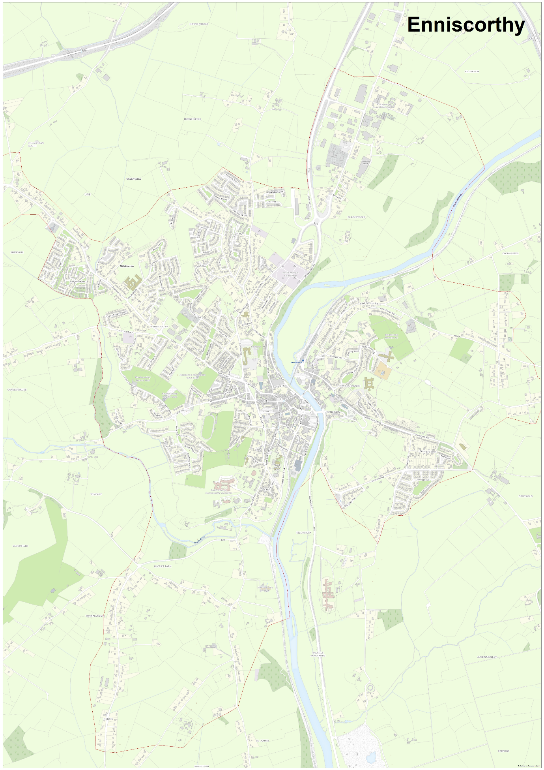
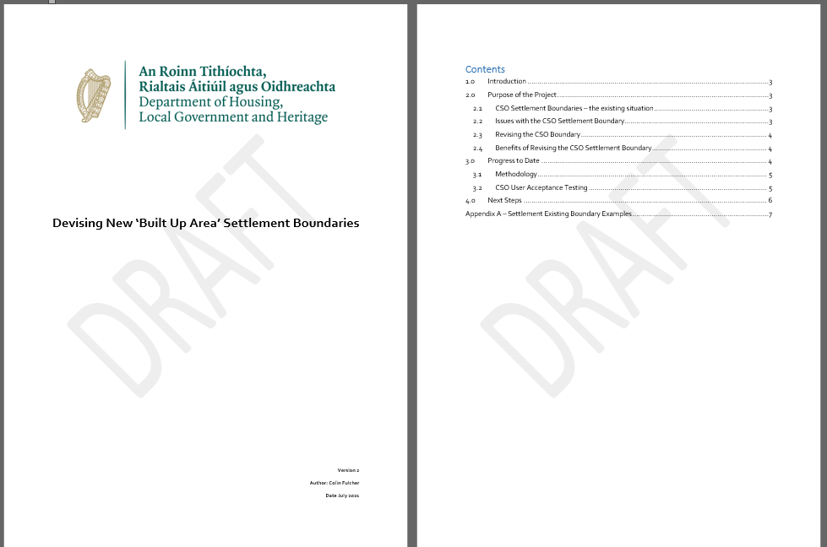

Slide 34
Statistical Product overview (2) “Built up Areas” / “Urban areas”
In Development since 2019, introduced in 2023
Defined algorithmically using an objective methodology, methodology developed / tested by CSO, passed to OSi for implementation core concepts: “data driven, objective, consistent”
The Algorithm searches for a cluster of minimum 100 Buildings (not dwellings) with a maximum distance of 65 meters between any of them
It analyses the clusters to determine if any are related to one another (i.e. different parts of the same larger urban area) and combines clusters where it determines they are in the same locale (threshold 250 meters)
It then generates a “minimum bounding geometry” around these super clusters and takes in building land parcels inside the minimum area
These land parcels are then combined into a “hull” and passed to CSO for review
CSO then aligned the hulls to our Statistical Small Areas, hence, a built up area is created by combining these SSAs

Slide 35
Statistical Product overview (2) Built up Areas
Methodology was agreed between Department of Housing, OSi and CSO
The Building Land parcel ensures erroneous green space is kept to a bare minimum
CSO still “owners” as they are aligned to our small areas but the hull defined objectively on Prime2 - not CSO “inc” saying this is or isn’t a settlement!
This also means they nest to other geographies (bringing them in line with the norm)
Definition is land cover based, but also topologically constricted (SSAs must nest to CSO EDs) so some non-urban land cover is included

Slide 36
Overview of boundaries

Slide 37
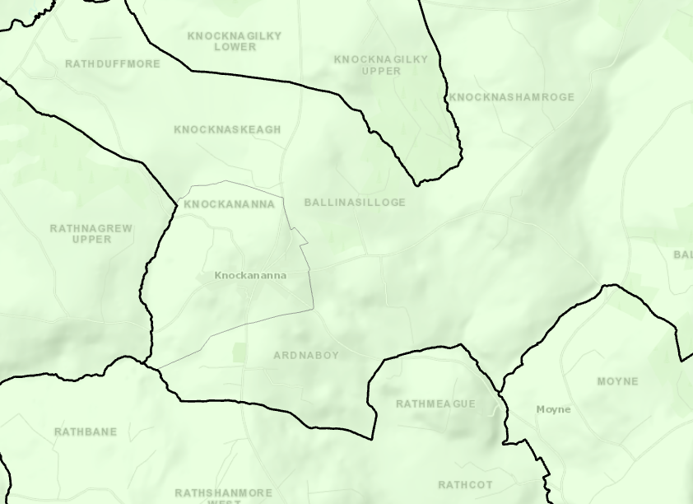
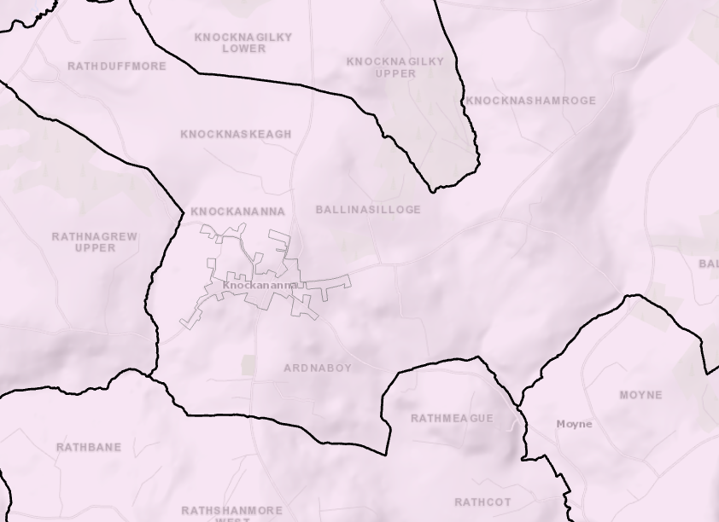

Slide 38
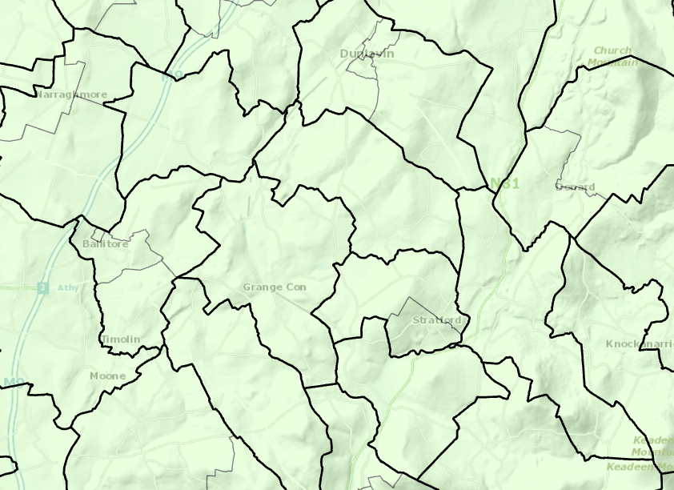
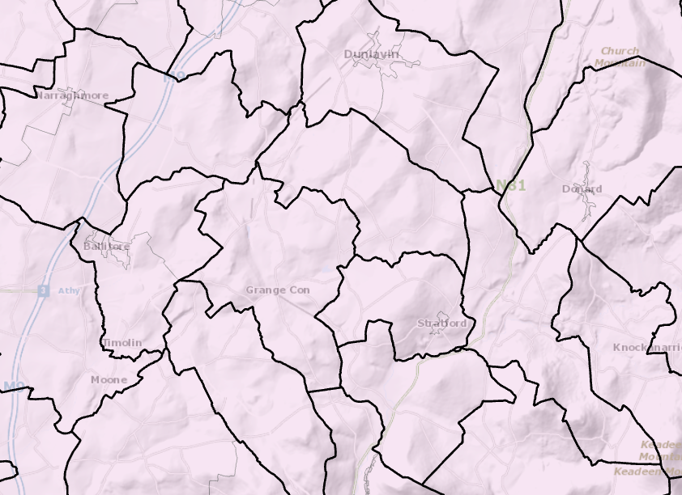

Slide 39
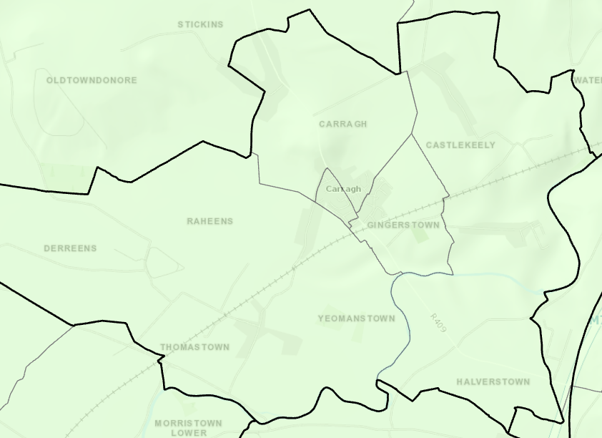
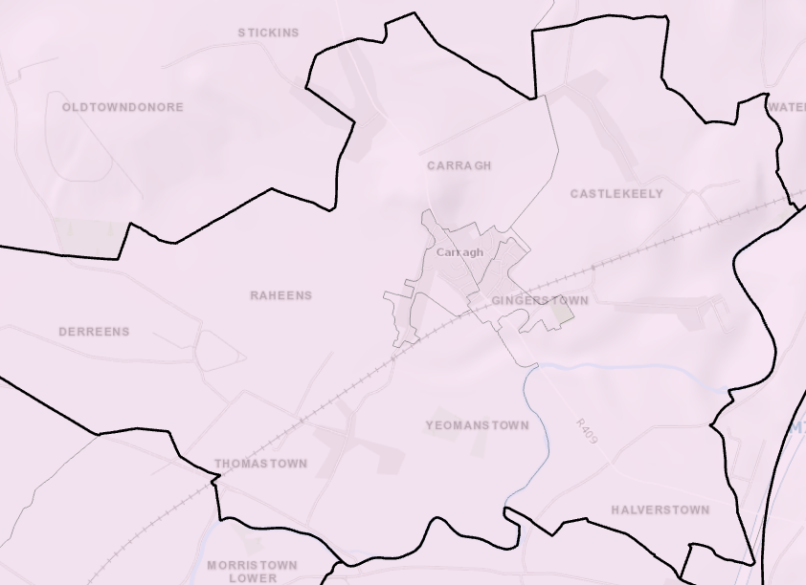

Slide 40
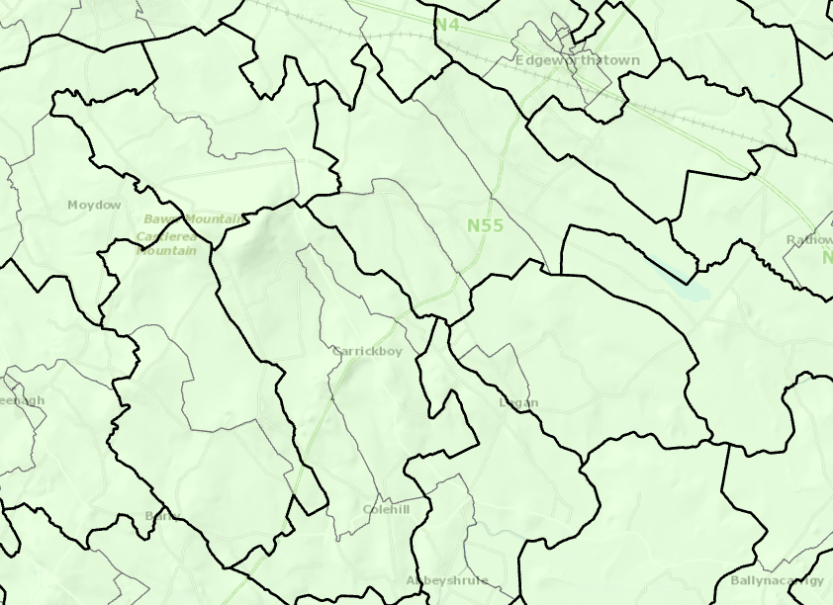
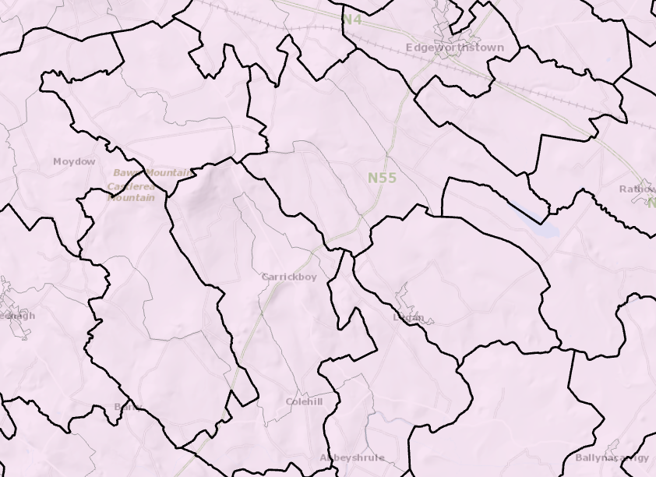

Slide 41
Statistical Product overview (1) Settlements

Slide 42
Statistical Product overview (2) Built up Areas

Slide 43
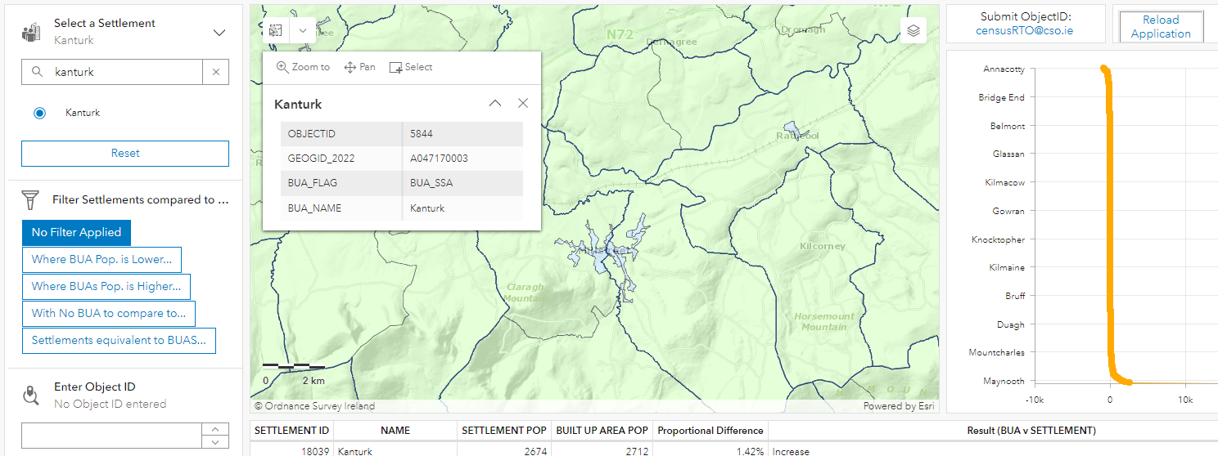
Comparisons between the two products
Demo

Slide 44
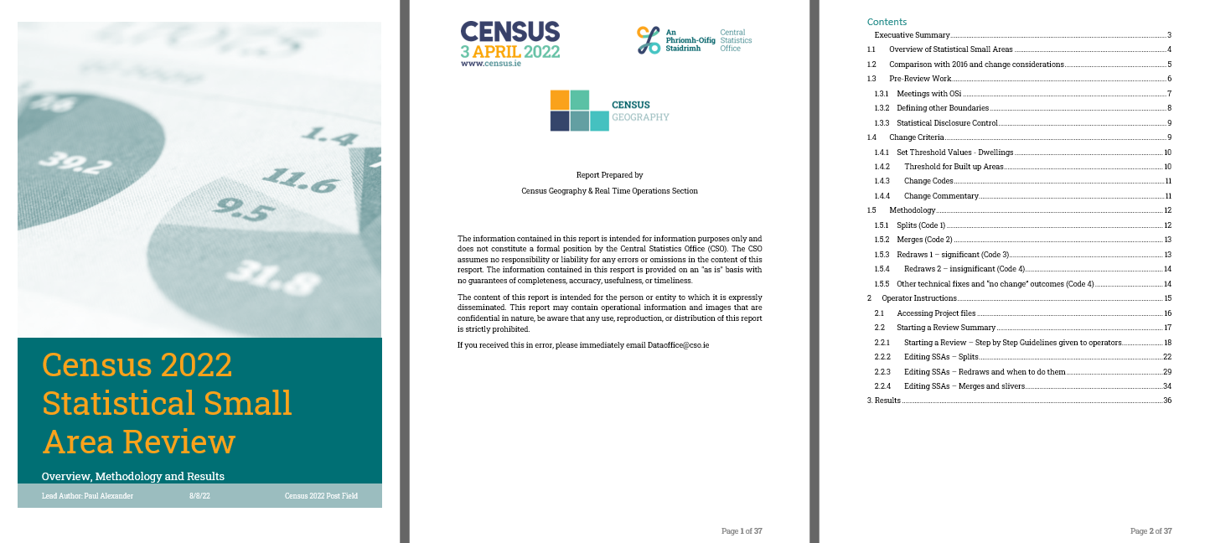
https://ie-cso.maps.arcgis.com/apps/dashboards/485741ea3d7d41e3b99e923456fe4eb3

Slide 45
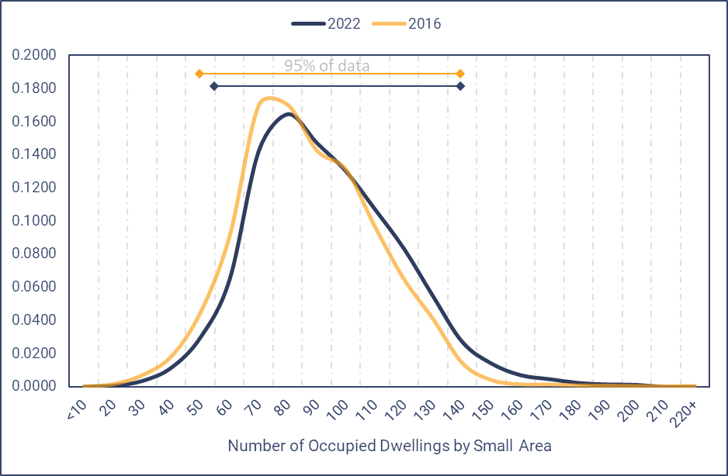
Summary Results of Statistical Small Area Review | N | p
Code 0 - No Change | 14553 | 76.9%
Code 1 - Split | 701 | 3.7%
Code 2 - Merge | 318 | 1.7%
Code 3 - Redraw (significant i.e., dwellings moved) | 2497 | 13.2%
Code 4 - Redraw (insignificant i.e., dwellings didn’t move) | 849 | 4.5%

Slide 46
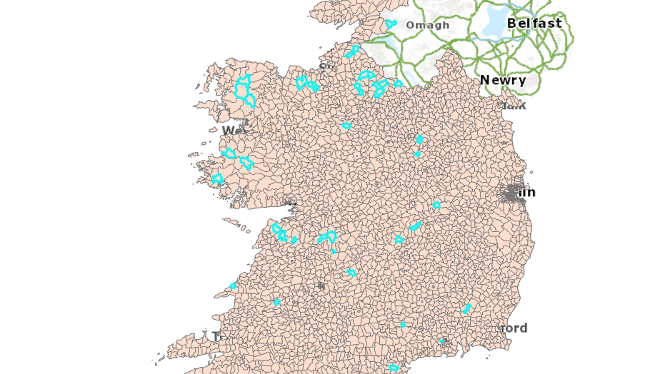

Slide 47
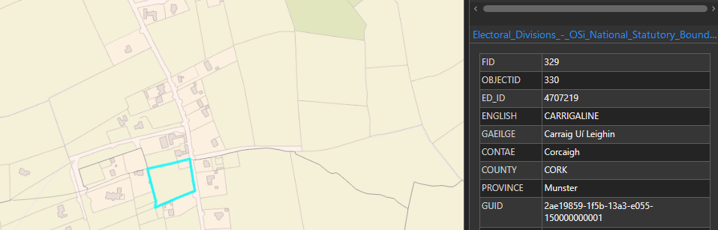

Slide 48
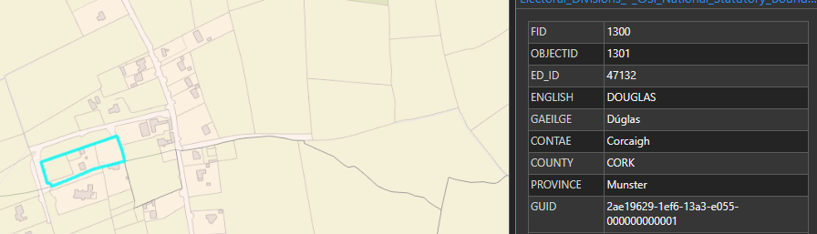

Slide 49
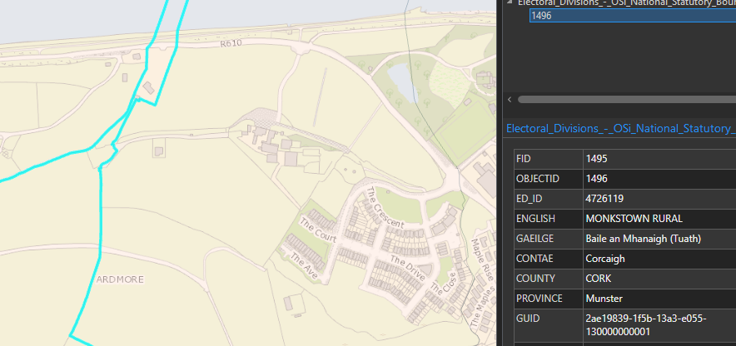

Slide 50
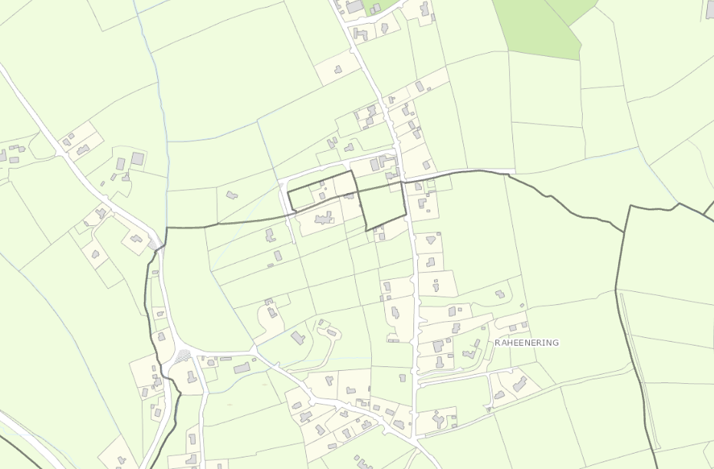
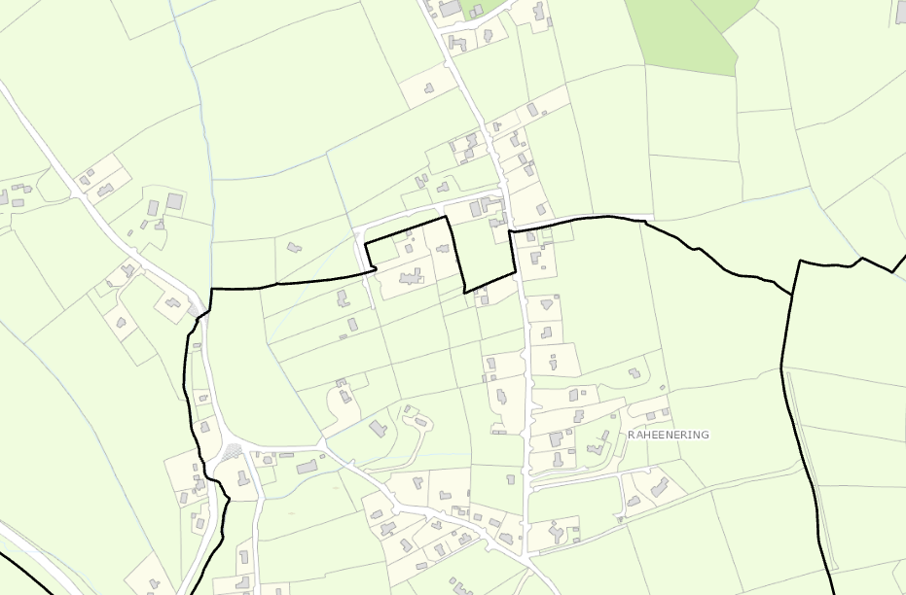

Slide 51
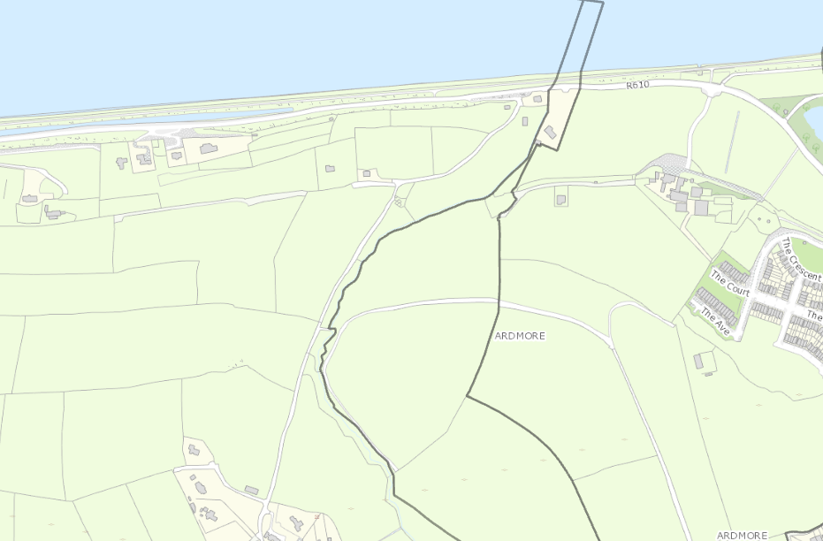
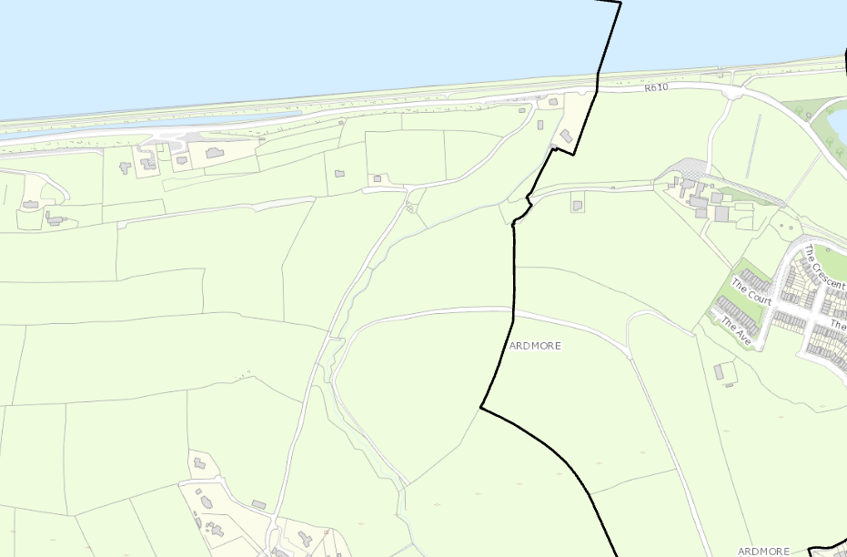

Slide 52
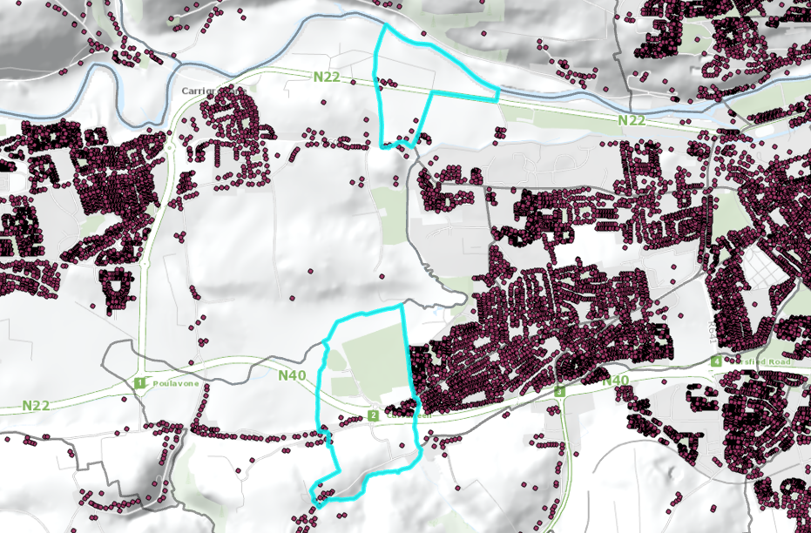
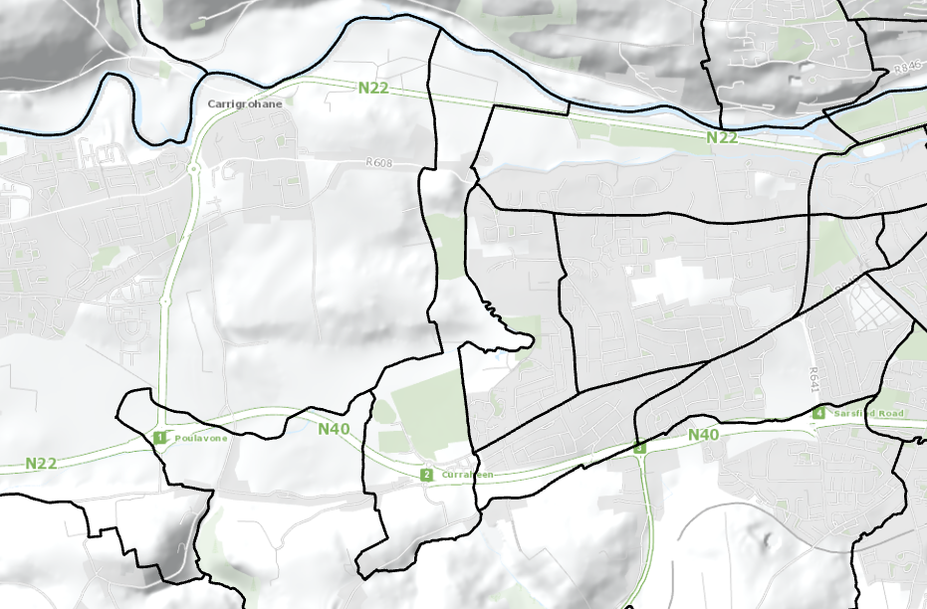

Slide 53
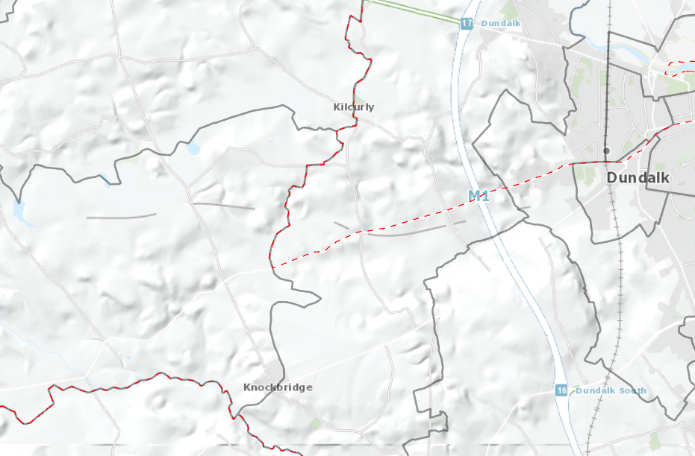
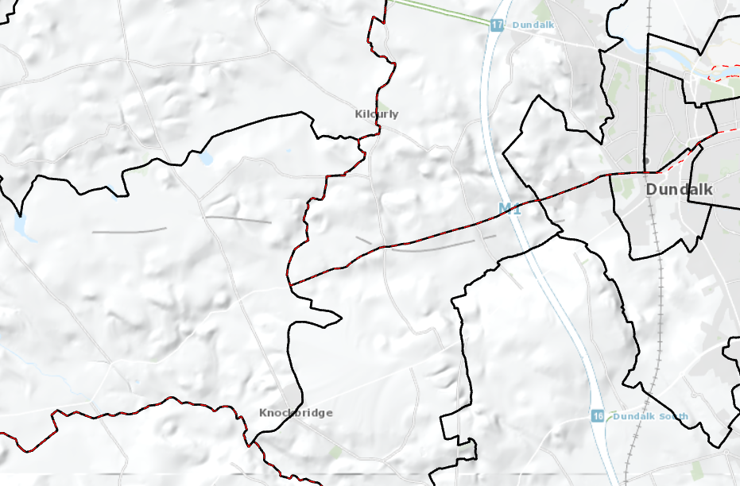

Slide 54
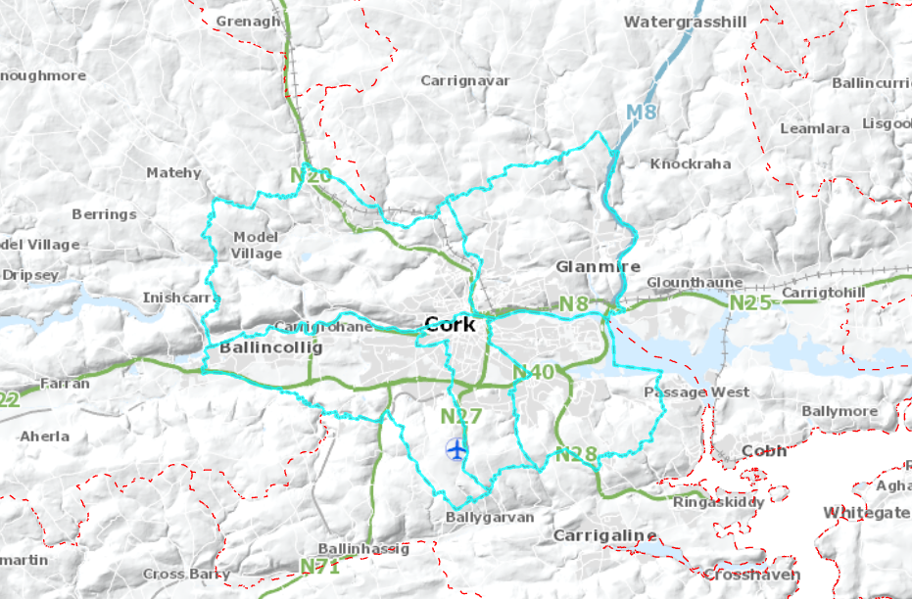
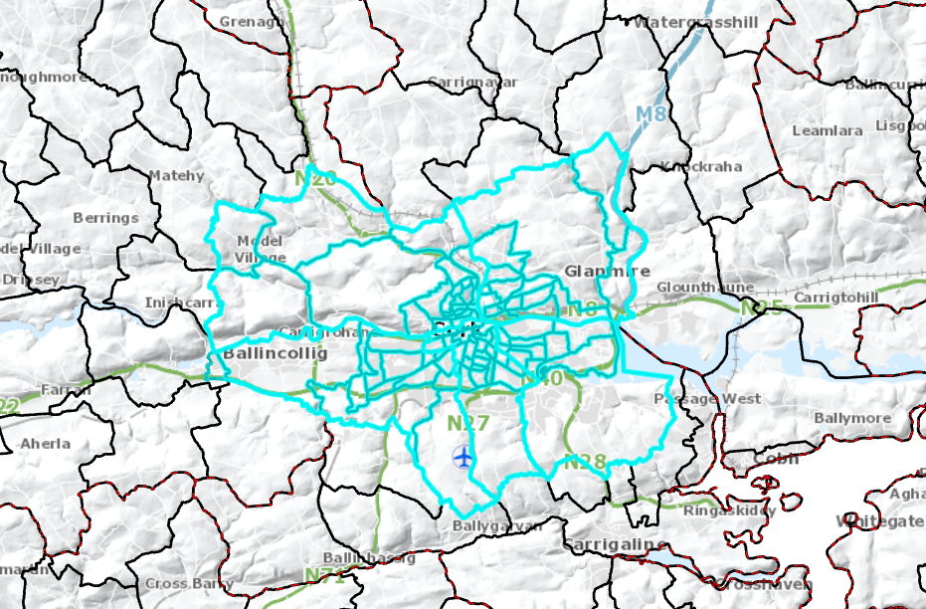

Slide 55
Questions & Answers

Slide 56
Frequently Asked Questions
Question
Answer
Why do some Settlements not have an equivalent BUA?
How are BUAs defined?
Generally because the BUA is bisected by an ED, and the resulting parts are too small in their own right to be considered Small Areas or they were not identified by the algorithm because a) there aren’t enough buildings and/or b) buildings are spaced too far apart
As a minimum of 100 buildings within 65 meters of one another, with a maximum distance of 250 meters between clusters

Slide 57
Frequently Asked Questions
Question
Answer
How are Settlements Defined?
How are Settlements Drawn?
As a cluster of 50 occupied dwellings within 100 meters of each other, with evidence of an “urban core”
Manually by CSO staff using Geographic Information Systems (GIS)

Slide 58
Frequently Asked Questions
Question
Answer
How are BUAS drawn?
A BUA/Settlement looks strange…
Automatically by a machine selecting Prime2 objects, then CSO Staff align these “hulls” our SSAs (to their edge using GIS)
Generally for BUAs, this will be caused by an ED, for Settlements could be human error

Slide 59
Frequently Asked Questions
Question
Answer
I think a Small area is being excluded from a BUA when I think it should be included, should I raise this?
I think a Small area is being included with a BUA when I think it should be excluded, should I raise this?
100% yes please - Please note down the SSA GUID and send it (with your observation) to census@cso.ie

Slide 60
Questions and Answers?
Anything unclear?
Would you like to know more about our processes?
Ideas, suggestions, experiences you have regarding how “urban” is defined in your organisation?

Slide 61
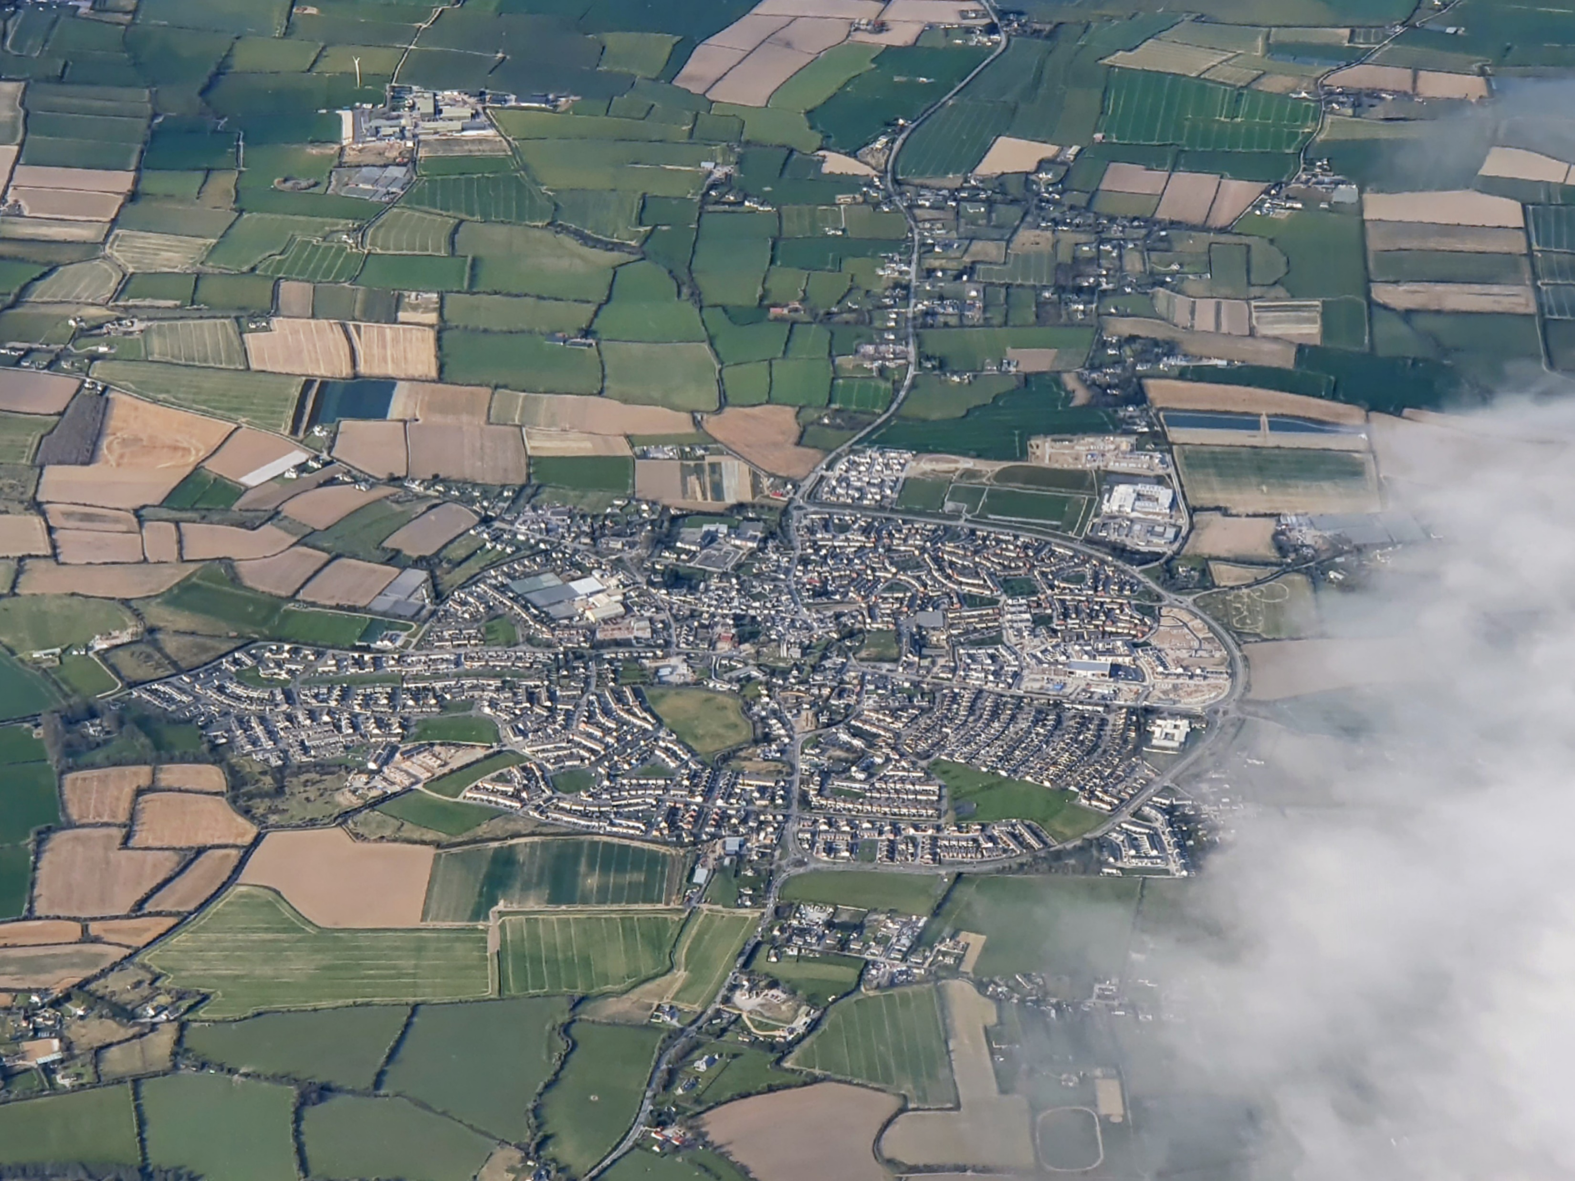
Thank
you

