Slide 1
Profile 2 – Housing in Ireland
27 July 2023

Slide 2
Housing stock
Occupancy status
Vacancy
Holiday homes
County change

Slide 3
Housing stock change, 2016 to 2022
Census 2022 housing stock was 2,112,121, over 5% higher than in Census 2016
Occupied households increased by 8% to 1.85 million
Vacant dwellings fell by nearly 20,000 (-11%) to 163,433
Holiday homes unoccupied on Census Night rose by 8% from 62,148 to 66,956

Slide 4
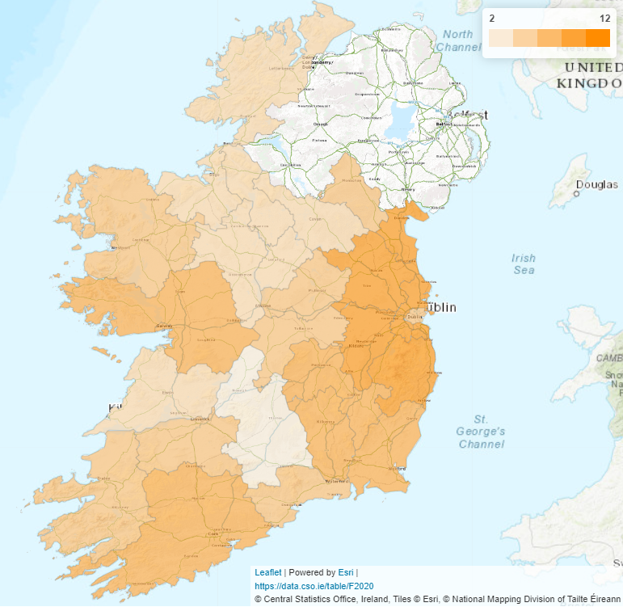
Housing stock change by county
Housing stock % change, 2016 to 2022
The growth in the housing stock varied by county
The fastest growth was in Meath and Kildare driven by new dwelling completions, both up 11%
Housing stock growth was slowest in Tipperary, Donegal and Leitrim, up 2% in each county

Slide 5
Occupied dwellings
Year built
Central heating
Renewable energy
Internet connectivity

Slide 6
Occupied dwellings by year built and type
Almost 90% more dwellings built between 2016 and 2022 than between 2011 and 2015
Number of houses has doubled, driven by increase in semi-detached and terraced homes
Apartments are up over 50%

Slide 7
Central heating
Central heating by year built, 2022
Newer dwellings more likely to use electricity for central heating and less likely to use oil
Natural gas used by almost 1 in 3 dwellings
Very few new dwellings using solid fuels as the main source of fuel for heating

Slide 8
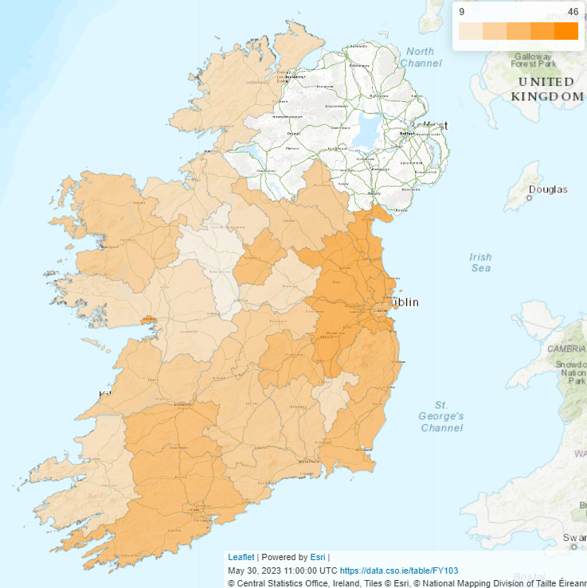
Renewable energy
Solar panel usage in new builds (%)
1 in 4 households used renewable energy
Wood was the most common source, mainly in older homes
73% of new homes used renewable sources, mainly solar panels and heat pumps

Slide 9
Internet connectivity
Type of internet connection by age, 2022
1.46 million (79%) homes had a broadband connection
Just 3% of householders aged 30 to 44 had no internet connection
34% of people aged 65 or over and living alone had no internet connection at home

Slide 10
Devices accessing the internet
69% of homes used a laptop
87% used mobile phones and 51% used tablets
59% used smart TVs and 28% used video consoles

Slide 11
Home ownership and rent
Owner occupiers
Private rental accommodation
Average weekly rent

Slide 12
Home ownership and rent
Home ownership rate down from 68% in 2016 to 66% in 2022
Owner-occupied with a mortgage or loan down 1%
Owned outright up 11%
Total rented properties now over half a million

Slide 13
Private rental accommodation
Age of householders in private rental accommodation
Up 7% to over 330,000
Up 83% where head of the households was aged 65 or over
Up 69% for householders aged 60 to 64 years

Slide 14
Home ownership rates by age
By the age of 36, more than half of householders owned their home, up from 35 in 2016
By age 44, two thirds of householders were homeowners, up from 41 in 2016

Slide 15
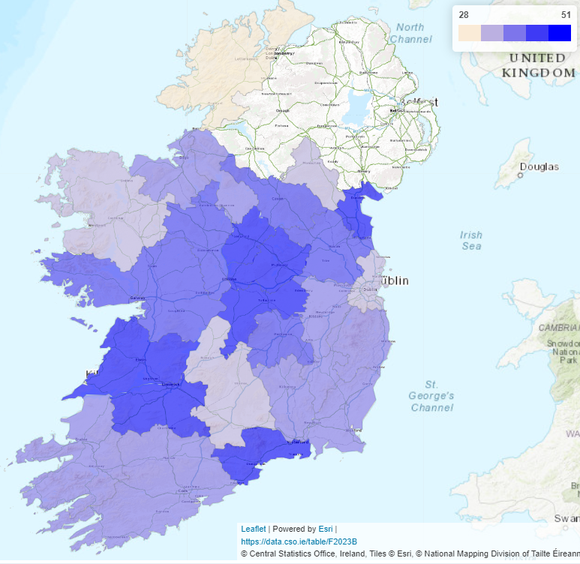
Average weekly rent*
Change in average weekly rent* (%)
Up 37% to €273 in 2022 from €200 in 2016
Highest average rents in Dublin
Rising fastest in Longford, Louth, Westmeath and Clare
*In private rental accommodation

Slide 16
Vacancy
Vacancy change
Long-term vacancy

Slide 17
Housing stock and vacancy change
As the housing stock increased rapidly in the 2000s, the number of vacant dwellings increased at an even faster rate
Since 2011, growth in the housing stock has slowed and vacancy has fallen

Slide 18
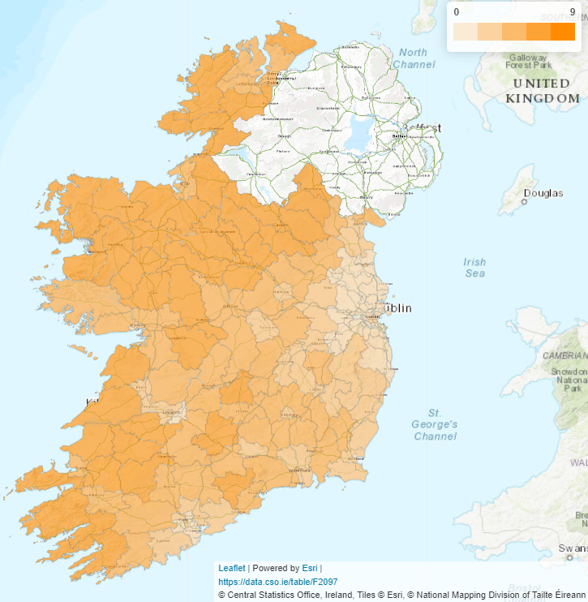
Long-term vacancy
Long-term vacancy rates by LEA, 2022
Just under 48,000 homes that were vacant in the 2022 census were also vacant in the 2016 census, 2% of the housing stock
In parts of Dublin and Kildare less than 1 in 200 homes were vacant in 2022 and also in 2016

Slide 19
Census 2022 link and contact details
https://www.cso.ie/en/statistics/population/censusofpopulation2022/
Phone (+353) 1 895 1300
Email census@cso.ie

Slide 20
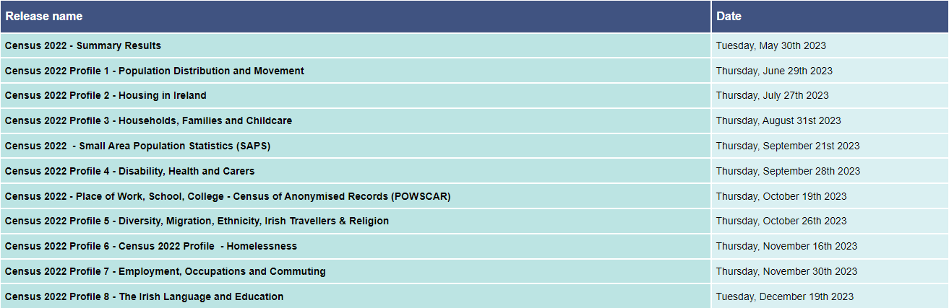
Census 2022 publication schedule
Notes:
Thank you for taking the time to watch todays presentation. The next results from the census, on Households, families and childcare, will be published at the end of August.

Slide 21
