Slide 1
December 1st 2023

Slide 2
Census 2022
Social Inclusion indicators & Census 2022 background
Child deprivation
Migrant integration
Longitudinal microdata

Slide 3
Social Inclusion
Many indicators derived from CSO surveys
Survey on Income and Living Conditions (SILC)
  At Risk of Poverty
  Material Deprivation
  Household amenities and access to services
Labour Force Survey
  Employment / Unemployment rates
Growing Up in Ireland
  Determinants and impacts of social exclusion in children and young adults

Slide 4
Census 2022 Background
Census Night – Sunday, 03 April 2022
Six years since previous Census
Over 5,600 field staff
10-week period field operation
Census Processing May 2022 to February 2023
Thematic publications and data released throughout 2023 & 2024
Small Area Population Statistics released September 2023
All data and publications available now on www.cso.ie

Slide 5
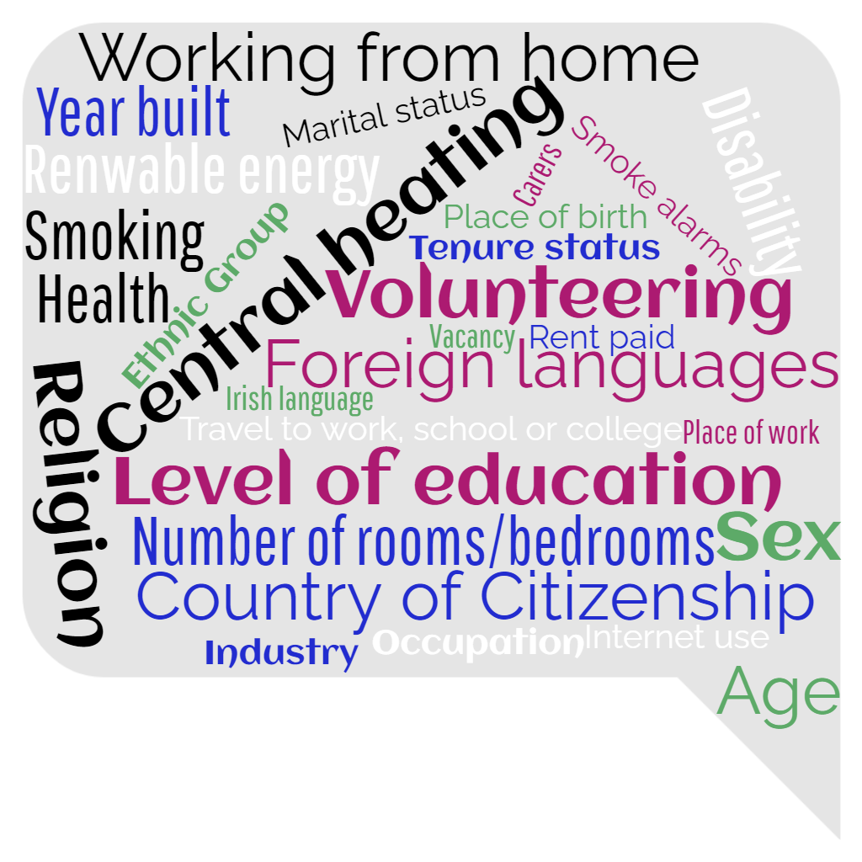
Census 2022
5.15 million people
2.1 million dwellings
45 questions
Over 100,000 data tables

Slide 6
Census : Social Inclusion
Housing
Education
Employment
Digital Inclusion
Access to transport
Ability to speak English
Disability / Activity Limitation
Health
Volunteering
Income (via linkage to administrative data)
by
Age
Ethnicity
Country of citizenship
Place of birth
…….

Slide 7
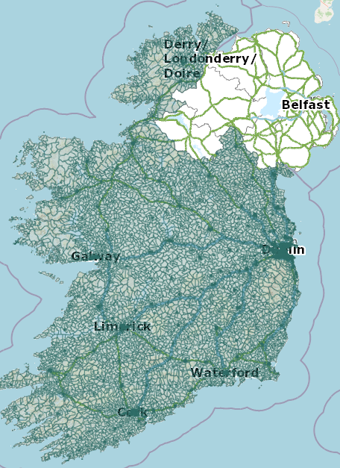
Geographical Disaggregation
8 Layers of Geography now available
  Small Areas (18,000+)
  CSO Electoral Divisions
  CSO Local Electoral Areas
  Local Authorities
  Limistéir Pleanála Teanga
  NUTS 3 Regions
  Provinces
  Towns
15 themes and 50 data tables for every area

Slide 8
Census 2022 Child deprivation
New high-level analysis
Defined using Deprivation Index
Areas classified as ‘Extremely’ or ‘Very’ deprived
196k people, 45k children. 4% of population
33% in Dublin, 10% in Limerick, 9% in Cork
Cause & effect caveat
More granular analysis is possible, including income

Slide 9
% in rental accommodation
% in rental accommodation significantly higher
Majority in Local Authority rental properties
Relatively low proportion in private rentals
68%

Slide 10
Dwelling type & Relative crowding

Slide 11
Household composition
Children in less deprived areas more likely to be part of a ‘married couple family unit’
Children in deprived areas more likely to be part of one parent mother family units

Slide 12
Economic status of householder
Householder more than twice as likely to be unemployed in very deprived areas
Also more likely to be full time looking after family or unable to work
53% at work in deprived areas

Slide 13
Self-assessed Health
Less reporting of very good health among all cohorts of children in deprived areas
Discrepancy worsens among secondary school age children

Slide 14
Disability
Disability low among all cohorts
However, more pronounced in deprived areas
Further analysis possible on disability types and extent

Slide 15
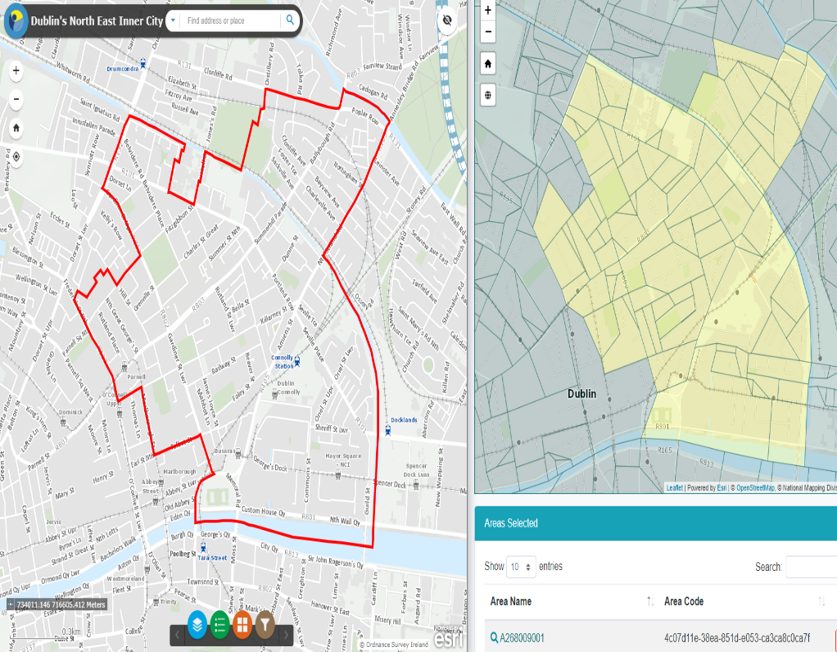
Geographical Disaggregation

Slide 16
Migrant integration
People who were present on Census Night 2022
Born outside Ireland
Country of origin
‘Longer term’ migrants arrived pre-2020
‘Newer’ migrants arrived 2020, 2021 & 2022
Many ways to examine this topic!

Slide 17
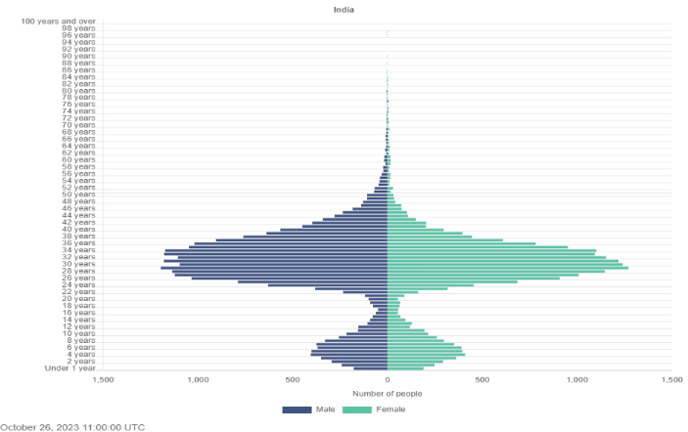
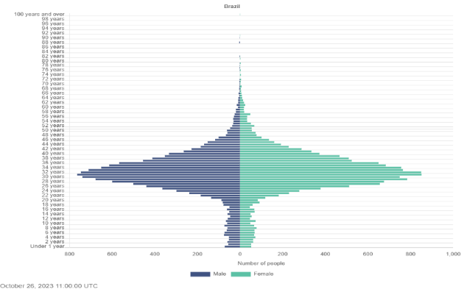
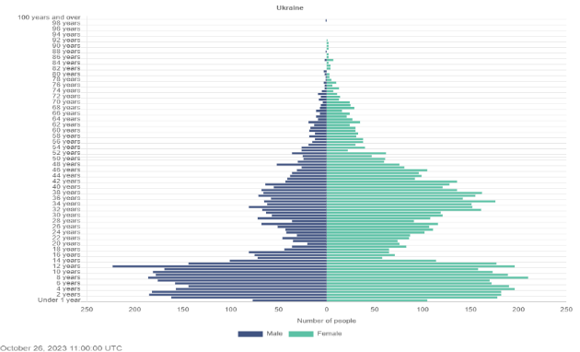
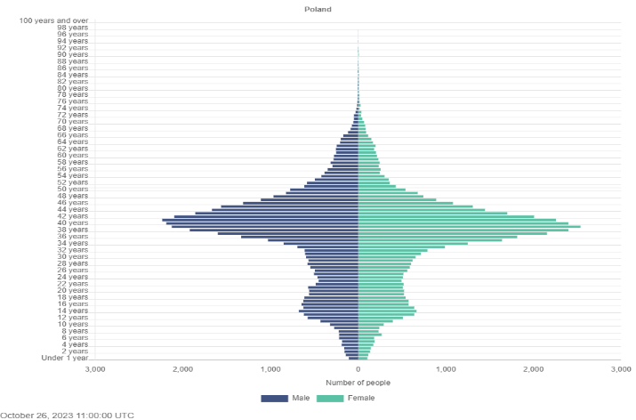
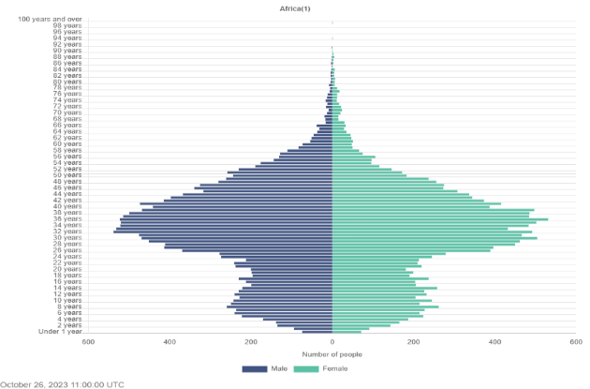
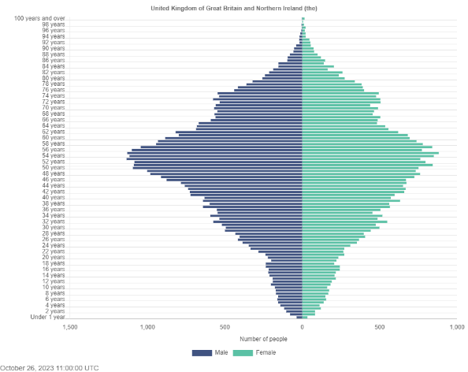
Age profile
Indian
Brazilian
Ukrainian
Polish
Africa
UK

Slide 18
Tenure
Nationally 28% rent
Renting less likely among more established migrants
Among most new migrant groups, very high % of renters
Variation by country of origin
Persistence of renting among Brazilian migrants
Relatively low among Chinese migrants

Slide 19
Relative crowding
Nationally 6% overcrowding
Higher for many migrant groups
Higher among newer migrants
Pronounced among newly arrived Indians and Brazilians
Persistent among Other Asia group

Slide 20
Irish citizenship
Irish citizenship much higher among longer-term migrants
Significant variation by country of origin
Lower among longer term Chinese and Indian migrants than African and other Asian
Very low among Brazilian migrants
Citizenship may have been acquired before arrival

Slide 21
Labour force participation
Persons 15+ either at work or unemployed
National average 61%
Generally higher among longer term migrants
Lower among some cohorts for newer migrants which include more students
61%

Slide 22
Unemployment
Percentage of persons unemployed as a proportion of the Labour Force
National average 8%
Higher among newer migrants
Lower among many longer-term migrant groups

Slide 23
Level of education
National average 45%
Migrants much more likely to have third level education
More recent African, Chinese and other Asian migrants better educated
More recent Brazilian migrants slightly less well educated
45%

Slide 24
Sector of employment
Human health & social work
IT and communication services
Professional, scientific and
technical activities
More concentrated sectorally than general population

Slide 25
English ability
English language ability generally better among longer term migrants
Chinese and Brazilian newer migrants have lower English ability
Most longer-term migrants have at least reasonable spoken English

Slide 26
Volunteering
National rate 14%
High rates among longer-term migrants
High level among newer African migrants
Volunteering among religious and social groups prominent

Slide 27

Longitudinal Research File
10% anonymised sample of the 2022 population
Linked back to 2016 (and possibly 2011)
Facilitates examination of outcomes over time
Continuous rather than discrete analysis
E.g. labour market, housing, health, education
Available to approved researchers in 2024

Slide 28
Thank you!

