Slide 1
Labour Force Survey
Quarter 1, 2026
21st May 2026

Slide 2
Labour Force Survey and NACE Rev. 2.1.
Today’s Labour Force Survey (LFS) uses the new NACE Rev. 2.1. as the primary classification for industrial sectors.
Labour market estimates in today’s publication and PxStat now reflect the updated NACE classification.
We will continue to publish estimates with the NACE Rev. 2.0 classification on PxStat.
The biggest differences can be seen NACE G “Wholesale & Retail Trade” and NACE S-V “Other Services”

Slide 3
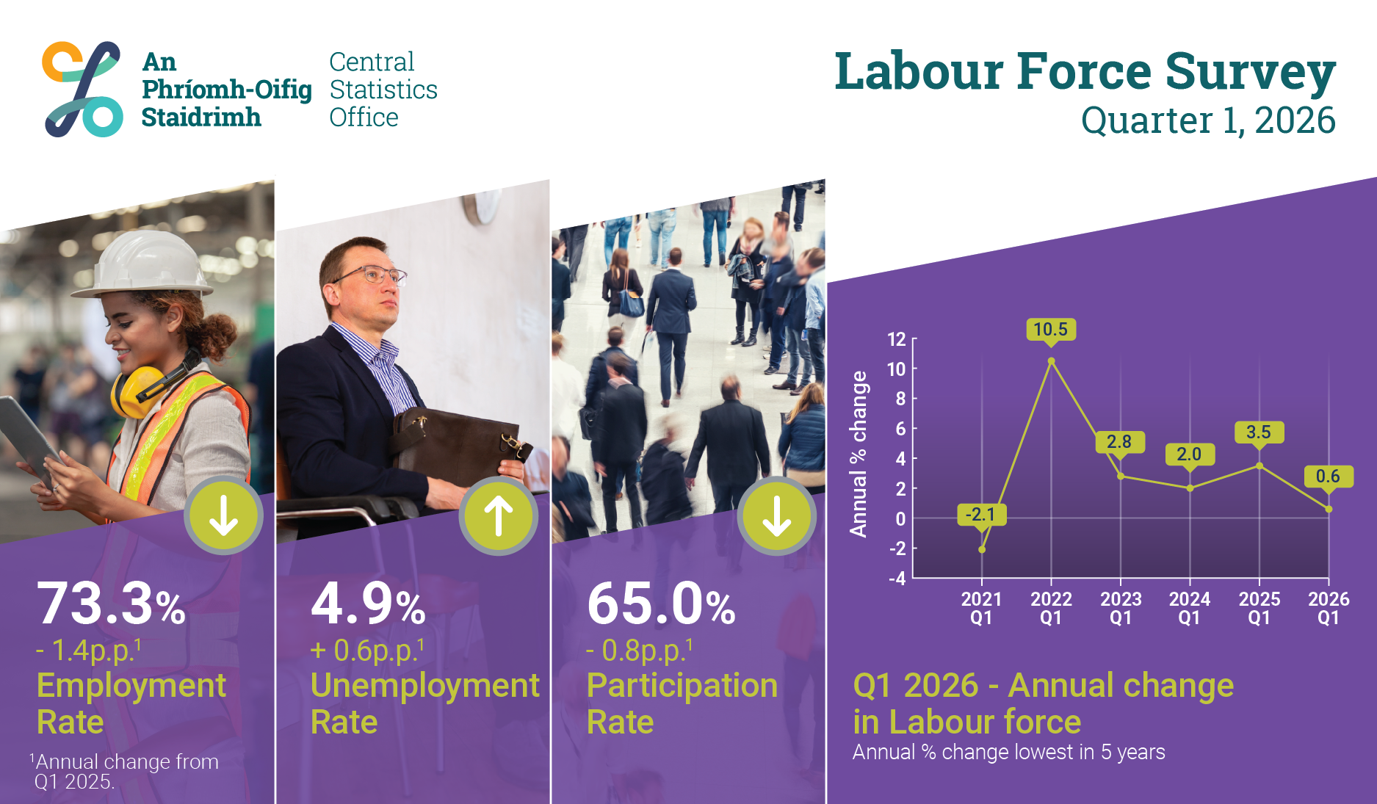
Infographic
Thousands

Slide 4
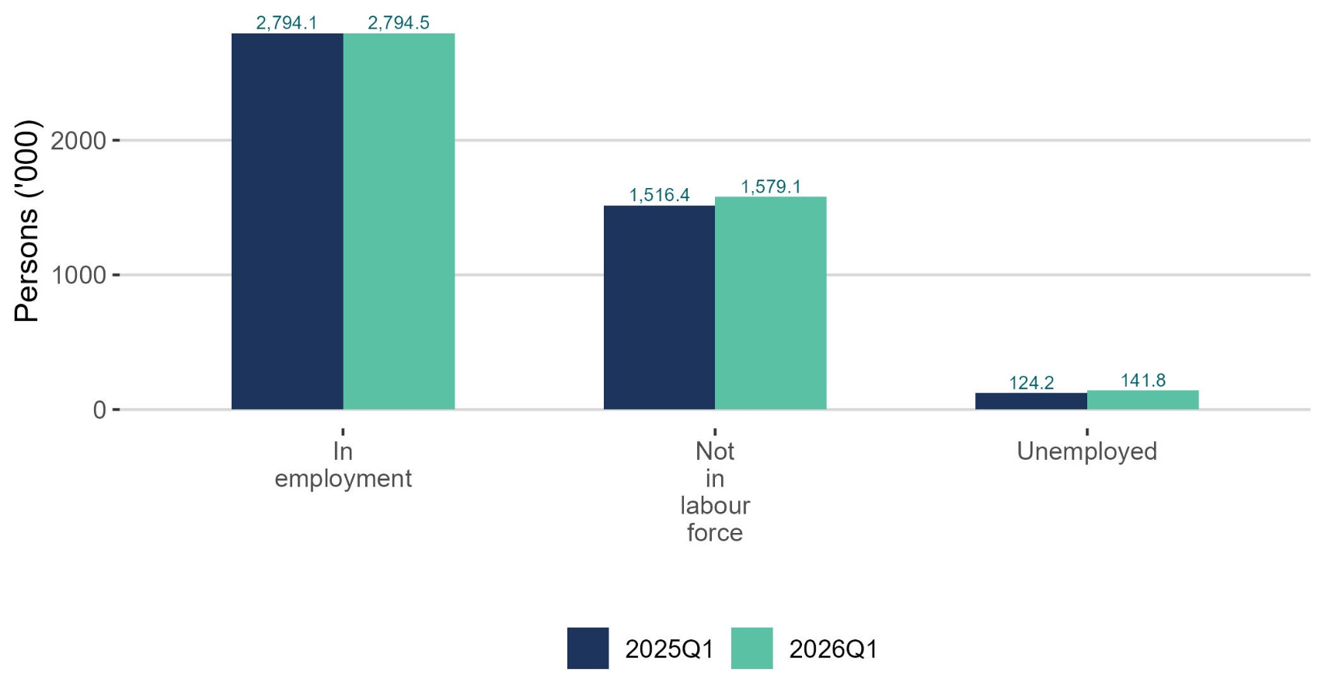
Unemployment increased 14.2% compared with a year ago
thousands

Slide 5
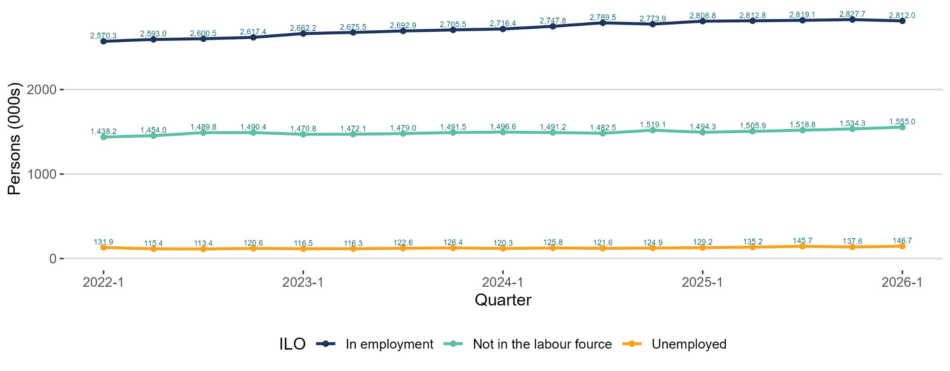
Seasonal adjustment employment down 0.6% from last quarter
thousands

Slide 6
In employment
Q1 2026:
Persons in employment: 2,794,500 up 400 persons
Employment rate (15-64): 73.3% -1.4 p.p.
Seasonally adjusted: 2,812,000 -0.6% on Q4 2025

Slide 7
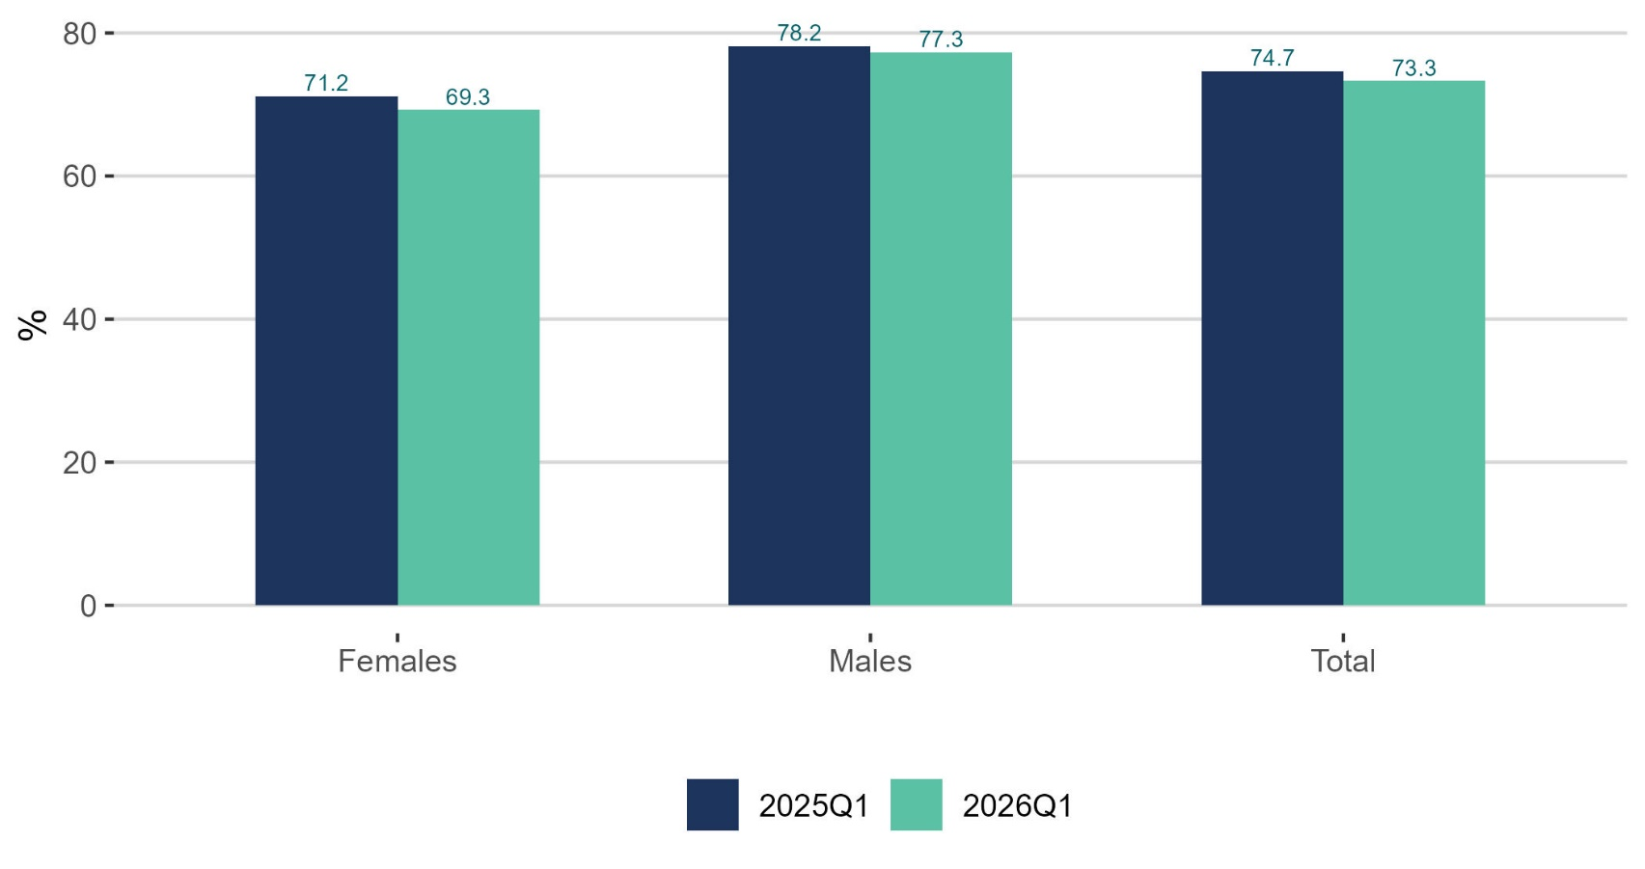
Employment rate declined for males and females
%

Slide 8
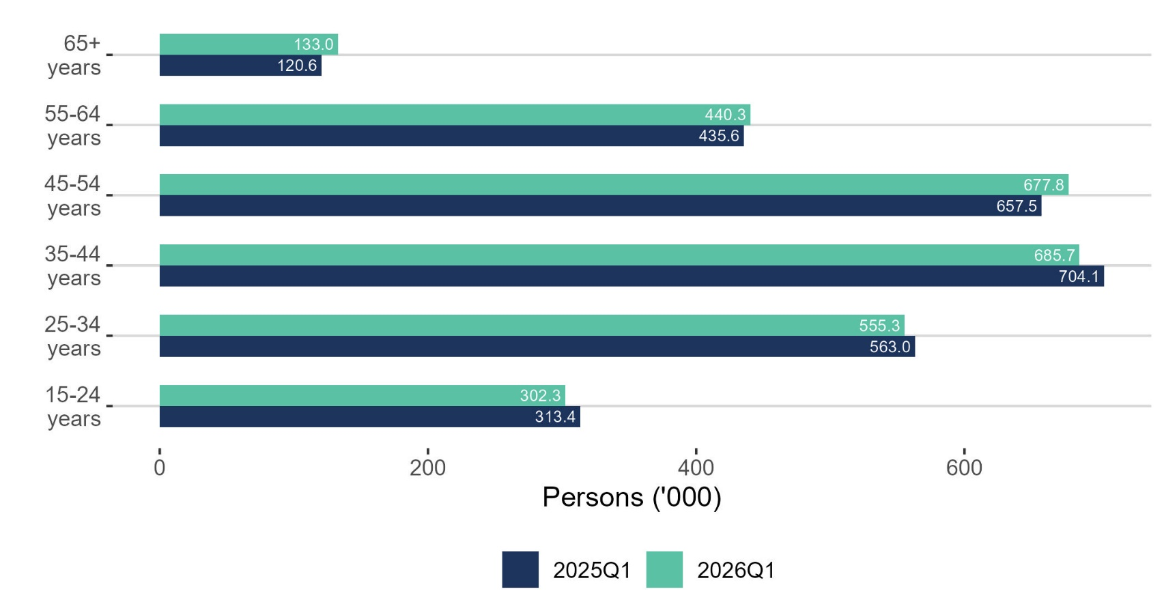
Employment decreased for younger age groups
thousands

Slide 9
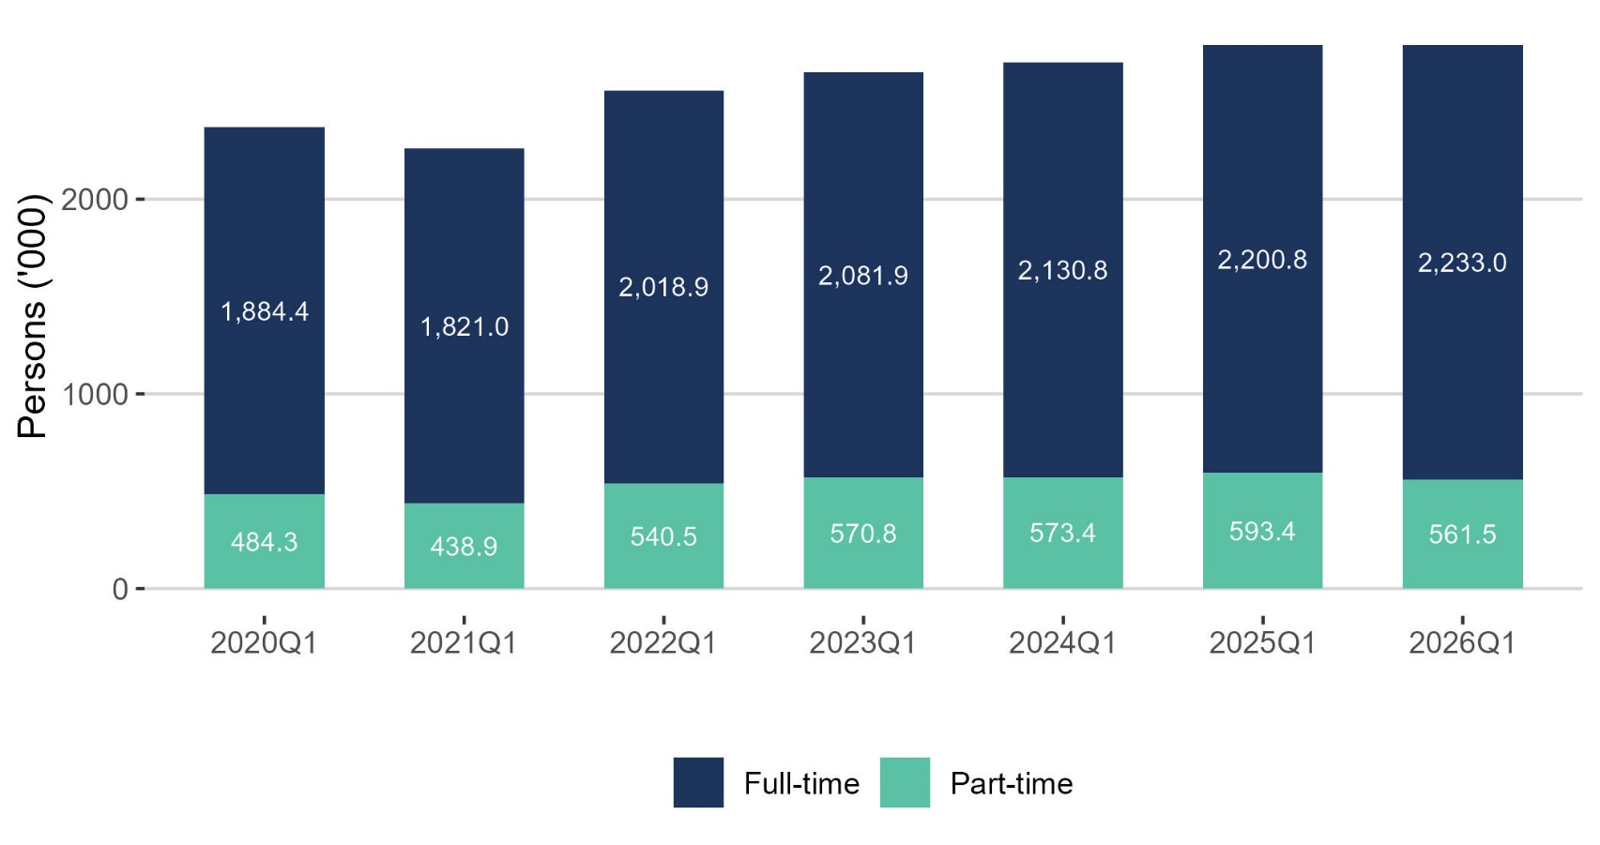
Full-time employment up 18.5% over six years
thousands

Slide 10
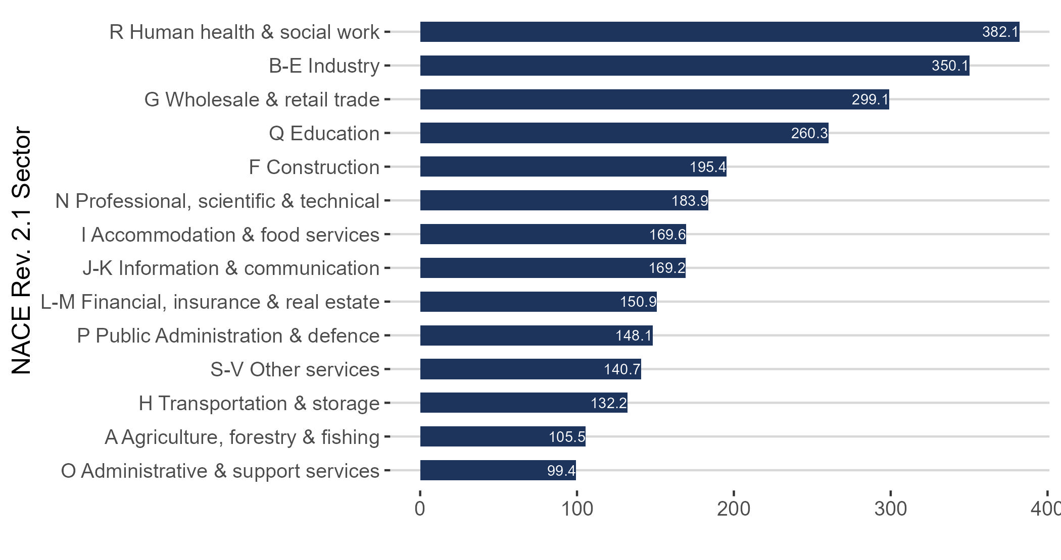
Human heath & social work the largest NACE Rev. 2.1. sector
thousands

Slide 11
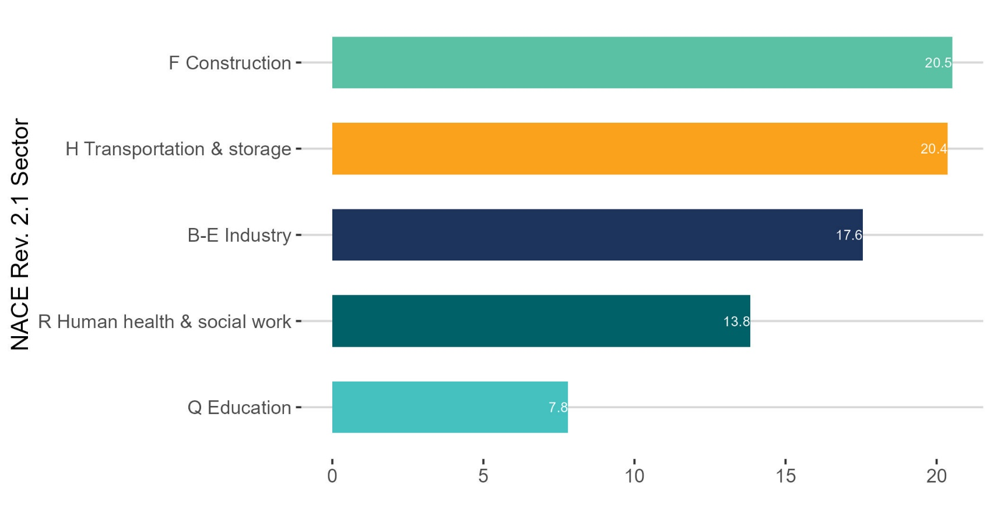
Largest increase in Construction
thousands

Slide 12
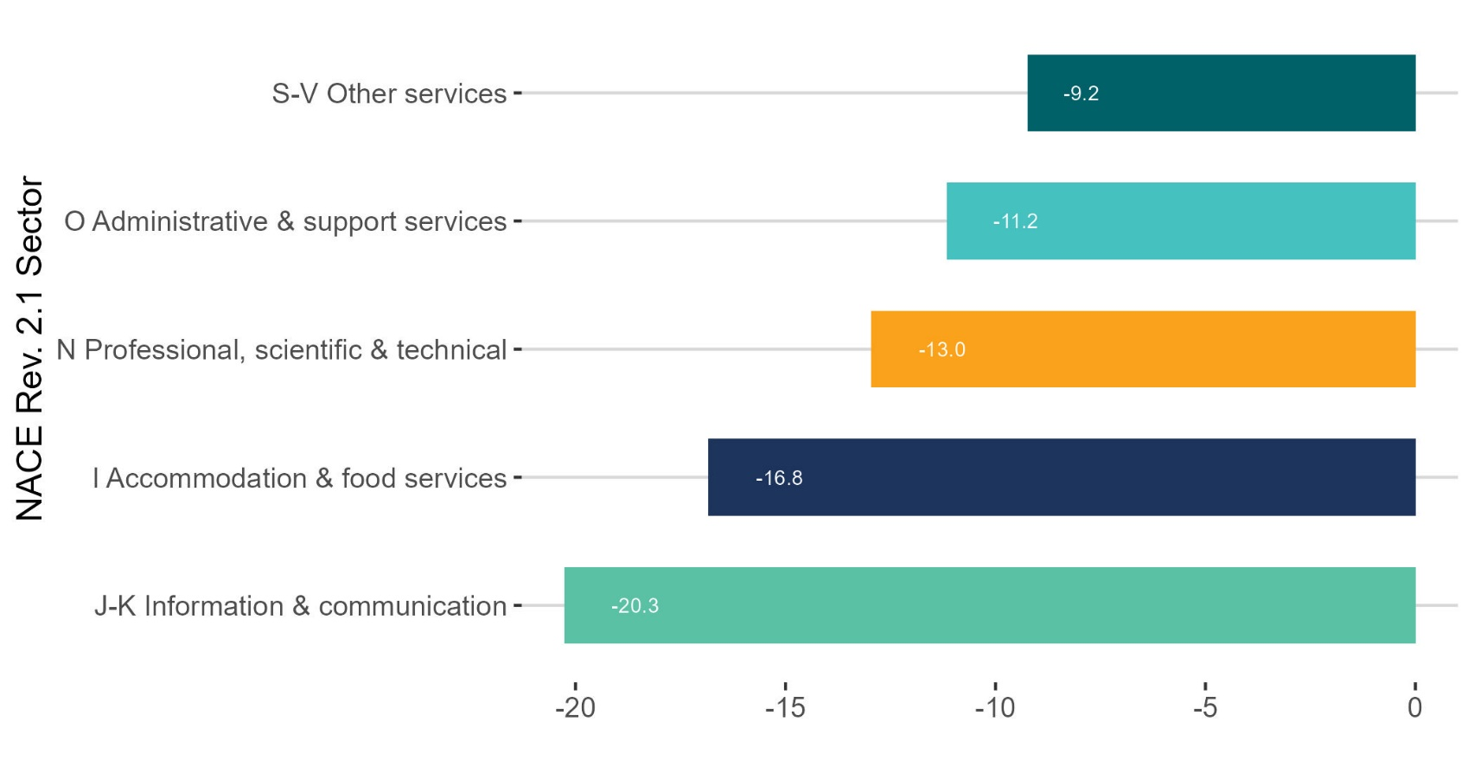
Largest decrease in Information & communication
thousands

Slide 13
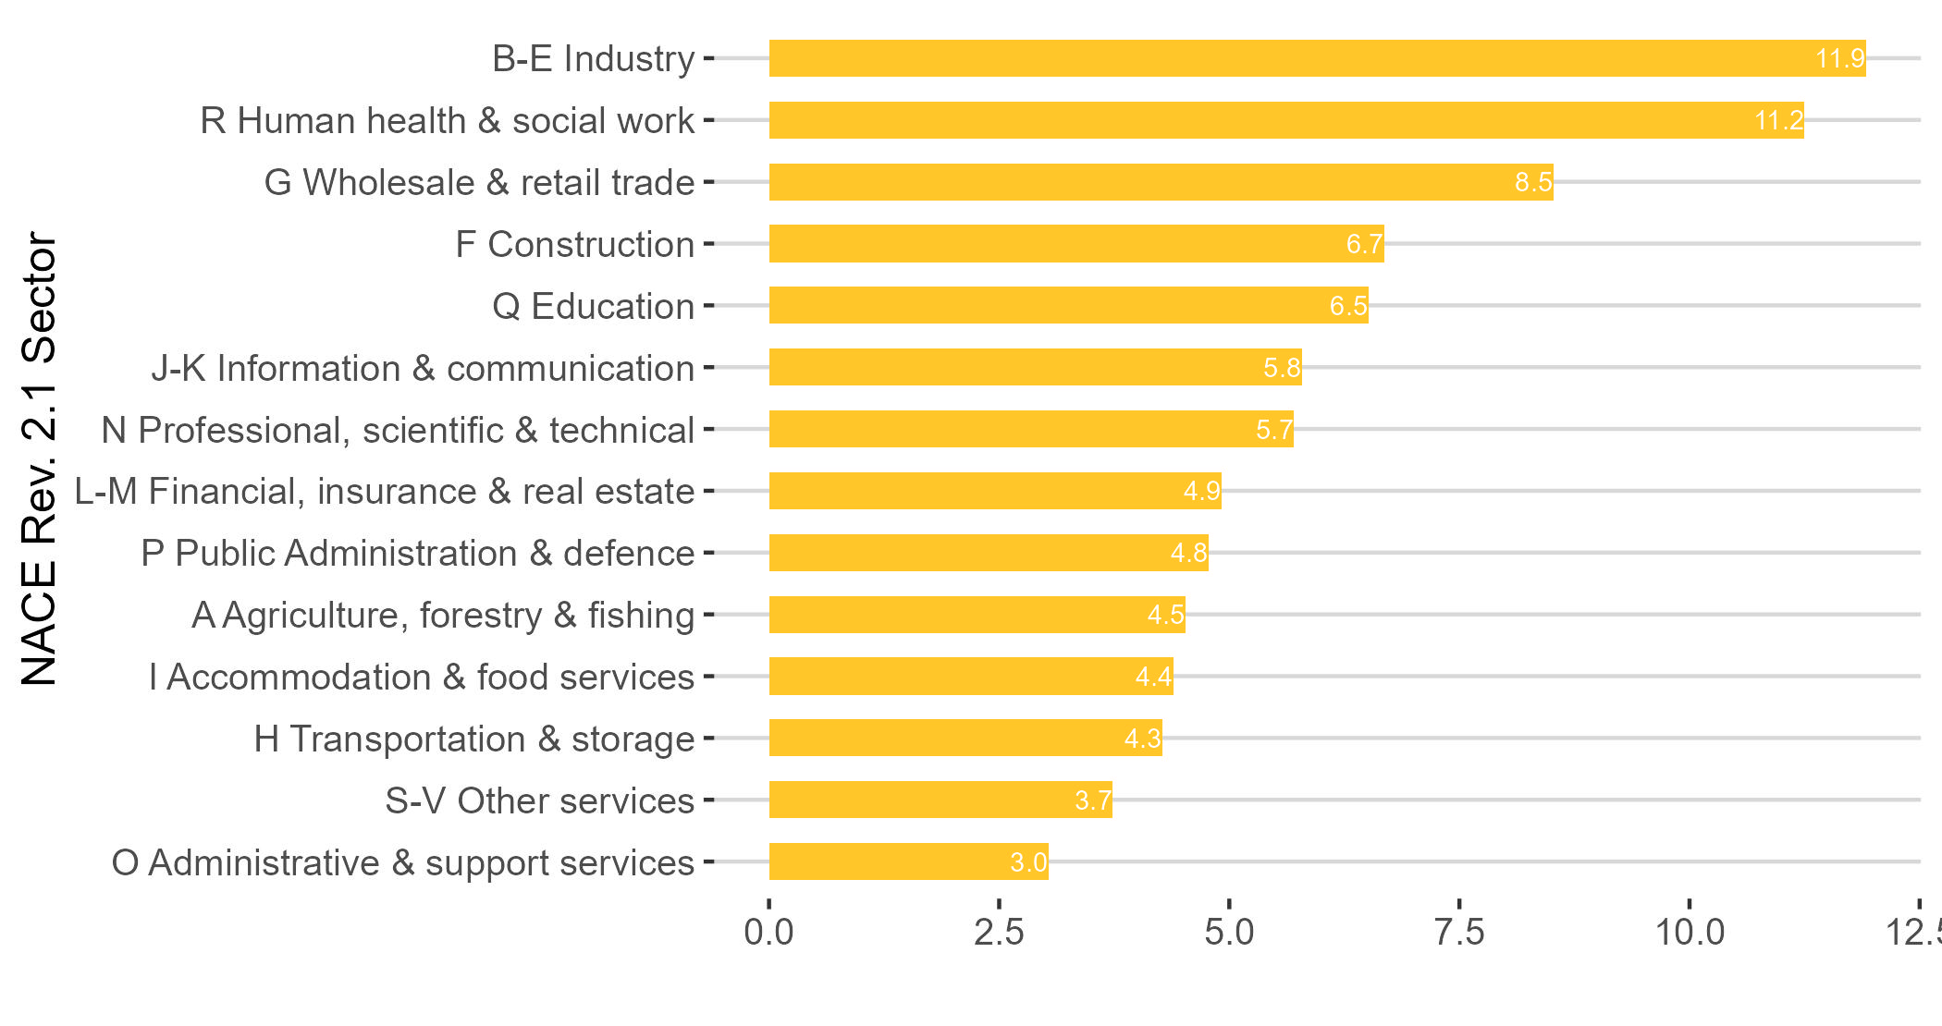
Most actual hours worked (millions) per week in Industry
millions

Slide 14
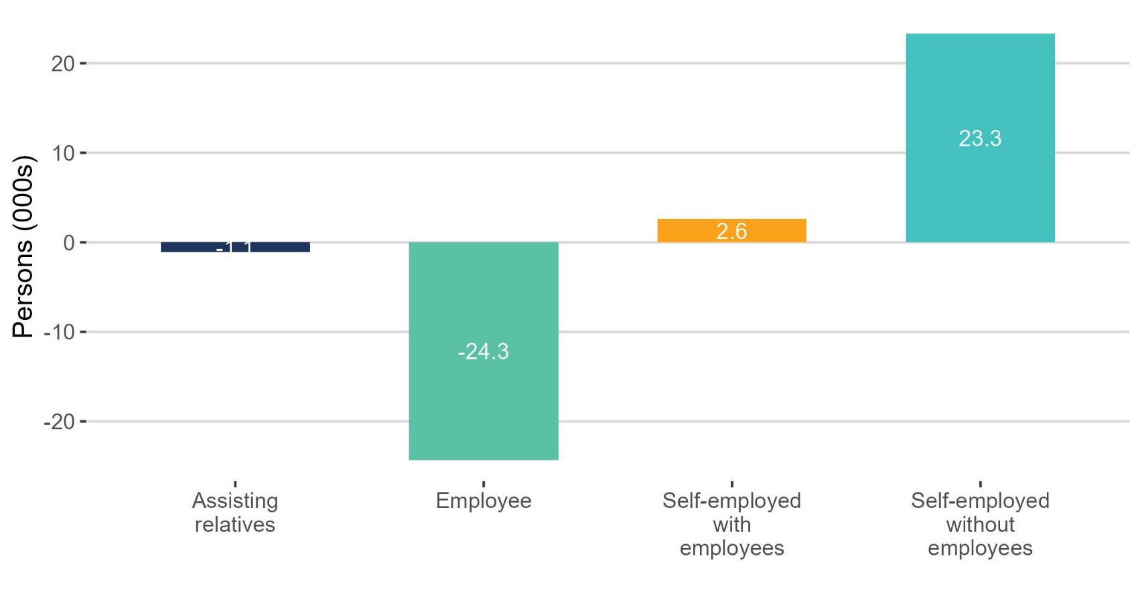
Self-employed up 7.3% compared to a year ago.
thousands

Slide 15
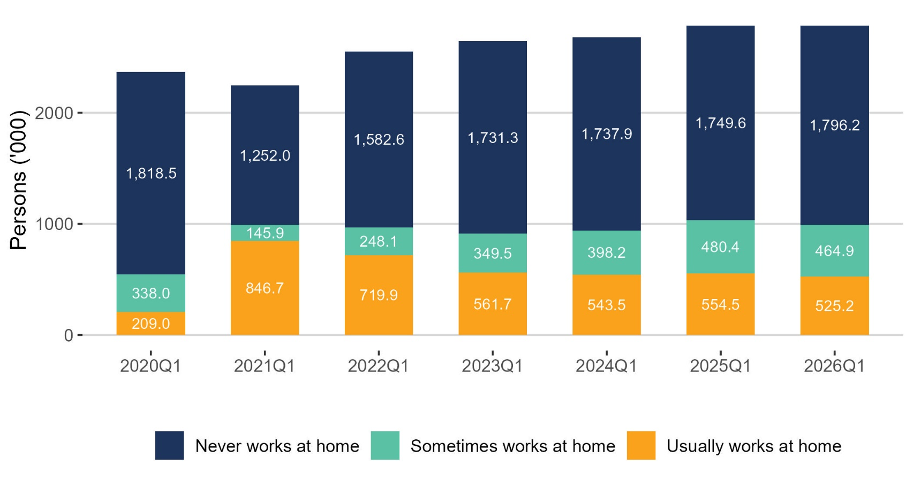
Remote working decreased
thousands

Slide 16
Unemployment
Q1 2026:
Persons unemployed: 141,800 +14.2%
Unemployment rate (15-74): 4.9% +0.6 p.p
Persons unemployed (SA): 146,700 +6.6% on Q4 2025
Seasonally adjusted rate: 5.0% +0.3 p.p on Q4 2025

Slide 17
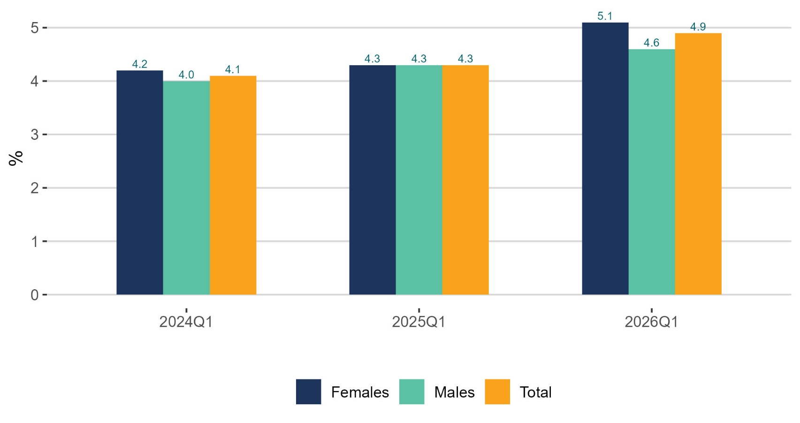
Unemployment rate increasing for both males and females
%

Slide 18
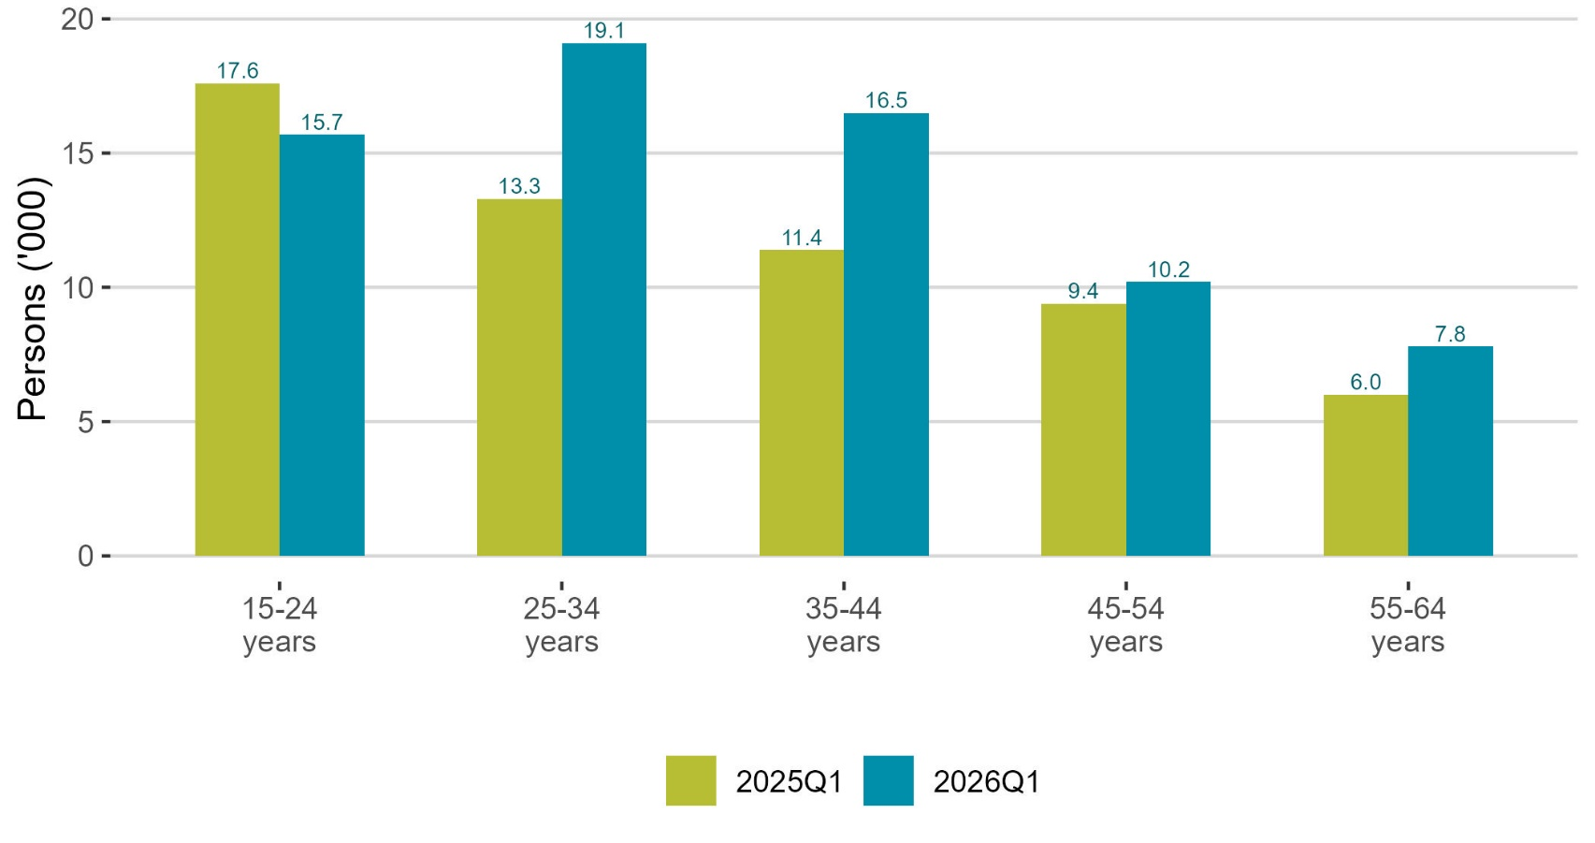
Female unemployment up across all age groups except youths
thousands

Slide 19
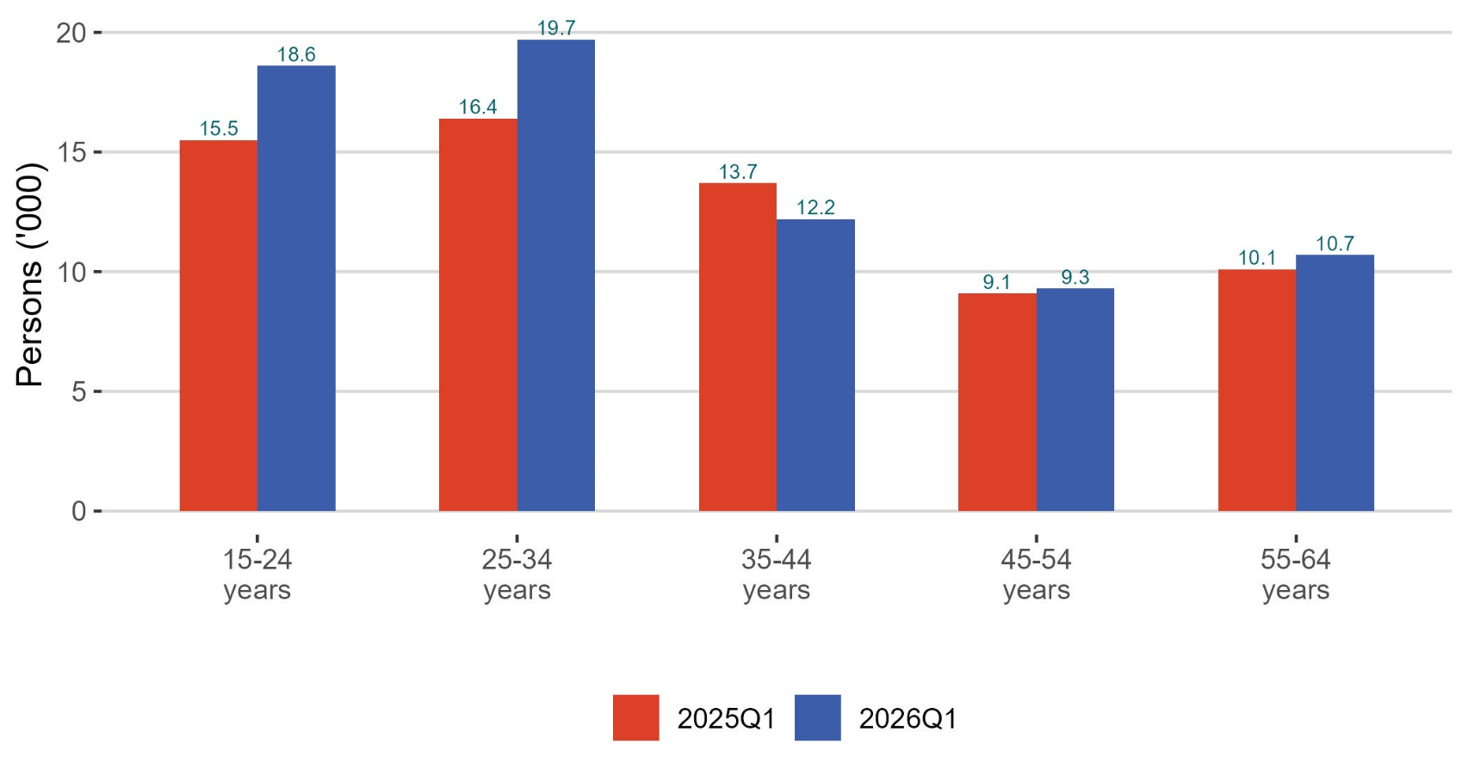
Male unemployment up across all age groups except 35-44 year olds
thousands

Slide 20
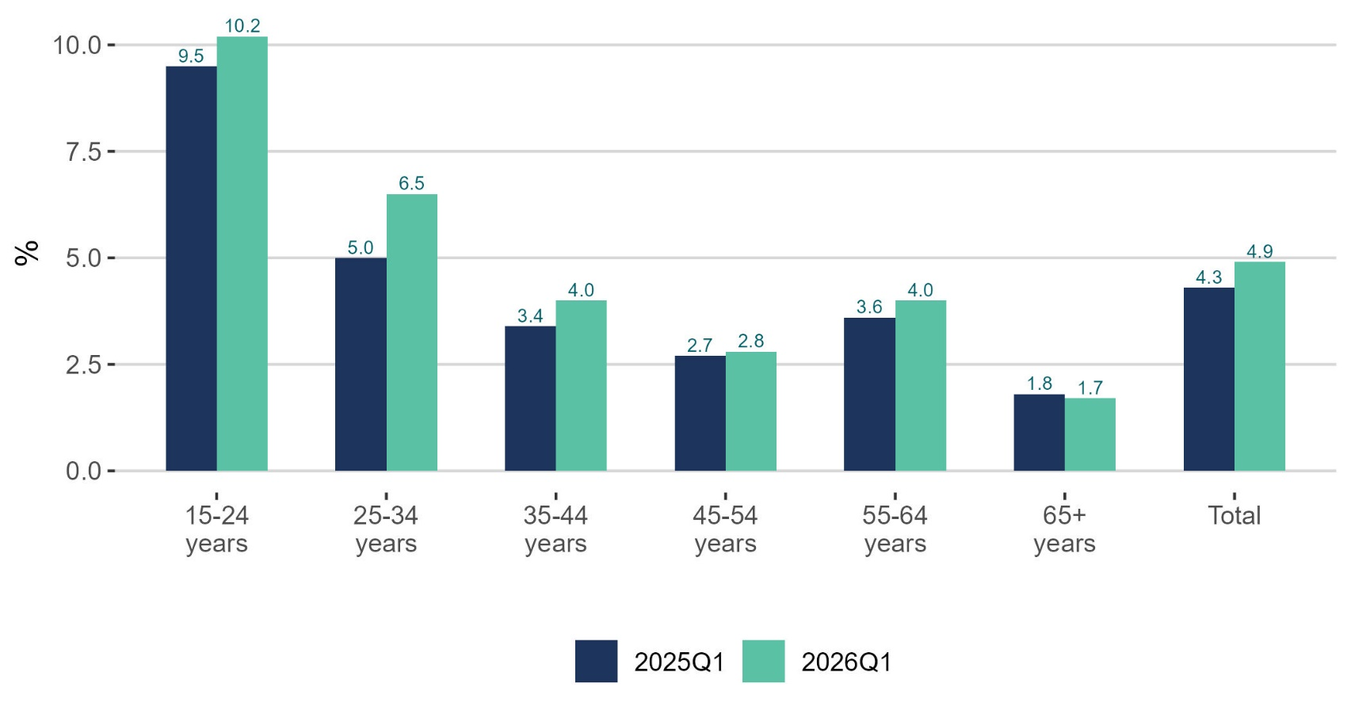
Unemployment rate up across all age groups except 65+
%

Slide 21
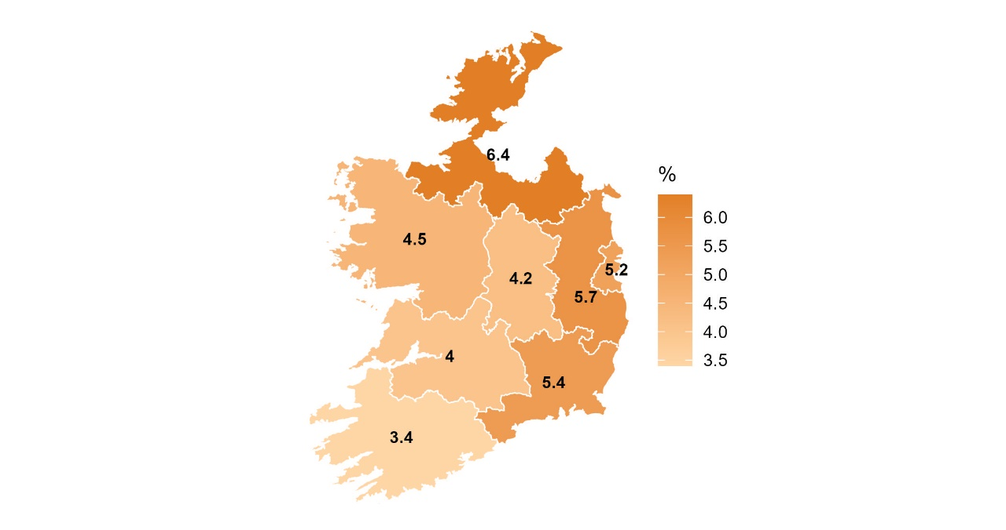
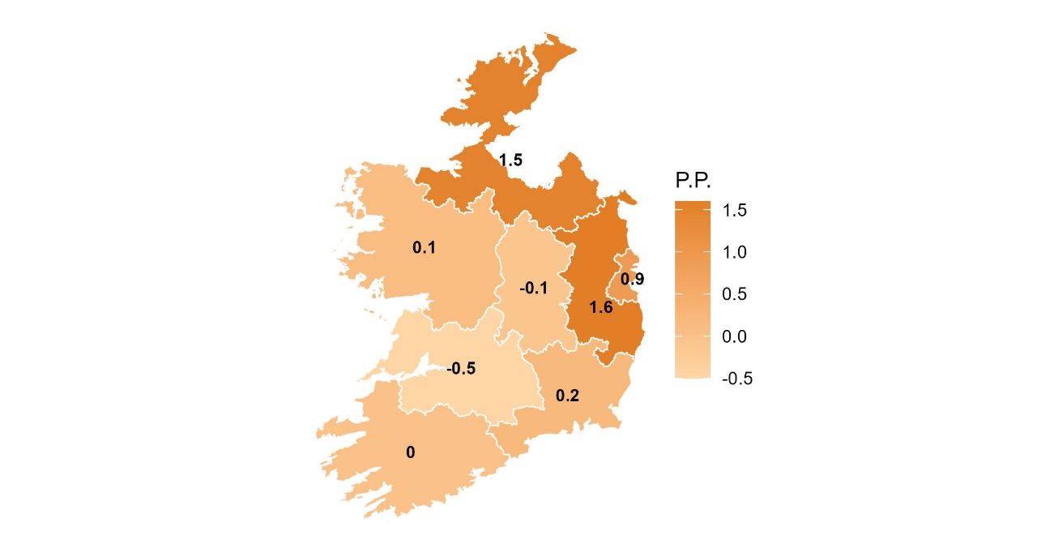
Unemployment rate increased in East and Border
Unemployment rate
Change in unemployment rate
%

Slide 22
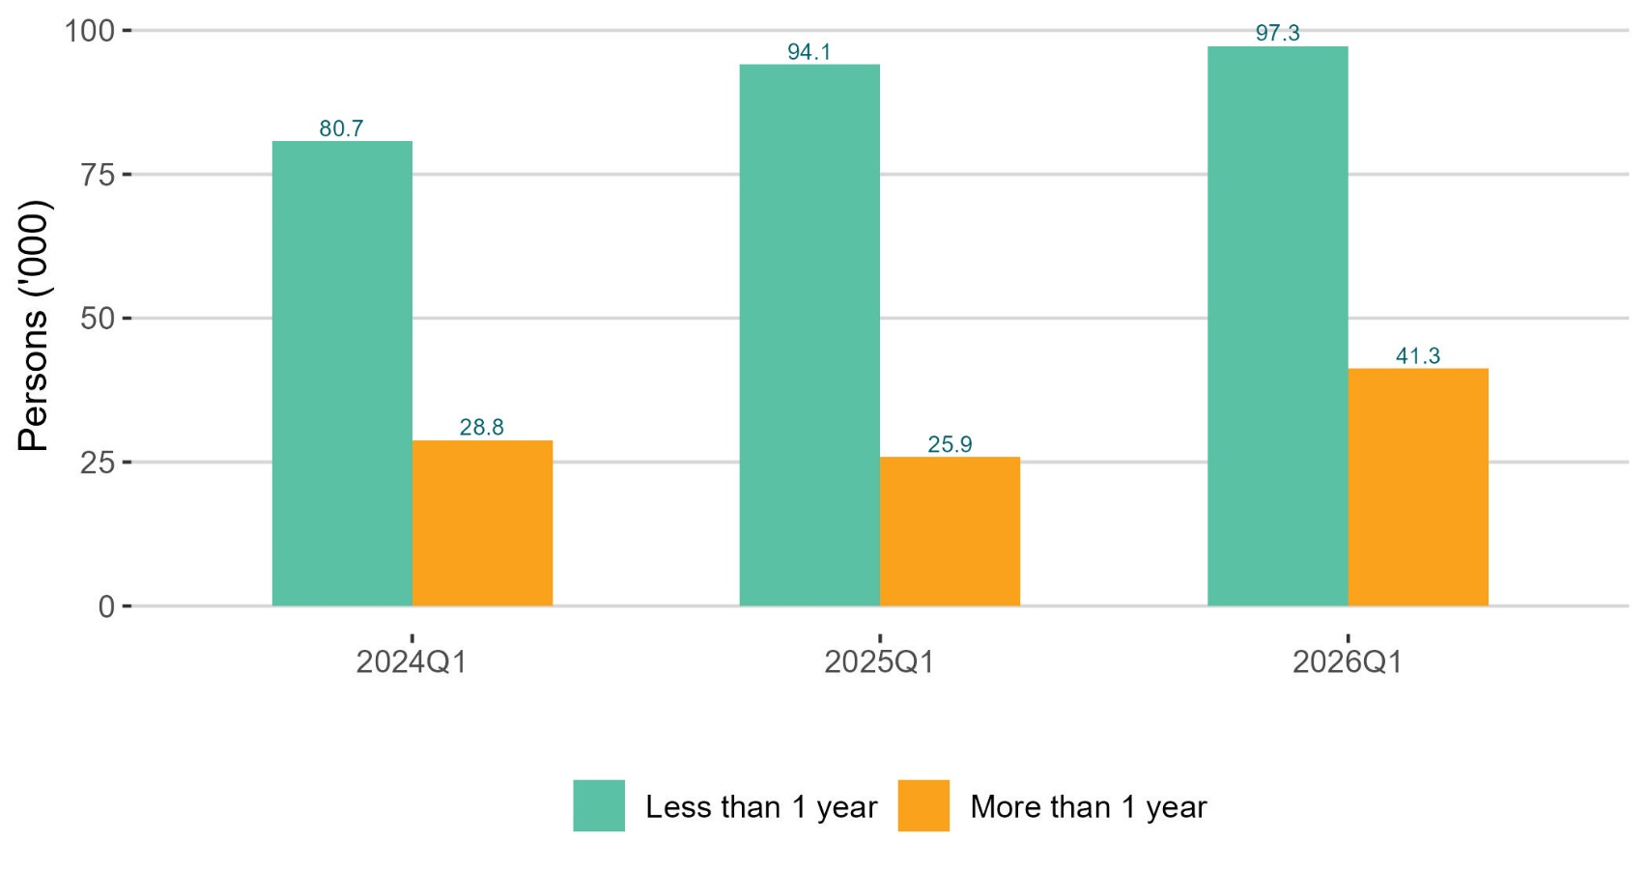
Long-term unemployment increased 25,900
thousands

Slide 23
Labour Force
Q1 2026:
Persons in labour force: 2,936,300 +0.6%
Participation rate (15+): 65.0% -0.8 p.p.
Seasonally adjusted participation rate: 65.5% -0.4 p.p from Q4 2025

Slide 24
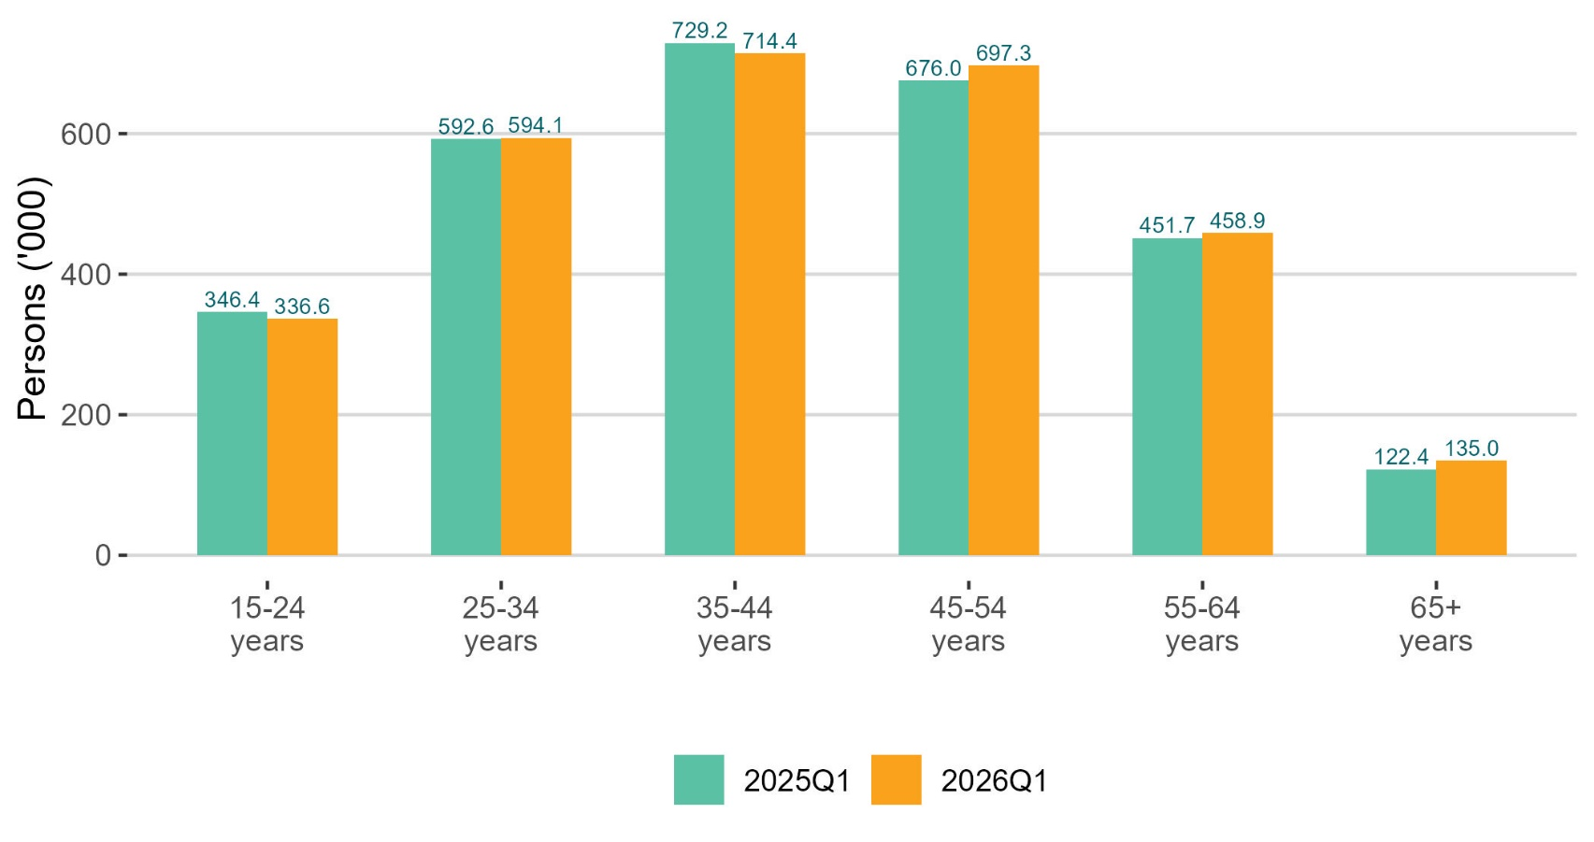
Labour force increased for older age-cohorts
thousands

Slide 25
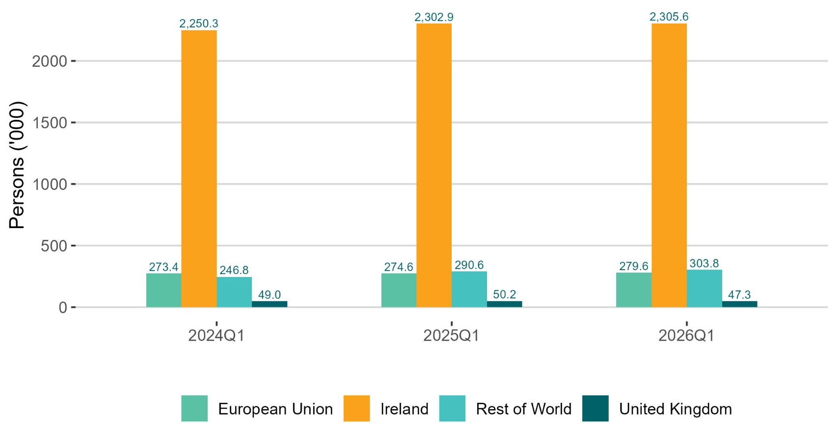
Largest increase in labour force from Rest of the World
thousands

Slide 26
Labour Force
Unadjusted
  Increased by 18,000 (0.6%) over the year to 2,936,300 in Q1 2026
  Demographic effect +40,600
  Participation effect -22,600
  Participation rate decreased by 0.8p.p. to 65.0%
Adjusted
  Decrease of 7,500 or 0.3% over the quarter to 2,958,500 in Q1 2026

Slide 27
Not in the Labour Force
Q1 2026:
Persons not in the Labour Force: 1,579,100 +4.1%
Potential additional Labour Force: 103,700 -12.1%

Slide 28
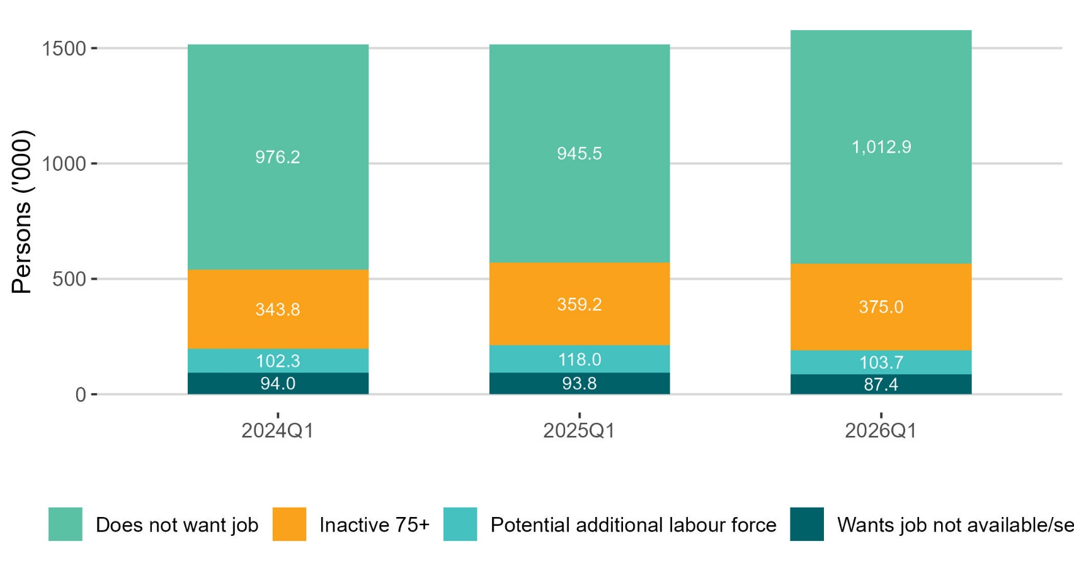
Does not want a job up
thousands

Slide 29
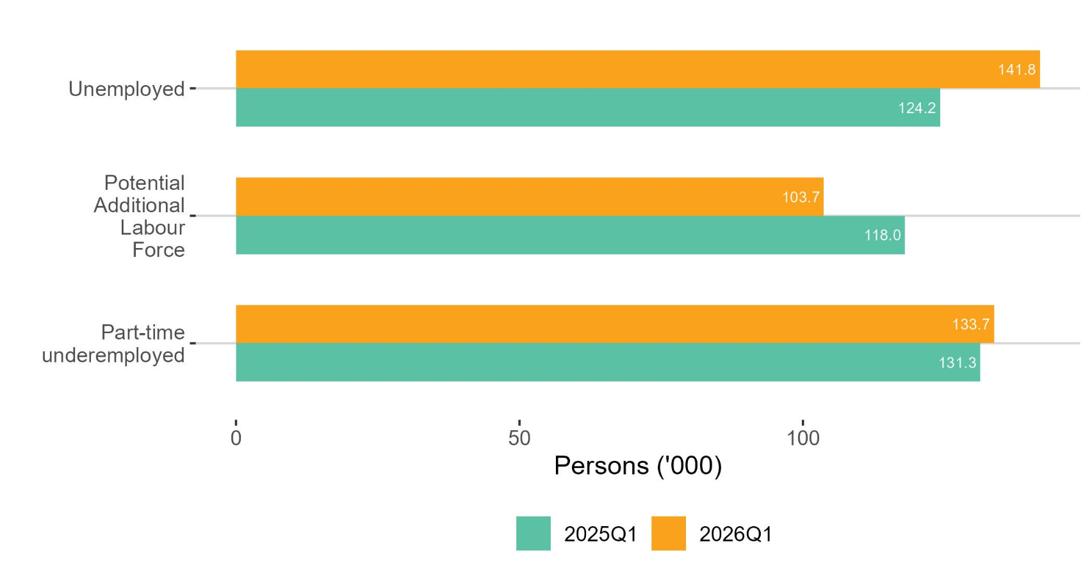
Part-time underemployed decreased
thousands

Slide 30
Young people (15-24) in the labour force
Q1 2026:
Employment rate: 42.9% -2.4 p.p.
Unemployment rate: 10.2% +0.6p.p.
Participation rate: 47.7% -2.3 p.p.
NEET rate 6.4% +1.2 p.p.

Slide 31
LFS Q1 2026 results summary
EMPLOYMENT
Employment rate down 1.4 p.p. to 73.3%; down 1.9 p.p. for females
Full time employment was up 1.5% to 2,233,000
Industry & Construction increased while Services decreased
UNEMPLOYMENT
Increased 14.2% to 141,800
Unemployment rate up 0.6 p.p. to 4.9%
Unemployment rate up across all working age cohorts
LABOUR FORCE
Lowest increase in five years
Participation down 0.8 p.p. to 65.0%

Slide 32
Labour Force Survey
Quarter 1 2026
Thank you.
LFS Q2 2026 results provisionally due for publication on 20th August 2026

Slide 33
Births 2001-2022
Notes:
Source: PxStat VSA16

Slide 34
Annex:
ILO Definitions and concepts
IESS Regulation
Impact of COVID-19 on LFS
Arrivals from Ukraine in Ireland

Slide 35
ILO classification in the LFS
Employment (15-89 years)
  Persons who worked in the week before the survey for one hour or more for payment or profit, including work on the family farm or business and all persons who were away from work during the reference week but had a job to which they could return to

Slide 36
ILO classification in the LFS
Unemployment (15-74 years)
  Persons who in the week before the survey, were
    without work – i.e. did not meet criteria to be classified as employed under ILO
    available to start work within the next two weeks
    had taken specific steps, in the previous four weeks to find work

Slide 37
ILO classification and LFS
Inactive (15+ years)
  All other persons

Slide 38
Integration of European Social Statistics (IESS) Regulation
New European regulation came into force on 01 January 2021
Implications for Irish Labour Market Statistics :
  https://www.cso.ie/en/releasesandpublications/in/lfs/implicationsoftheimplementationoftheintegrationofeuropeansocialstatisticsiessframeworkregulationonlabourmarketstatisticsinirelandin2021/
Impact of the regulation on the LFS series:
  https://www.cso.ie/en/releasesandpublications/ep/p-lfs/labourforcesurveyquarter12021/technicalnote/
The LFS questionnaires for Ireland up to Q1 2023 are available here: https://www.cso.ie/en/methods/surveyforms/labourforcesurvey/

Slide 39
Arrivals from Ukraine in Ireland
https://www.cso.ie/en/statistics/population/arrivalsfromukraineinireland/
As of the 3rd February 2026 there had been 121,048 Beneficiaries of Temporary Protection from Ukraine in Ireland.
Of these arrivals from Ukraine, 69% had activity in administrative data after 30 November 2025, based on data currently available to the Central Statistics Office (CSO).
Women and men aged 20 year and over made up 45% and 28% of arrivals respectively, while 27% were people aged under 20 years.
https://www.cso.ie/en/releasesandpublications/fp/p-aui/arrivalsfromukraineinirelandseries18/
Live Register figures for January 2026: 12,594 persons benefitting from Temporary Protection Directive:
https://www.cso.ie/en/releasesandpublications/ep/p-lr/liveregisterjanuary2026/

Slide 40
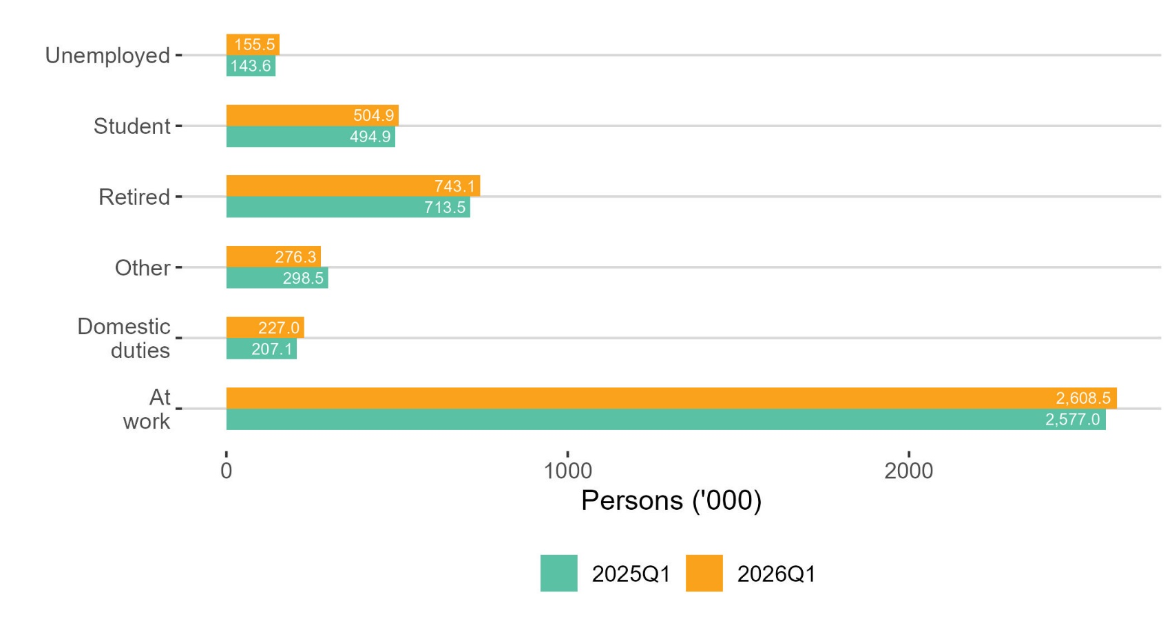
At work by principle economic status increased
thousands

