Slide 1
Labour Force Survey
Quarter 2 2022 Results
25 August 2022

Slide 2
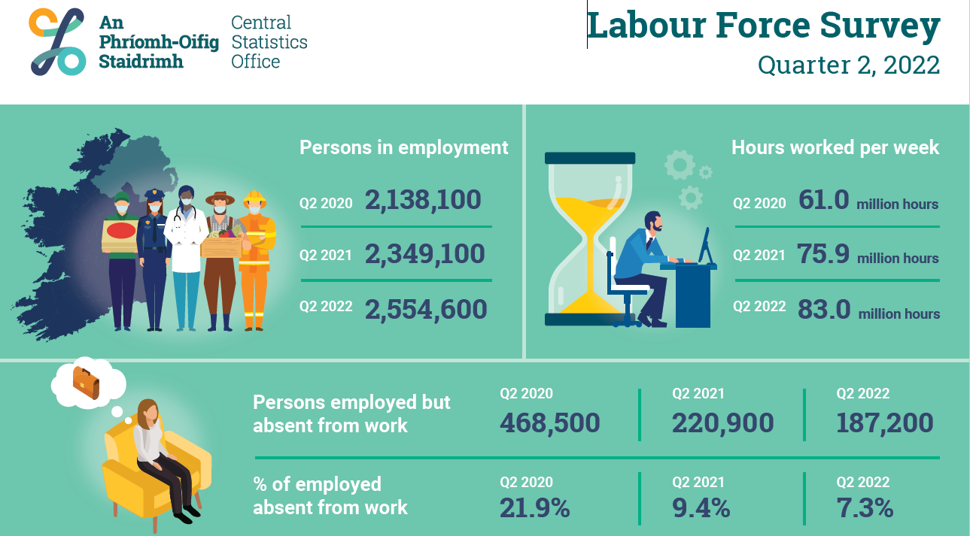
Infographic
Thousands

Slide 3
Persons by employment status in 2 year intervals
Thousands

Slide 4
Section 2:
In employment
Q2 2022:
Persons in employment: 2,554,600 (+8.7% YoY)
Employment rate: 73.5% (+4.9 p.p. YoY)
Seasonally adjusted: 2,552,600 (+1.0% QoQ)

Slide 5
Employment rate by sex
%

Slide 6
Employment rate by age
%

Slide 7
Persons in employment, by full time/part time (FTPT)
‘000

Slide 8
Persons in employment by NACE sector, Q2 2021 and Q2 2022
Thousands

Slide 9
Absences (as % of number employed), by NACE sector, Q2 2021 and Q2 2022

Slide 10
Total actual hours worked (millions) per week, by NACE sector, Q2 2021 and Q2 2022
(hours) millions

Slide 11
Employment status
‘000

Slide 12
In employment (seasonally adjusted), number of persons
‘000

Slide 13
% of employed working at home

Slide 14
Section 3:
Unemployment
Q2 2022:
Persons unemployed: 119,900 (-64,200 YoY)
Unemployment rate: 4.5% (-2.8 p.p. YoY)
Seasonally adjusted: 116,400 (-12,100 QoQ)
Seasonally adjusted unemployment rate: 4.4% (-0.5 p.p. QoQ)

Slide 15
Unemployed persons
‘000

Slide 16
Unemployed by duration of unemployment
Thousands

Slide 17
Unemployment rate (seasonally adjusted)
%

Slide 18
Section 4:
Labour Force
Q2 2022:
In labour force: 2,674,500 (+5.6% YoY)
Participation rate: 65.2% (+2.1 p.p. YoY)
Seasonally adjusted participation rate: 65.3% (+0.1 p.p. QoQ)
Outside the labour force: 1,424,800 (-3.9% YoY)

Slide 19
Labour Force
Unadjusted
  Increased by 141,300 (+5.6%) over the year to 2,674,500 in Q2 2022
  Participation rate increased over the year from 63.1% to 65.2%
  Demographic effect +45,600
  Participation effect +95,700
Seasonally Adjusted
  Increase of 19,700 or 0.7% over the quarter to 2,672,600 in Q2 2022

Slide 20
Participation rate by sex
%

Slide 21
Participation rate by age
%

Slide 22
Participation rate by NUTS3 region
%

Slide 23
Participation rate (seasonally adjusted)
%

Slide 24
Section 5:
Summary

Slide 25
Infographic
Thousands

Slide 26
Thank You

Slide 27
Annex:
ILO Definitions and concepts
IESS Regulation
Impact of COVID-19 on LFS
Arrivals from Ukraine in Ireland

Slide 28
ILO classification in the LFS
Employment (15-89 years)
  Persons who worked in the week before the survey for one hour or more for payment or profit, including work on the family farm or business and all persons who were away from work during the reference week but had a job to which they could return to

Slide 29
Attachment to job
Testing for Job attachment pre and post IESS
 | Pre-IESS | Post-IESS
Holidays | No | No
Working time arrrangements | No | No
Illness/disability | No | No
Maternity/Paternity | No | No
Job related training | No | No
Parental | No | Yes
Off season | No | Yes
Temporary layoff | Yes | Yes¹
Other reason | No | Yes
Waiting to start a new job | n/a | No
¹ Post-IESS include all layoffs
Rules for attachment to job for absences from work
Pre-IESS | Post-IESS
Length of absence and share | Length of absence and salary payment
of salary paid applied to temporary | for parental leave
layoffs only
 | Off-season - whether person does any occasional work for employer or not
 | Layoffs/Other reason - length of absence
 | only

Slide 30
ILO classification in the LFS
Unemployment (15-74 years)
  Persons who in the week before the survey, were
    without work – i.e. did not meet criteria to be classified as employed under ILO
    available to start work within the next two weeks
    had taken specific steps, in the previous four weeks to find work

Slide 31
ILO classification and LFS
Inactive (15+ years)
  All other persons

Slide 32
Integration of European Social Statistics (IESS) Regulation
New European regulation came into force on 01 January 2021
Implications for Irish Labour Market Statistics :
  https://www.cso.ie/en/releasesandpublications/in/lfs/implicationsoftheimplementationoftheintegrationofeuropeansocialstatisticsiessframeworkregulationonlabourmarketstatisticsinirelandin2021/
Impact of the regulation on the LFS series:
  https://www.cso.ie/en/releasesandpublications/ep/p-lfs/labourforcesurveyquarter12021/technicalnote/
The LFS questionnaires for Ireland up to Q1 2022 are available here: https://www.cso.ie/en/methods/surveyforms/labourforcesurvey/

Slide 33
COVID-19 and the Labour Force Survey (LFS)
With the PUP scheme having finished on the 25 March 2022, COVID-19 Adjusted Measures of Employment and Unemployment in the LFS have been discontinued since the number of persons in receipt of the PUP at the end of the reference period is zero.
Users should note the following Information Note published with the Q2 2020 LFS results in August 2020 for information regarding these measures. Please see link https://www.cso.ie/en/releasesandpublications/in/lfs/informationnote-implicationsofcovid-19onthelabourforcesurvey-quarter22020update/
Labour Force Survey data for Quarter 2 2022 was collected by a combination of telephone and face-to-face interviews carried out by CSO Household Survey Interviewers.

Slide 34
Arrivals from Ukraine in Ireland
https://www.cso.ie/en/statistics/population/arrivalsfromukraineinireland/

