Slide 1
Labour Force Survey
Quarter 3, 2024
20th November 2024

Slide 2
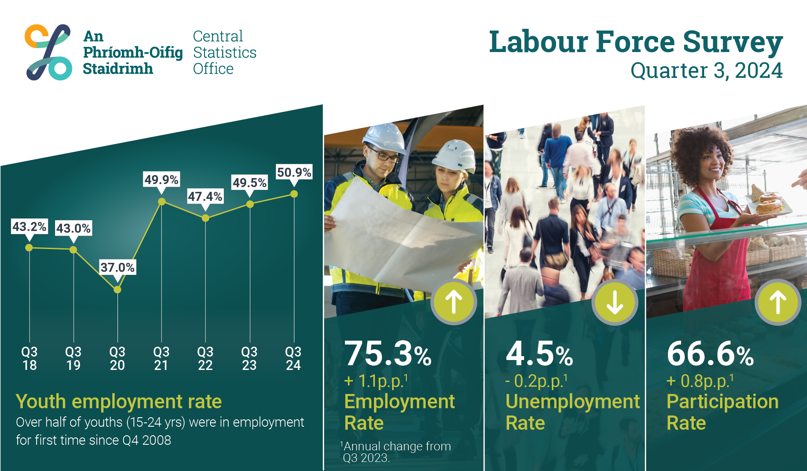

Slide 3
Seasonally adjusted persons (‘000) in employment (15-89), unemployment (15-74), & not in labour force (15+), Q3 2020 to Q3 2024
‘000

Slide 4
In employment
Q3 2024:
Persons in employment: 2,794,800 +3.7%
Employment rate (15-64): 75.3% +1.1 p.p.
Seasonally adjusted: 2,785,000 +1.4% on Q2 2024

Slide 5
Employment rate (%) in Q3 2024, by age group and sex
%

Slide 6
Annual change in employment volume (‘000) by age and sex, Q3 2024

Slide 7
Annual change in employment volume (‘000) by age and employment status, Q3 2024
‘000

Slide 8
Employment volume (‘000) by NACE Rev 2. sector, Q3 2023 & 2024
‘000

Slide 9
Employment status (%) by NACE Rev 2. Sector, Q3 2024
%

Slide 10
Annual change in total actual hours worked per week by NACE Rev. 2 sector, Q3 2024
million hours

Slide 11
Annual change (‘000s) in working from home status by sex and region, Q3 2024
‘000

Slide 12
Unemployment
Q3 2024:
Persons unemployed: 129,500 -0.3%
Unemployment rate (15-74): 4.5% -0.2 p.p
Seasonally adjusted rate: 128,400 +2.2% from Q2 2024

Slide 13
Unemployment rate (%) by age group and sex, Q3 2024
%

Slide 14
Annual change in unemployment (‘000s) to Q3 2024, by age and sex
‘000s

Slide 15
Unemployment rate (%) by NUTS3 region, Q3 2024
%

Slide 16
Long term unemployment rate (%), Q1 1998 to Q3 2024
%

Slide 17
Labour Force
Q3 2024:
Persons in labour force: 2,924,400 +3.5%
Participation rate (15+): 66.6% +0.8 p.p.
Seasonally adjusted participation rate: 66.3% +0.4 p.p. on Q2 2024

Slide 18
Annual change (‘000) in labour force by age and sex, Q3 2024
‘000

Slide 19
Annual change in Participation Rate (%) by sex and age group, Q3 2024
p.p

Slide 20
Labour Force
Unadjusted
  Increased by 98,200 (3.5%) over the year to 2,924,400 in Q3 2024
  Participation rate increased by 0.8p.p. to 66.6%
  Demographic effect +58,300
  Participation effect +40,000
Adjusted
  Increase of 38,800 or 1.4% over the quarter to 2,910,200 in Q3 2024
  Seasonally adjusted participation rate increased by 0.4p.p. to 66.3%

Slide 21
Not in the Labour Force
Q3 2024:
Persons Not in the Labour force: 1,465,100 500
Persons Not in the Labour force: 1,480,700 -0.8%
(Seasonally adjusted)
Potential additional labour force 129,400 +41.2%

Slide 22

Not in labour force (‘000), Q3 2023 & Q3 2024

Slide 23
Annual change in labour market slack (‘000) for Q3 2022 to Q3 2024

Slide 25
Labour Force Survey
Quarter 3 2024
Thank you.
LFS Q4 2024 results provisionally due for publication on 20th Feb 2025

Slide 26
Annex:
ILO Definitions and concepts
IESS Regulation
Arrivals from Ukraine in Ireland
ILO Composition

Slide 27
Attachment to job
Testing for Job attachment pre and post IESS
 | Pre-IESS | Post-IESS
Holidays | No | No
Working time arrrangements | No | No
Illness/disability | No | No
Maternity/Paternity | No | No
Job related training | No | No
Parental | No | Yes
Off season | No | Yes
Temporary layoff | Yes | Yes¹
Other reason | No | Yes
Waiting to start a new job | n/a | No
¹ Post-IESS include all layoffs
Rules for attachment to job for absences from work
Pre-IESS | Post-IESS
Length of absence and share | Length of absence and salary payment
of salary paid applied to temporary | for parental leave
layoffs only
 | Off-season - whether person does any occasional work for employer or not
 | Layoffs/Other reason - length of absence
 | only

Slide 28
ILO classification in the LFS
Unemployment (15-74 years)
  Persons who in the week before the survey, were
    without work – i.e. did not meet criteria to be classified as employed under ILO
    available to start work within the next two weeks
    had taken specific steps, in the previous four weeks to find work

Slide 29
ILO classification and LFS
Inactive (15+ years)
  All other persons

Slide 30
Integration of European Social Statistics (IESS) Regulation
New European regulation came into force on 01 January 2021
Implications for Irish Labour Market Statistics :
  https://www.cso.ie/en/releasesandpublications/in/lfs/implicationsoftheimplementationoftheintegrationofeuropeansocialstatisticsiessframeworkregulationonlabourmarketstatisticsinirelandin2021/
Impact of the regulation on the LFS series:
  https://www.cso.ie/en/releasesandpublications/ep/p-lfs/labourforcesurveyquarter12021/technicalnote/
The LFS questionnaires for Ireland up to Q4 2023 are available here: https://www.cso.ie/en/methods/surveyforms/labourforcesurvey/

Slide 31
Arrivals from Ukraine in Ireland
https://www.cso.ie/en/statistics/population/arrivalsfromukraineinireland/
As of the week ending 29th September 2024 there had been 109,566 Beneficiaries of Temporary Protection from Ukraine in Ireland.
Of these arrivals from Ukraine, 75% had activity in administrative data after 30 June 2024, based on data currently available to the Central Statistics Office (CSO).
Women and men aged 20 year and over made up 46% and 25% of arrivals respectively, while 30% were people aged under 20 years.
  https://www.cso.ie/en/releasesandpublications/fp/p-aui/arrivalsfromukraineinirelandseries14/
Live Register figures for October 2024: 13,078 persons from Ukraine benefitting from Temporary Protection Directive:
  https://www.cso.ie/en/releasesandpublications/ep/p-lr/liveregisteroctober2024/

Slide 32
ILO composition (‘000s) by sex

Slide 33
ILO composition (‘000s) by age

Slide 34
ILO composition (‘000s) by NUTS3 region

